Slide 1
PRESENTATION
PROJECT ISTC 3345 EVAN
TASK 6
EXPERIMENTAL INVESTIGATIONS OF CONTAINMENT PARAMETERS IMPACT ON VOLATILE IODINE CONTENT AND CORRELATION

Slide 2
In severe accident conditions sludge including ferric oxides and hydroxides, silicates and gels of siliceous acid will be accumulated in the containment sump. Ferric ions come into water phase by the steel corrosion (mainly carbon steel) and in a state of aerosols from corium molten pool (sources – “sacrificial” ferric oxide and structure core materials); silicium also can come with aerosols from corium molten pool (refractory facing) and as impurity from construction materials. These impurities can influence the iodine content in the water phase, as they are capable to adsorb and to retain the iodide-ions, accordingly reducing a possibility of iodide-ions oxidation and accumulation of volatile iodine species in the containment atmosphere.

Slide 3
Therefore the principal task of this work is experimental investigation of influence of ferric and siliceous sludge on rate of formation and accumulation in gas phase of iodine volatile compounds in interval temperatures 25 - 150 ⁰C, pH – from 4 up to 8, iodide-ion concentration – 10⁻⁴-10⁻⁷ mol/l, in the presence of γ-irradiation with dose rate ~ 1 kGy/h and in its absence. Experimental investigations are produced according to work plan on Task 6 and matrix of tests (table 1).
Table 1. Matrix of tests on project EVAN, Task 6, Phase 1
Test
Test
object
P
arameter
Analysis
Work
scope
p
eriod
Sludge composition: ferr
ic
sludge
(FeOOH
);
Iodine and its
Si
species
-
Determination of
sludge
(H
SiO
·n
H
O);
2
3
2
concentration
sludge effect on
Fe/Si=10;
m
/V=0; 1 g/l;
I
6
-
B
-
1
,2
T=25; 50;
95
in gas and
-
100
iodine content and
;
4 quart.
I6
-
1
-
5
150
o
C; pH=
water phases;
4
-
speciation in
8;
pH; E
; C
in
water/gas phases
H
BO
=1
0
g/l;
h
Fe
3
-
3
water phase;
4
-
C
=10
-
7
I
10
mol/l;
γ
T
-
irradiation
=
0;
1
kGy/h

Slide 4
Ampoules for γ-irradiation at 50-100 ⁰C are manufactured of stainless steel. They are cylindrical vessels with hermetically cover, supplied with two stop-cocks with needle valves for sampling gas and liquid phases. Ampoules have volume 55-60 cm³, volume of aqueous phase in experiments - 20-30 cm³, gas phase - 40-25 cm³. At 150 ⁰C irradiation is performed in ampoules from stainless steel with total volume 360 cm³; volume of aqueous phase - 100 cm³, gas - 260 cm³. γ-irradiation is produced on installations RChM-γ-20. Power of absorbed doze 0,85-0,924 kGy/h. Source of γ-ray is ⁶⁰Со.

Slide 5
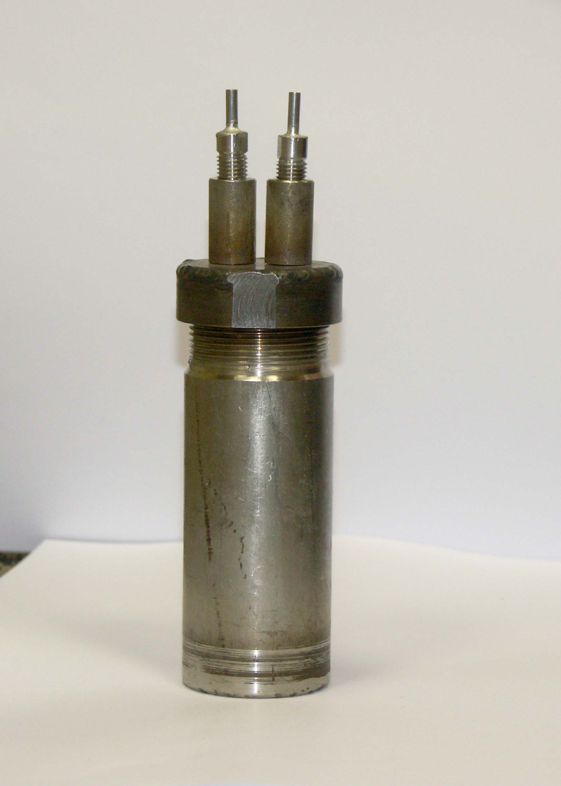

Slide 6
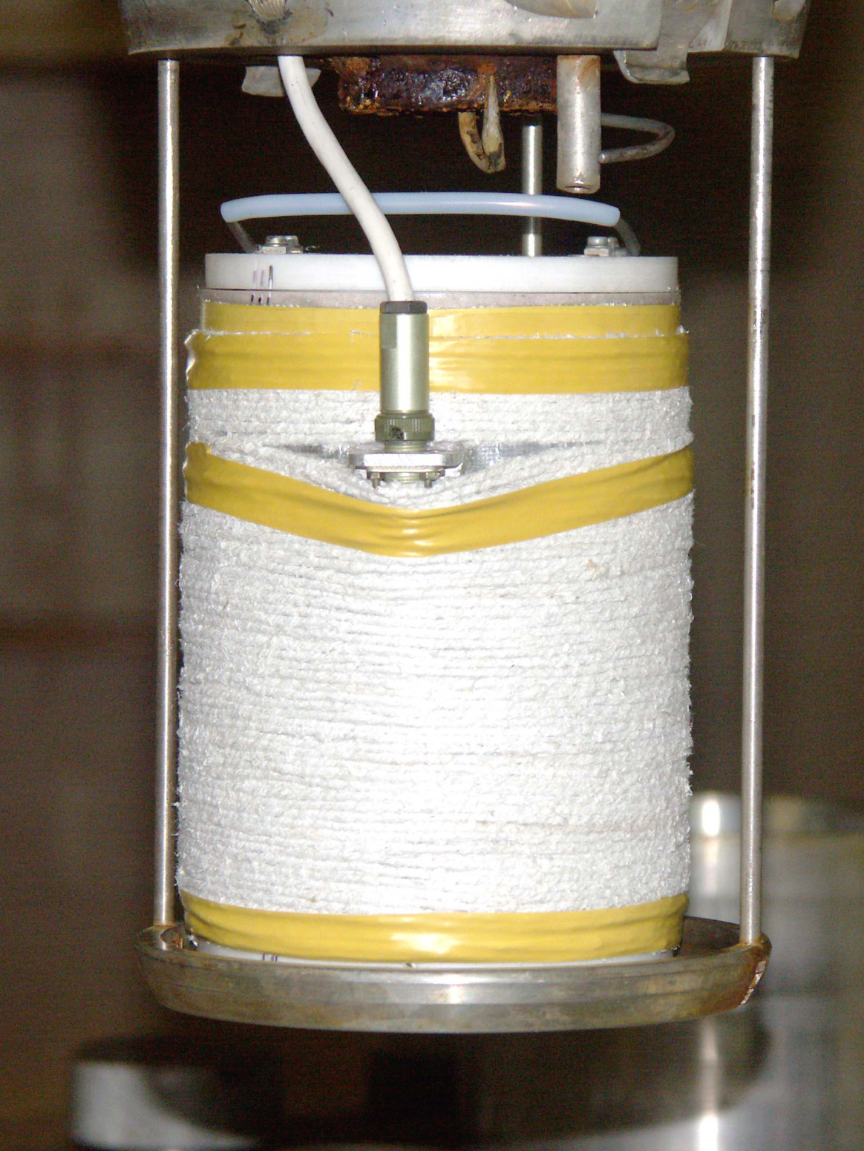

Slide 7
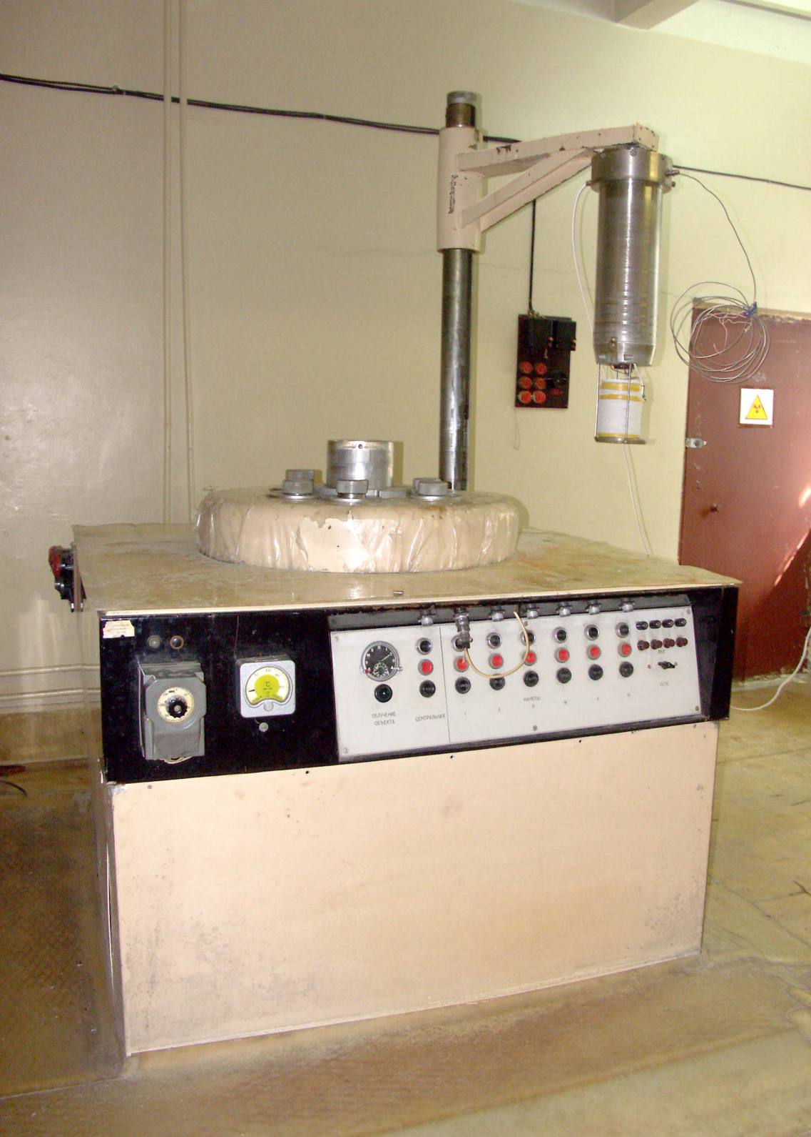

Slide 8
SCHEMATIC DIAGRAM OF THE APPARATUS FOR THE EXPERIMENTAL INVESTIGATION OF IODINE WATER/GAS PARTITIONING
1 - thermostat (20-150 ºС); 2 – autoclave (Teflon); 3 – gas phase; 4 – aqueous solution (I⁻); 5 – iodine source; 6 – iodine concentration and species analysis in the aqueous phase; 7 – pH, potential and pI measuring instrument; 8 –iodine species separation in gas samples: 8a – adsorbing filters (or sorbents); 8b – barbateur; 9 – water-jet pump; 10 - thermocouple; 11 – platinum electrode;
12 – compared electrode; 13 – glass electrode; 14 – iodide-selective electrode; 15 – iodine sensor;
16 – locked tap; 17 – line of solution sampling or vapour I₂ (gas) supply; 18 – heater;
19 – gas sample volume measuring
8

Slide 9
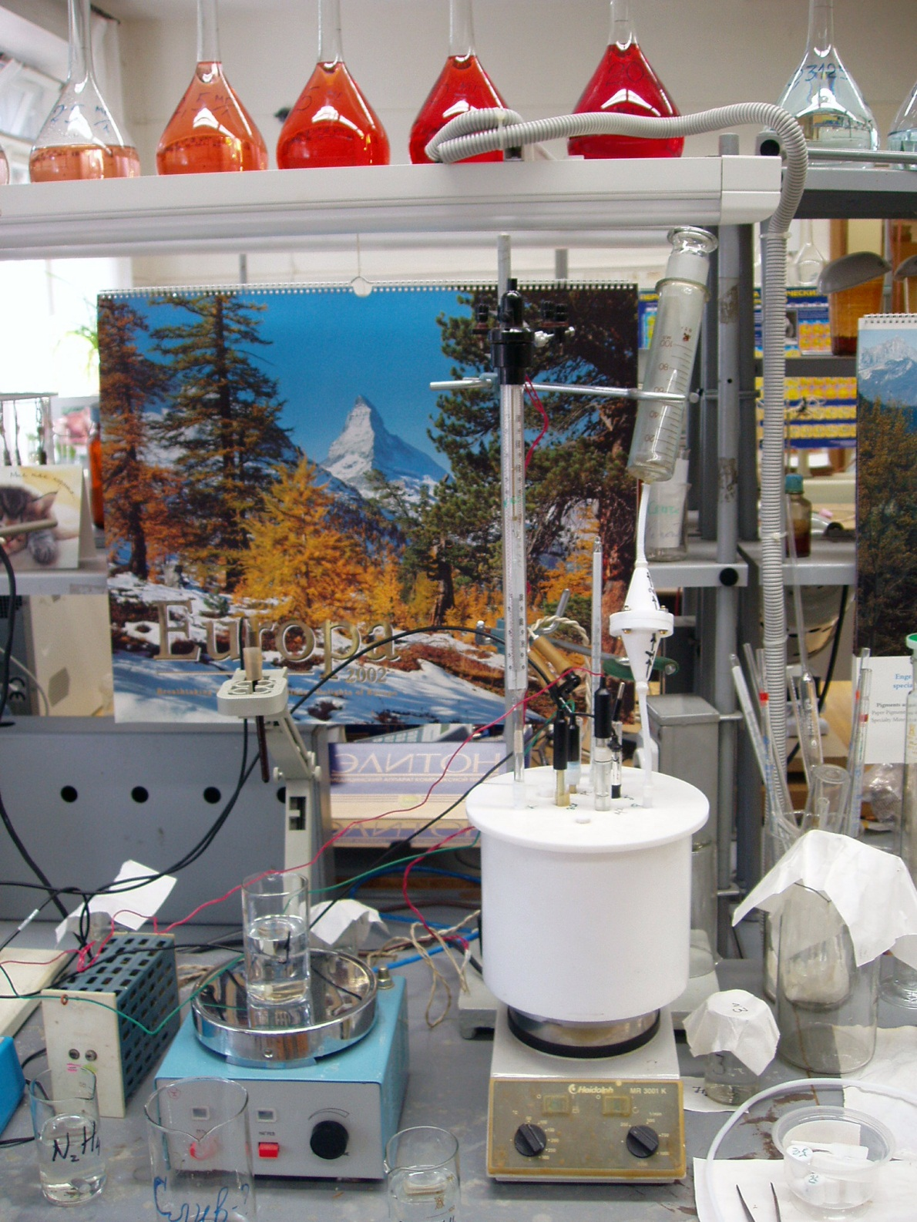

Slide 10
The autoclave is a cylindrical vessel from Teflon, volume 2,2 l. In hermetically cover following detective elements are inserted into and compressed: electrodes - glass, platinum, iodide-selective, reference; the thermometer, the electric heater, tubes for sampling aqueous and gas medium. The relationship of volumes of aqueous and gas phases can vary from 1,5 l/0,7 l up to 0,5 l/1,7 l. All lines are executed from Teflon. Electrodes are connected to measuring device рН/ionometer-Anion 4110.

Slide 11
This slide presents the used analytical methodics of iodine determination in water and gas phases.
Iodine Analytical Methods
Aqueous solution
Air atmosphere
Kinetic-photometric
method
(0,2-1 mkg/l)
Spectrometry
of ionic mobility
(≥1 mkg; iodine
forms
identification)
Absorption
and desorption
of volatile
iodine forms
by fibrous
carbon
materials
(0,2-0,8 mkg
in sample)
Ion-chromatography
(25 mkg/l – 5 mg/l)
Iodide-selective
electrode
(10⁻¹ – 10⁻⁷ mol/l)

Slide 12
Iodate-ion on column Transgenomic AN 2SC. Rate of flow - 1,2 ml/min. Eluent 0,015 mol/l NaOH
A - iodate and iodide-ions on 200 mkg/l
B - 33 mkg/l of iodate and 28 mkg/l of iodide

Slide 13
Iodate-ion 100 mkg/l on column R1000. Eluent 0,0025 mol/l NaOH. Rate of flow 1,5 ml/min. Peak 1 - fluoride

Slide 14
Dependence of optical density of calibrating solutions (D) from a time after their mixture at the iodide-ion content in sample:
1, 2 - 0,2 mkg (parallel definitions);
3, 4 - 0,5 mkg;
5, 6 - 0,8 mkg
All measurements are carried out within 3 hours

Slide 15
Reproducibility of the calibrating graph for definition of iodide - ion
1, 2 - parallel measurements;
3 - average values

Slide 16
Method IMS consists in space separations of ions on their mobility in a length-wise or cross electric field during advance of ions to a collector in a counter-flow of the drifted gas. Depending on a method of reception of initial ions - ionization by radioactive radiation, photo ionization, corona discharge, in the chamber ion-formation originate various sets of molecular fragments of analyzed substance, ions and radicals. Changing polarity of an impressed voltage, it is possible to detect negative and positive ions. Ionic mobility is a characteristic value dependent on weight, a charge and a size of an ion, electric field tension. The registered spectrum of mobility represents dependence of an ionic current on drift time of ions.

Slide 17
Drift time of an ion from the moment of its yield from the ionic chamber before hit in a collector:
t_{d} = 273P(1/0,1KET_{g})
where Р - pressure, МPа; T_{g} - temperature of the drifted gas, K; E – gradient of electric field tension, V/cm; K – coefficient of ionic mobility.
The analysis by method IMS includes the following sequence of operation:
- ionization of researched gas or a vapour;
- separation of ions on a time of their movement in an electric field of the drifted space at atmospheric pressure;
- registration of ionic currents on a collector of ions;
- processing of electric signal with the purpose of identification of components in a received spectrum of ionic mobility.
Basic element of a spectrometer is the measuring cell consisting of the block ions formation and the drifted chamber, manufactured of teflon.

Slide 18
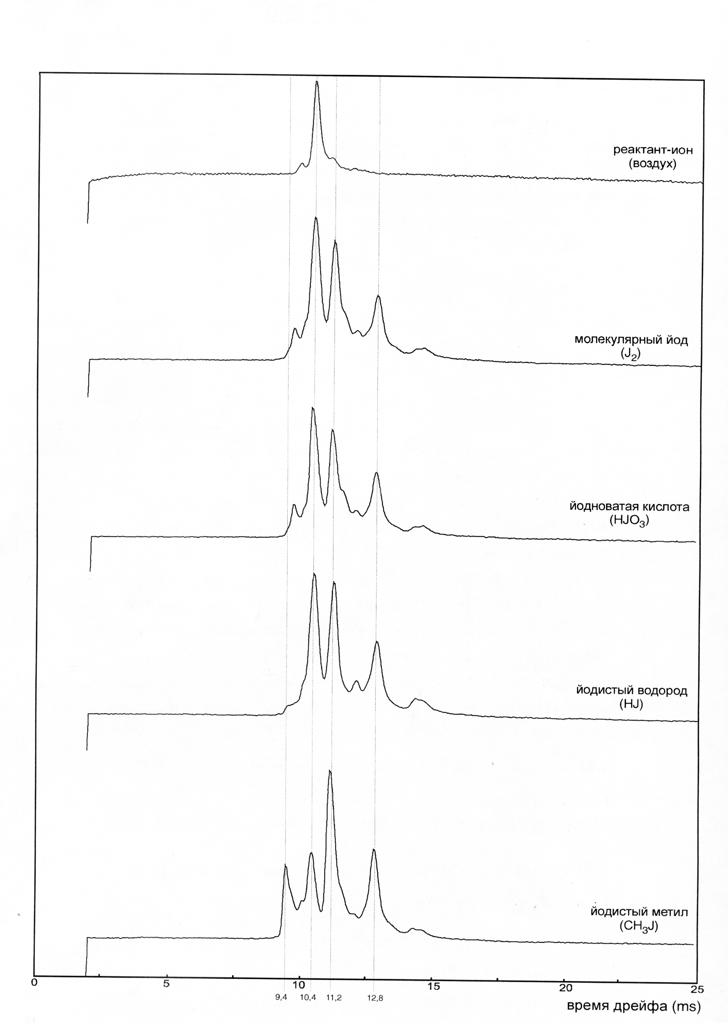
Spectrums of mobility of the ionized forms of iodine compounds

Slide 19
Presented on sl.18 spectrums of ions illustrate a separation process ionizated components of gas mixture on their mobility. Magnitude of the ionic current created on a collector by a concrete component of gas mixture is proportional to its concentration. Introduction in a gas phase of slight quantities CH₃I (~1 ppb) calls emersion on a spectrum of mobility of one well solvable peak, and its drift time is 9,4 mks. Intensity of peak correlates with concentration methyl iodide in the steam-gaseous mix.
The received data confirm an probability of use of method IMS for measurements of ultra small concentration of iodine and its compounds in air medium.

Slide 20
Table 2. CHARACTERISTICS OF PREPARED FERRIC HYDROXIDES SLUDGES
Total Fe
Concentration
Sludge solubility in
Н
3
ВО
3
content in
of
Fe(II),
Fe(III)
10
g/l solution
Specific
Dispersity of
Sample
sludge
soluble forms in
Soluble
Disperse
surface
particles, mass
%
mass
%
water
,
m
2
/
g
mol/l
forms
forms
64,9
<1,0 ·10⁻⁶
2 ·10⁻⁶
(FeOOH+
Fe(II) 1,7·10⁻⁶
Ferrigel
admixture
mol/l
,
mol/l
-
-
Fe(III) ≤3·10⁻⁷
<66
mkg/l
182
mkg/l
FeO)
-
>10
μ
m
-
80
-
88
64,0
0,35 ·10⁻⁶
1,8 ·10⁻⁶
FeOOH
(95%FeOOH
Fe(II) 3,3·10⁻⁷
mol/l
mol/l
96,4
1
-
10
μ
m
-
12
-
20
(1)
+6,15%Fe
O
)
Fe(III) 4,3 ·10⁻⁷
30,8
mkg/l
158±10
82,2
0,15
μ
m
~
0,008
2
3
(±6
mkg/l
)
mkg/l
≤0,15
μ
m
–
<0,002
0,34 ·10⁻⁶
>10
μ
m
-
80,73
FeOOH
mol
/
l
1,9 ·10⁻⁶
10
-
3,5
μ
m
–
19,25
(2)
66,1
-
30,25
mkg
/
l
mol/l
55
,
5±3,5
3,5
-
1
μ
m
–
0,0127
(±2,55
mkg/l
)
69,7
mkg/l
1
-
0,15
μ
m
–
0,0027
<0,15
μ
m
–
0,0014

Slide 21
Table 3. Aqueous solution parameters and volatile iodine forms content in gas phase (10 g/l H₃BO₃)
Initial parameters
Ultimate parameters of
Iodine
of solution
solution
Lengt
total
Iodine
Test
T,
h of
content
escape in
Note
code
E
,
C
,
C
,
M
,
o
C
in gas
gas
pH
h
I
pH
E
, mV
I
Fe
test, h
mV
mg/l
h
mg/l
mg
phase,
phase, %
mkg
I6
-
2
-
1
5.5
+290
1.02
5.7
+265
1.02
-
150
3
8.4
8.2
5.6
+167
2.67
0.96
γ
-
I6
irradiation, 2 kGy,
-
2
-
2
5.5
+167
11.43
3.9
+157
0.17
2.52
150
2
1056
92.4
condensate
I6
0.1 g/l FeOOH; 2
-
2
-
3
4.9
+166
11.43
3.8
+162
7.40
150
2
240
2.1
kGy
I6
5
91
0.12
-
4
-
1
7.1
-
182
110
8.4
-
55
115
109
24
32
0.04
7
0 mg N
H
I6
8.4
5
125
0.16
2
4
-
4
-
2
-
6
250
110
8.42
-
90
178
109
24
42
0.03
5
70
0.09
70 mg N
H
I6
2
4
-
4
-
3
6.9
-
139
110
6.53
+1
102
55
24
36
0.05
stainless steel
2
I6
375 cm
-
4
-
4
6.8
-
159
110
6.25
-
93
108
0.04
90
5
53
0.07
V
Ч
2
corr
~0.2 mg/h
m
These results were corroborated that the change of pH and temperature has light influence on iodine volatility in absence of γ-radiation. Formation of iodine volatile compounds with yield up to 90% and high velocity of stainless steel corrosion are revealed at γ-irradiation at 150 ºC solution of CsI and H₃BO₃ (10 g/l). In the presence of FeOOH iodine volatility reduced.
21

Slide 22
CONCLUSION
1. Methodic of the analysis of iodine forms in aqueous and gas phase are fulfilled. For analyses of aqueous phase chromatographic and kinetic analytical methods are selected; for the analysis in a steam-gaseous phase - method of spectrometry of ionic mobility and sorption-desorption of iodine gaseous forms by CFM with subsequent determination iodide-ion in a solution.
2. Equipment for carrying out of experiments is performed and approved: ampoules and an autoclave; devices for sampling aqueous and gas phases; devices for maintenance of the given temperature during experiment; installations for a gamma irradiation of investigated systems.
3. Procedure of fulfillment of experimental tests, sampling and sample analysis for experiments with γ-irradiation and without it, is carried out and approved.
4. Fulfillment of tests is started according to a matrix of experiments. Formation of volatile iodine compounds with a yield of 0,03-0,1% is established at heating solutions of iodide in boric acid at 55-90 ⁰C which reason are impurities of organic matters in deionized water.
5. Formation of volatile iodine compounds with a yield up to 90% is revealed at gamma irradiation at 150 ⁰C solution of iodide cesium in boric acid. High rate of stainless steel corrosion in conditions of gamma-radiation are observed at 150 ⁰C. Correction of parameters of high-temperature tests in a matrix of experiments is necessary for reception of reliable results
22

