Slide 1
Progress Report on the ISTC project #3592
“Investigation of Corium Melt Interaction with NPP Reactor Vessel Steel”
(METCOR-P)
A.P. Alexandrov Research Institute of Technology (Russia)
Presented by S. Bechta
15th CEG-SAM meeting
March 10-12, 2009, Villigen

Slide 2
Contents
General information
Objectives of METCOR-P project
Experimental matrix for METCOR-P project
VVER vessel steel corrosion at its interaction with
oxidized corium melt in the oxidizing atmosphere
VVER vessel steel corrosion at its interaction with
suboxidized corium melt
Publications
Organizational issues

Slide 3
General information
Project participants and coordination
Collaborators
FZK, Germany
FORTUM, Finland
JRC ITU,
EK
CEA,
France
AREVA NP,
Germany
FZD, Germany
IRSN,
France
Coordinator
ISTC, Moscow
Steering committee
Operation Agent: A.P. Alexandrov RIT, Russia
SPb Electrotechnical State University, Russia

Slide 4
Objectives of METCOR-P project
Qualification and quantification of physicochemical phenomena of corium melt interaction with reactor vessel steel with a focus on:
Interaction characteristics at the vertically positioned interface
Peculiarities of interaction with European vessel steel
Corium melt oxidation transients

Slide 5
Experimental matrix for METCOR-P project
*) In accordance with a decision of the 1st project meeting, it is replaced by MCP-2 test with UO_{2+x}– ZrO₂ corium in air and horizontally positioned interface

Slide 6
METCOR-P experimental part status
Interaction characteristics at the vertically positioned interface:
MCP-1 test with the vertical orientation of specimen surface have not shown any significant difference with MC6 test results in respect to the final corrosion depth and IZ composition
At present the ultrasonic technique is adjusted to measure corrosion kinetics of vertically positioned steel specimen

Slide 7
METCOR-P experimental part status (2)
Peculiarities of interaction with European vessel steel:
The tests are under preparation
AREVA has shipped European vessel steel specimens; their delivery is delayed due to customs formalities
A three-party agreement between AREVA, ISTC and NITI has been prepared. Specimens are sending to the ISTC
Corium melt oxidation transients:
One test (MCP-3) and its analyzes have been made
Results interpretation is in progress

Slide 8
VVER vessel steel corrosion at its interaction with
oxidized corium melt in the oxidizing atmosphere

Slide 9
Objective
Development of model and correlations describing METCOR experimental data
Reactor application of the results to the IVR conditions

Slide 10
Experimental Data
Test | Corium | Atmosphere | Point # | Specimen Surface Temperature, °C | Heat Flux, MW/m² | Corrosion Rate, mm/h
MC1 | UO_{2+X}-ZrO₂-FeO_{y} | Air | 1 | 950 | 0.90 | 0.1
MC2 |  |  | 1 | 900 | 0.39 | 0.014
 |  |  | 2 | 990 | 0.44 | 0.068
 |  |  | 3 | 1050 | 0.47 | 0.076
 |  |  | 4 | 720 | 0.30 | 0.003
MC10 | UO_{2+X}-ZrO₂ | Steam | 1 | 1035 | 0.95 | 0.55
 |  |  | 2 | 1185 | 1.05 | 1.07
 |  |  | 3 | 1235 | 1.1 | 2.07
MC11 | UO_{2+X}-ZrO₂-FeO_{y} |  | 1 | 950 | 0.99 | 0.17
 |  |  | 2 | 1050 | 1.16 | 0.25
 |  |  | 3 | 1130 | 1.23 | 2.8
 |  |  | 4 | 1200 | 1.29 | 7.8
MC12 |  | Air | 1 | 1000 | 0.92 | 0.10
 |  |  | 2 | 1035 | 0.95 | 0.31
 |  |  | 3 | 1075 | 0.98 | 0.51
 |  |  | 4 | 1135 | 1.04 | 3.25
 |  | Steam | 5 | 1065 | 1.00 | 0.46
 |  |  | 6 | 1125 | 1.09 | 2.78
MCP-2 | UO_{2+X}-ZrO₂ | Air | 1 | 870 | 0.74 | 0.085
 |  |  | 2 | 950 | 0.81 | 0.13
 |  |  | 3 | 1080 | 0.92 | 0.7
 |  |  | 4 | 1165 | 1.00 | 1.77
 |  |  | 5 | 1210 | 1.04 | 2.38
 |  |  | 6 | 1230 | 1.06 | 3.46
 |  |  | 7 | 1325 | 1.15 | 4.25
 |  |  | 8 | 1350 | 1.17 | 4.75
 |  |  | 9 | 1370 | 1.19 | 5.8

Slide 11
Qualitative experimental results
Oxidation follows the linear law
Corrosion rate is sensitive to the following factors: temperature on the specimen surface, corium – steel heat flux and corium composition
Intensified corrosion at higher temperatures (above 1050°С on the steel specimen surface) for corium with a high content of iron oxides
Corrosion rate is not sensitive to the replacement of air with steam

Slide 12
Correlations
For UO_{2+X}-ZrO₂ corium:
Solid-phase diffusion
Diffusion at corium crust
liquefaction
For UO_{2+X}-ZrO₂-FeO_{y} corium:
where W – corrosion rate, m/s
q – heat flux, MW/m²
T_{S} – temperature of the steel surface, K
T_{sol} – solidus temperature, K
(2723 K – the 1st case and 1613 K – the 2nd case)

Slide 13
Generalization of Experimental Data
No corium crust
liquefaction
Corium crust
liquefaction
Explained by the difference of diffusion
potential - iron concentration in the melt

Slide 14
Conclusion remarks to the 4th Part
Corrosion phenomena are determined by the diffusion of Fe²⁺ ions through the surface corium crust
Corrosion rate of vessel steel interacting with fully oxidized corium follows the Arhenius law
Intensified corrosion at higher temperatures (above 1050°С on the steel specimen surface) for corium with a high content of iron oxides is caused by liquid-phase percolation channels formed in the corium crust
Semi-empirical correlations have been used for IVR analyses of VVER

Slide 15
VVER vessel steel corrosion at its interaction with
suboxidized corium melt

Slide 16
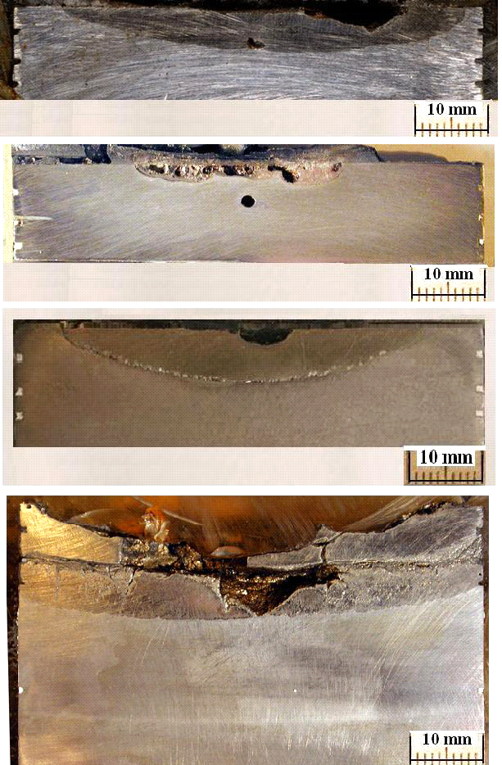
Objectives
MC6
МС6
MC7
Acoustic defect
МС7
MC8
МС8
Shrinkage cavity
МС9
MC9
Chip
Develop a model for determining temperature of corrosion front final position (T_{B})
Get experimental data about influence of thermogradient conditions on U, Zr and Fe partitioning between oxidic and metallic melts

Slide 17
Results of Tests with Suboxidized Corium
Test | Corium oxidation index, С_{n} | Temperature of corrosion front final position, T_{B} ,°С | Mass fraction of interacted steel of specimen, % | IZ composition*, mass% |  |  | Composition of metallic body, mass%
 |  |  |  | U | Zr | Fe | U | Zr | Fe
МС6 | С-30 | 1120…1200 | 3.4 | 25.6 | 5.4 | 64.4 | 55.0 | 25.0 | 15.0
МС7 | С-30 | 1030…1100 | 0.4 | 44.0 | 2.2 | 50.0 | Metallic body was not found
МС8 | С-70 | 1200 | 2.9 | 22.0 | 6.1 | 68.2
МС9** | С-30 | 1060…1100 | 9.2 | 33.3 | 8.3 | 53.0 | − | − | −
МСР-1 | С-17 | 1000…1090 | 7.1 | 44.0 | 14.0 | 40.0 | 57.0 | 24.0 | 18.0
* – oxygen content on the IZ is not given in the table (from 0.2 to 0.5 mass%)
** – a considerable part of iron transferred to the melt volatilized during the pool exposition

Slide 18
Temperature of corrosion front final position in comparison with simplified phase diagram
T, ⁰C MC7 T, ⁰C MC9 T, ⁰C MCP-1
1500
U/Zr = 7.66
1500
U/Zr = 1.54
1500
U/Zr = 1.20
1400
1400
1400
1300
1300
1300
1200
1200
1200
1100
1100
1100
1000
30
40
50
60
70
80
90
1000
40
50
60
70
80
90
1000
30
40
50
60
70
80
90
U, Zr Mass.% Fe U, Zr Mass.% Fe U, Zr Mass.% Fe
T, ⁰C MC6 T, ⁰C MC8
experiment
calculation of solidus (eutectic) and liquidus temperature by NUCLEA
binary eutectic point ( )
1500
U/Zr = 1.82
1500
U/Zr = 1.38
1400
1400
U/Zr ratio in IZ !
1300
1300
Hypothesis
1200
1200
1100
1100
1000
40
50
60
70
80
90
1000
40
50
60
70
80
90
U, Zr Mass.% Fe U, Zr Mass.% Fe

Slide 19
Influence of thermal gradient on U, Zr and Fe partitioning
In MASCA tests:
In METCOR tests:
In comparison with MASCA Fe concentration in the metallic phase is considerably higher, i.e. U and Zr extraction considerably decreases

Slide 20
Conclusion remarks to the 5th Part
Thermal gradient conditions are found to have considerable influence on the partitioning of components between oxidic and metallic phases. This factor is to be taken into account in determining the molten pool configuration. Quantitative characteristics and model development require a dedicated experimental study
Specified final temperature on the corrosion front (T_{B}) is not likely to have relevance for IVR of VVERs, as shown in*, corrosion is not dangerous for the vessel integrity. But vessel steel corrosion contributes to the molten pool composition and configuration
Model for T_{B} evaluation is under development. It will be discussed with collaborators at the 3rd METCOR-P meeting
* – S.V. Bechta, V.S. Granovsky, V.B. Khabensky, E.V. Krushinov, S.A. Vitol, V.F. Strizhov, D. Bottomley, M. Fischer, P. Piluso, A. Miassoedov, W. Tromm, E. Altstadt, H. G. Willschutz, F. Fichot, O. Kymalainen “VVER Steel Corrosion During In-Vessel Retention of Corium Melt” Proc. of the 3rd European Review Meeting on Severe Accident Research (ERMSAR 2008), Nesseber, Bulgaria, September 23-25, 2008, Paper 2.7

Slide 21
Publications of 2008
  S.V. Bechta, V.S. Granovsky, V.B. Khabensky, E.V. Krushinov,
  S.A. Vitol, A.A. Sulatsky, V.V. Gusarov, V.I. Almiashev,
  D.B. Lopukh, D. Bottomley, M. Fischer, P. Piluso, A. Miassoedov,
  W. Tromm, E. Altstadt, F. Fichot, O. Kymalainen “Interaction
  between Molten Corium UO_{2+X} - ZrO₂- FeO_{y} and VVER Vessel
  Steel”, Proceedings of ICAPP ’08, Anaheim, CA USA, June 8-12,
  2008, Paper 8052
  S.V. Bechta, V.S. Granovsky, V.B. Khabensky, V.V. Gusarov,
  V.I. Almiashev, L.P. Mezentseva, E.V. Krushinov, S.Yu. Kotova,
  R.A. Kosarevsky, M. Barrachin, D. Bottomley, F. Fichot,
  M. Fischer “Corium Phase Equilibria based on MASCA,
  METCOR and CORPHAD Results”, Nuclear Engineering and Design 238 (2008), pp. 2761-2771

Slide 22
Publications of 2008 (2)
  S.V. Bechta, V.S. Granovsky, V.B. Khabensky, E.V. Krushinov,
  S.A. Vitol, V.F. Strizhov, D. Bottomley, M. Fischer, P. Piluso,
  A. Miassoedov, W. Tromm, E. Altstadt, H. G. Willschutz, F. Fichot,
  O. Kymalainen “VVER Steel Corrosion During In-Vessel
  Retention of Corium Melt”, Proc. of the 3rd European Review
  Meeting on Severe Accident Research (ERMSAR 2008), Nesseber,
  Bulgaria, September 23-25, 2008, Paper 2.7
  S.V. Bechta, V.S. Granovsky, V.B. Khabensky, E.V. Krushinov,
  S.A. Vitol, A.A. Sulatsky, V.V. Gusarov, V.I. Almiashev,
  D.B. Lopukh, D. Bottomley, M. Fischer, P. Piluso, A. Miassoedov,
  W. Tromm, E. Altstadt, F. Fichot, O. Kymalainen “VVER Vessel
  Steel Corrosion at Interaction with Molten Corium in Oxidizing
  Atmosphere” ”, Nuclear Engineering and Design (in Press,
  Corrected Proof, http://dx.doi.org/10.1016/j.nucengdes.2008.12.009)

Slide 23
Publications of 2008 (3)
  S.V. Bechta, V.S. Granovsky, V.B. Khabensky, E.V. Krushinov,
  S.A. Vitol, A.A. Sulatsky, V.V. Gusarov, V.I. Almiashev, D.B. Lopukh,
  D. Bottomley, M. Fischer, P. Piluso, A. Miassoedov, W. Tromm,
  E. Altstadt, F. Fichot, O. Kymalainen “Interaction between Molten
  Corium UO_{2+X} - ZrO₂ – FeO_{y} and VVER Vessel Steel”, Nuclear
  Technology (Accepted for Publication)

Slide 24
Organizational issue
In August 2007 ROSATOM Export Control required export license for METCOR-P project and a partner to be responsible for the project result confidentiality
The situation was discussed at the 13th and 14th CEG-SAMs
In August 2008 JRC-ITU confirmed their ability to be the project partner
In November 2008 NITI initiated the 2nd expertise of ROSATOM Export Control

Slide 25
Organizational issue (2)
In February 2009 ROSATOM Export Control approved METCOR-P Work Plan but required a confirmation to be provided to NITI that:
  The project results will NOT be used for military purposes
  IAEA INFCIRC/254/Rev.6/Part 1 procedure will be applied in Germany for re-export control
  Nuclear and special materials, facilities and equipment (developed with use of the project results) will be under IAEA control and will have IAEA-recommended physical protection during all operation time in Germany (or under German jurisdiction)

Slide 26
Conclusions
Essential results of completed METCOR and METCOR-P tests have been summarized and published
There is a delay of project experimental part due to the Export control problem
The Export control problem of project realization is practically solved now
If the METCOR-P Work Plan is not fulfilled within the predetermined timeframe; OA will ask for project prolongation without requesting additional funding
The next METCOR-P project meeting will be held in
St Petersburg, May 25, 2009

