Slide 1
Experimental investigation of aerosols transport in the primary circuit pipes
Presented by Dr.Oleg Krektunov
JSC СKTI R&D and
Production Association

Slide 2
Presentaiton outline
Intro
Test matrix
Experimental setup description
Perspective for Phase 2
Conclusions

Slide 3
Test matrix (Phase 1)
Test | Goals | Specs | Comment | Time
EVAN–AER1 | Investigation of deposition and resuspension of aerosol particles | Vertical pipes, Re 400‑10000, solid aerosol NH4Cl and liquid aerosol (JEM PRO-SMOKE HIGH DENSITY (SP MIX) FLUID) | Atmosphere inert (N2) or dry air | 1 – 4 quarters

Slide 4
Test matrix description:
Experimental setup employs existing pipe with extensive instrumentation
Options of open-circuit and closed-circuit (preferred)
Vertical test sections. Various pipe diameters possible with different instrumentation capabilities.
Two aerosol types: solid NH₄Cl and liquid JEM PRO-SMOKE FLUID.
N2 carrier gas or dry air. Normal conditions
Reynolds numbers from 400 to 10000.

Slide 5
Measured parameters:
- Gas-carrier velocity profile (two components and pulsed component);
- Suspended phase velocity profile (for large particles);
- Concentration profile (volumetric and mass concentrations, local and cross-section averaged);
- Deposition layer thickness;
- Particles size.

Slide 6
Experimental setup description
1 – Working section(s);
2 – Current supply clamps;
3 – Water heater;
4 – Heat insulation;
5 – Air temperature probes;
6 – Optical windows;
7 – Aerosol generator;
8 – Fan;
9 – Gas sampling line;
10 – Deposition measurement plugs.

Slide 7
Perspective for Phase 2
Basis: closed-loop circuit with optical instrumentation for two-phase flow diagnostics
Building curcuits of complex geometry (primary LEGO™):
  Pipes of various diameter
  Bends
  Inlet/outlet conditions (chambers)
Exended (reasonably) boundary conditions
  Thermal conditions
  Carrier media
  Materials and characteristics of surfaces
Other aerosol types (CsI, CsOH?)

Slide 8
Goals for Phase 1 (Basis for Phase 2) :
To workout the experimental technique
To design the setup extenstion.
To obtain main equipment.
To specify goals for Phase 2 based upon the Phase 1 results

Slide 9
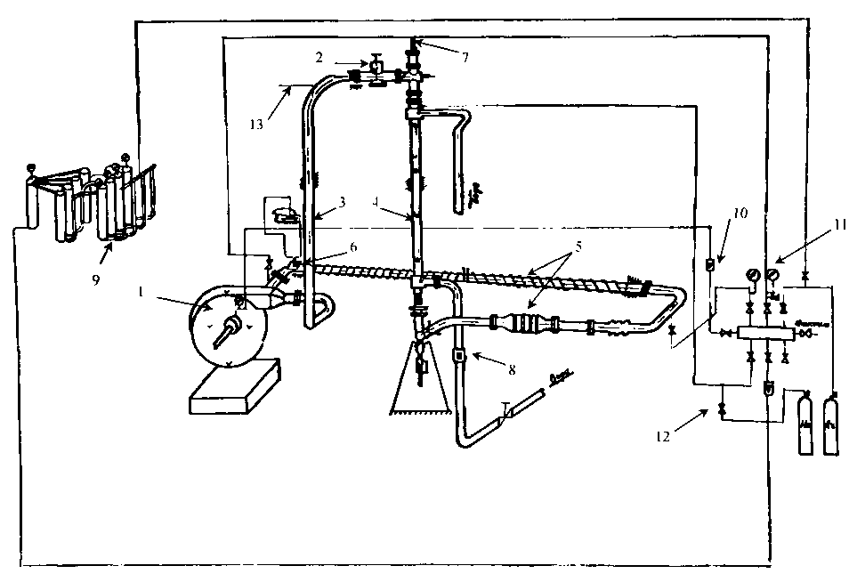
Complex geometry closed-loop setup prototype

