Slide 1



Progress report on the ISTC project #3813: Phase relation in corium systems
(PRECOS)
A.P. Alexandrov Research Institute of Technology
ETU
Saint-Petersburg
SPbSIT (TU)
Presented by S. Bechta
18th CEG-SAM meeting
St. Petersburg, Russia
September 28-30, 2010

Slide 2
Contents
  General information
  Project objectives
  PRECOS test matrix
  Scope of work in quarters 8 - 9
  Test results:
  UO₂-CaO system
  UO₂-SiO₂- FeO system
  UO₂-CaO- FeO system
  Concluding remarks

Slide 3
PRECOS project general information
Project participants and coordination
Collaborators
FZK, Germany
IRSN,
France
ITU,
EU
CEA,
France
Areva NP, Germany
Coordinator
ISTC,
Moscow
Steering committee
Operation Agent: A.P. Alexandrov RIT, Russia
IVTAN,
Russia
SPb State
Technological University, Russia
SPb State Electrotechnical University,
Russia

Slide 4
Project objectives
Experimental determination of:
liquidus – solidus temperatures
coordinates of reference points (eutectics, etc.)
solubility limits of solid solutions
compositions of liquids coexisting in the miscibility gap

Slide 5
PRECOS test matrix
Task | Composition | Atm | Experimental data | Priority level | Number of tests scheduled /carried out
1 | U-Zr-Fe-O | Argon | Selected points (liquidus, solidus, tie-lines in the miscibility gap) | 1 | 6/8¹
2 | ZrO₂ - FeO_{y} | Air and p_{O2} control | liquidus, solidus, solubility limits | 2 | 3/3²
 | UO₂ - SiO₂ | Neutral | liquidus, solidus, solubility limits, eutectic point | 1 | 7/(5³+40⁴)
 | CaO - UO₂ |  |  | 1 | 7/7³
3 | UO₂ – FeO – SiO₂ |  | liquidus, solidus, solubility limits, tie-lines in the miscibility gap, ternary eutectic point | 1 | 10/(1³+4⁴)
 | UO₂ – FeO – CaO |  | liquidus, solidus, solubility limits, ternary eutectic point | 1 | 10/1³
 | ZrO₂ - FeO - SiO₂ |  | ternary eutectic point | 2 | 2/0
 | ZrO₂ - FeO - CaO |  | ternary eutectic point | 2 | 2/0
4 | Eutectic composition measurement of a realistic complex corium mixture | Argon or Air | System (atmosphere) proposed by: - French partners (1 system) German partners (1 system) - Russian partners (1 system) | 2 | 3/0
Notes: 1-LPH (Zr-O), 2- HTM, 3- VPA IMCC, 4- VPA in Galahov microfurnace

Slide 6
Scope of work in quarters 8-9
Experiments in the UO₂-CaO, UO₂-FeO-CaO,
UO₂-FeO-SiO₂ systems have been conducted.
Post-test analysis of samples is in progress
IVT RAN setup with laser heating has been
additionally equipped with 300 mW diode laser for
specimen lighting
IVT RAN setup with laser heating has been used
for the verification experiments on previously
studied Zr-O and ZrO₂-FeO systems
Construction work necessary for getting a license
on uranium handling has been completed. The
license is expected to be issued in December 2010;
after that the U-Zr-Fe-O studies will be started

Slide 7
Scope of work in quarters 8-9 (2)

Slide 8
UO₂ - CaO system: PRS 11 test results
Experimental objectives
T_{liq} determination
Determination of the components final solubility in the formed solid solutions
Charge composition
mol.% 30UO₂ + 70CaO
Tliq
Samples
From 4829 s, the pool was pulled
out from inductor at 8.5 mm/h for
2.4 hours. This has ensured close
to equilibrium crystallization and
the eutectic liquid displacement
into the ingot upper part
T_{liq} was measured 3 times by VPA IMCC with melt sampling

Slide 9
UO₂ - CaO system: PRS 11 test results (2)
VPA IMCC: Example of thermogram 3 from the test showing
melt surface
Melt samples
composition
Sample | Cha | XRF
 | UO₂ mol.%
#1 | 30.5 | 32.0
#2 | 30.1 | 32.9
#3 | 30.8 | 34.5
    Results of T_{liq} measurements:
    1912, 1910, 1907oC
SEM/EDX in progress

Slide 10
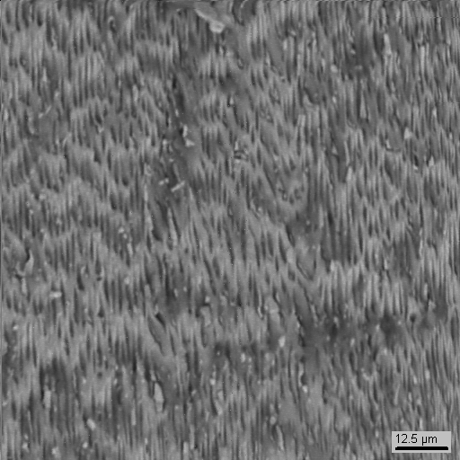
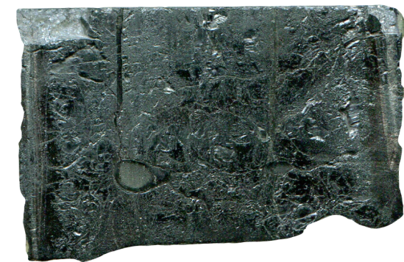
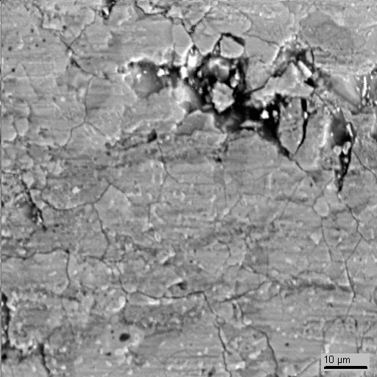
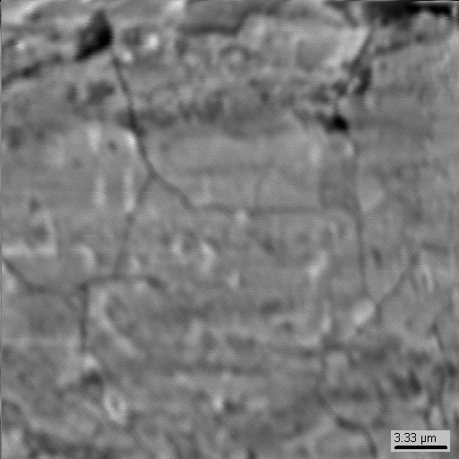
UO₂ - CaO system: PRS 11 test results (3)
SEM/EDX analysis of the ingot
5
mm
Eutectic |  | UO₂ | CaO
EDX | mass % | 69.7 | 30.3
 | mol% | 32.4 | 67.6
8
9
6
7
4
5
3
10
1
2
2
_{12.5µm}
1
1
1
Ca₂UO₄
_{10µm}
_{3.3µm}
Ingot practically consists of Ca₂UO₄ and small eutectic regions
Eutectic composition is close to the chemical compound, and during the
long-term exposure the crystallized eutectic regions undergo recrystallization
Notes:
Eutectics for UO2 from 34.8 to 32.4mol.% on PRS10 and 11 respectively. In chemical compound UO2-33.3 mol%
The polished section of the ingot specimen top is presented, there the eutectics was driven/activated/started, куда отгоняли эвтектику.
The charge composition was close to the assumed eutectics, therefore extensive eutectics was expected. But eutectics was formed only in region 9. All other regions practically showed monophase layer of Ca2UO4, which is shown in the bottom images. As some publications mention the existence of this compound in the suboxidized region, we believe that here the eutectics is recrystallized in the suboxidized region into the chemical compound.Agreed with Almyashev.

Slide 11
UO₂ - CaO system: PRS 12 test results
Experimental objectives
T_{liq} determination at high UO₂ content
Charge composition
mol.% 60UO₂ + 40CaO
Tliq
Samples
Tliq
Samples
Two melt compositions have been
realized within one melting cycle
6 melt samples were taken and T_{liq} was
measured 6 times by VPA IMCC

Slide 12
UO₂ - CaO system: PRS 12 test results (2)
Charge composition, mol.% 60UO₂ + 40CaO
VPA IMCC: Fragment of the experiment thermogram 3 showing
melt surface
Melt samples composition
Sample | Cha | XRF
 | UO₂ mol.%
№1 | 57.3 | 55.03
№2 | 52.3 | 56.3
№3 | 59.3 | 55.1
    T_{liq} was measured 3 times:
    2440, 2420 and 2432oC
SEM/EDX in progress

Slide 13
UO₂ - CaO system: PRS 12 test results (3)
Charge composition (after CaO addition in to the melt)
mol.% 70UO₂ + 30CaO
VPA IMCC: Fragment of the experimental thermogram 4 showing
melt surface
Melt samples composition
Sample | Cha | XRF
 | UO₂ mol.%
№4 | 71.6 | 70.3
№5 | 64.8 | 70.1
№6 | 64.0 | 68.6
    T_{liq} was measured 3 times:
    2589, 2620 and 2595oC
SEM/EDX in progress

Slide 14
Test results on the UO₂ - CaO system
Compositions of the final solid solutions and the eutectics will be refined after SEM/EDX has been
performed for PRS12
The posttest analysis of samples from the corium ingot from VULCANO VP-U1, an ECOSTAR test,
has detected CaO solubility in UO₂ (aproximately 47.9 мол.%) in one of the samples

Slide 15
UO₂ – FeO – SiO₂ system: PRS 13 test results
Experimental objectives
T_{liq} determination by VPA IMCC.
Determination of the ternary eutectic composition
Charge composition
mol.% 30.00 UO₂ + 46.67 FeO +23.33 SiO₂
Samples
Tliq
From 3276 s, the pool was pulled out from inductor at 9 mm/h for 3.6 hours. This has ensured close to equilibrium crystallization and the eutectic liquid displacement into the ingot upper part
T_{liq} was measured 4 times by VPA IMCC and accompanied by melt sampling

Slide 16
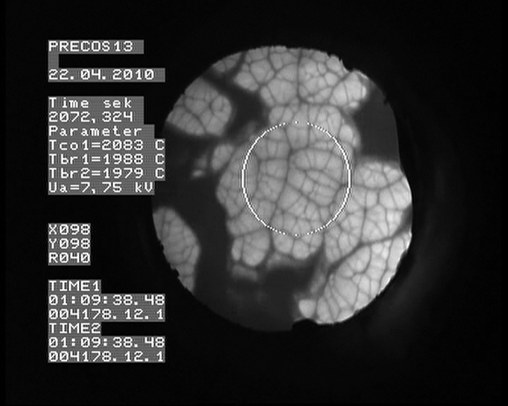
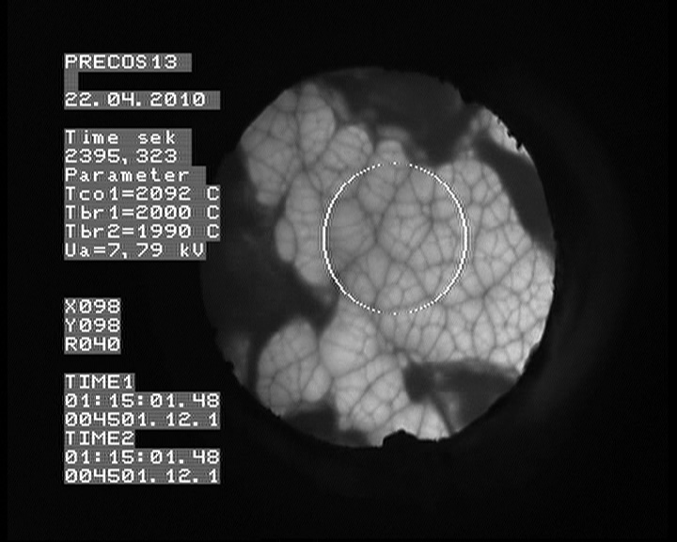
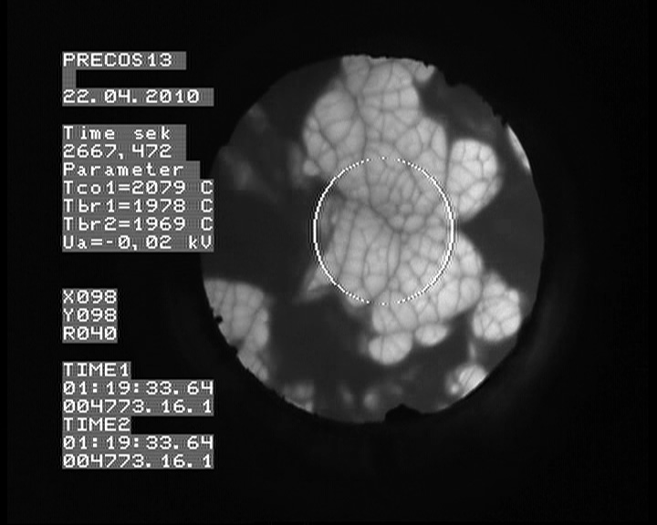
UO₂–FeO–SiO₂ system: PRS 13 test results (2)
VPA IMCC: Example of thermogram 1 from the test
showing melt surface
# 2
# 3
# 4
    Results of T_{liq} measurements: 2055, 2083, 2092, 2079oC

Slide 17
UO₂–FeO–SiO₂ system: PRS 13 test results (3)
Chemical analysis of melt samples
In progress:
- SEM/EDX analysis of melt samples;
- chemical analysis of other fused products (ingot, crusts,
dry spillages and aerosols) for composing the elemental
material balance

Slide 18
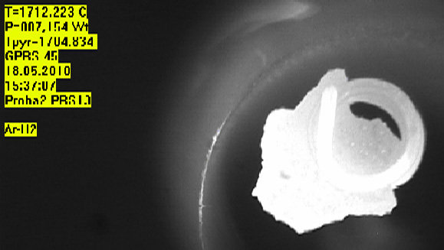
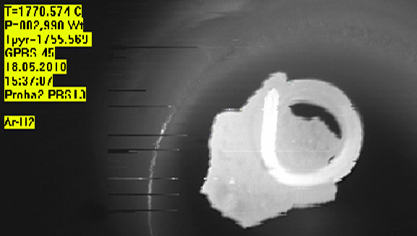
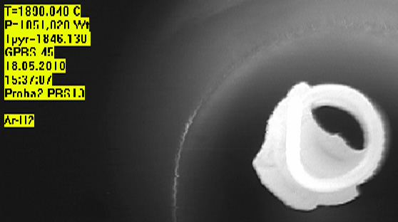
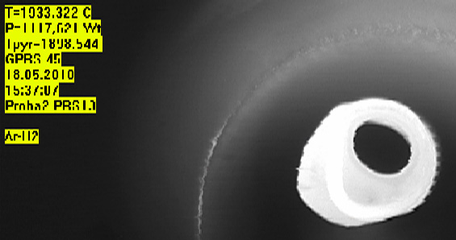
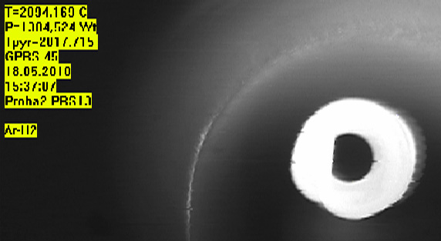
UO₂ –FeO-SiO₂ system: PRS 13 test results (4)
T_{liq} and T_{sol} determination in the Galakhov microfurnace
Sample 2
1704°C
1755°C
1846°C
Beginning of melting
Complete spreading
1898°C
2017°C
Visual polythermal analysis in the Galakhov microfurnace T_{sol}= 1755°С; T_{liq}=2017°С
T_{liq}, determined by the VPA IMCC (2083±30°С) and by the Galakhov method
(2017°С) for the composition in question differ by 66°С, presumably, due to the
interaction of the sample with the holder in the Galakhov microfurnace

Slide 19
UO₂-FeO-SiO₂ system: GPRS #33-36 test results (5)
UO₂
Experimental objectives
Study the miscibility gap boundaries
Determine ternary eutectic point
GPRS36
GPRS35
Annealing, melting and quenching in the Galakhov
microfurnace (estimation of ternary eutectic position)
SiO₂
Fe₂SiO₄
FeO
Test | Content, mol.% |  |  | Tempera-ture, °С | Exposure time, min | Note
 | UO₂ | SiO₂ | FeO
GPRS33 | 5.0 | 70.0 | 25.0 | 1100 | 60 | Annealing
 |  |  |  | 2100 | 5 | Melting and quenching
GPRS34 | 10.0 | 80.0 | 10.0 | 1100 | 60 | Annealing
 |  |  |  | 1850 | 5 | Melting and quenching
GPRS35 | 20.0 | 73.0 | 7.0 | 1100 | 60 | Annealing
 |  |  |  | 1950 | 5 | Melting and quenching
GPRS36 | 1.7 | 65.5 | 32.8 | 1100 | 60 | Annealing
 |  |  |  | 1300 | 20 | Melting
 |  |  |  | 1300-900 | 240 | Cooling at 100°C/h
GPRS33
GPRS34
UO₂ of >99.0 % purity, SiO₂ of 99.99% purity, charge mass – 150 mg, molybdenum
crucibles ∅ 6 mm

Slide 20
UO₂-FeO-SiO₂ system:GPRS #33-36 test results(6)
SEM/EDX GPRS 33
SQ1
25 μm
.P3
.P2
167 μm
Conditions:
Charge composition, mol%
5UO₂ + 25FeO +70SiO₂
isothermal exposure at 1100°С for 1 h., heating up to 2100°С, 5-min. exposure, quenching
.P1
0.92 μm
No macrostratification was found in the oxidic part of the polished section
Microstructure resembling that of the ‘heavy’ liquid in the UO₂-SiO₂ system.
As a result of the interaction between the melt and the crucible, the composition
got depleted in Fe, but no molybdenum was found in the oxidic part
Notes:
The slide shows specification and polished section of experiment with microimages of characteristic zones. In the oxidic part no macro-stratification into light and heavy liquids is observed, and similar to the UO2-SiO2 system the microstructure resembles the heavy liquid one. There the interaction of crucible material (Mo) with iron is observed. The iron was introduced in excess for FeO stoichiometry, but in the oxidic part Mo is absent.

Slide 21
SEM/EDX GPRS 34
UO₂-FeO-SiO₂ system:GPRS #33-36 test results(7)
Conditions:
Charge composition, mol% 10 UO₂ + 10 FeO +80 SiO₂
Isothermal exposure at 1100°С for 1 h., heating up to 1950°С and a 5-min. exposure, quenching
UO₂
SQ3
Fe
124 μm
SiO₂ with inclusions
100 μm
25 μm
FeSiO₃
SQ2
SQ1
SiO₂ with inclusions
Mo(Fe)
100 μm
49.9 μm
12.5 μm
UO₂
6.67 μm
Indication of MG
The microstructure is nonuniform. Inclusions
of irregular shape indicate that the melt
exposure time was insufficient (equilibrium
was not reached). The globules of heavy
liquid contain Fe_{met} drops
Notes:
The slide shows specification and polished section of experiment with microimages of characteristic zones. Microstructure is inhomogeneous. Inclusions have irregular shape, which indicates the insufficient time of melt exposition (equilibrium not reached). Heavy liquid globules and light liquid matrix confirm that the composition was in the miscibility gap. For future studies it is suggested to increase the melt exposition time to 20 minutes.

Slide 22
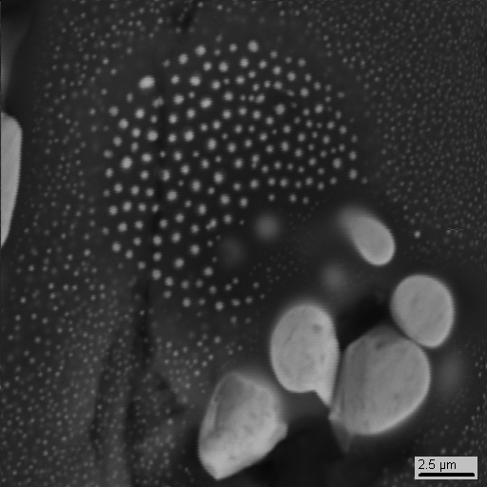
UO₂-FeO-SiO₂ system:GPRS #33-36 test results(8)
SEM/EDX GPRS 35
Conditions:
Charge composition, mol%
20 UO₂ + 7 FeO +73 SiO₂
Isothermal exposure at 1100°С for 1 h., heating up to 1850°С, 5-min. exposure, quenching
SQ1
4 μm
Though the macrostructure
is uniform, the
microstructure is extremely
inhomogeneous and
resembles that in
UO₂-SiO₂ near the binodal
SQ2
167 μm
SQ3
2.5 μm
144 μm
6.67 μm
Notes:
The slide shows specification and polished section of experiment with microimages of typical zones. The macrostructure is homogeneous. But the microstructure is definitely inhomogeneous. Note that the microstructure in UO2-SiO2 is above binodal. For this composition it is planned to decrease annealing temperature to 1800С

Slide 23
UO₂-FeO-SiO₂ system:GPRS #33-36 test results (9)
XRD of sample of GPRS 36 test
2θ
The analysis was done using FARAD desktop diffractometer
with CrKα₁ radiation (λ = 0.22897 nm)
Notes:
After the experiment a sample was prepared and its XRF analysis made. The result on slide confirms that the composition is located in the sectoral triangle of the diagram: UO2-Fayalite-SiO2

Slide 24
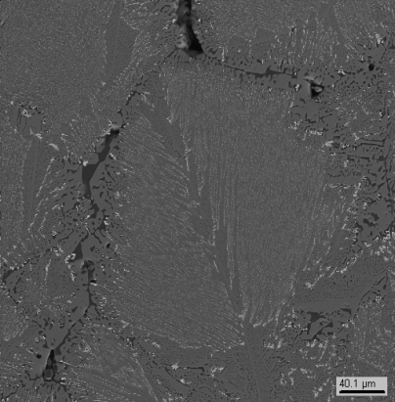
SEM/EDX GPRS 36
UO₂-FeO-SiO₂ system:GPRS #33-36 test results(10)
SQ1
SQ2
SQ3
144 μm
40.1 μm
1.67 μm
Conditions:
Charge composition, mol% 1.7 UO₂ + 32.8 FeO +65.5 SiO₂
Isothermal exposure at 1100°С for 1 h., heating up to 1300°С, 20-min. exposure, chilling from 1300 down to 900°С for 240 min.
Microstructure in the lower part of the crucible shows the eutectic crystallization.
In terms of composition, this eutectics lies within a specific triangle
UO₂-Fe₂SiO₄-SiO₂.
Notes:
The slide shows specification and polished section of experiment with microimages of characteristic zones. Eutectic microstructure in the bottom part of the crucible is found; its composition is given in the table.

Slide 25
UO₂-FeO-SiO₂ system: GPRS #33-36 test results(11)
SiO₂
Characteristic points of the diagram
Bulk composition of the total microstructure in GPRS 35
Initial composition of the charge
Composition of the liquid at T~Tq~1950C (above MG)
Bulk composition in GPRS 33 (no MG)
Light matrix composition in GPRS 35 (T is presumably around Tm)
‘Heavy’ liquid in GPRS 34 (T from Tq up to Tm)
Composition of globules in the light matrix in GPRS 35 (T is presumably around Tm)
Composition of the ‘light’ liquid with globules in GPRS 34 (T~Tq~1850C)
Ternary eutectics composition in GPRS 36
Composition of the light matrix in GPRS 34 (T~Tm)
Solid phase composition in GPRS 36
Notes:
The slide presents preliminary experimental results of completed studies: shifts of integral compositions from charge compositions and determined compositions of heavy and light liquids. It also shows the composition of eutectics, temperature of which will be determined in a separate experiment

Slide 26
UO₂-FeO-SiO₂ system: test results (12)
The performed tests confirm the existence of
a miscibility gap in a fairly narrow region adjacent
to the diagram corner on the SiO₂ side
The ternary eutectics has been determined within
a particular triangle of the UO₂ - Fe₂SiO₄ - SiO₂
ternary system
The PRS13 test has been performed for
determining composition of the second ternary
eutectics within a particular triangle of the
UO₂ - Fe₂SiO₄ - FeO ternary system. The ingot
analysis is underway

Slide 27
UO₂ – FeO – CaO system: PRS 14 test results
Experimental objectives
T_{liq} determination by VPA IMCC
Determination of eutectic composition
Charge composition
mol.% 20.1UO₂ + 66.7FeO +13.2CaO
Samples
Tliq
From 4519 s, the pool was pulled out from the inductor at 9 mm/h for 5.9 hours. This has ensured close to equilibrium crystallization and the eutectic liquid displacement into the ingot upper part
T_{liq,},was measured by VPA IMCC 3 times; video record of one
measurement could not be deciphered. Samples were taken 3 times

Slide 28
UO₂ – FeO – CaO system: PRS 14 test results (2)
VPA IMCC: Example of thermogram #2 showing melt surface
# 3
    Results of T_{liq} measurements: 1238, 1247oC

Slide 29
UO₂ – FeO – CaO system: PRS 14 test results (3)
XRF and Chemical analysis of melt samples
* - determined from residue
The results of corium samples XRF and chemical analysis were found
to differ significantly
XRF results are believed to be more accurate, since the content of CaO
was not determined by chemical analysis, but calculated from the residue
In progress:
- the SEM/EDX analysis of melt samples
Notes:
The slide shows results of the melt sample analysis. Difference between XRF and chemical analysis has been found. XRF is more precise, because the chemical analysis determines CaO from the residue. The final composition will be determined after SEM/EDX analysis of melt samples.

Slide 30
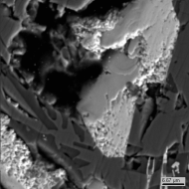
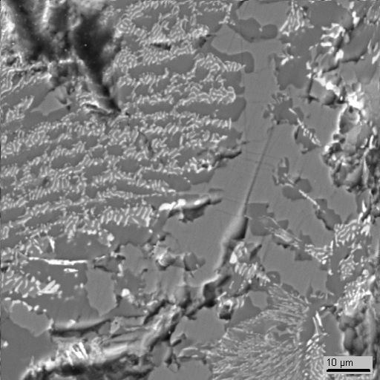
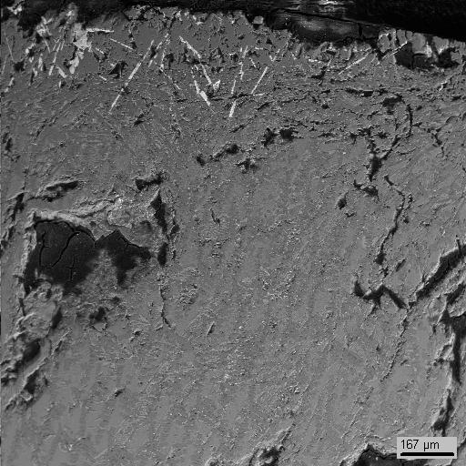
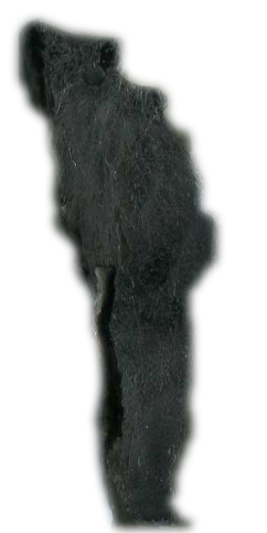
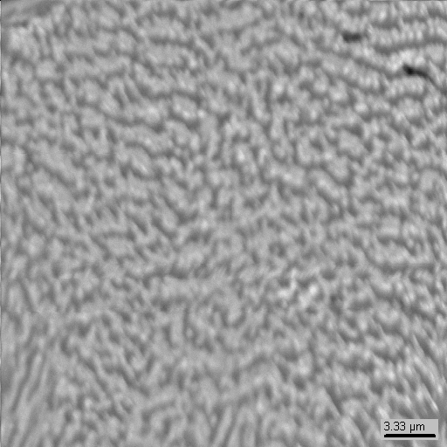
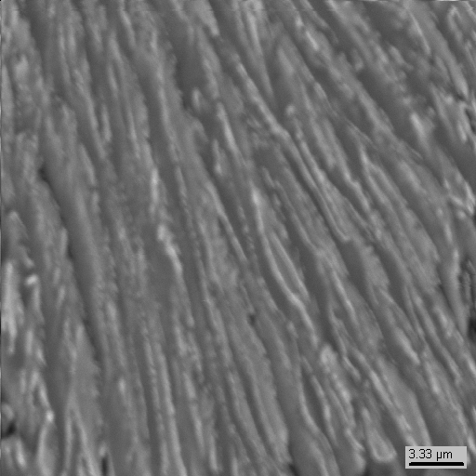
UO₂ – FeO – CaO system: PRS 14 test results (4)
CaU(Fe)O₃
SEM/EDX
Fe(Ca)O
CaFeO₃
15 μm
1 sm
ingot
250 μm
Eutectic |  | UO₂ | FeO | CaO
EDX | mass % | 10.3 | 62.4 | 27.2
 | mol% | 2.8 | 62.4 | 34.9
6 μm
Eutectic |  | UO₂ | FeO | CaO
EDX | mass % | 10.5 | 61.4 | 28.2
 | mol% | 2.8 | 61.2 | 36.0
6 μm
Notes:
A template was made from ingot. The ingot study is aimed at the detection and composition determination of ternary eutectics, this is exactly what has been done.

Slide 31
UO₂ – FeO – CaO system: PRS 14 test results (5)
VPA IMCC is used to determine liquidus
temperature of composition, mass%:
19.3±1.0 UO₂ + 66.6±3.3 FeO + 14.1±0.7 CaO –
T_{liq}= 1242±20 °C
EDX method is used to determine the ternary
eutectic composition, mass%:
10.4±0.1 UO2 + 61.9±0.5 FeO + 27.7±0.5 CaO

Slide 32
Joint publication with collaborators within the reported quarters
Almjashev V.I., Barrachin M., Bechta S.V., Bottomley D., Defoort F., Fischer M., Gusarov V.V., Hellmann S.,
Khabensky V.B., Krushinov E.V., Lopukh D.B., Mezentseva L.P., Miassoedov A., Petrov Yu.B., Vitol S.A.
Phase equilibria in the FeO_{1+x}–UO₂–ZrO₂ system in the FeO_{1+x}-enriched domain
// JNM. 2010. V. 400. N. 2. P. 119–126

Slide 33
3rd PRECOS project meeting
( June 2, 2010, St. Petersburg)
Objectives:
Discuss test results related to binary and ternary oxidic
systems:
UO₂-SiO₂; UO₂-CaO; ZrO₂-FeO_{y}
UO₂-FeO-SiO₂; UO₂-FeO-CaO
Discuss and agree upon future works
Discuss possible reasons of discrepancies between XRF,
Chemical and EDX analyses of UO₂-SiO₂ and UO₂-CaO
samples
Publications
To discuss PRECOS project prolongation without additional
funding

Slide 34
3rd project meeting decisions about further work
Conduct 1 experiment in the UO₂-SiO₂ system by
LPH method
Cancel the studies of eutectic points in the
ZrO₂–FeO–SiO₂, ZrO₂–FeO–CaO systems for a
more detailed study of priority system
Check melt pollution by the crucible material
in the GPRS experiments in the UO₂-FeO-SiO₂
system, to determine a possibility of studies in
the Mo crucibles and discuss it with collaborators

Slide 35
Concluding remarks
Experimental studies in the UO₂-CaO system have
been completed
Study of the UO₂-CaO-FeO ternary system have
been started
Plans for quarters # 10 - 11:
Complete the UO₂-CaO systems and start a report
preparation
Continue study of the ZrO₂-FeO_{y} ; UO₂-SiO₂-FeO; CaO-UO₂-FeO and U-Zr-O systems (the last one by LPH in IVT RAN)

