Slide 1

Long-term behavior of Chernobyl lava
RRC “KI”

Slide 2
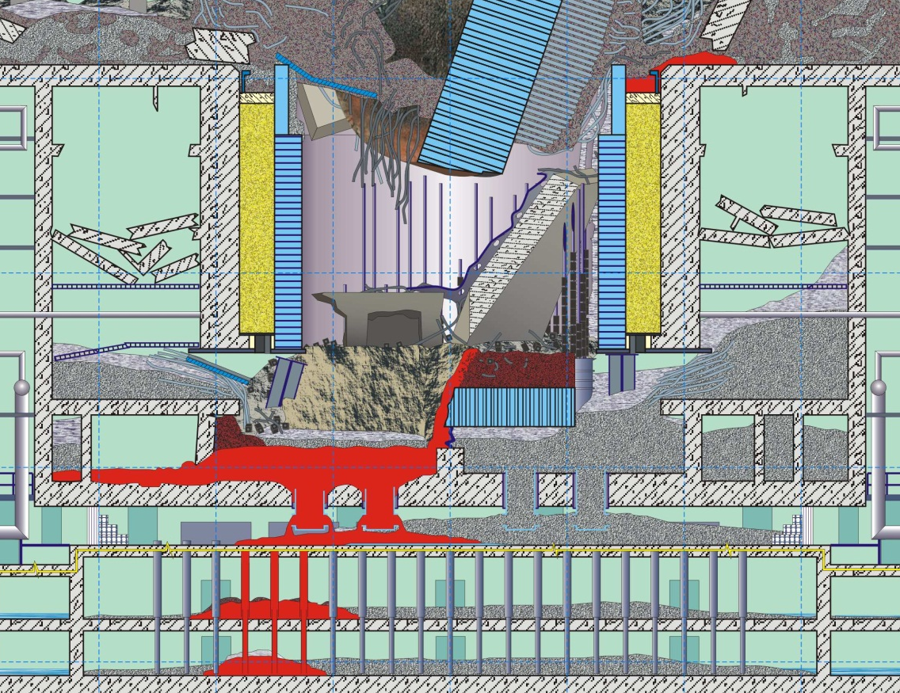
Chernobyl experience
RRC “KI”
Humidity
Chemical Interactions
Temperature
Self Irradiation
Destruction
Dust
Soluble Compounds

Slide 3
Problem definition
RRC “KI”
In case of severe reactor accident resulted in corium formation, there is no practical opportunity to withdraw quickly fuel containing material outside the Unit, or properly isolate it (like in case of the ChNPP).
What can we expect from the accidental fuel inside the building from the viewpoint of the LFCM transformation?
How much time do we have before drastic measures for fuel withdrawal / isolation will be necessary?
What sort of corium will we have to the time of its withdrawal and disposal of?

Slide 4
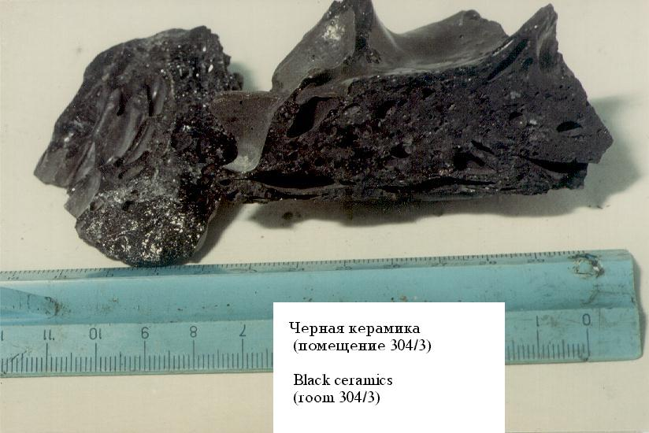
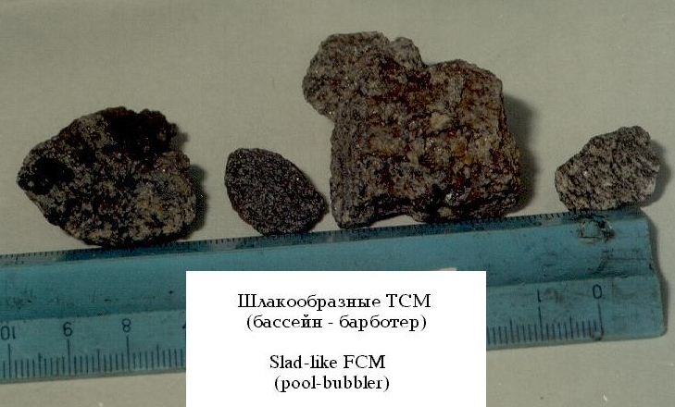
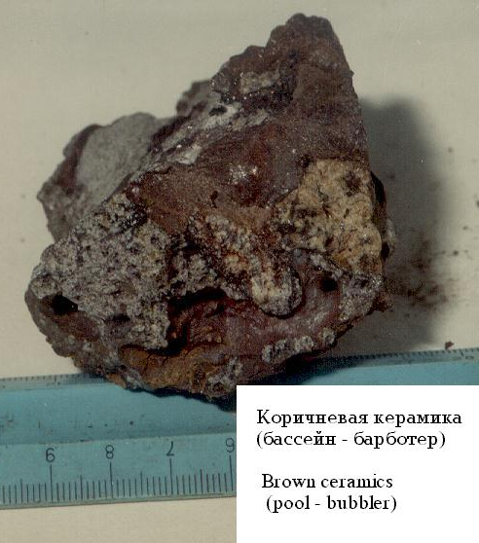
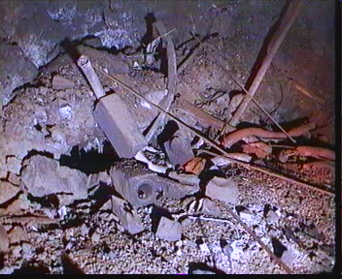
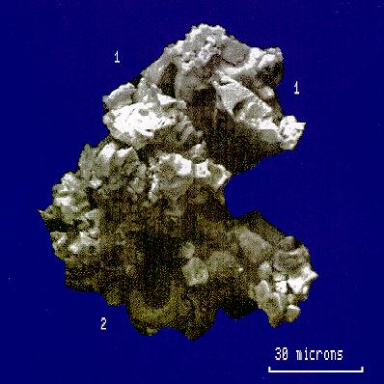
W1. Basic forms of accidental fuel, their properties and circumstances resulted in their origination
RRC “KI”
“Black lava”
“Brown lava”
“Porous lava”
Active core fragments
Secondary products of corium formation
ACE MCCI Test L4

Slide 5
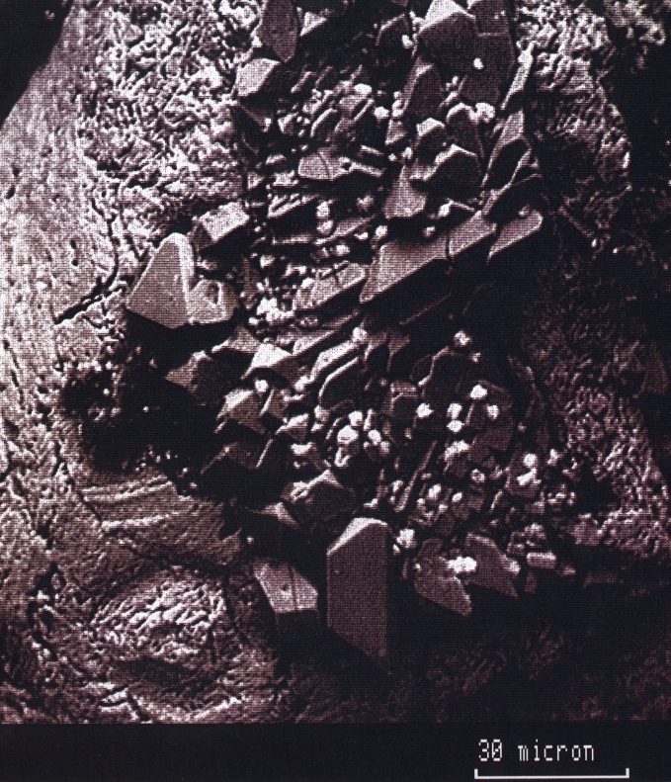
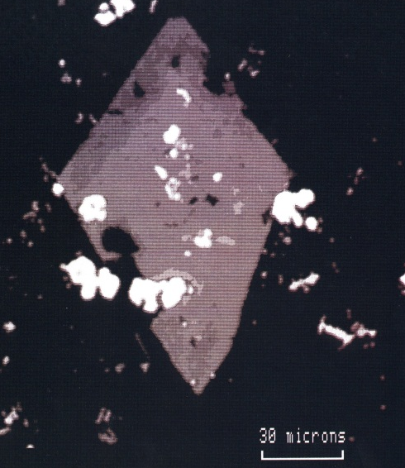
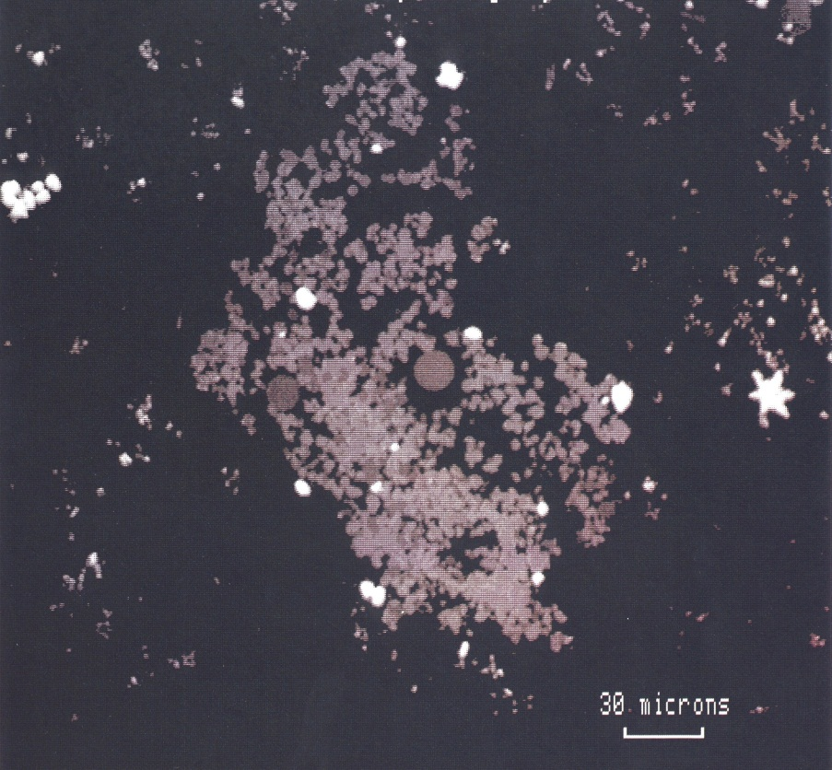
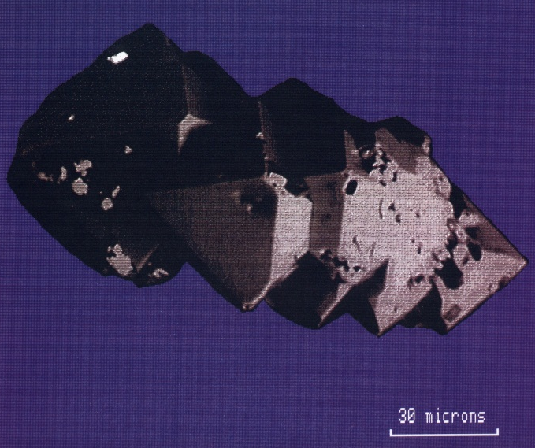
W2. Micro- structure of Chernobyl lavas (matrix, inclusions, radioactivity distribution etc.)
RRC “KI”

Slide 6
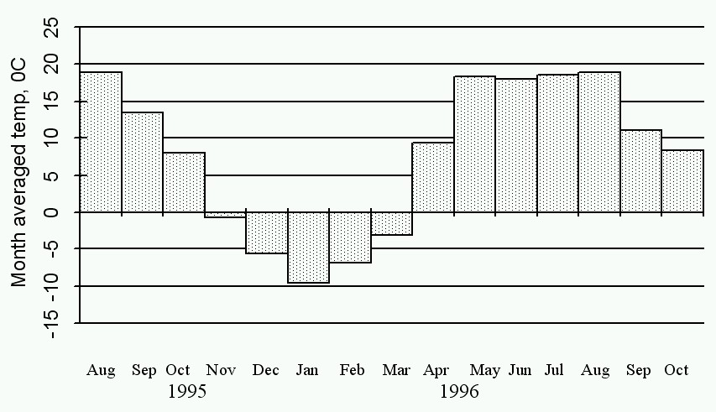
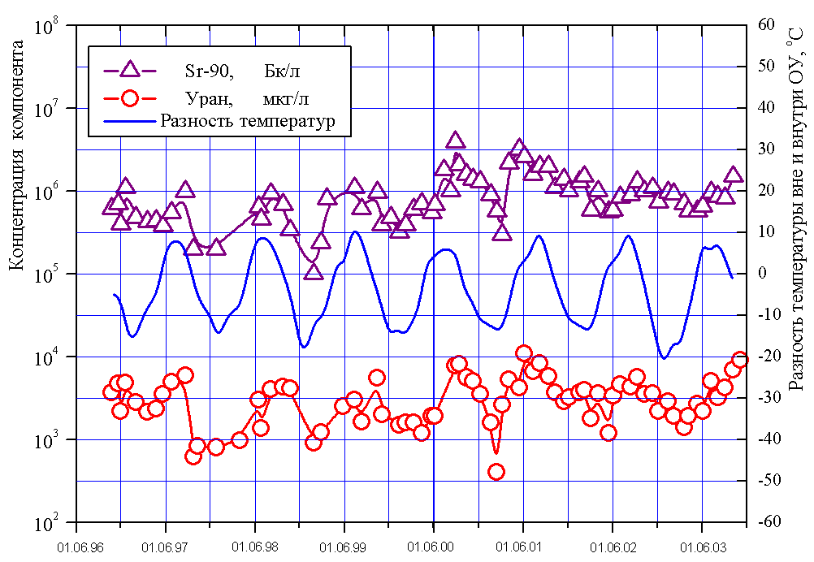
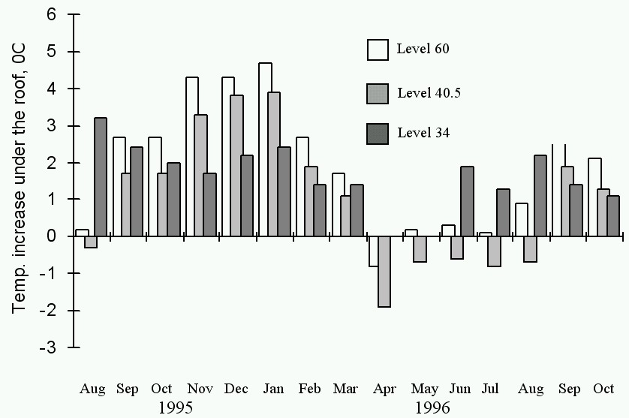
W3. External and internal factors influenced on long-term behavior of different forms of accidental fuel:
RRC “KI”
Humidity variations;
Temperature variations

Slide 7
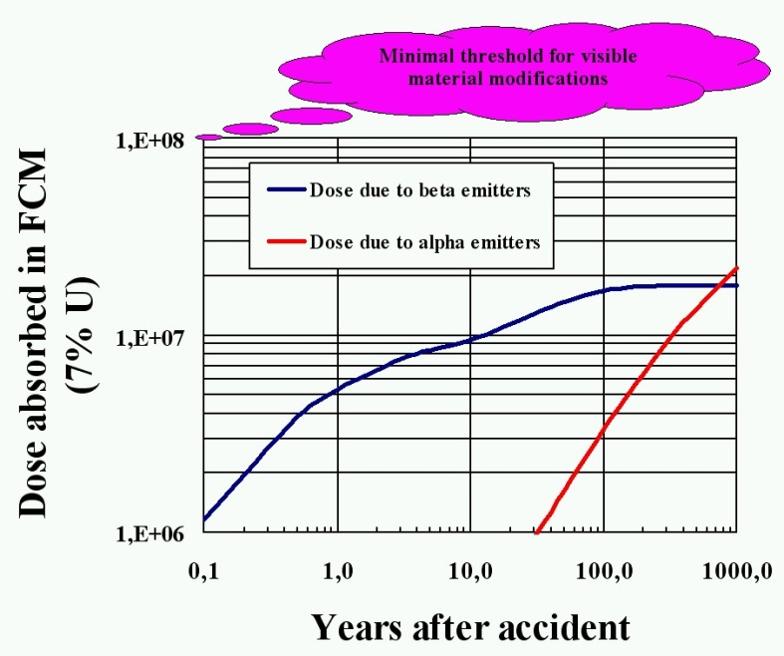

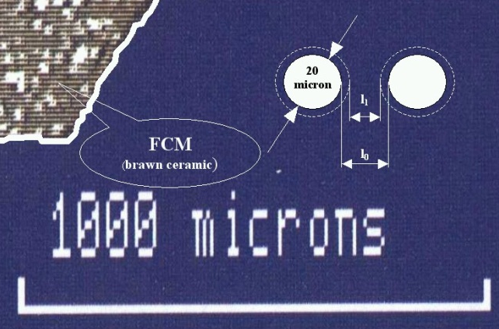
W3. External and internal factors influenced on long-term behavior of different forms of accidental fuel:
RRC “KI”
Radiation model (external and self irradiation, accumulation of the defects in the material)
Most significant mechanisms for destruction

Slide 8
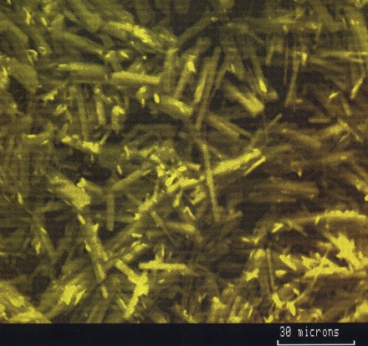
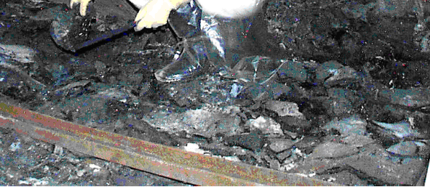
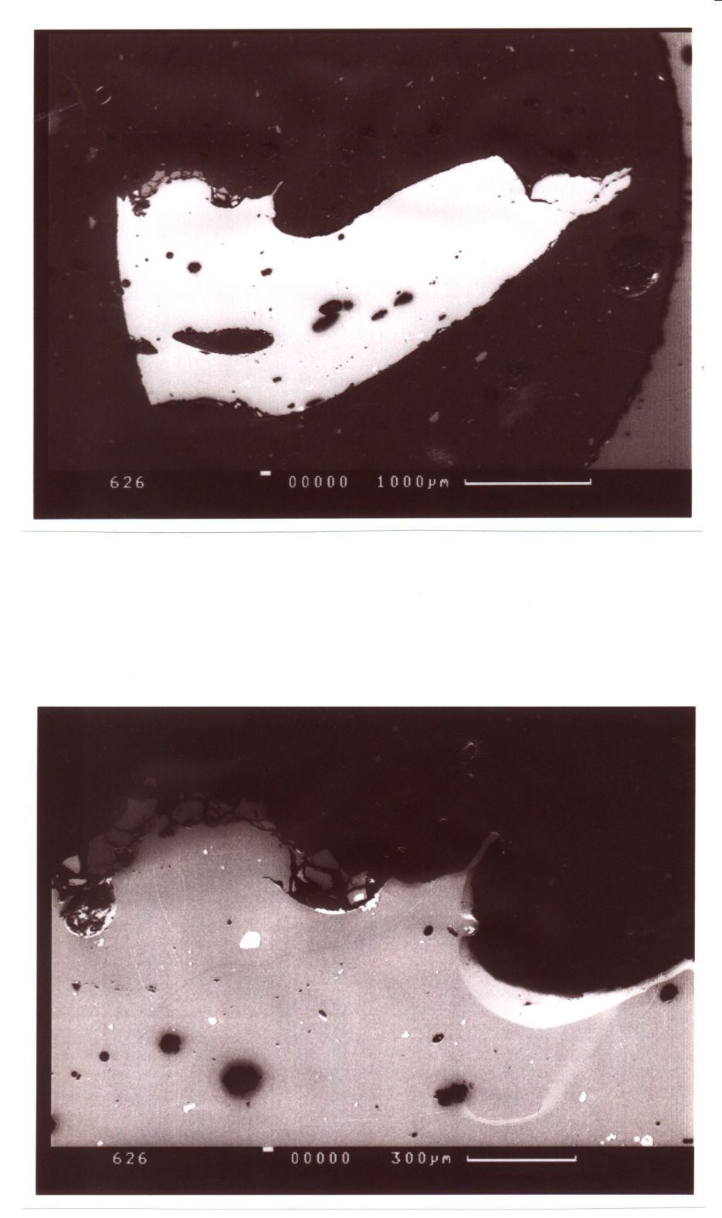
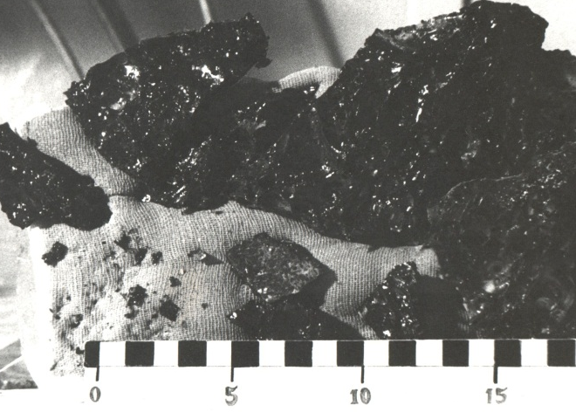
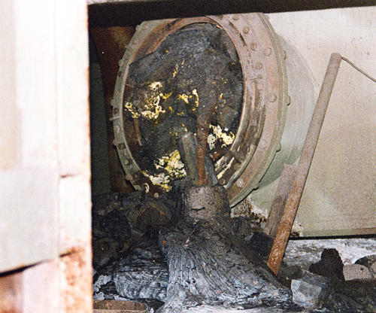
W4. Direct studies of the FCM transformation
RRC “KI”

Slide 9
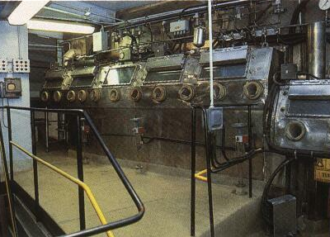
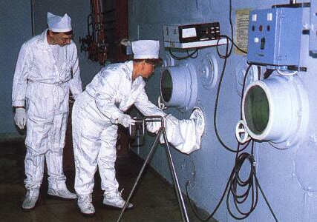
W5. Description of the FCM behavior in storage facilities of RRC “KI”, “Radium Institute” etc.
RRC “KI”

Slide 10
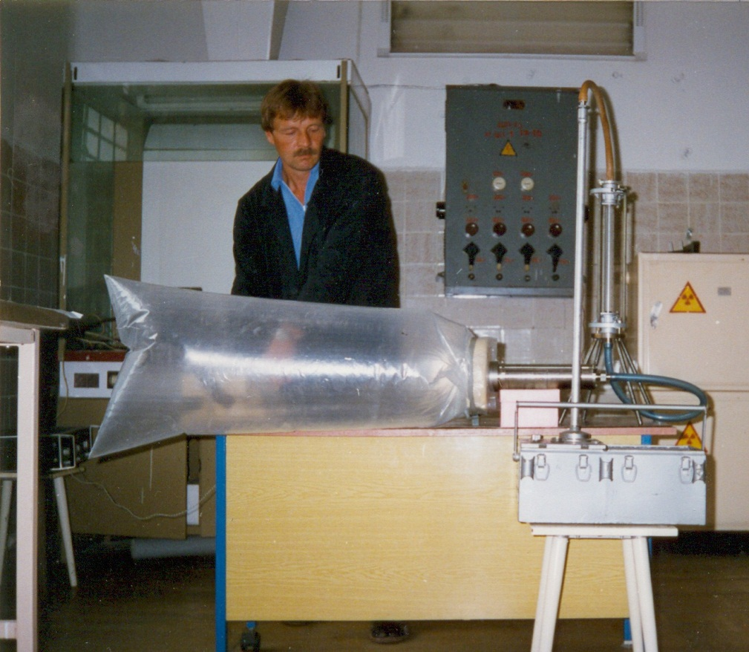
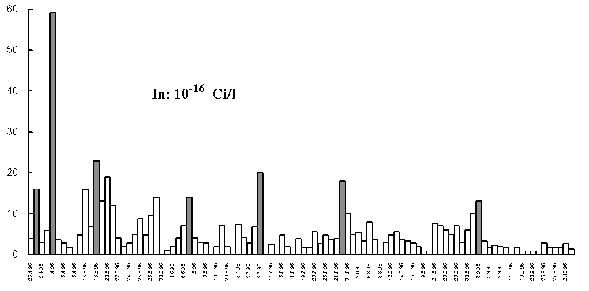
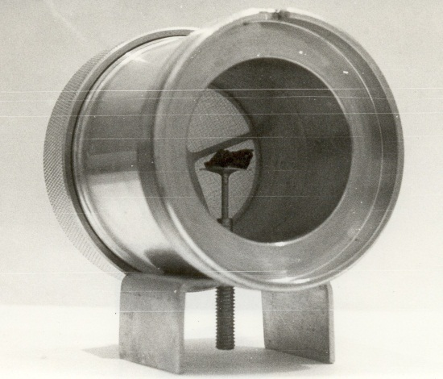
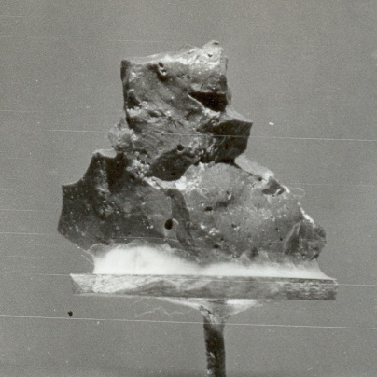
W6. Lavas as a source of dust formation
RRC “KI”

Slide 11
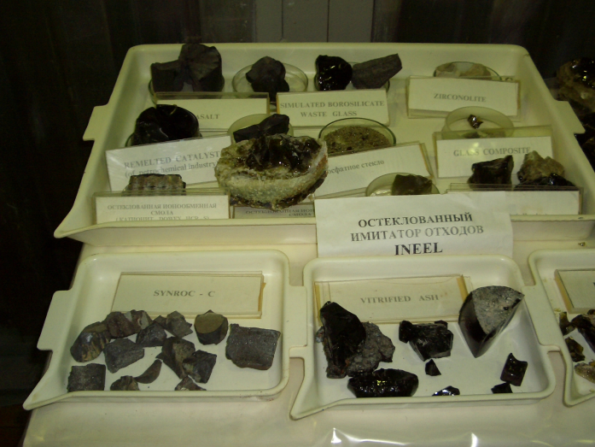
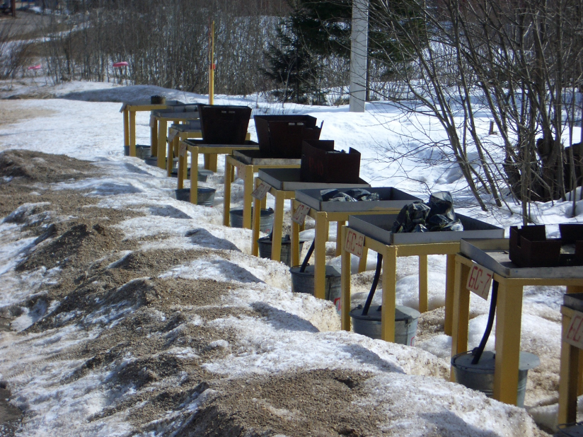
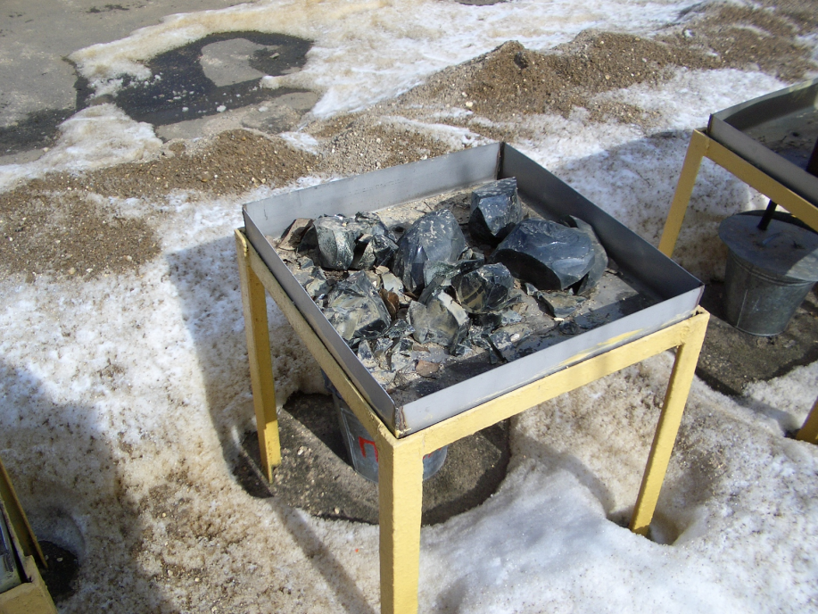
W7. Existing LFCM analogues and their studies
RRC “KI”

Slide 12
Summary
RRC “KI”
An objective of the work is study of the dynamics of solidified corium transformations depending on internal composition and external conditions.
As a new experimental work, description of long-term behavior of lava and similar solidified radwaste samples in storage facilities could be considered.
Anticipated resources:
Participating personnel 15-20 (10-12 “weapon” scientists);
Project duration 30 months;
Estimated cost 250,000…300,000 USD

