Slide 1
Update on SARNET2
Presented by B. Clément (IRSN)

Slide 2
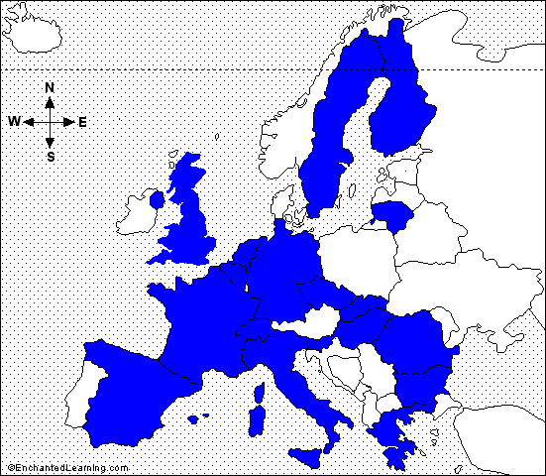
Add Title by Clicking
General features
Severe Accident Research NETwork of excellence
Add Text by Clicking
SARNET2 Project in 7th EC Framework Programme (follow-up of SARNET FP6 project 2004-2008)
21 countries (European Union, plus Switzerland, Canada, USA and South-Korea)
42 organizations
(KINS entrance on April 1, 2010)
(soon BARC (India) entrance)
24 Research organizations
7 Universities
5 Industry/Utilities
6 Safety authorities or Technical supports
≈ 230 researchers (+ PhD)
Starts April 1st, 2009 for 4 years
≈ work of 40 persons-year per year
≈ 8,5M€ effort per year
≈ 1,5M€ per year funded by EC

Slide 3
Research priorities
6 issues remain open with high priority:
Core coolability during reflooding and debris cooling,
Ex-vessel melt pool configuration during MCCI (Molten Core Concrete Interaction) & ex-vessel corium coolability by top flooding,
Melt relocation into water & ex-vessel FCI (Fuel Coolant Interaction),
Hydrogen mixing and combustion in containment (flame acceleration),
Oxidising impact on source term (Ru oxidising conditions or air ingress for HBU and MOX fuel elements),
Iodine chemistry in RCS and in containment.

Slide 4
Work-Packages
WP1: NoE Management, incl. updates of the research priorities,
WP2: Spreading of Excellence (courses, ERMSAR conferences, mobility of researchers)
WP3: Information Systems (web, ACT, DATANET)
WP4: ASTEC (capitalisation of knowledge, assessment, extension to BWR and CANDU)
WP5: corium and debris coolability (core reflooding..)
WP6: MCCI
WP7: steam explosion and hydrogen combustion in containment
WP8: oxidising impact on source term (Ru, HBU and MOX fuel), iodine chemistry in circuit and containment
R&D
The WP5 to 8 cover the 6 high-priority issues defined by SARP in SARNET.

Slide 5
Main progress in the last 6 months
Oct.2010: SARNET2 newsletter N°3.
Oct.11-15, 2010: 4th ASTEC Users’ Club in GRS/Cologne.
Nov. 15, 2010: WP5 meeting on reflooding/coolability of degraded core.
Nov.17, 2010: 1st meeting of the Severe Accident Priorities Group (see presentation by Martin Sonnenkalb).
Nov. 18-19, 2010: WP6 meeting on MCCI.
Nov. 22-24: WP8 Source Term meetings, including THAI benchmark.
Jan. 11-14, 2011: Course in Pisa (Italy) on Severe accident phenomenology including GEN.III NPPs.
Feb. 15, 2011: 1st meeting of SARNET2 Advisory Committee (12 experts from end-users organizations, only 2 SARNET2 members).
Feb. 17-18, 2011: Kick-off meeting of OECD/WGAMA – SARNET2 benchmark on alternative TMI2 scenario.
Mar. 7-9, 2011: SARNET2 participation to ASAMPSA2 Workshop.

Slide 6
Main next milestones
Mar. 29-30, 2011: WP8 meetings on Source Term.
April 2011: SARNET2 newsletter N°4.
May 2-5, 2011: paper on a general presentation of SARNET2 at ICAPP’11 conference in Nice (France).
June 2011: 2nd meeting of the Severe Accident Priorities Group (see presentation by Martin Sonnenkalb).
5th ERMSAR conference in March 2012, hosted by GRS in Cologne.

