Slide 1
Post test analysis of PARAMETER-SF3, -SF4
Jon Birchley and Leticia Fernandez-Moguel (PSI)
Presented by Salih Guentay,
CEG-SAM, 30 September 2010, St. Petersburg, Russia

Slide 2
Outline
Summary of models used
SF3 analysis
effect of oxidation correlation
effect of CCFL on reflood quench
SF4 analysis
treatment of air flow boundary conditions
thermal response
hydrogen generation
oxygen consumption
Conclusions and forward plans

Slide 3
SCDAP/RELAP5 and SCDAP/Sim
Both packages based on RELAP5 thermal-hydraulics and SCDAP modelling of core components
neither code as yet recognises oxygen as an active species
Versions used
SCDAP/RELAP5/Mod3.2/irs-psi
extensions for PARAMETER heater rod
axially uniform shroud and insulation spanning entire length of Ta/Mo/brass heater
alternative oxidation kinetics (Sokolov, air) and reaction heat (oxygen)
SCDAP/Sim/Mod3.4/psi
essentially same pedigree as SCDAP/RELAP5 version above
composition of shroud and insulation can vary along axial length
SCDAP/Sim/Mod3.5
under development
oxygen recognised as an active species
new air oxidation model

Slide 4
SCDAP/RELAP5 noding
Same base model for SF2, SF3, SF4
28 axial nodes for test section (lower, central and upper sections)
Radial noding: 1/1/4 in lower/central/upper sections
Heater: 14 Ta, 2x6 Mo, 2x1 brass
Cooling jackets for central and upper sections
Shroud/insulation for central bundle; dummy insulation applied in lower and upper sections (forced by SCDAP limitation)
Except where stated, base model uses default or recommendations
Same external resistance in base case models (8.5 mΩ/rod)

Slide 5
Physical models
Oxidation in steam
Cathcart-Pawel/Urbanic-Heidrick correlations (default in SCDAP)
d(m²)/dt = 33.6 * exp(-20065/T) ; 10.85 * exp(-16610/T) T < 1853 K ; T > 1853 K
Sokolov correlation
d(m²)/dt = 318.0 * exp(-23040/T); 196.5 * exp(-20800/T) T < 1773 K ; T > 1773 K
Oxidation in air (SF4 air ingress phase); Benjamin et al
d(m²)/dt = 6.22 * exp(-14630/T) (coded in MELCOR)
Δh corresponds to steam or oxygen, as appropriate
The units are kg² m⁻⁴ s⁻¹ for oxygen mass gain
Interphase friction
Ishii drift-flux model (default in RELAP5); SF3: user-chosen CCFL correlation
j_{g}*^{1/2} + 1.22 j_{f}*^{1/2} = 0.88 (No, Lee and Song; Nucl. Engrg. Tech. 37, 557-564)
j_{g}*^{1/2} + j_{f}*^{1/2} = 0.725 (Wallis original; One-Dimensional Two-Phase Flow)
j_{i}* = j_{i} (ρ_{i}/(g d_{hyd} (ρ_{f} – ρ_{g})) ^{½} (i = f,g)

Slide 6
PARAMETER-SF3
Effect of Oxidation correlation
thermal response
hydrogen generation
Effect of CCFL on reflood quench

Slide 7
Effect of oxidation correlation
Moderate effect of oxidation correlation on temperature history
Major effect on hydrogen release
Neither correlation gave ideal agreement; CP/UH chosen for best estimate
Nominal conditions overestimated hydrogen generation and temperature rise during final excursion; power reduced after 13700 s to obtain good initial conditions for reflood simulation
Some uncertainty about experimental power distribution poses difficulty with definition power
Shift in maximum temperature location
code-data difference may be due to temperature discrepancy at 6000-8000 s

Slide 8
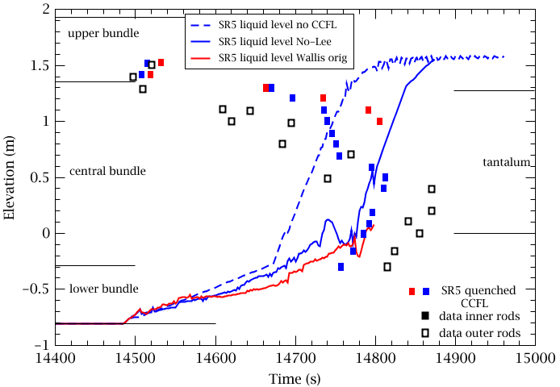
Effect of CCFL on reflood quench
CP/UH oxidation model and reduced power during final excursion to give best conditions for reflood simulation
Experiment shows slow top-down quench to half way down, followed by faster bottom up quench
Without CCFL, quench follows refill curve (not plotted)
No et al CCFL roughly follows experiment; Wallis is too slow
Start of injection

Slide 9
PARAMETER-SF4
Modelling
both SCDAP/RELAP5 and SCDAP/Sim used; same noding
boundary conditions
Thermal response
overall
air ingress
reflood
Hydrogen generation
Oxygen consumption

Slide 10
SF4 boundary conditions
Pre-oxidation (0 - 13886 s)
- 2 g/s Ar; 3.5 g/s steam (start at 1716 s)
- power staged increase to 7900 W
Cooling phase (13886 - 16022 s)
- power reduced to 4000 W
Air ingress (16022 - 17511 s)
- 0.48 g/s air simulated with steam
- number of O atoms and total volume flow preserved
- air oxidation kinetics and Zr+O heat of reaction
- power increased to 6000 W during this phase, tripped at 17412 s
Reflood (17434 - 17908 s)
- bottom injection: 80 g/s water (midway period at 40 g/s)
- switch Ar injection to upper volume

Slide 11
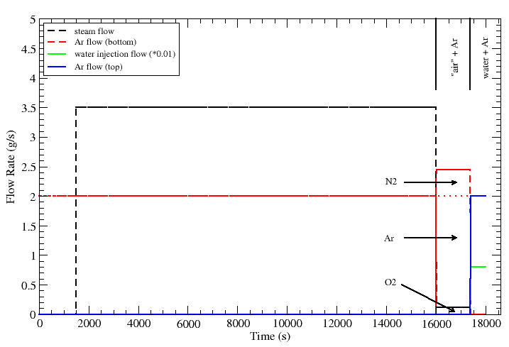
Modelling of SF4 inlet flows
SCDAP/RELAP5 does not recognise oxygen as an active species
“Air” is modelled by using steam as the oxidising agent and argon as a diluent; flows are defined to preserve total number of oxygen atoms and total molar flow
Oxidation kinetics modified for air
Heat of reaction modified for oxygen
“Air” = argon
+ steam

Slide 12
SF4 temperature at 1250 mm
S/R5
S/Sim
SF4 data
Both codes give fair agreement for temperatures at 1250 mm during pre-oxidation in steam
Minor effect of choice of oxidation correlation
SCDAP/Sim calculates better agreement for temperature rise during air ingress.
SCDAP/Sim calculates mild excursion during reflood
SCDAP/REPA5 calculates immediate cooling at start of reflood
S/R5
S/Sim
SF4 data

Slide 13
SF4 hydrogen generation
During pre-oxidation CP/UH gives better total hydrogen generation than Sokolov when used with both SCDAP/RELAP5 and SCDAP/Sim
During reflood SCDAP/Sim calculated a moderate oxidation excursion but underestimated hydrogen generation
During reflood SCDAP/RELAP5 did not calculate any excursion
Code difference might be due to better representation of upper shroud in S/Sim
Pre-oxidation
CP/UH
Sokolov
Reflood
S/Sim
S/R5

Slide 14
SF4 oxygen consumption
Immediate switch to air kinetics calculates too early consumption and starvation of oxygen
Some discrepancy for oxygen exit flow
Comparison with scaled experimental curve indicates better transient evolution and timing if Sokolov steam kinetics are retained during air phase (CP-UH kinetics gave large excursion) Note: this is not proper modelling, only to illustrate above point
start of complete O2 starvation

Slide 15
Conclusions and forward plans
PARAMETER-SF3 and -SF4 analysed with SCDAP/RELAP5 and SCDAP/Sim
SCDAP/Sim provides better description of facility and better agreement
SF3 results show important effect of CCFL during top reflood
reproduced by SCDAP/RELAP5 with recent CFFL correlation
recommended for plant applications with upper plenum or hot leg injection
SF4 shows strong thermal response to switch from 3.5 g/s steam to 0.5 g/s air
initially due to reduced cooling
oxygen consumption gradually increases, leading to complete starvation
immediate switch to air kinetics calculates too early starvation
Default steam kinetic correlation (Cathcart-Pawel/Urbanic-Heidrick) gives better agreement for hydrogen generation than Sokolov, for these cases/models
applies for both code versions
New model for air oxidation developed
currently being implemented in SCDAP/Sim (Mod 3.5)
analysis of SF4 will continue with this code version

Slide 16
Thank you for your attention
Notes:
Beispiel um die Schlussfolie als Danksagung zu nutzen

