Slide 1
S. Guentay
Containment thermal-hydraulics of current and future LWRs for severe accident management
ERCOSAM in Coopeartion with SAMARA
20. CEG-SAM Meeting
October 11-12, 2011
ISTC, Moscow

Slide 2
Outline
Containment hydrogen issue
ERCOSAM: addressing better understanding margins for hydrogen management possibilities
Project partners
Current Status

Slide 3
Containment hydrogen issue
The presence of a stratification in a NPP containment is a source of concern, as pockets of hydrogen in high concentration could lead to a deflagration or detonation risk which might challenge several equipment necessary for safety functions and even the containment structural integrity.
The objectives of ERCOSAM:
establish whether in a test sequence representative of a severe accident in a LWR, well chosen from existing plant calculations, a hydrogen (helium) stratification can be established during part of the transient starting from the initiation of the loss of coolant accident (LOCA) blowdown until the end of bulk hydrogen release from the reactor vessel into the containment,
how this stratification can be broken down by the operation of Severe Accident Management systems (SAMs); sprays, coolers and Passive Auto-catalytic Recombiners (PARs).

Slide 4
ERCOSAM: addressing better understanding margins for hydrogen management possibilities (1)
Two tier approach
Experiments in four containment simulators with very small to very large scales at conditions scaled down prototypical accident conditions in real plants
Planning, pre- and post test calculations using 3D, CFD and lumped parameter codes to gain improved confidence in the codes for future plant safety analyses (PSA L2, plant behavior, assessment and design of SAM measures for hydrogen management)

Slide 5
ERCOSAM: addressing better understanding margins for hydrogen management possibilities (2)
Experiments planned at
“small scale” TOSQAN (IRSN, Saclay),
"medium scale" in the MISTRA (CEA, Saclay),
“large scale”in PANDA (PSI, Villigen) and
"nearly prototypical scale" bechmarking experiments in the HYMIX conceptual facility (only for code benchmarking)
“small scale” SPOT (JSC “Afrikantov OKBM” Nizhny Novgorod).

Slide 6
Project partners at the time of Project Proposal
ERCOSAM
PSI
IRSN
CEA
NRG
KIT
AECL
SAMARA
IBRAE
IPPE
Consortium Agreement
Coordination Agreement

Slide 7
Current Project partners
ERCOSAM
PSI
IRSN
CEA
NRG
KIT
AECL
JUELICH
NRC
SAMARA
IBRAE
IPPE
JSC “Afrikantov OKBM”
Consortium Agreement
Coordination Agreement
Paper work is underway for the participation of:
JUELICH
JSC „Afrikantov OKBM“
NRC

Slide 8
Current Status
IRSN prepared a ‚scaling study‘ which
Considers plant studies provided by IRSN, PSI and IBRAE about the steam and H2 loads to certain PWR designs
Transposing the information to a generic 1000 MWth plant containment size, which is also determined
Conducted study to determine H2 distribution for a several conditions for the ‚reference size‘
IRSN (WP1) prepared the ranges of initial and boundary conditions of the tests to be conducted in TOSQAN, MISTRA, PANDA facilities, which are under discussion
PSI (WP2) coordinates planning analysis for the first tests to be conducted

Slide 9
Current Status
Three Management team (MT) meetings held
Two Project meetings (PM) held
4th MT and 3rd PM to be held on 3-5 Oct. 2011 in Toronto
1st MB of ERCOSAM and Project Steering Committe Meeting of ERCOSA-SAMARA held on 30. May 2011
1st Periodic Report and Form C‘s for 2010-2011 submitted to EC
Planned is to conduct the 1. PANDA test late this year
Web base information/document/data exchange fully functional und under continuous update

Slide 10
Web site: http://ercosam.web.psi.ch

Slide 11
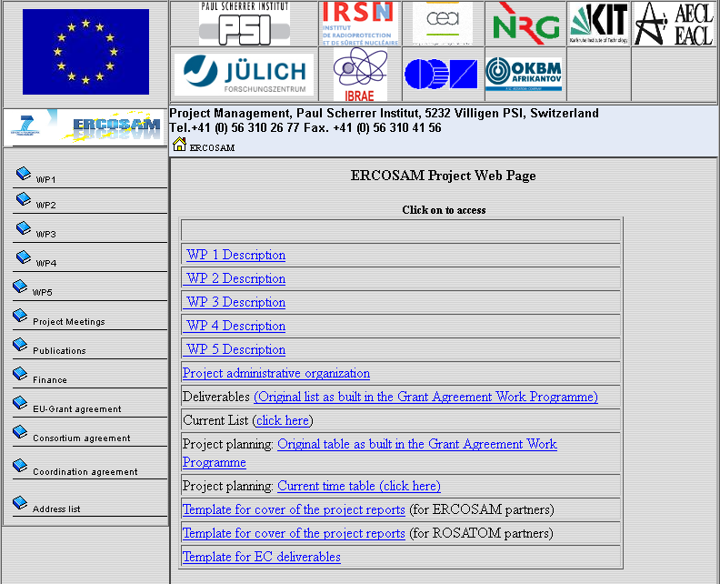
Web site: http://ercosam.web.psi.ch

Slide 12
Thank you for your attention

