Slide 1
Post test analysis of PARAMETER-SF4
Jon Birchley and Leticia Fernandez-Moguel (PSI)
Presented by Salih Guentay,
CEG-SAM, 14-16 March, Pisa, Italy

Slide 2
Outline
SCDAP/Sim modelling
background
new air oxidation model
SCDAP model for PARAMETER
treatment of boundary conditions
SF4 analysis
pre-oxidation
air phase
reflood
Conclusions and forward plans

Slide 3
SCDAP/Sim modelling
Previous analysis (presented CEG-SAM 2010) made with standard versions of SCDAP/RELAP5 and SCDAP/Sim
neither code contains full model for air oxidation
new SCDAP/Sim version (Mod3.5) includes
PSI air oxidation kinetic model
oxygen as an active species; nitrogen as a catalyst species
now provides correct gas composition (for flow rate, heat transfer)
treatment of melt oxidation
Present analysis concentrates on SCDAP/Sim/Mod3.5 calculations
Oxidation kinetics based on standard correlations (Cathcart-Pawel/Urbanic-Heidrick, Sokolov...) plus
breakaway treated by imposing an upper limit on effective oxide thickness
criterion based on temperature and oxidising medium

Slide 4
PSI oxidation model - 1
Define breakaway condition as an upper limit on effective oxide thickness
cladding oxidation rate/area: R = ρ_{Zr} d(δ)/dt ~ A exp(-B/T) / δ,_{eff}
where δ,_{eff} = max (δ₀ , min ( δ, δ* ) )
δ₀ is some tiny minimum (<<< δ* )
and δ = true oxide thickness
Separate values of δ* are defined for air and steam
typically: δ, δ*_{air} < δ*_{steam} (i.e. breakaway possible in air, unlikely in steam)
In general δ* is a function of temperature, material and possibly other factors
We also define a criterion for onset of breakaway δ,_{crit} ( ≥ δ*) and timescale τ over which the limit value δ* is applied
Model parameters δ,_{crit}, δ*, τ will be mostly based on results of recent and current separate-effects experiments

Slide 5
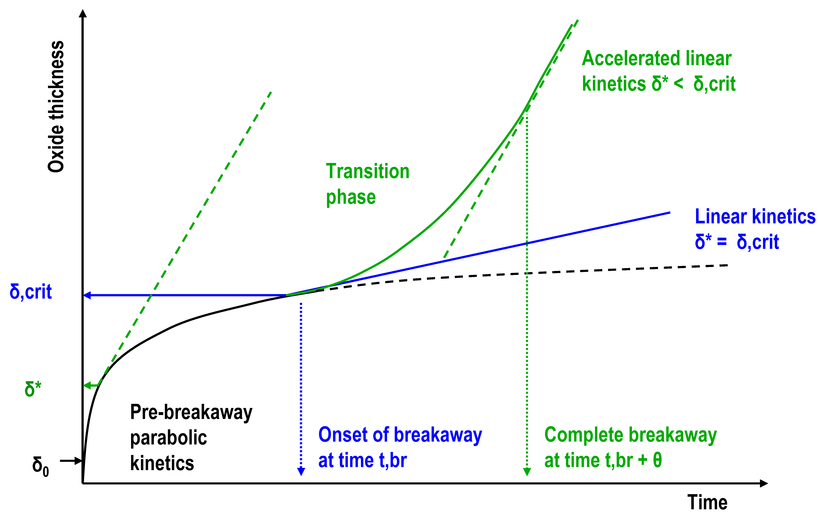
PSI oxidation model - 2
Outline of model concept - 2
continued parabolic if no δ,crit

Slide 6
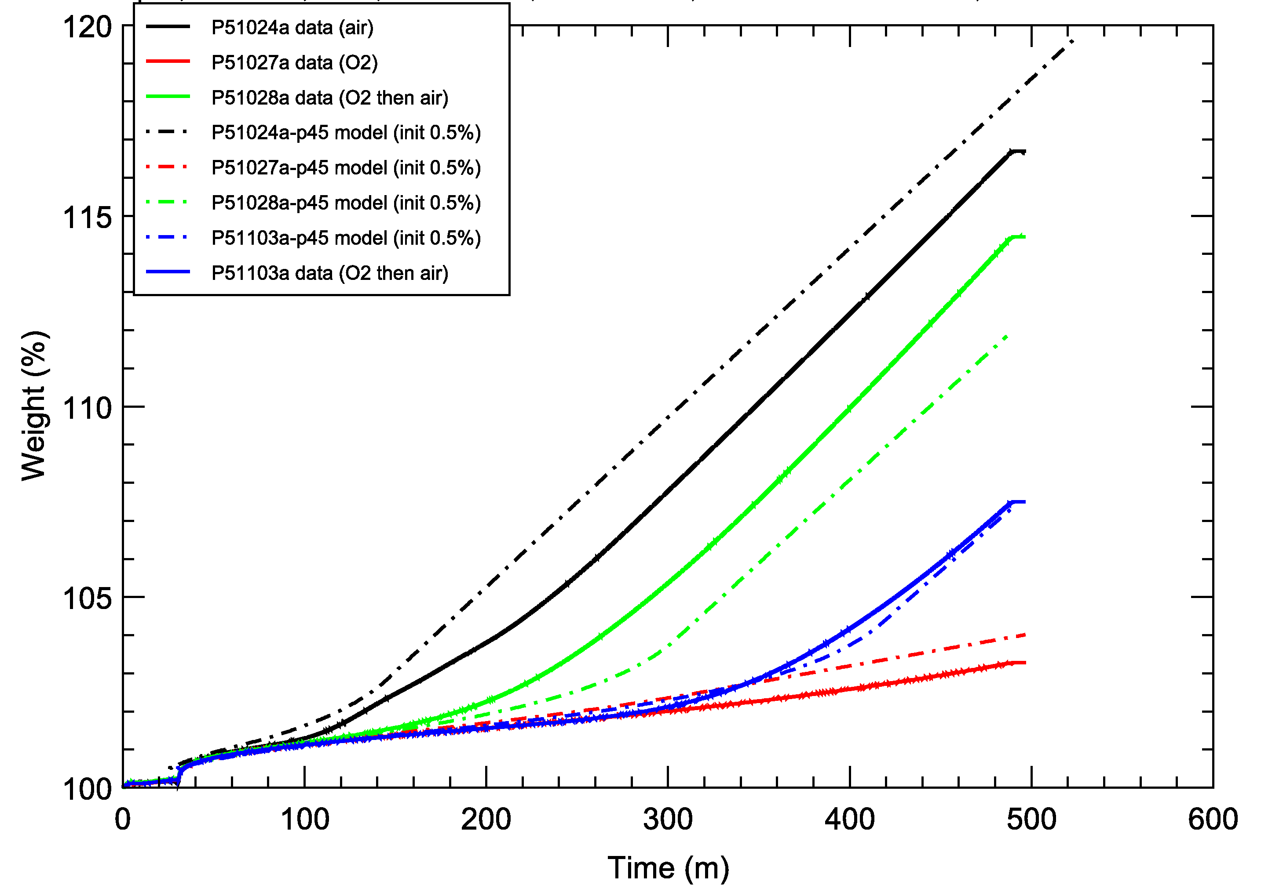
Comparison with KIT thermal balance tests in O₂ and air (T = 800 ºC)
PSI oxidation model - 3
Air alone
193 s O2
then air
390 s O2
then air
O2 alone

Slide 7
SCDAP/RELAP5 noding
Same base model for SF2, SF3, SF4
28 axial nodes for test section (lower, central and upper sections)
Radial noding: 1/1/4 in lower/central/upper sections
Heater: 14 Ta, 2x6 Mo, 2x1 brass
Cooling jackets for central and upper sections
Shroud/insulation for central bundle; dummy insulation applied in lower and upper sections (forced by SCDAP limitation)
Except where stated, base model uses default or recommendations
Same external resistance in base case models (8.5 mΩ/rod)

Slide 8
SF4 boundary conditions
Pre-oxidation (0 - 13886 s)
- 2 g/s Ar; 3.5 g/s steam (start at 1716 s)
- power staged increase to 7900 W
Cooling phase (13886 - 16022 s)
- power reduced to 4000 W
Air ingress (16022 - 17511 s)
- 0.48 g/s air (normal oxygen-nitrogen mixture)
- 2 g/s Ar continued
- power increased to 6000 W during this phase, tripped at 17412 s
Reflood (17434 - 17908 s)
- bottom injection: 80 g/s water (midway period at 40 g/s)
- switch Ar injection to upper volume

Slide 9
SF4 preoxidation
Temperatures
Hydrogen generation
Oxide scale buildup

Slide 10
Temperatures
Minor underestimate of temperatures in highest elevations

Slide 11
H2 generation
Minor underestimate of H2, may be related to slight underestimate of temperatures
No strong influence of PSI model of possibility of breakaway during steam oxidation

Slide 12
Oxide thickness
PSI model can predict breakaway in steam
Slighly increased oxidation at some locations
For base case model we focus on cases without steam oxidation breakaway
no effect at highest elevation

Slide 13
SF4 air ingress phase
Temperatures
lower elevations
upper elevations
Effect of oxidation model
Oxygen starvation
Oxide scale buildup

Slide 14
Effect of oxidation model
Initial heat up due to reduced heat transfer
Accelerated heating at T > ca. 1400 K
Faster acceleration if already in breakaway
Early acceleration with Melcor kinetic parameters
Uneven escalation indicates progression of starvation front

Slide 15
Temperatures (upper)
Initial heat up due to reduced heat transfer
Slow heatup at highest elevations
Maximum temperatures ca. 1800 K
Starvation occurs earliest at top of bundle and progresses downward
onset of starvation

Slide 16
Temperatures (lower)
First acceleration in heatup not due to breakaway
Downward progression of starvation front
Calculated a bit early
progression of starvation

Slide 17
Oxygen consumption
SF4 data normalised to maximum
Base model comes closest to rate of consumption and no breakaway
Some effect of earlier breakaway in steam (if calculated)
MELCOR kinetic parameters strongly overestimate kinetics and calculate breakaway as well

Slide 18
Oxide scale buildup
start of injection
Most oxidation in air ingress phase occurs at mid-elevations in bundle bundle (300 - 800 mm)
Further oxidation during reflood, mostly at same elevations

Slide 19
Reflood phase
Temperatures
Hydrogen generation
Effect of oxide scale failure (=> melt breakout)

Slide 20
Reflood temperature excursion
High temperature and delayed cooling calculated at 200 - 500 m
Earlier cooling above and below
Behaviour due to melt oxidation
Absent if no melt breakout

Slide 21
Temperatures in molten zone
SSim calculated high temperatures and delayed cooling in melt zone 200-500 mm
No thermal data for 200-300 mm but indicated at 600-700 mm
Bundle examinations showed extensive melting down to 260 mm

Slide 22
Reflood hydrogen generation
Significant H2 generation due to oxidation of metallic melt
Total amount about right but kinetics overestimated
May be reason for such high calculated temperatures

Slide 23
Conclusions and forward plans
PARAMETER-SF4 analysed with new version of SCDAP/Sim
full treatment of air oxidation
Default air oxidation model largely based on default model in SCDAP (Cathcart-Pawel /Urbanic-Heidrick) plus possibility to calculate breakaway
model can also calculate breakaway in steam
Conclusion about air phase not very different from earlier analysis (using steam oxidation model with modified parameters)
overestimation with Melcor kinetic parameters confirmed
breakaway effects at most minor
Large excursion during reflood linked to oxidation of metallic melt
broadly consistent with experimental results
suppressed by higher temperature criterion for melt breakout (2500 K instead of 2200K)
low temperature melt breakout may have occurred due to earlier oxygen starvation
New version still being assessed; analyses will continue

Slide 24
Thank you for your attention
Notes:
Beispiel um die Schlussfolie als Danksagung zu nutzen

