Slide 1
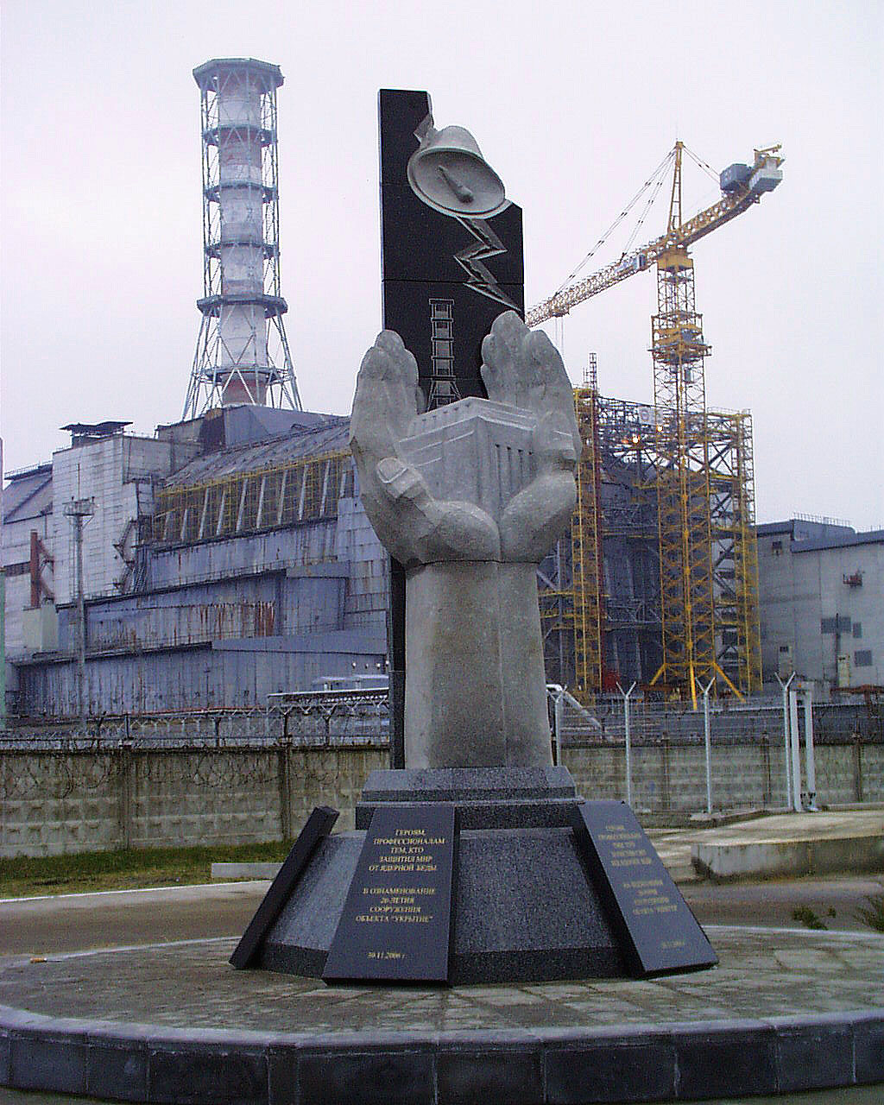
Klyuchnykov
Oleksandr Oleksandrovych
«SHELTER» OBJECT - MYTHS AND REALITY
Institute for safety problems of
nuclear power plants of Ukraine’ NAS
2008

Slide 2
Chornobyl accident has been constantly attracting the attention of society and still remains a source of diverse versions and hypotheses.
In line with one mentioned above, in 1986 a nuclear explosion of low power had a place there, and after that, no fuel, practically, remained within the Unit 4 rooms.
However, the results of many years’ researches testify quite another thing.

Slide 3
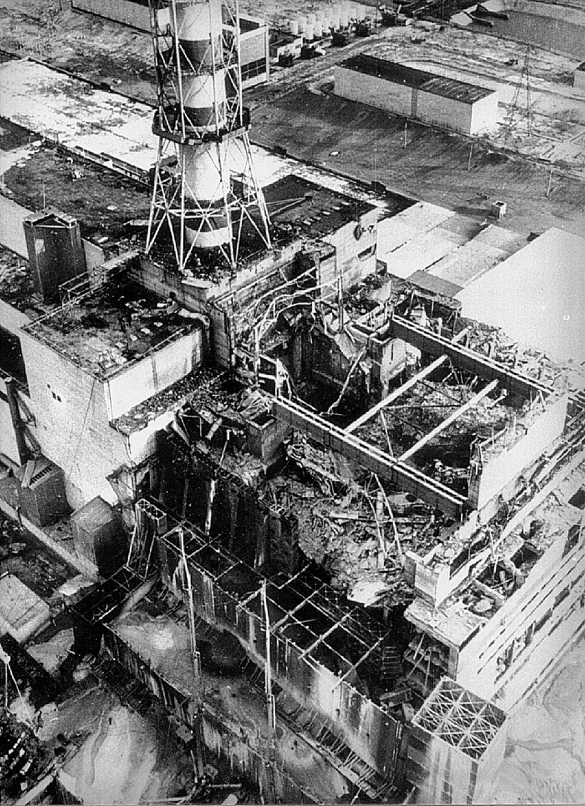
Irradiated nuclear fuel in ruined ChNPP Unit 4
(«Shelter» object)

Slide 4
Fuel-containing materials (FCM) in «Shelter» object are contained in diverse conditions:
fuel assemblies with fresh fuel in Central hall;
fuel assemblies with spent fuel in southern exposition pool;
active core fragments in shape of fuel pellets, fuel elements and assemblies’ debris, graphite cladding parts;
lava-like fuel-containing materials (LTCM);
fuel dust
hidden nuclearly -hazardous clusters in room 305/2

Slide 5
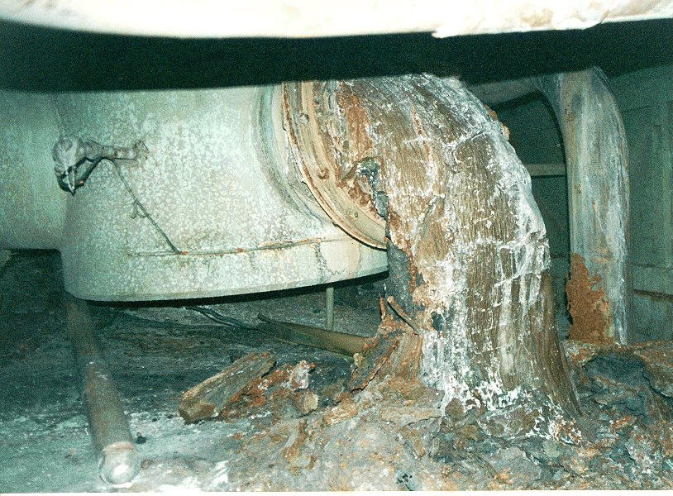
Core fragments in room 305/2
Lava-like fuel-containing materials
in steam distribution corridor

Slide 6
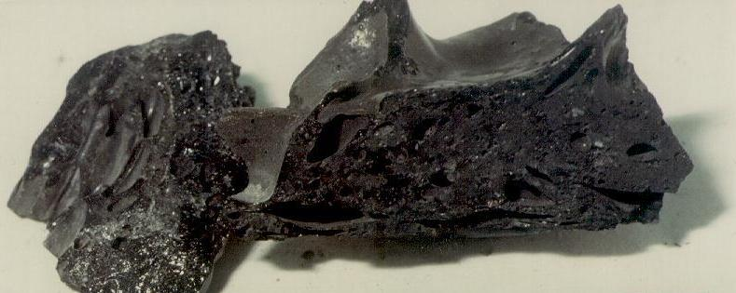
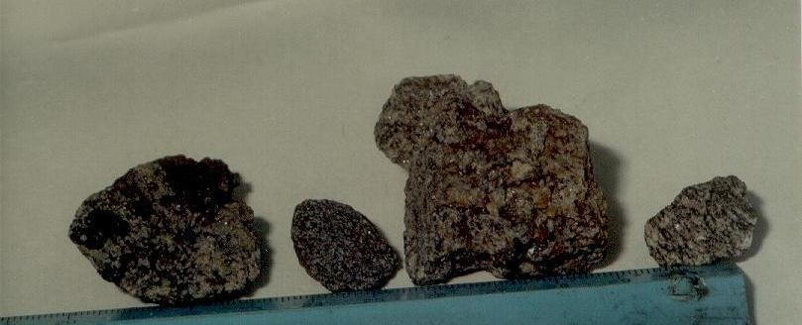
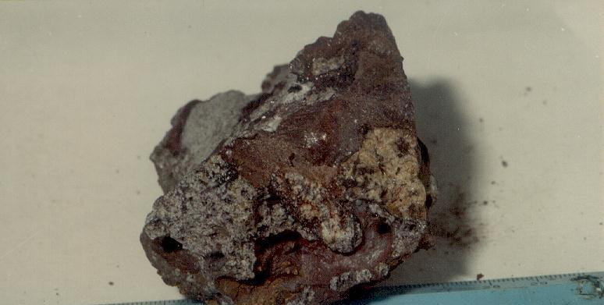
Black ceramics -room 304/3
Slag-like LTCM – pressure suppression pool
Brown ceramics - pressure suppression pool

Slide 7
Major part of irradiated nuclear fuel inside «Shelter» Object rooms are contained within lava-like fuel-containing materials.
For today, estimate of fuel amount in detected clusters made 150 t (on uranium) of 190.2 t, which were located in reactor at accident moment.
As result of last researches carried out by us it is shown that inside «Shelter» Object there are around 30-40 t fuel in room 305/2 clusters, which are hidden beneath “fresh” concrete.
In more details that clusters will be highlighted in report of our Institute’s staffer – Yevgeniy Vysotskiy.
A major enough fuel part (around 30 t) is contained as radioactive dust of different dispersity (including submicron).
A generator for such dust can be FCM during its destruction.
Last year researches show a probability of annual spontaneous production on FCM surfaces of dozen kilograms of radioactive fine-dispersed dust.

Slide 8
Fuel amount estimate in “Shelter” Object rooms

Slide 9
Name (numbers) of rooms | FCM modifications | Detected fuel, t (U) | Notes
Central Hall (CH), room (914/2), reactor vault (room 504/2, mark +24.000 and above) | Core fragments, lava-like fuel-containing materials (LTCM) within scheme “E” are | 23 | 48 fresh assemblies (5,5 t). Probable LFCM presence in other CH areas
Southern exposition pool, room (505/3) | Core fragments | 14,8 | 129 spent fuel rods
All upper rooms, including CH (mark +24.00 and higher) | Fuel dust | 30 | Estimate 30 t includes surface contamination in obstruction center in CH and in all other rooms
304/3 | Lava -like fuel-containing materials | 6 | «Horizontal lava flow». LFCM in breach between rooms 304/3 and 305/2 considered
301/5+301/6+303/3 | Lava -like fuel-containing materials | 4,5 | «Horizontal flow», main LTCM mass poured with concrete in 1986
217/2 | Lava -like fuel-containing materials | 0,4 | «Elephant foot», «stalactites». LFCM penetrated from «horizontal flow»
Rooms 305/2 and 504/2, marks +9.700 - +24.000 | Core fragments, lava-like fuel-containing materials, fuel dust | 70 | Start of all LFCM flows
“Hidden” clusters in room 305/2 in sub-reactor plate body | Lava-like fuel-containing materials, non-melted fuel | 30 | Estimates were made for two LFCM clusters
Steam distribution corridor (SDC) Rooms: (210/5+210/6+210/7) | lava-like fuel-containing materials | 12 | «Big and small vertical flow» .
Pressure suppression pool-2 (PSP-2) Rooms: 012/14+012/15+012/16 | lava-like fuel-containing materials | 8 | Considerable LFCM part is poured with concrete in 1986.
Pressure suppression pool-1 (PSP-1) Rooms: 012/5+012/6+012/7 | lava-like fuel-containing materials | 1 | Considerable LFCM part is poured with concrete in 1986
Fuel under cascade wall | Core fragments Fuel dust | ?
Water in all reactor department rooms | Uranium soluble salts | 4 kg
Fuel on «Shelter» site | Core fragments Fuel dust | 0,75
Total: |  | Around 200 | From them around 180 t – ruined reactor fuel

Slide 10
As you see, all, practically, irradiated fuel has remained inside «Shelter» object in its local area and now it is being its main source of nuclear and radiation hazard.
Negative environmental impact of «Shelter» object is, mainly, stipulated by destruction processes occurring in FCM under action of both external factors and their own properties.
Further search of fuel remains is withstood by high rates of radiation fields and, therefore, by complicated access to some rooms. However, the works in this area are in progress now.

Slide 11
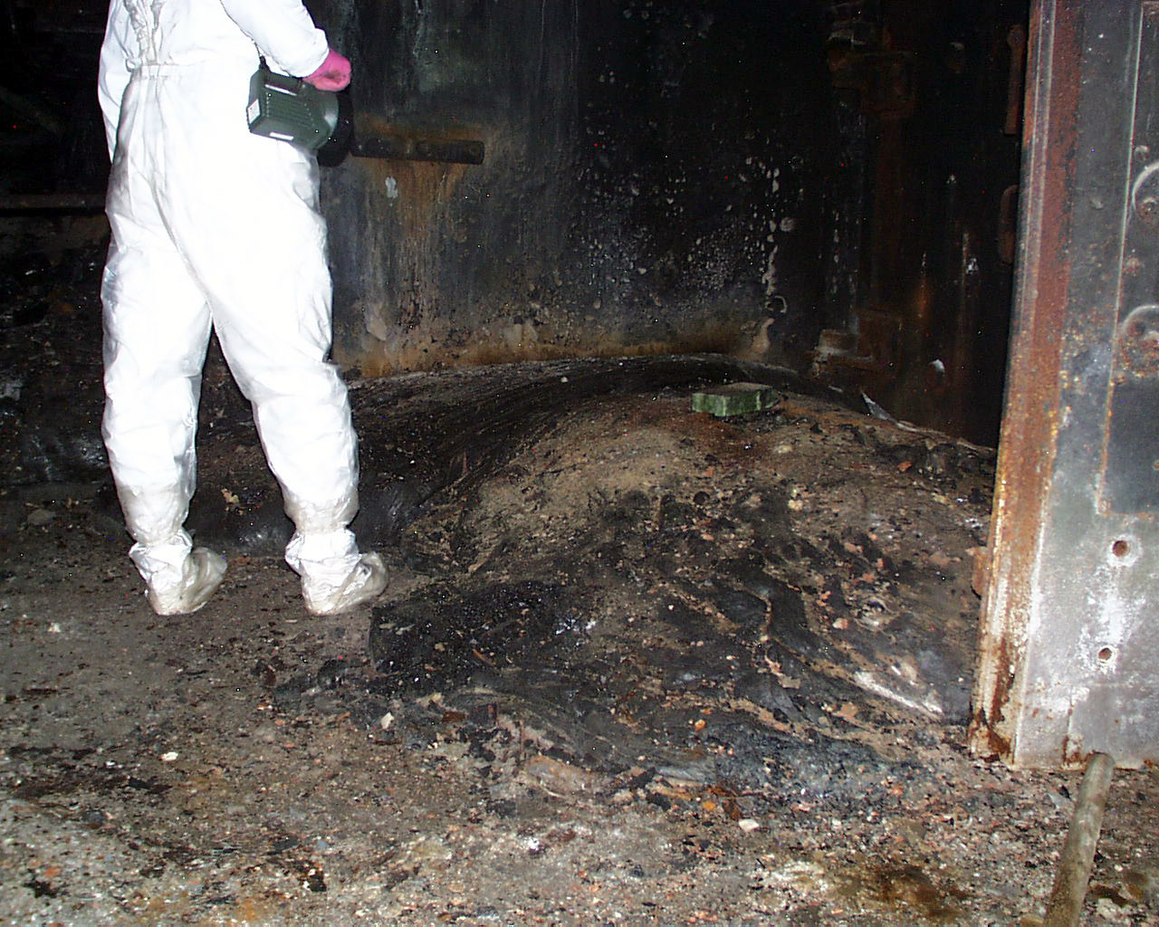
Diversion – as ChNPP Unit 4 cause of accident

Slide 12
Another myth caught up by mass media was a statement about a diversion that would be a cause of ChNPP Unit 4 accident.
Such a version occurred after detection in «Shelter» object of so called «yellow spots», which were interpreted by sensation amateurs as trotyl or plastid remains
Really, «yellow spots» are water-soluble uranium salts appearing in the course of interaction of water with irradiated nuclear fuel

Slide 13
«Yellow spots» in steam distribution corridor

Slide 14
One more myth disseminated by mass media is the fact that over a short enough time period, LRW from «Shelter» Object could penetrate into groundwater, to rivers Prypyat and Dnipro. At the same time, around 35 mln persons can meet with radionuclide impact hazard.
“Shelter” Object liquid radwaste (LRW)

Slide 15
One of factors possible to destabilize achieved now level of radiation and ecological safety of «Shelter» object is water penetration process inside Object and its accumulation on bottom Unit marks. Total annual water amount penetrating in «Shelter» object makes around 3000 m³.
Water being penetrated in “Shelter” object rooms and being flown from upper to bottom marks interacts with structural and fuel-containing materials, flowing out and solving fissionable materials, long-living radionuclides, producing by that liquid radwaste (LRW).
Major part of liquid radwaste (LRW) producible in Unit 4 southern part is accumulated in «Shelter» object room 001/3.
Monitoring of dynamics of plutonium isotope concentration in water from that room shows a tendency to increase plutonium average concentration in «Shelter» object LRW
.

Slide 16
²³⁸⁺²³⁹⁺²⁴⁰ Pu concentration dynamics in LRW clusters in «Shelter» object room 001/3
Bq/m³
Annual average concentration

Slide 17
A cause for raising plutonium concentration in water cluster in 2003–2005 years of «Shelter» Object room 001/3 was an increase in volumetric activity of radionuclides (inclusive transuranic elements and uranium) in LRW leakages from sub-reactor rooms, especially from distribution corridor. LFCM degradation probability is not also ruled out and as result of increase in radionuclide and uranium leaching by water leakages
Major activity portion incoming with water flows is concentrated in «Shelter» object room 001/3 sludges. This sludge volume is estimated as 100 m3 with summary mass being around 150 t

Slide 18
Dynamics of ⁹⁰Sr volumetric activity in LRW from steam distribution corridor
Бк/м³
Bq/m³

Slide 19
Dynamics of ²³⁸⁺²³⁹⁺²⁴⁰ Pu volumetric activity in LRW from steam distribution corridor
Bq/m³

Slide 20
Nowadays, radionuclide concentration in bottom sediment exceeds two-three orders their concentration in “Unit water” .
Bottom sediments drying in case of leakage stoppage and water pumping will, inevitably, lead to significant increase in radioactive aerosol concentrations in SO rooms and their consequent carry over into environment .
Monitoring of radioactive isotope content in ground waters does not yet allow stating with absolute certainty about LRW leakage from «Shelter» object into geological medium. However, this phenomenon can be extraordinary dangerous in future - when Unit waters penetrate in underground aquifers .
Unfortunately, first results testifying the initiation of such a process were already obtained.
In more details about that problems will be highlighted in the report of our Institute staffer –Aleksey Odintsov

Slide 21
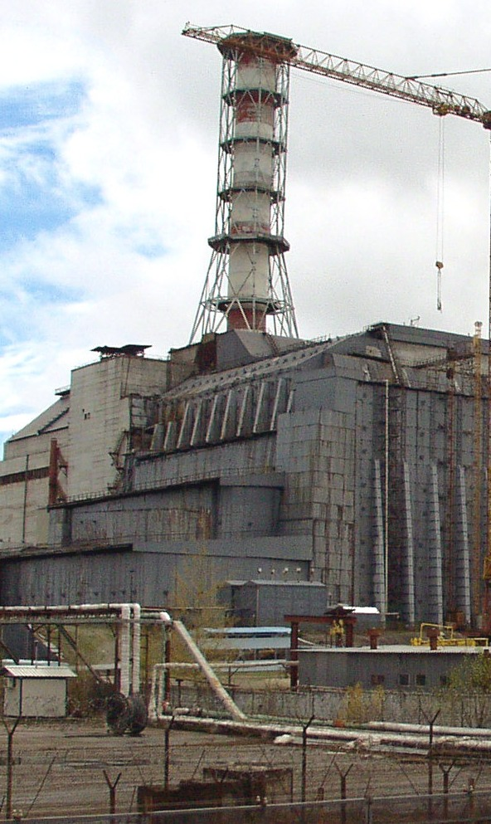
«Shelter» object radioactive aerosols
Another myth is also information on the fact that object «Shelter» object radioactive aerosols can spread at long distances and reach the Europe.
Besides, catastrophic aftermath of their precipitation on European continent will be much more, than during 1986 year accident.

Slide 22
Radioactive aerosols from «Shelter» object are carried over via «Bypass» system and ventilation stack «VS», as well as via loose connections (cracks, apertures, process hatches) of external building structures. To monitor airflows in multiple structures’ cracks – it is an extraordinary challenge.
Aerosols of 2-6 mkm diameter have low gravitation precipitation velocity and, coming out of ventilation stack «VS», at height 150 m are carried over in atmosphere at long distances
Today, stabilization of value of aerosol release activity is observed.
However, it does not mean that aerosol release monitoring in “Shelter” object shall be terminated, since the start of LFCM degradation process will provoke an increase in release activity, that in its turn will demand taking of appropriate measures

Slide 23
Dynamics of radioaerosol releases via “Shelter” object roofing cracks
MBq/m³
years

Slide 24
Collapse of «Shelter» object building structures and their potential probability

Slide 25
Mass media often inform that guaranteed lifetime of «Shelter» object makes 30 years. However, this above solely refers to new metal structures applicable during erection. If to take into account that they were erected on ruined foundations with runaway from legislative requirements, «Shelter» object, therefore, built in 1986 has undefined lifetime.
That is why the risks pertaining to destruction of «Shelter» object building structures are high enough, even the nearest future is taken.

Slide 26
First of all, it is associated with conditions of western fragment of «Shelter” object, which was seriously damaged and is in unstable state. Potential destruction of this fragment will bring to collapse of heavy tube sheeting. Its falling on CH obstructions can provoke FCM drift, change in its geometry, and as a consequence, probability of nuclear incident is not ruled out, especially when water is penetrated in that place .
Considering radioactive dust amount located on breach surface inside “Shelter” object, summary activity of salvo release, under adverse conditions, will 150 thousand times exceed regulated daily release from “Shelter” object under normal operation .
Besides, the main impact factor will be inhalation intake of radionuclides. To additional surface contamination from 0,3 to 4 kBk/m² will subject territory of total area being more 400 км^{2.}

Slide 27
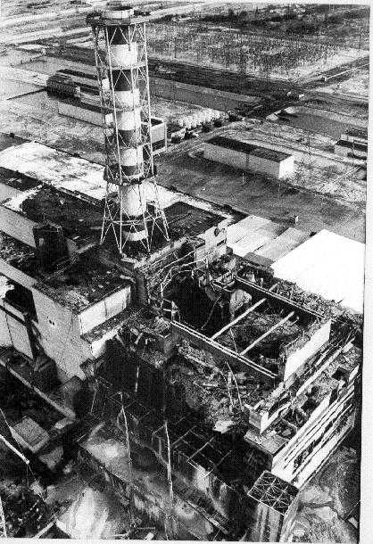
Western fragment destructions

Slide 28
To prevent in the future some adverse aftermath of probable collapse of «Shelter» object building structures, in 2002 - 2003 years consortium KSK, which integrated Ukrainian organizations such as Kyiv Institute „Energoproyekt”, NIISK and our Institute, developed and coordinated with Ukraine’s regulating bodies a Work project providing implementation of stabilization measures.

Slide 29
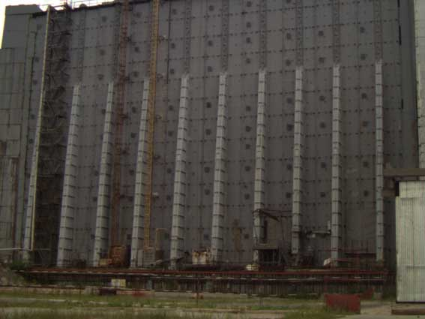
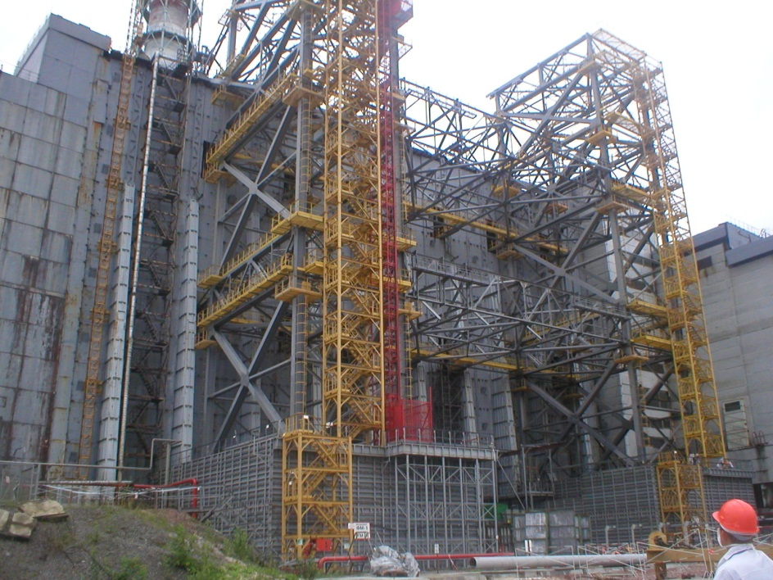
That project assumed:
1. First of all, western fragment stabilization
And strengthening of eastern and western supports of «Mammoth» beam, northern and southern shields-clubs, deaerating stack.
Clip 06-stabilization

Slide 30
Project was also realized by Ukrainian building organizations united in consortium „Stabilization”.
In 2007, project «Stabilization» was successfully terminated.

Slide 31
Pluses and minuses for creation of new protective sheath around “Shelter” object – new safe confinement (NSC)

Slide 32
Creation of new protective sheath – new safe confinement (NSC) is only a first step providing exclusion of fuel-containing materials.
In the last years, runaway of strategy is observed, which was taken within the SIP framework, and confirmed by Ukraine. Development of procedure for extraction of fuel containing materials and conduct of appropriate demonstration experiment was excluded of main tasks of NSC creation project .
Nowadays, international experts abandon themselves to the idea that consists of as follows: to erect only arch «Shelter», with leaving to Ukraine to solve all other problems on long-term period (more 100 years) .
These actions have already brought to lessening of scientific potential of Ukrainian institutions working in this area, restriction of their workforce .

Slide 33
Results of scientific researches of last years testify a need to perform all the tasks for both «Shelter» object stabilization and for extension of researches in area of provision of its nuclear and radiation safety, creation of effective barriers, which would prevent harmful environmental Object impact, development of novel equipment and procedures to retrieve and manage fuel-containing materials.

