Slide 1
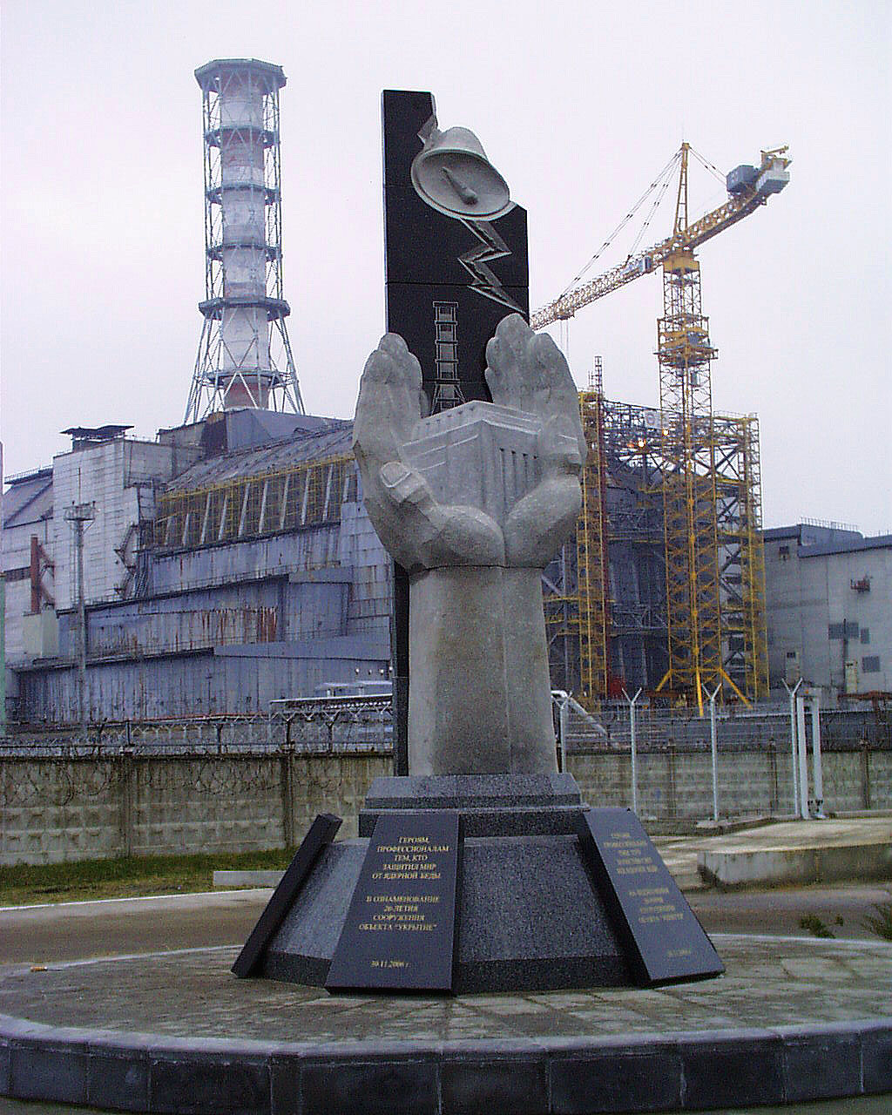
Presented at 16th
CEG-SAM Meeting
Institute for Safety
Problems of NPP, National Academy of
Sciences of Ukraine
September 08-09 2009
Moscow
Status of STCU Project #4758:
«Estimate - experimental research of hidden nuclearly -hazardous clusters of fuel-containing materials in ruined ChNPP Unit 4»
Notes:
1

Slide 2
Contents:
Preliminary remarks concerning Project #4758:
Collaborators
Expected results
Status of the project
2. Main work results for Project #4758 over February 2009 – September 2009

Slide 3
Preliminary remarks concerning Project #4758

Slide 4
Collaborators
GRS, Germany
Dr. H.Teske
Dr. G. Pretzsch
CEA Cederech,
DEN/ DTN/STRI, France
Dr. Christophe Journeau
JRC-ITU Institute of Trans-uranium Elements Karlsruhe, Germany
Dr. P. Bottomley
Coordinator
Project is coordinated by:
Viktor Stepanenko (STCU)
STCU,
Kyiv, Ukraine
Operation Agent: Institute for NPP safety problems of UNAS, Ukraine, Chornobyl
ChNPP
Ukraine, Chornobyl
Project Duration: 30 months
Total Project Cost : 199080 USD

Slide 5
Expected results:
In this Project will be analyzed:
visual observation data;
information obtained when drilling research boreholes;
results of sampled fuel-containing materials (FCM) analysis;
instrumental measurement data;
mechanisms of FCM cluster production with high - content uranium.
Considering above data, as well on the basis of neutron and heat estimates, new instrumental measurement data and research results of physicochemical properties of newly taken samples from cluster area, will be:
defined, structure, geometry, and FCM physicochemical properties in two critmass risk areas, in south-west quadrant of room 305/2 ChNPP Unit 4 (object «Shelter»);
researched, neutron physical processes occurring in clusters under impact of external factors.

Slide 6
Status of the project:
1. Permission for Project #4758 work implementation is obtained from Ukraine’s Ministry of Sciences and forwarded to STCU Affiliate.
2. Project Collaborator Letter from Dr. Pretsch is received and also forwarded to STCU.
3. From STCU Affiliate the Project is coordinated by Viktor Stepanenko (STCU).
4. Dr. Bottomley and Dr. Journeau Support Letter is received and forwarded to Mr. Andrew Hood, STСU Executive Director address.
5. The proposal is ready to sent to party reviewers by STCU (March 2009).
6. For today, Project funding was not yet initiated. But in spite of this fact the works being planned in Project were performed by us in 2008 year and they are in progress in 2009 year.

Slide 7
2. Main work results over February 2009 - September 2009

Slide 8
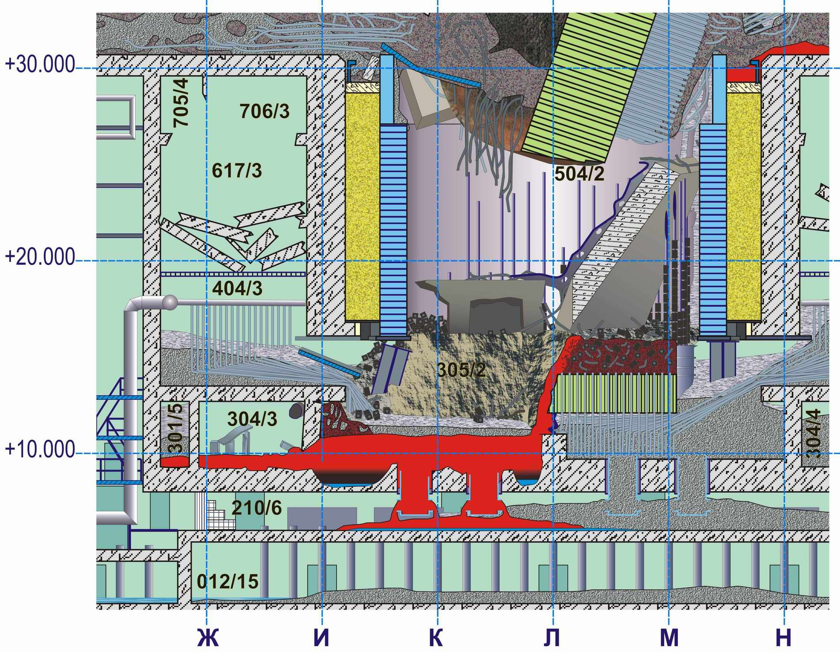
Reactor vault and under reactor room 305/2 after catastrophe (reconstruction)
Based on the last researches (data on borehole core’s activities, temperature and neutron fields’ dynamics), it was stated that ChNPP accident in the year of 1986 had provoked a melting in foundation plate of reactor vault.
As a result, two fusion penetration areas had produced, which contain FCM with fuel concentration making 40% (on mass) and more.
Fusion penetration area №1, №2
Reactor vault’s foundation plate

Slide 9
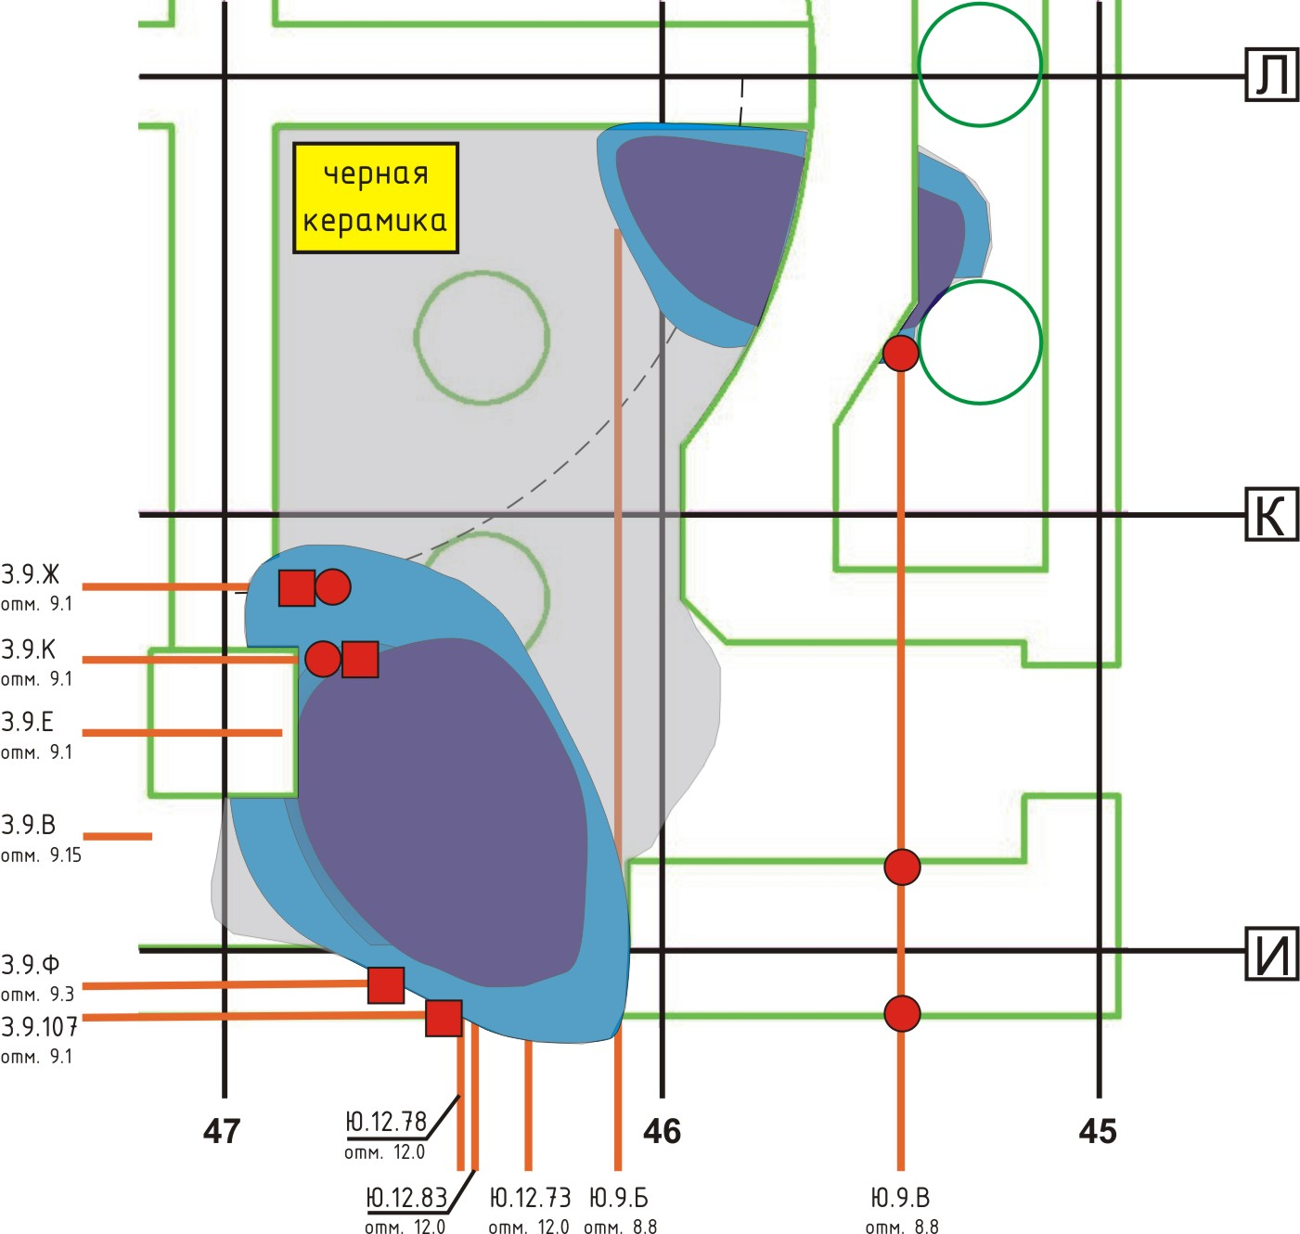
Fusion penetration areas of foundation plate
L
To obtain data (on temperature, neutron activity), in 2009 year, we have conducted the works for cleaning and equipping new boreholes Ю.9.Б and Ю.9.В, which are in close vicinity to these fusion penetration areas of foundation plate.
Black ceramics
№2
K
№1
I
Within the framework of this Project we develop new boreholes: З.9.Ф, З.9.107 and Ю.12.78

Slide 10
Upper (light) FCM layer, during its production process, was flowing down via a breach in room 304/3 object «Shelter» wall with forming horizontal flow of more 50-m length.

Slide 11
In 2009, we have carried out a preliminary evaluation of mass- and geometry parameters of multiplying systems (homogenous and heterogenous with U content from 50-65%).
Estimate results have demonstrated that the systems, whose geometry is inscribed in volume of fusion penetration area No1, reach their criticality under a specified wetting. Water excess does bring that systems in subcritical state.

Slide 12
Measurement of temperature in boreholes in 2009 year have shown that in borehole Ю.9.Б (fusion penetration area No 1) temperature discharges in water effusing from this borehole are observed.
In fusion penetration area No2 (borehole Ю.9.В), water is, assumedly, absent or located below the mark +8.80 m.

Slide 13
In 2009 we have in detail disassembled and have restored dynamics neutrons stream density growth (June 1990) in a zone of profusion №1 and have shown, that:
1. Neutrons stream density growth was caused by critical incident which has occurred as a result of a gulf water of hot congestion FСМ in this zone.
2. Critical incident proceeded within 92 hours. The total number of divisions has made more than 10¹⁸ and energy evolution - 170 Мj.
3. Self-clearing has occurred as a result of congestion humidifying, makes subcritical К_{F}> 0,98.

Slide 14
Research of neutron anomaly in June, 1990 has shown, that there was a critical incident.
Incident interpretation on congestion model has allowed to estimate geometrical and mass parametres of a congestion. In a profusion zone are an order 40 т FСМ with concentration of fuel more than 50 % on weight of uranium.
Congestions FСМ which structure is unknown, constantly are in water, them subcritical with К_{F}> 0,98.
Decrease of volumes of water in a congestion, and also temperature growth can lead to occurrence SCFR ( Self-sustained chain fission reaction) .
Now, in the absence of the detailed information on structure, physical and chemical and neutron-physical characteristics of a congestion definition of preventive measures of suppression of criticality is not obviously possible.
In the course of research nuclearly - hazardous clusters of fuel-containing materials in ruined ChNPP Unit 4 should be reconsidered as the general balance of distribution of fuel and the scenario of formation FСМ at an active stage of accident.

Slide 15
Condition Project #4758
1. The project is not financed till now.
2. On 15th CEG-SAM Meeting we have come to conclusion about necesserity of updating of the name of the project and volumes of some directions of works.
3. Dr. Bottomley has directed us the remarks and offers. Now we are ready to discuss it.

Slide 16
Thank You for attention and support of Project: #4758

