Slide 1
Investigation accidents at RFNC VNIITF
RFNC VNIITF
Nikolay GORIN
E-mail: n.v.gorin@vniitf.ru
Elena LIPILINA
E-mail: e.n.lipilina@vniitf.ru
The most important works were reviewed that were carried out by the experts form VNIITF, NIKIET, RSC КI and IAE NNC of RK to study accidents on power reactors. The works were mentioned that would desire ISTC financial support.

Slide 2
VNIITF carries out the works in the following fields :
Development of experimental techniques to be applied in the studies carried out for the sake of nuclear power engineering safety.
Carrying out experiments on IGR.
Development and verification of calculation techniques for features of flash uranium-graphite reactor and irradiated samples.
Experimental study and precision of physical processes and specifications of IGR operation modes.
Preliminary development of MIGR reactor facility design.

Slide 3
1. VNIITF experimental techniques
The techniques allow measuring:
temperature on various components of testing devices and fuel elements
pressure inside fuel pipes
energy-release in fuel
parameters of the coolant during fuel melting process
The techniques allow:
Visualization of fuel elements destruction process by gamma-neutron image techniques and autoradiography
X-ray imaging and photographing destructed fuel elements
Optical metallography of shell material
Evaluation of fragmentation nature

Slide 4
1. VNIITF experimental techniques
Here it is an oscilloscope picture of temperature recording obtained in the course of IGR experiments.

Slide 5
2. IGR experiments
In 90-s, IGR was applied to study the behavior of fragments of BN-800 reactor fuel elements made of U-235-enriched UO₂ to 2%, 6% and 10%. The length of fragments was ∼140 mm. The fuel elements were placed in a dry ampoule without coolant; in an ampoule filled with sodium; in one experiment, in an ampoule purged with sodium and then dried at the end of neutron pulse. During the experiments, temperature was measured in the center of fuel elements, on their shell, in the coolant; gas pressure was measured in the central cavity of fuel elements.
In the whole, 5 experiments were carried out. Two experiments were carried out with the fuel of VVER precision assemble reactors that guaranteed the equal gap between the pellets and the shell. In one of them, fuel was brought to melting. One experiment was carried out with the fuel elements of BREST design reactor (2% and 5%-enriched uranium mononitride) with lead coolant heated to the temperature of 450°С. During the experiment, 10%-enriched fuel element was melted and fuel particles were spread to the different parts of the ampoule by convective streams where they hardened in lead.
In all the experiments fuel and shells of fuel elements were studied, the material authority analysis was carried out.
Suggested 1-1,5 year ISTC project intends:
Description of the set of experiments and their results
Mathematical model development for verification calculations;
Analysis and estimation of the experiment error and mathematical model;
Test calculations according to the chosen program.

Slide 6
3. Verification Results of Calculation Techniques
By critical configurations of core IGR.
By efficiency and interference of control rods.
By neutrons life time.
By fluences of thermal and fast neutrons and by their distribution along the axis of the reactor central experimental channel.
By change of neutron field at moving along the channel of neutron absorber.
By reactivity temperature effect at the temperature of ∼1500C.
By change of three-dimensional neutron field of core reactor depending on control rods position.
By change of neutron flow distribution at the height of experimental cannel at various positions of control rods and various temperatures..
By neutrons spectral distribution.
By change of relationship of thermal neutrons fluence to energy-release at various initial temperature of core .
By shape and features of reactor triggering.
By shape and parameters of the impulse in the “flash on the plateau” mode.

Slide 7
3. The Potential of VNIITF Calculation Techniques
The calculation error is shown at the figure that presents calculated and experimental points for an IGR experiment: fluence of thermal neutrons was measured and calculated that was standardized for a unit of energy-release at various temperatures of core fuel.

Slide 8
ISTC Project К-527: Verification of the Technique for Calculation of Construction Materials Radiation Heating on Test Reactors, 2000 г.
In the course of the project, it was intended to measure heating temperature of Fe, Al, Zr, Ti, Cu, Pb, Sn, C, B₄C, Li, U, W, Ta, Mo, H₂O at the exposure on IGR and IGRIK and to verify calculation techniques and constants

Slide 9
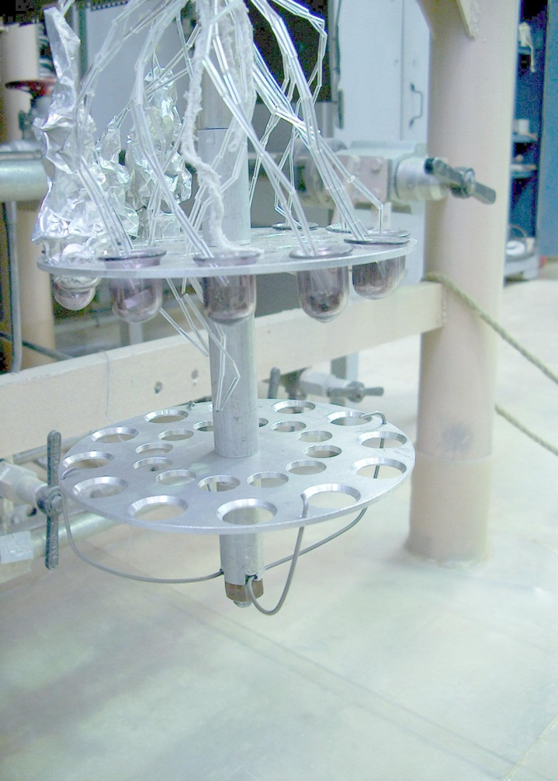
ISTC Project К-527: Verification of the Technique for Calculation of Construction Materials Radiation Heating on Test Reactors, 2000 г.
Picture of measuring device with material samples

Slide 10
Project No. 2771 Development and Study of Properties of Enhanced Density Composition Materials for Construction Activities at Nuclear Power Facilities, 2003.
Concrete samples with the following properties will be produced:
Average density, kg/m³ 5500 ... 7500
Ultimate strength at compression, МPа 15 ... 45
Porosity, % 4 ... 10
Water absorption, % 0.06 ... 1.4
Strength of coupling with steel
reinforcement, МPа 1.9 ... 4.1
Frost-resistance of the cycles: > 200 ... 250
Chemical stability factor in acid, alkali and salt
solutions : 0.9 ... 1

Slide 11
Conclusions
Within last years, calculation and experimental works on IGR have been carried out by the experts from scientific centers of Kazakhstan and Russia for the sake of accidents studies.
ISTC support is desirable for the projects К-527 (radiation heating, 2000), 2771 (heavy-weight concrete, 2003) and experimental results processing on IGR (1992) that is needed for more efficient organization of accidents studies.

