Slide 1
ISTC Project #3831
Heating and Retention of Corium
Stage I: middle scale
A. V. Kondrashenko, VNIIEF
(edited by J. Stuckert, KIT)

Slide 2
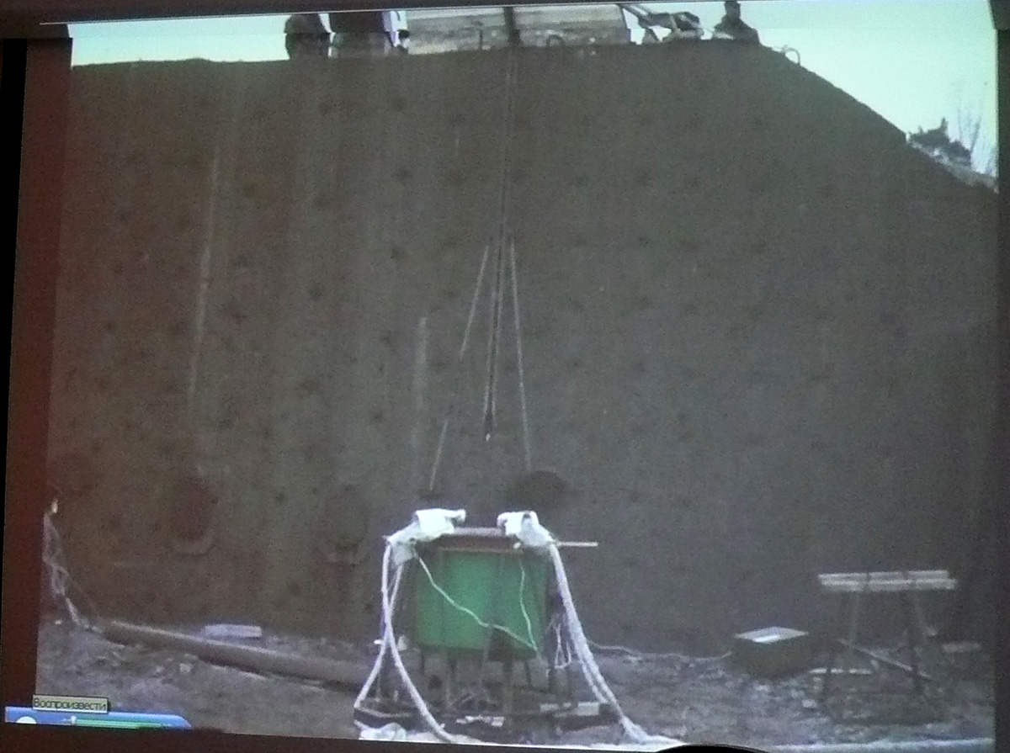
Test facility

Slide 3
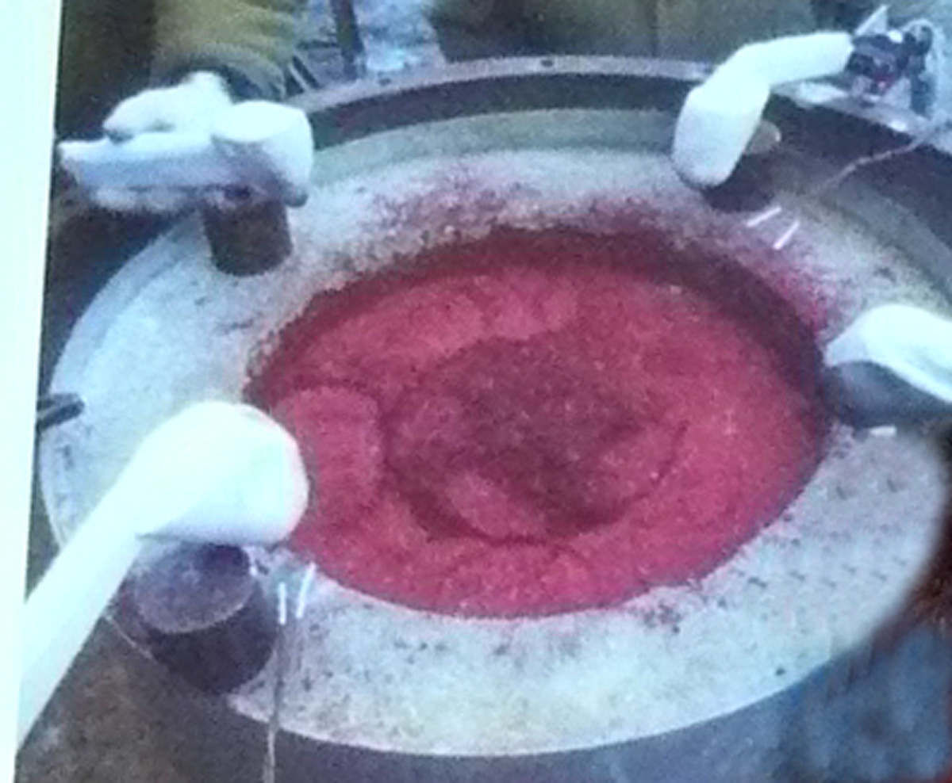
4 gas burners before test initiation on 16.12.2009; 16:00

Slide 4
1st camera
mirror
PyroTechnic Compound (PTC):
Zr + Fe₂O₃ briquettes (m_{br}=120 g)
introduced with Δt ~ 7 s
during ~ 500 s
with 280 J/briquette
5 m
60°
2nd camera

Slide 5
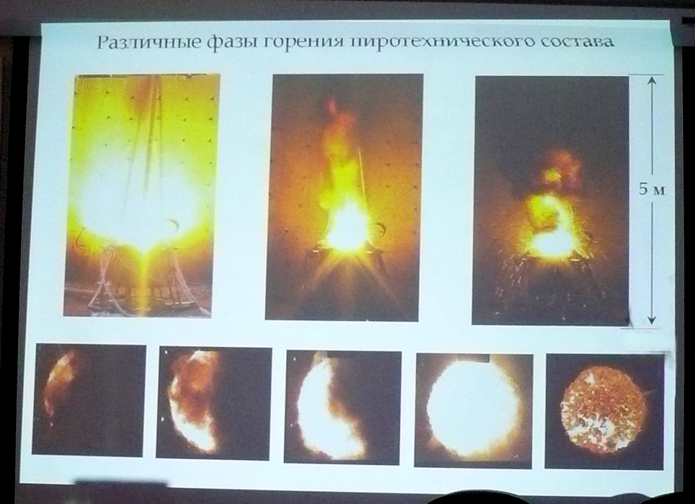
burning phases

Slide 6
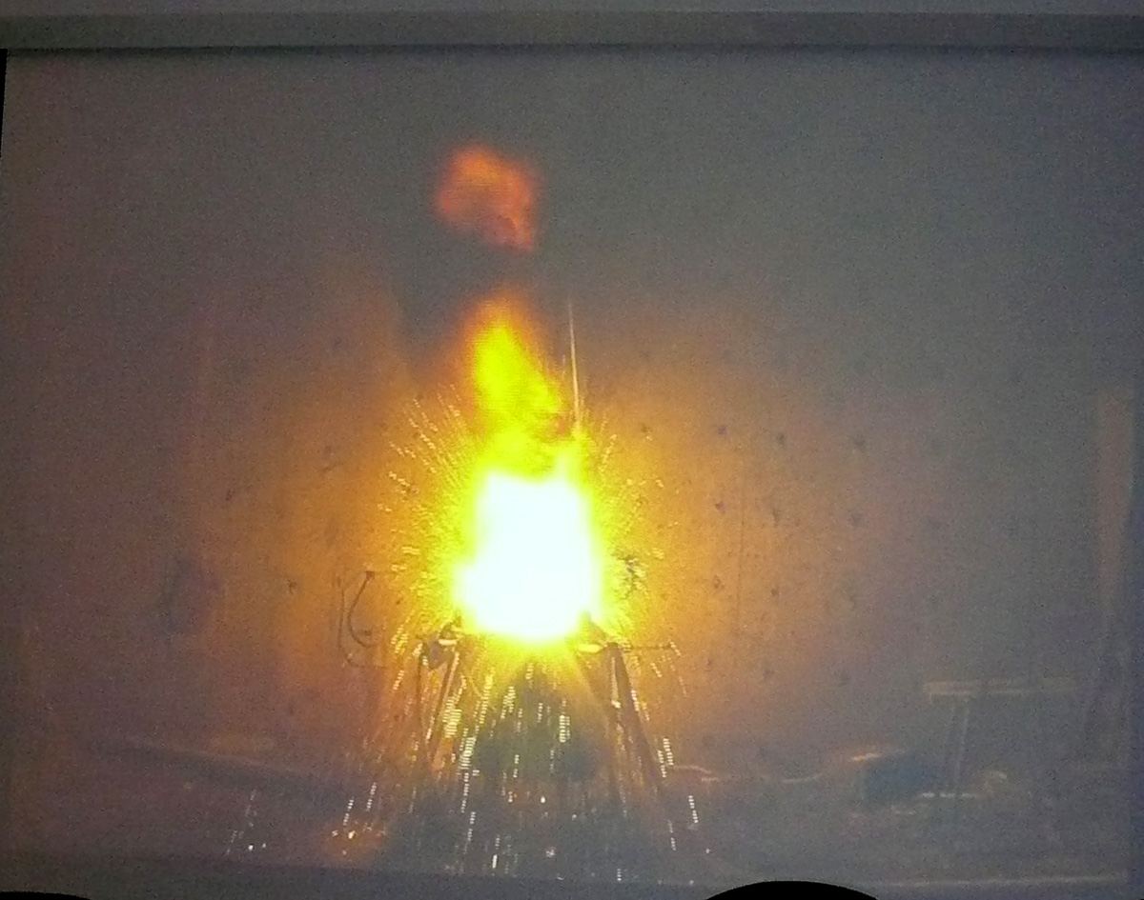
splashes after briquette introduction; m _{splashes} ~ 1.5-2 kg

Slide 7
bottom TC:
3 TC depth 5 mm
5 TC depth 10 mm
5 TC depth 20 mm
5 TC depth 25 mm
4 TC depth 30 mm
TC placement: 2 W/Re (19, 20),
20 bottom NiCr/Ni (13-18, 21-34),12 sidewall NiCr/Ni (1-12),
3 pyrometer plate positions (35 – 37)

Slide 8
3 points of pyrometer measurements: W, Mo, Ta foils at crucible bottom;
view from crucible top

Slide 9
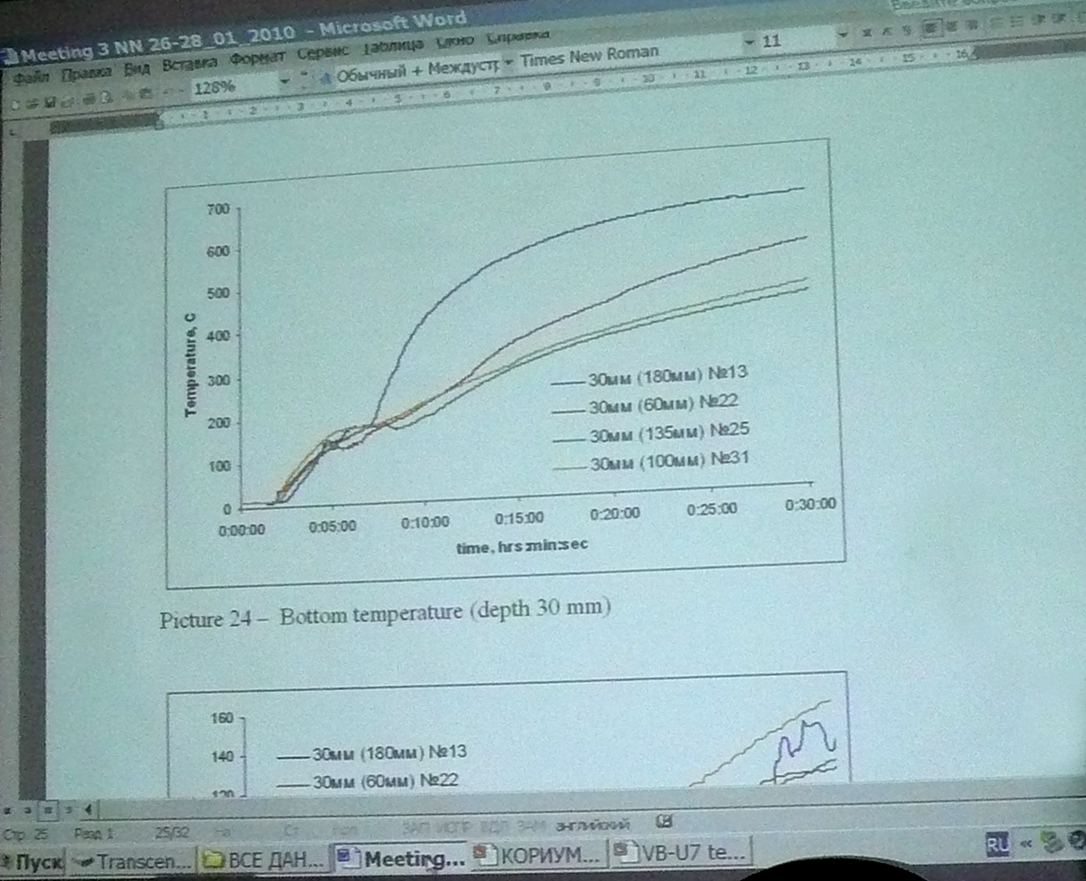
NiCr/Ni TC measurements at elevation -30 mm

Slide 10
crucible bottom
“W”
“Re”
relocation
of contact
“W” – Fe – “Re”
W/Re TC measurement

Slide 11
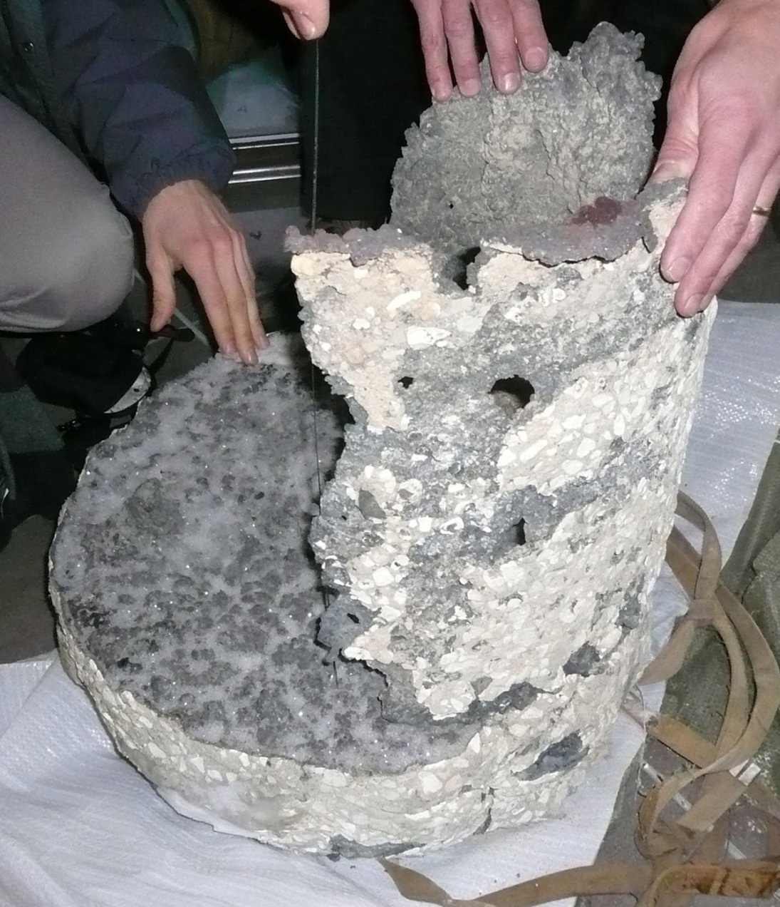
Frozen melt tablet and lateral scale

Slide 12
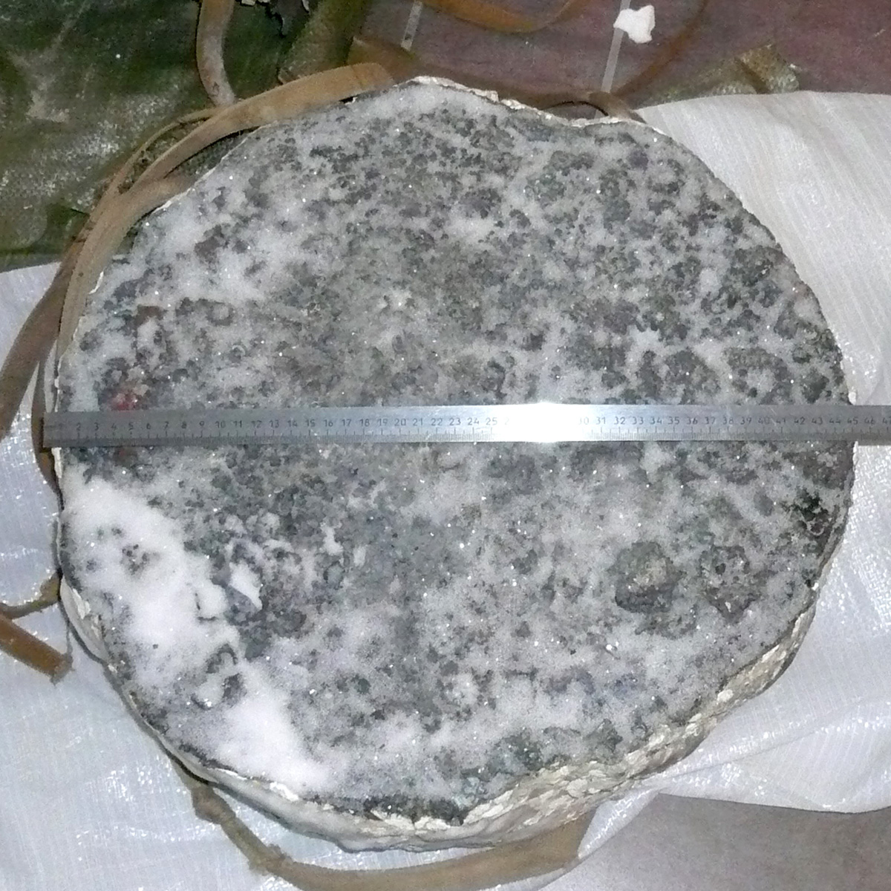
Frozen melt tablet, top view; D~45 cm

Slide 13
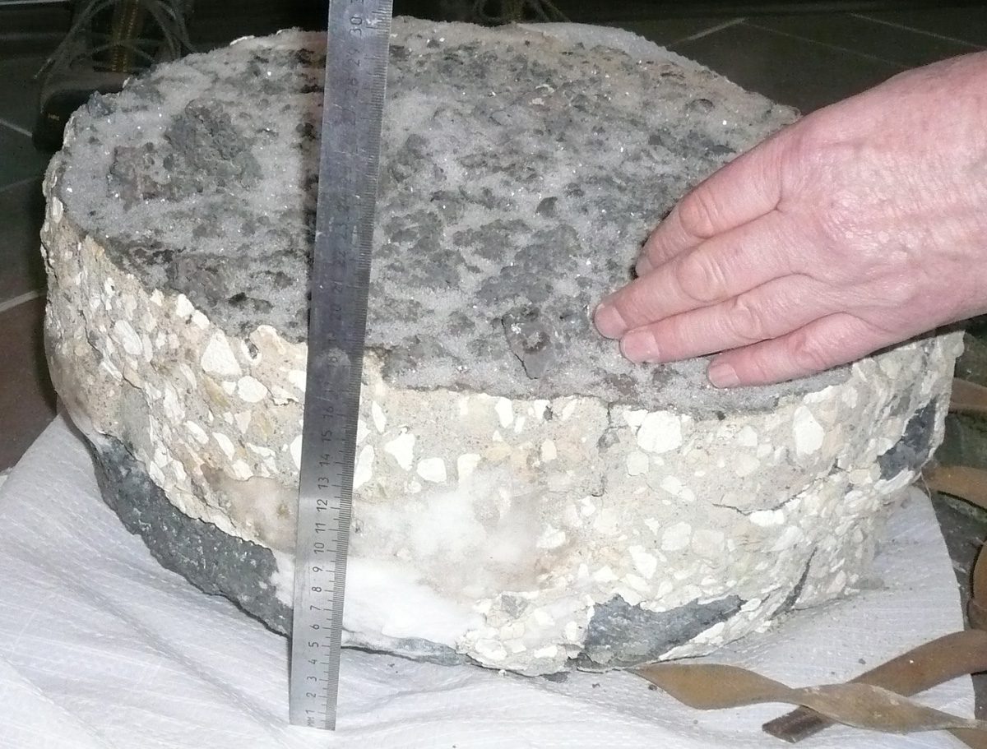
Frozen melt, side view; m=105 kg, H~18.5 cm

Slide 14
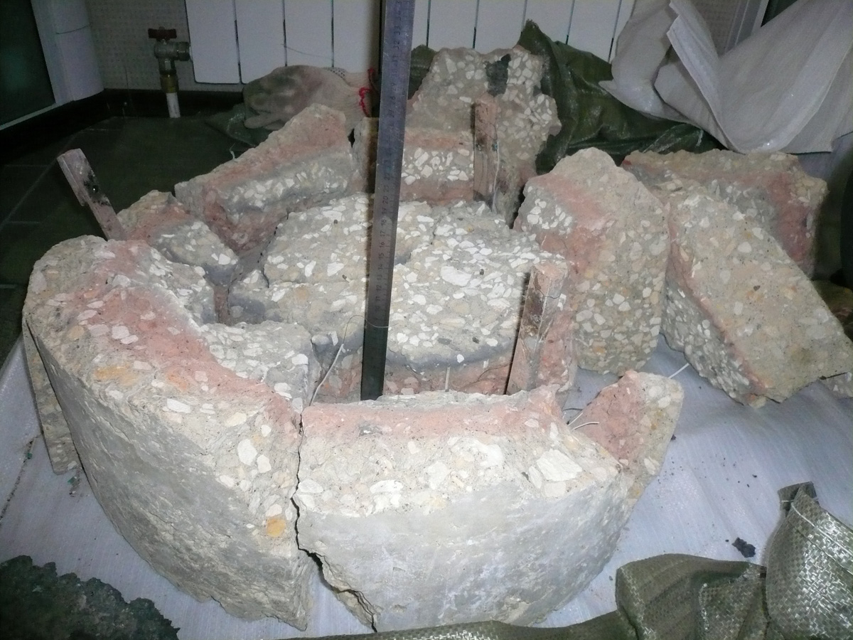
Concrete side
ablation: 25 mm
Crucible bottom.
Concrete bottom ablation: 30 mm

Slide 15
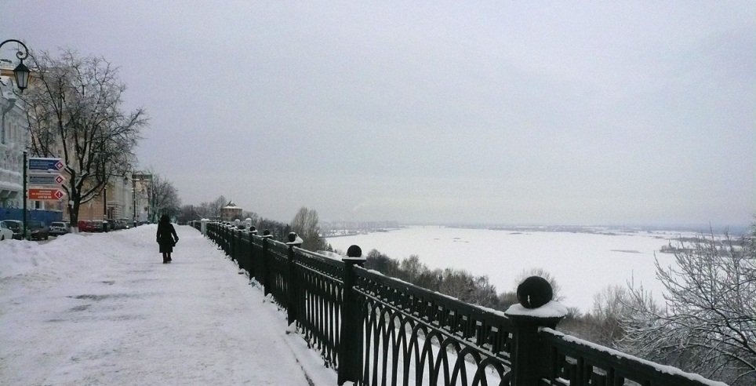
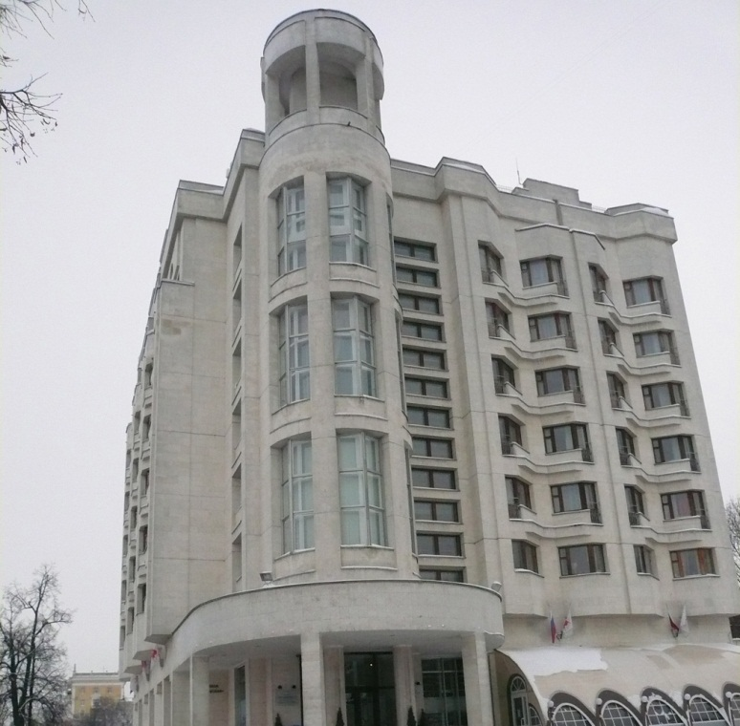
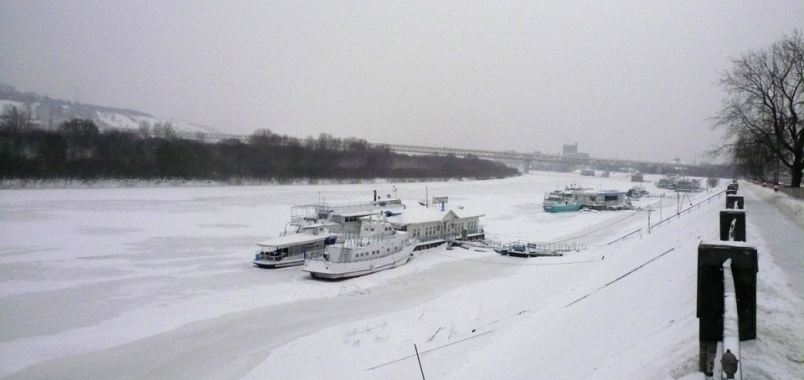
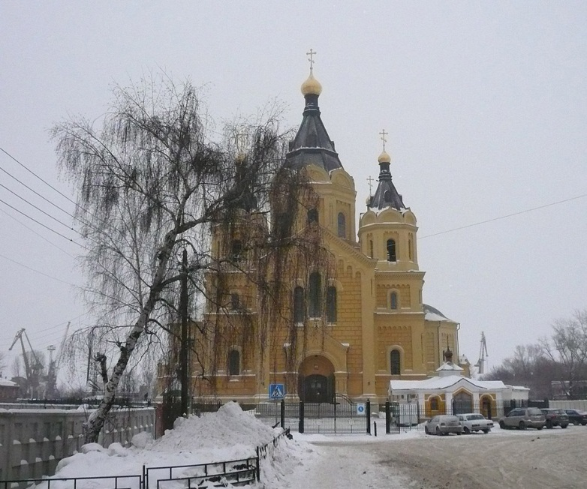
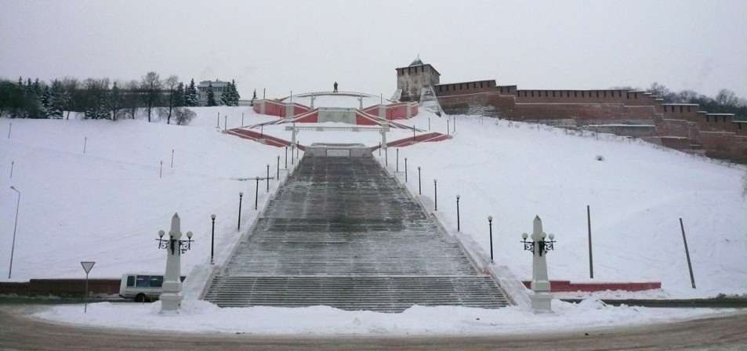
icy Volga
hotel
“Oktyabrskaya”
Nizhny
Novgorod,
January 2010
icy Oka river
Chkalov staircase from Kremlin to Volga
Jahrmarktdom

