Slide 1
NPO “LUTCH”
IBRAE RAS
Fuel assembly tests under severe accident conditions (PARAMETER Facility)
Presented by N.Ya.Parshin
13-16 September, 2004, Dimitrovgrad

Slide 2
Content
Introduction
Experimental facility and equipment
Modeling
Project proposal
Goals
Tasks
Results

Slide 3
Introduction
ISTC – 1134: Development and Fabrication of Experimental Facility Supplementary Equipment and Control System and Monitoring System Relating to Simulation of VVER (PWR) Severe Accident Scenarios and Tests of Fuel Assemblies and Fuel Rods as well as Their Elements
Leading institute: NPO Lutch, Podolsk, Moscow reg., Russia
Date: October 1997
Status: Delayed without approval

Slide 4
Goals of PARAMETER Tests: top and bottom flooding of overheated bundle.
Bundle behavior (Тcore≤ 1200оС) under DBA conditions :
Cladding deformation;
Fuel rod depressurization :
Blockage formation;
Post test material examination of claddings and spacer grids.
Bundle behavior (Тcore>1200оС) under SA conditions:
Hydrogen release;
Bundle degradation;
Material properties.

Slide 5
Experimental Facility
Model FA type | VVER
Number of FE | up to 37
FE length, mm | up to 3500
Fuel | UO₂ pellets
Initial inner pressure in FE, MPa | 2,0 – 3,0;
Heat insulation | ZrO₂;
Coolant flow rate, g/s per FE | up to 0,2
FA test temperature: DBA, ^{о}С Severe accidents, ^{о}С | up to 1200; up to 2000;
Integral electric power, kW | up to 400
Water flow rate in the system of “top” and “bottom” FA flooding, g/s | up to 200
Cooling water temperature, ^{о}С | up to 60

Slide 6
Bundle Specification
Heated rod
Unheated rod
Bundle

Slide 7
Instrumentation
Recording process-system parameters (U, I, T, p – up to 100 control points);
Collection and recording test parameters of model FA (U, I, T, p – up to 200 control points);
Gas analysis (hydrogen concentration) system;
Post-test operations (model FA flooding with a compound to fix position of its elements; partial/complete cutting; video recording, photography, etc.) and transport operations.

Slide 8
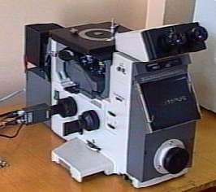
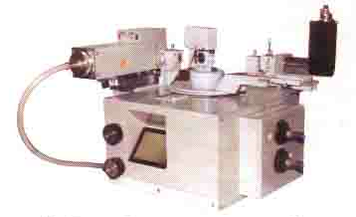
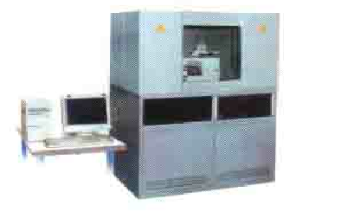
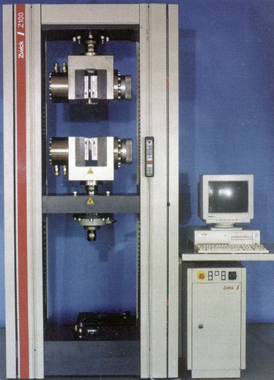
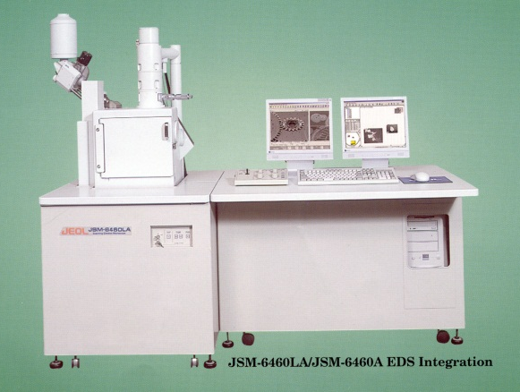
Post test Material Examination
Металлография
Рентгеноструктурный и
рентгенофазовый анализ
Микрорентгеноспектральный анализ
Cканирующая эл-я микроскопия
Механические испытания

Slide 9
Advantages of PARAMETER Facility
Wide range of possibilities:
Different assemblies: fuel, cladding, control materials, spacers
From DBA to BDBA and SA
Use of reactor materials
UO2 Pellets application available
Modern level of instrumentation
Simulation of accident management measures
Top and/or bottom flooding

Slide 10
Set of Performed Tests
Характеристики модельной ТВС и параметры испытаний | Номер модельной ТВС и год проведения испытаний
 | 1 | 2 | 3 | 4 | 5 | 6 | 7 | 8 | 9 | 10 | 11 | 12 | 13 | 14
 | 1999 |  |  | 2000 |  | 2001 |  | 2002 |  | 2003 |  |  |  | 2004
Общее количество твэлов в модельной ТВС, шт. | 19 | 19 | 19 | 37 | 37 | 37 | 37 | 37 | 37 | 37 | 37 | 19 | 19 | 19
Количество нагревательных твэлов, шт. | 19 | 19 | 19 | 24 | 22 | 23 | 36 | 36 | 36 | 36 | 36 | 18 | 18 | 18+ ПЭЛ
Высота активной части, мм | 800 | 800 | 800 | 1275 | 1275 | 1275 | 1275 | 1275 | 1275 | 1275 | 1275 | 1275 | 1275 | 1275
Материал оболочки твэла | Э-110 | Э-635 | Э-110 | Э-110 | Э-635 | Э-110 | Э-110 | Э-635 | Э-110 | Э-110 | Э-635 | Э-110 | Э-110 | Э-110
Исходное давление гелия при 20^{о}С, МПа | 2.0± 0.25 | 2.0± 0.25 | 2.0± 0.25 | 2.0± 0.25 | 2.0± 0.25 | 2.0± 0.25 | 3.0± 0.25 | 3.0± 0.25 | 2.0± 0.25 | 0.5-0.7 | 2.0± 0.25 | 2.0± 0.25 | 2.0± 0.25 | 2.0± 0.25
Температура пара на входе, ^{о}С | 300-450 | 300-450 | 300-450 | 300-480 | 300-480 | 300-480 | 300-480 | 300-480 | 300-480 | 300-480 | 300-480 | 300-480 | 300-480 | 300-480
Расход пара через сборку, г/с | 4 | 4 | 4 | 8 | 6 | 6 | 6 | 6 | 6 | 8 | 8 | 6 | 6 | 6
Скорость нагрева оболочек в момент разгерметизации, К/с | 1,5 ÷2,0 | 1,0 ÷1,5 | 0,2 ÷0,3 | 0,4 ÷0,5 | 1,5 ÷2,2 | 1,4 ÷1,8 | 3,0 ÷4,0 | 2,0-4,0 | 2,0-4,0 | 1,5 ÷3,5 | 2,0-4,0 | 0,5 | 0,5-1,0 | 0,5-1,0
Максимальная температура оболочек твэлов, ^{о}С | 1100 | 1200 | 900 | 1200 | 900 | 900 | 850 | 1100 | 1100 *) | 860 **) | 1100 *) | 1290 ***) | 2500 ***) | 2500 ***)
Скорость залива модельной ТВС водой снизу, мм/сек | *****) | *****) | 50 | 30 | 80 | 80 | 80 | 80 | 80 | 80 | 80 | 80 | 80 | 80
Примечание: *) Радиальный температурный перекос ∼ 300 град;
**) ТВС типа ВВЭР-440;
***) Испытания ТВС в условиях запроектной аварии.
*****) Программой не предусмотрен.

Slide 11
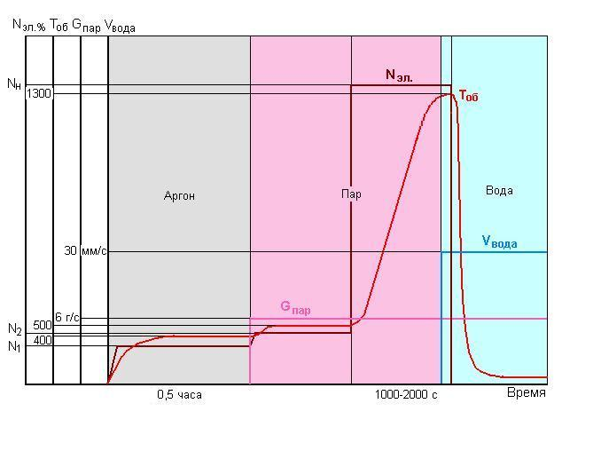
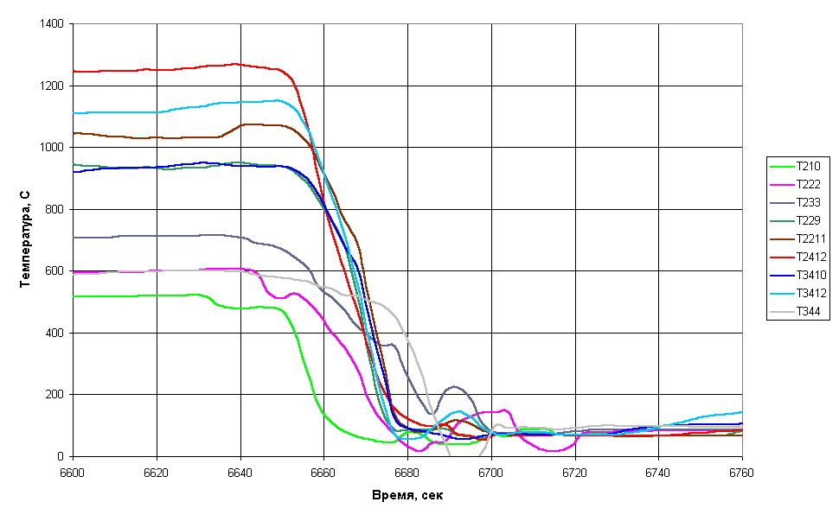
Some results of completed DBA tests
Test Scenario
Cladding Temperature
Internal Pressure
Т°.
Bottom Flooding
Notes:
лоч

Slide 12
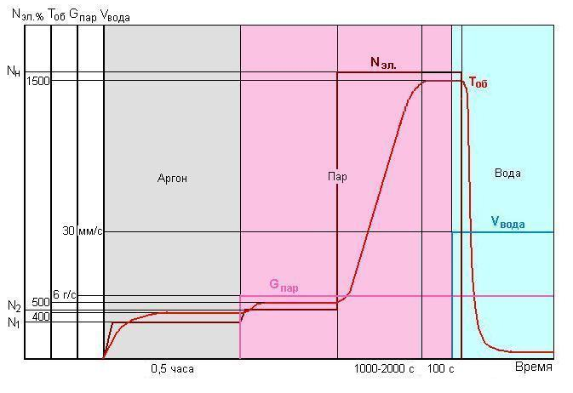
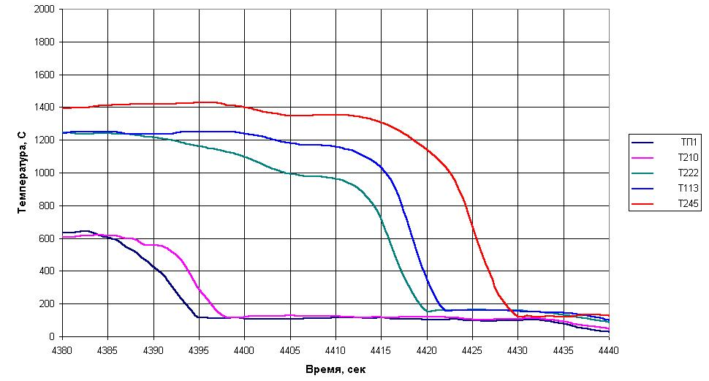
Some results of completed SA tests
Test Scenario
Cladding T
Internal Pressure
Залив снизу
Т°_{об.}
Bottom Flooding

Slide 13
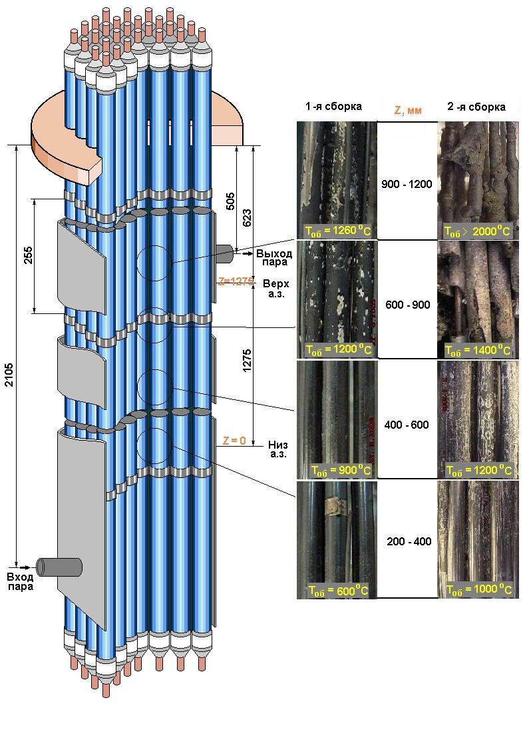
Post Test Bundle View
Вход пара
Залив снизу

Slide 14
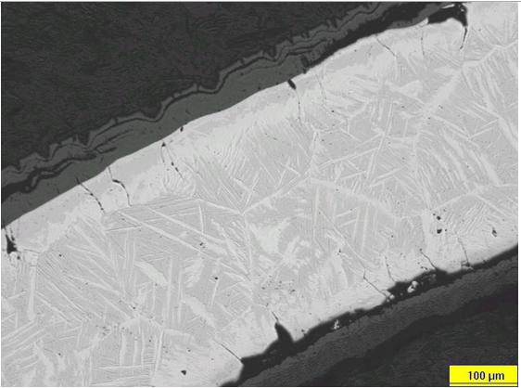
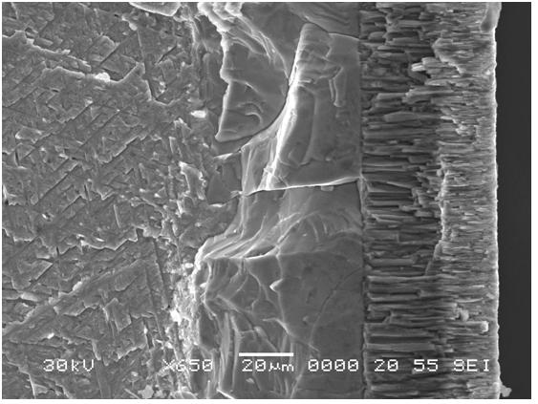
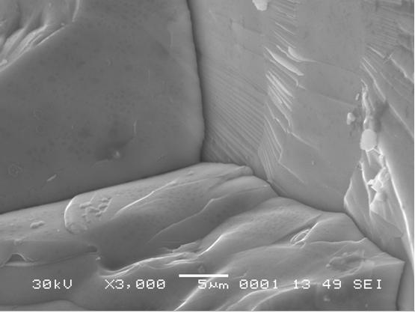
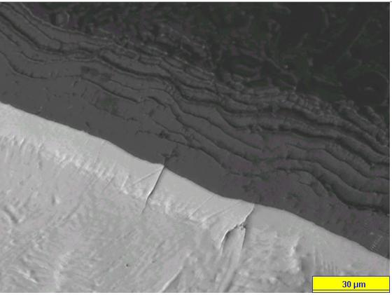
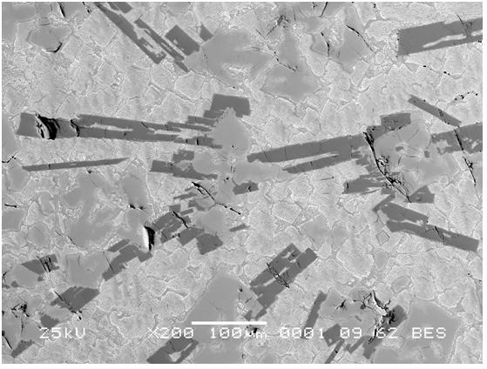
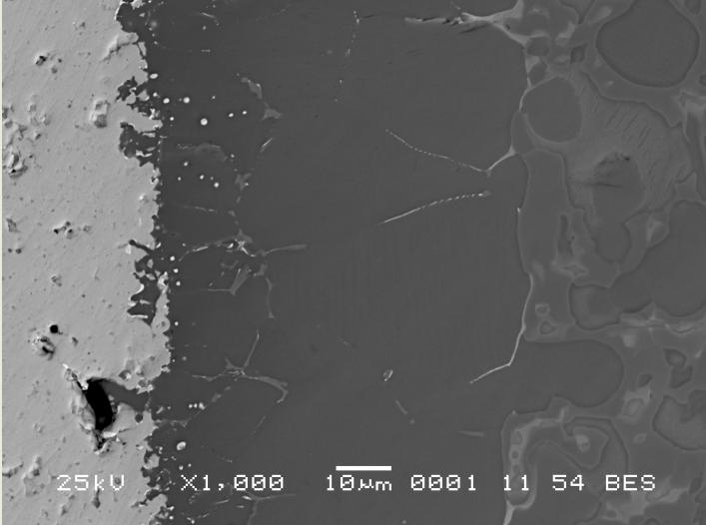
Post Test Material Investigations
BDBA
Cladding oxidation
Electron microscopy
SA
Cladding oxidation
Zr-Fe-Cr-U Eutectic melt Zr-U

Slide 15
Results of Facility modeling by RATEG/SVECHA Code
1.Cladding Temperatures

Slide 16
Results of Facility modeling by RATEG/SVECHA Code
2. Gap internal pressure
Heated rods

Slide 17
Results of Facility modeling by RATEG/SVECHA Code
3.Liner Temperature
4.Hydrogen Release
ЭКСП.

Slide 18
Current Status
Facility was successfully tested against set of BDBA and SA scenarios. Facility is ready to be used for future tests.
Code RATEG/SVECHA was successfully tested against PARAMETER Data. Obtained results demonstrated that main features of PARAMETER Facility can be well predicted by SA computer codes.

Slide 19
Project Proposal
Goal: Two test of overheated up to 2000 C bundle:
1-st test: top flooding
2-nd test: simultaneous top and bottom flooding
Project Manager: Nalivaev V.I.
Participating organization
NPO “Lutch”
IBRAE
Other organizations: IPPE, NIKIET, OKB “Gidropress"
Cost estimate: $360k
Equipment:$53k
Materials:$48k
Overhead: $36k
Personal grants: $180k
Travel: $21k
Other direct cost: $23k
Project duration: 24 months

Slide 20
Project proposal: Tasks
Task 1: Study of the top flooding of 19 FE bundle under severe accident conditions
Task 2: Study of the simultaneous top and bottom flooding of 19 FE bundle under severe accident conditions
Each task consists of the following subtasks:
Subtask 1.1 Preparatory work
Subtask 1.2 Pretest analysis, choice of the test scenario and parameters
Subtask 1.3 Test conduction
Subtask 1.4 Post test examination and analysis
Material study
Post test analysis

