Slide 1
PRECOS – May 2012
Results obtained with laser pulse heating facility
M.Sheindlin, A. Vasin, P. Vervikishko
Joint Institute for High Temperatures, Moscow
sheindlin@yandex.ru

Slide 2
The main task of IVTAN laser-heating experiments in the PRECOS project is an issue of possible immiscibility of liquid in the U-Zr-O system.
The required set of samples have been prepared at NPO “LUCH” however the transfer of the samples to IVTAN is delayed due to the license required for experiments with natural uranium.
The licensing was completed in late August 2011 and the transferring procedure was started immediately. However, in September 2012 it turned out that some samples prepared at NPO “LUCH” are completely disintegrated into powder.
Later we faced another problem: the samples at NPO “LUCH” had a status of “nuclear materials” however the license was issued for handling “radiated materials”.

Slide 3
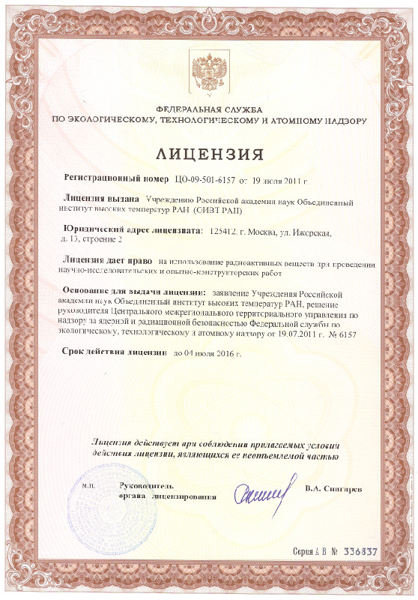
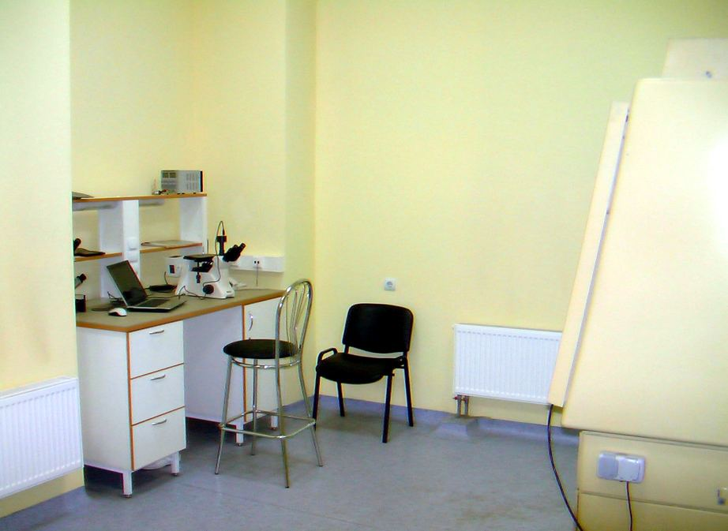
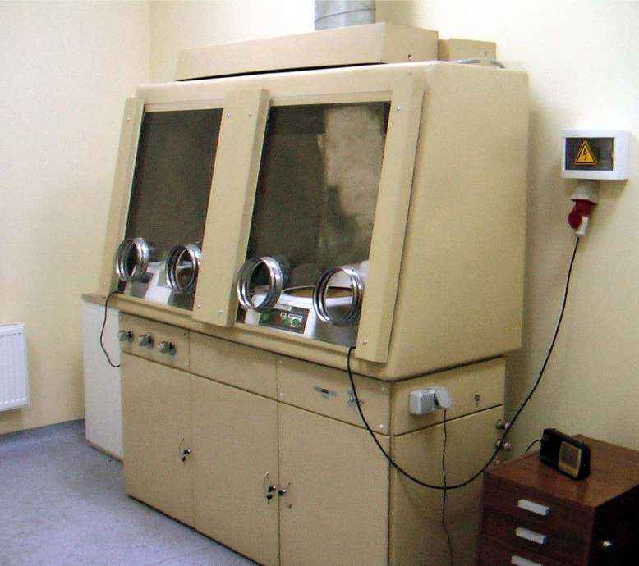
The licensing procedure was completed in August 2011
Laboratory Room Dedicated for Handling of Natural Uranium Samples

Slide 4
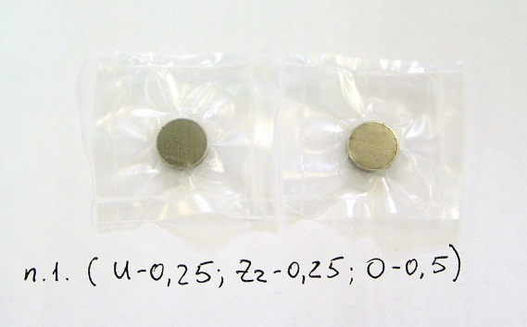
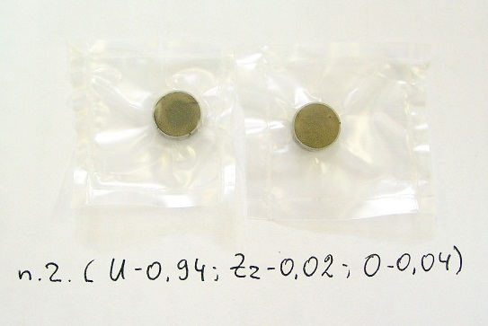
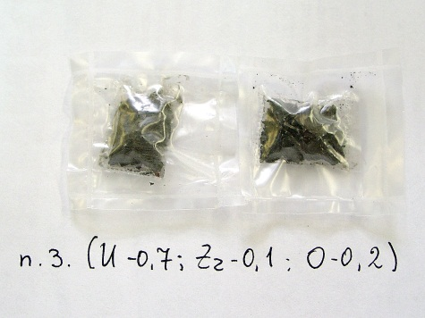
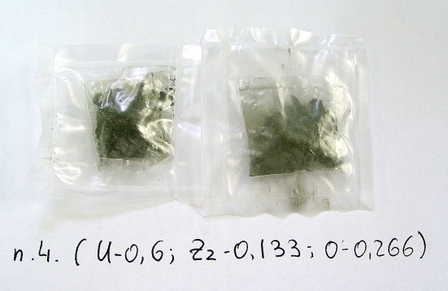
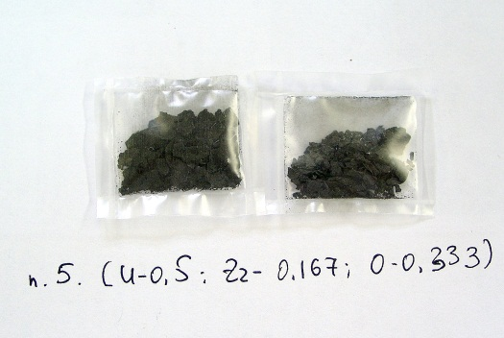
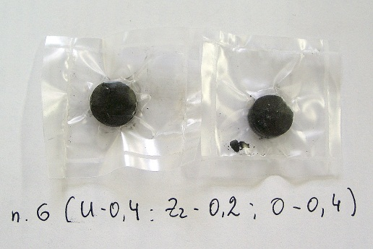
U-ZrO₂ samples for laser-heating experiments
Since we have much less samples at our disposal that it was planned previously one has to update the test matrix.

Slide 5
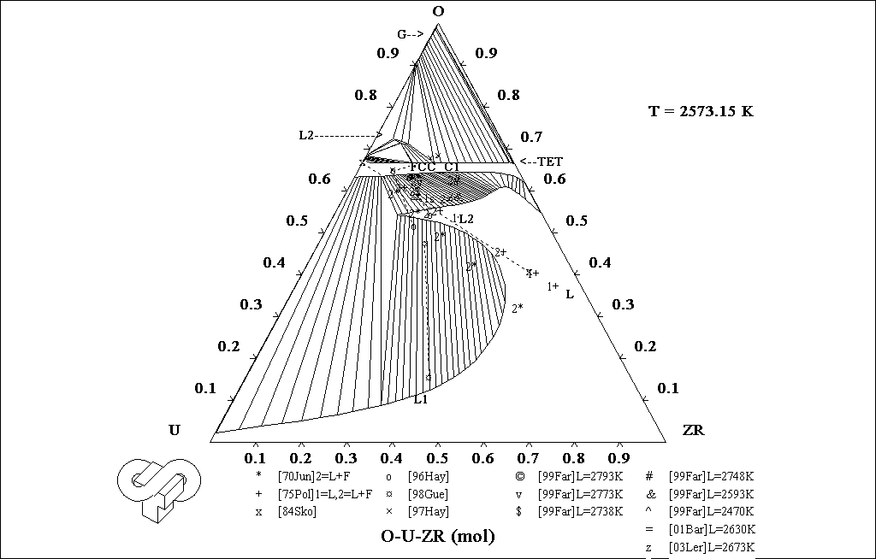
Disintegration of U-ZrO₂ samples sintered at NPO “Luch”
Samples remaining intact
Samples partially disintegrated
Samples completely disintegrated

Slide 6
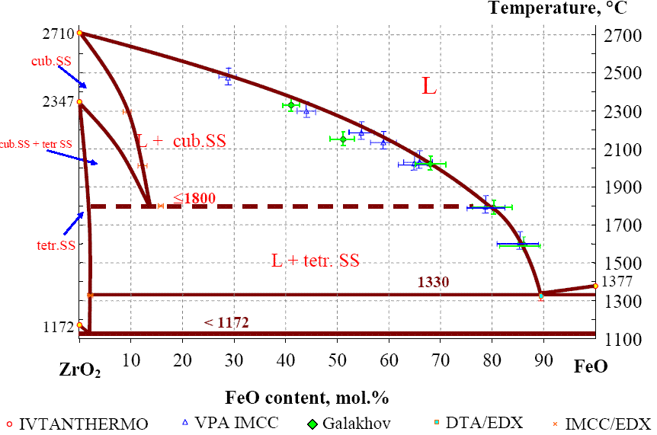
ZrO₂-FeO System: some experimental results
?
- IVTAN (2010), laser-heating
-March 2011
-May 2011, CORD samples
- Sept. 2011

Slide 7
Laser-Pulse Melting of CaO: further improvement of the setup, experimental procedure and refined experimental data.
Data of March 2010: First indication of “high melting point”.
Problems:
Unstable plateau of crystallization;
Avalanche-like heating by Nd-YAG laser;
Unknown degree of semitransparency of CaO at the vicinity of the melting point.

Slide 8
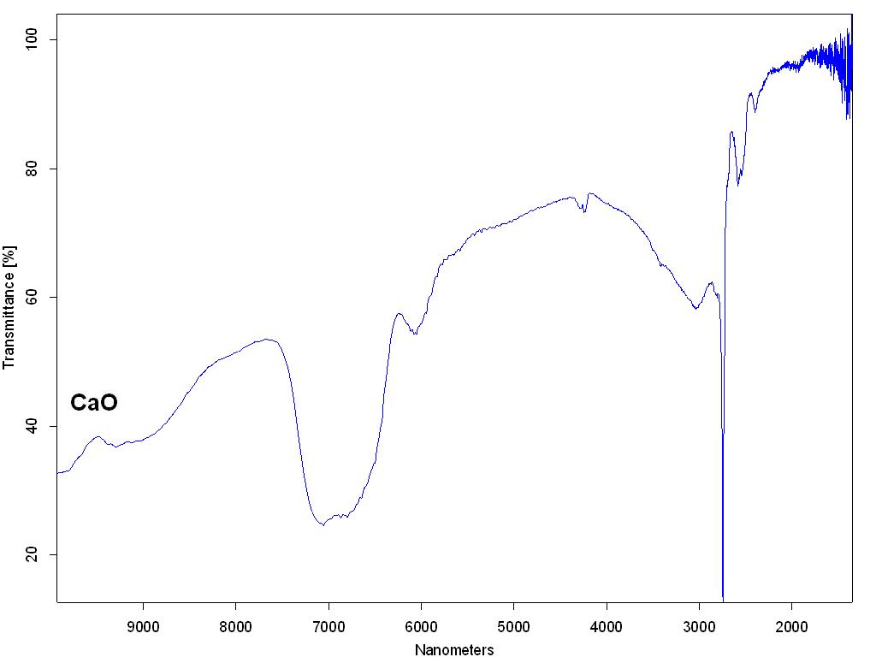
Melting of CaO
Measurements of hemispherical spectral reflectivity of CaO powder is performed using the Fourier spectrophotometer with a special attachment.
At room temperature CaO does not absorb radiation of YAG laser (λ=1064 nm) however it does absorb significant fraction of radiation of CO₂-laser (λ=10600 nm)
Reflectivity, %
λ, nm

Slide 9
Use of low power CO₂–laser along with YAG fiber-laser ensured controlled heating of CaO making a sort of ignition for the soft heating and cooling.

Slide 10
Schematic of the Set-Up
CO₂-laser

Slide 11
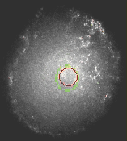
High-speed wide dynamic range camera is used to ensure perfect alignment of the pyrometer and spectropyrometer. The sample surface is illuminated by frequency doubled 300 mW YAG-laser (λ=532 nm), which cutoff the thermal radiation.
Pyrometers sighting spots

Slide 12
Typical experimental results and data evaluation

Slide 13
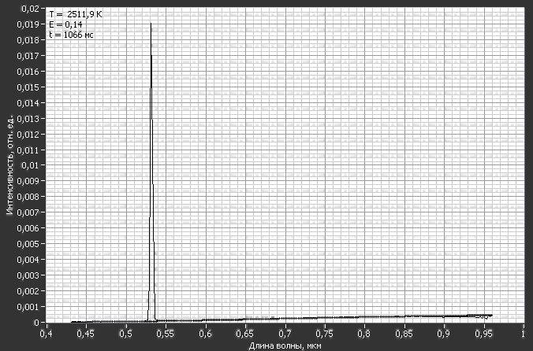
I(λ), arb. units
λ, μm

Slide 14
Conclusion (CaO):
1. True melting temperature is equal to 3170±15 K and emissivity at the melting point is equal to 0.92 ±0.05. Therefore this material can be considered as one of the few ultra-refractory oxides;
2. Calcium oxide remains semitransparent in the solid and most probably in the liquid phase. However, by the proper spectral analysis one can find conditions where precise temperature measurements can be performed;
3. Few more experiments can be made with CaO powder from another manufacturer to be sure that small deviation in the impurities does not affect the melting temperature.

Slide 15
Conclusion
All the formalities for the transferring of the remaining U-ZrO2 samples from NPO “LUCH” to IVTAN are settled;
The samples will be available for the experimental tests within a few days. In spite of the formal completion of the PRECOS project all necessary tests planned previously with these samples will be performed. The way of presentation of the test results has to be mutually agreed;
Detailed study of melting of Calcium oxide is presented. It is planned to publish the results in one of the appropriate journals with reference to the project.

Slide 16
Thanks for your attention

Slide 17
END

Slide 18
ZrO₂-FeO System
Verification of the laser-heating technique on relatively well studied binary system
Testing of applicability of the mixed oxide samples prepared by blending followed just by pressing without any heat treatment
Definition of number of the laser-melting cycles for complete homogenization of initially inhomogeneous low density samples
Example of the thermogram on IVTAN samples

Slide 19
Laser-melting of CORD-15 sample
Only the first shot is successful
Eutectic point is clearly seen both on ascending and descending flanks of the thermogram
Both variation of the reflection signal and the thermogram are used for identification of the solidus and liquidus points

Slide 20
Laser-melting of CORD-10 sample
One can see reproducibility of eutectic temperature and suggested liquids temperature. Their positions are independent on laser power density and intense vaporisation (in case of shot 3)

