Slide 1
FSUE SRI SIA “LUCH”
IBRAE RAS
FSUE EDO “GIDROPRESS”
Comparison results of post-test calculations of the PARAMETER-SF2 test
PARAMETER-SF3 test scenario and results of pre-test numerical modeling
Podolsk, 16 July 2008

Slide 2
Used codes and participants
SOCRAT –IBRAE
ICARE/CATHARE - NSI RRC KI
ATHLET-CD – GRS
RELAP - FSUE EDO “GIDROPRESS”
PARAM-TG - FSUE SRI SIA “LUCH”

Slide 3
Initial and boundary conditions
PARAMETER-SF2 post-test analysis
ATHLET
ATHLET

Slide 4
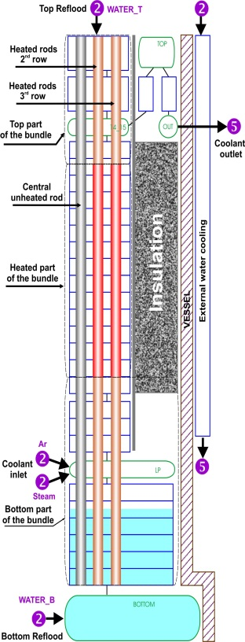
Heat balance
PARAMETER-SF2 post-test analysis

Slide 5
Heat balance
PARAMETER-SF2 post-test analysis
Pre-oxidation phase
Joel heating power ~ 7kW
Coolant heating power ~ 6kW
Before flooding onset
Joel heating power ~ 9.5kW
Coolant heating power ~ 9kW
Oxidation reaction power
Pre-oxidation phase - up to 1kW
Before flooding up to 2.3kW
Flooding phage up to 2.5 kW

Slide 6
Claddings temperature evolution PARAMETER-SF2 post-test analysis

Slide 7
Shroud temperature evolution
PARAMETER-SF2 post-test analysis

Slide 8
Hydrogen release
PARAMETER-SF2 post-test analysis
Hydrogen release
Experimental ∼28 g
ICARE ~ 25.5 g
ATHLET ~ 23 g
SOCRAT ~ 20 g

Slide 9
Main outcomes from SF2 post-test calculations
Post-test calculations and experimental data on temperature evolution are in a good agreement except temperature “hump” at 12000 s
The most codes underestimate hydrogen total amount.
In the course of post-test SF2 calculations heat loss due to external resistance and heat loss through shroud were specified.

Slide 10
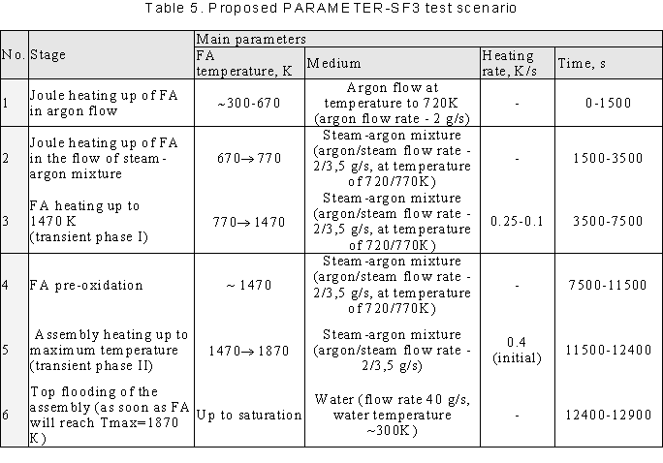
Proposed PARAMETER-SF3 test scenario

Slide 11
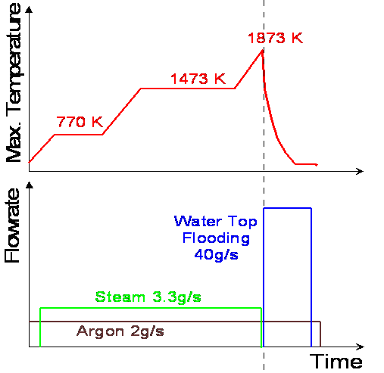
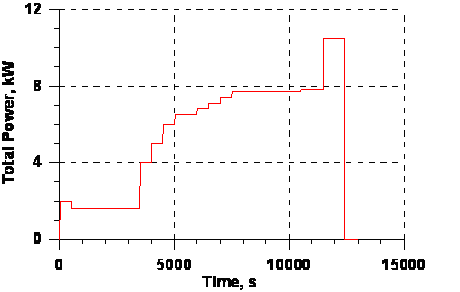
Initial and Boundary conditions
Electrical power
Pre-oxidation phase ~ 7.7 kW
Transient phase ~ 10.5 kW

Slide 12
Heat balance
PARAMETER-SF3 pre-test analysis

Slide 13
Heat balance
PARAMETER-SF3 pre-test analysis
Heat loss through shroud
at pre-oxidation phase
~15-20% of core power over 0-1275 mm

Slide 14
Claddings temperature evolution; hottest zone PARAMETER-SF3 pre-test analysis

Slide 15
Claddings temperature evolution; 700-1000 mm
PARAMETER-SF3 pre-test analysis

Slide 16
Shroud temperature evolution
PARAMETER-SF3 pre-test analysis

Slide 17
Temperature profile
PARAMETER-SF3 pre-test analysis

Slide 18
Oxide scale thickness
PARAMETER-SF3 pre-test analysis

Slide 19
Hydrogen release
PARAMETER-SF3 pre-test analysis
Hydrogen release predicted ~ 22-27 g
No extra hydrogen release at flooding stage

Slide 20
Flooding Phase (SOCRAT calculations)

Slide 21
Conclusions
SF2 post-test runs have been performed by SOCRAT, ICARE/CATHARE, ATHLET-CD, RELAP, PARAM-TG codes
(IBRAE, RRC KI, GRS, GIDROPRESS, LUCH)
Scenario for SF3 test was numerically justified.
Predicted temperatures are similar.
Predicted hydrogen release is estimated as 22-27g

