Slide 1
FSUE SRI SIA “LUCH”
IBRAE RAS
JSC OKB “GIDROPRESS”
Experimental results of complex starting-up and adjustment on preparation of the PARAMETER-SF4 Experiment
(Status of Project # 3690)
Presented by W. Konstantinov
29 July, 2009, Podolsk
Notes:
1
1

Slide 2
Objective
The study of behaviour of VVER-1000-type FA overheated to 1750°C under severe accident conditions with air ingress and bottom quenching

Slide 3
Main Tasks of the Project
Development of technological systems for carrying out of PARAMETER-SF4 Experiment :
а) The control of air flow rate;
б) The control of the gas environment;
в) Bottom flow;
г) Steam generation and heating of argon flow;
- Check up of technological systems
- Carrying out of control test up to 500 C
-

Slide 4
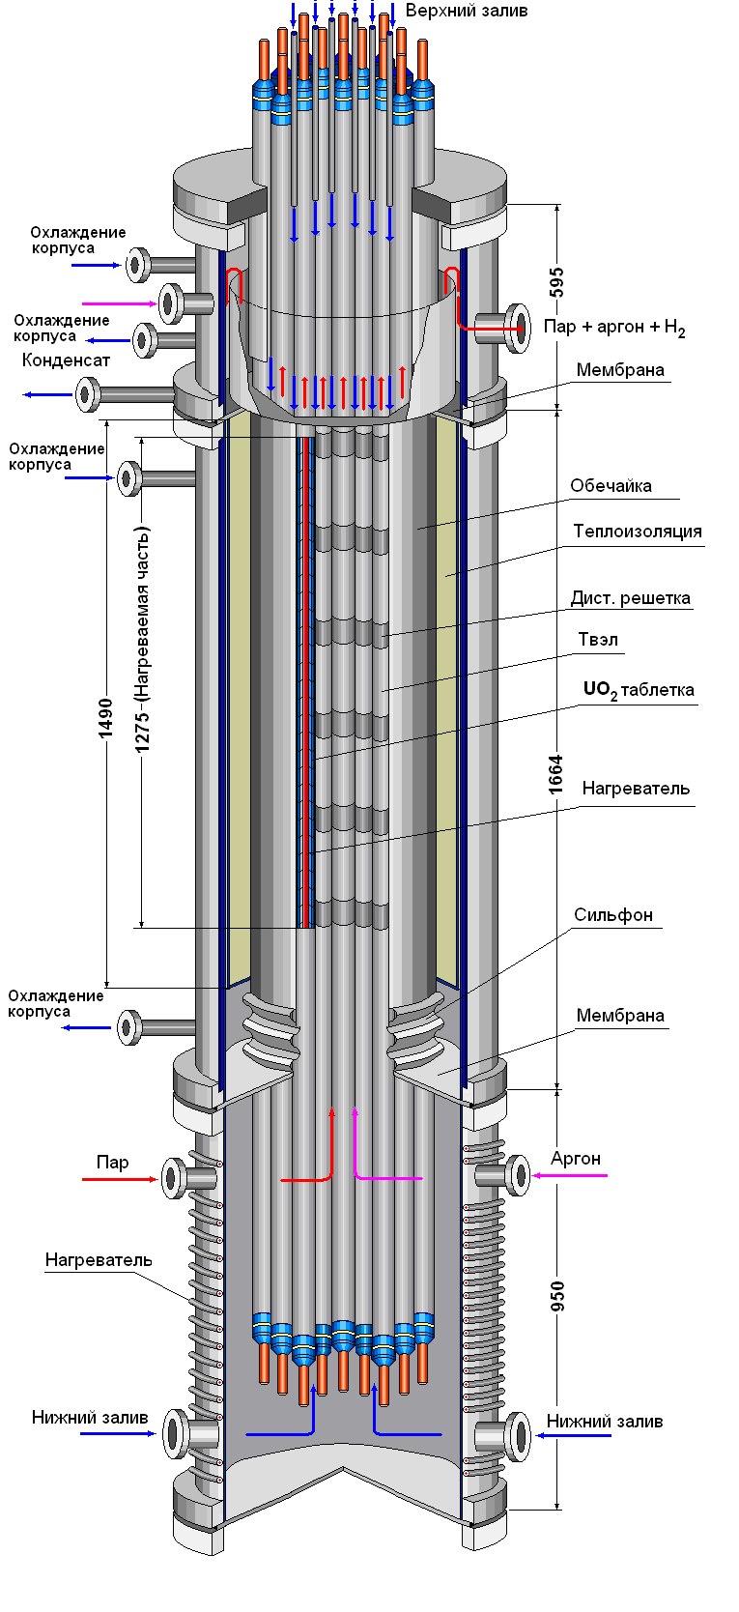
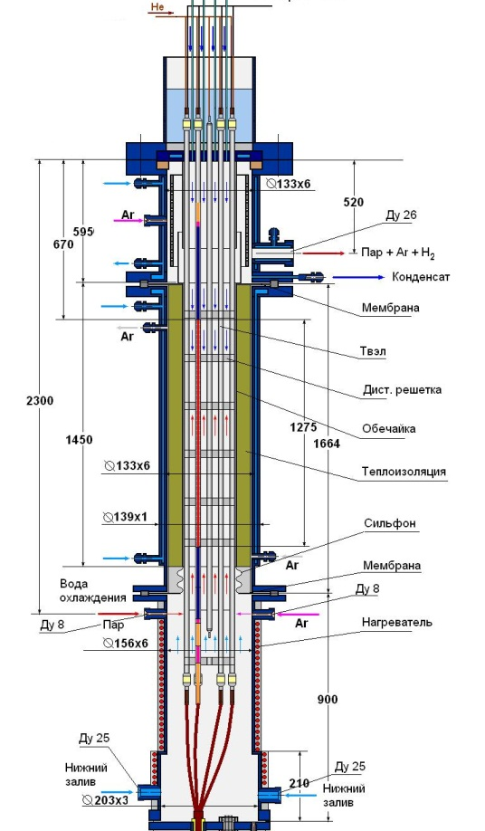
Test bundle
Main technical characteristics
Main technical characteristics
Bundle type VVER-1000
number of fuel rods 19
- heated 18
- unheated 1
Grid type triangle
Grid pitch, mm 12.75
Spacing grid Zr1%Nb
- height, mm 20
- spacing, mm 255
Shroud Zr1%Nb
- shape cylinder
- height, mm 1490
Thermal insulation ZrO2 ZYFB-3
- thickness, mm 23
- height, mm 1490

Slide 5
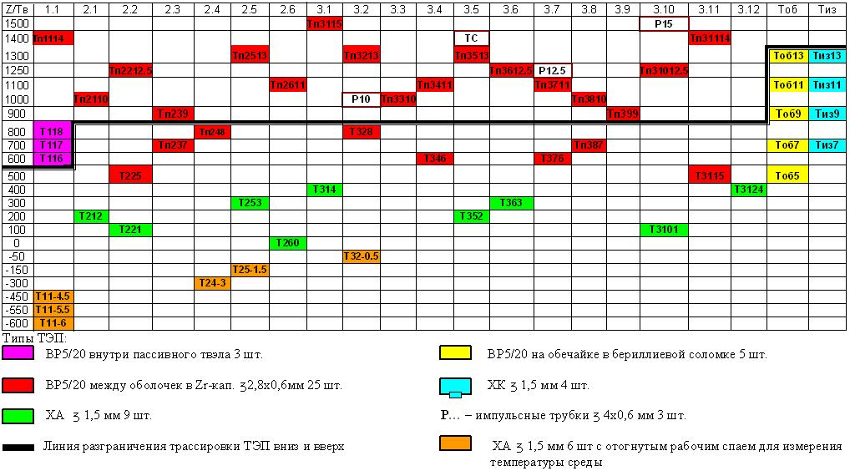
Test instrumentation

Slide 6
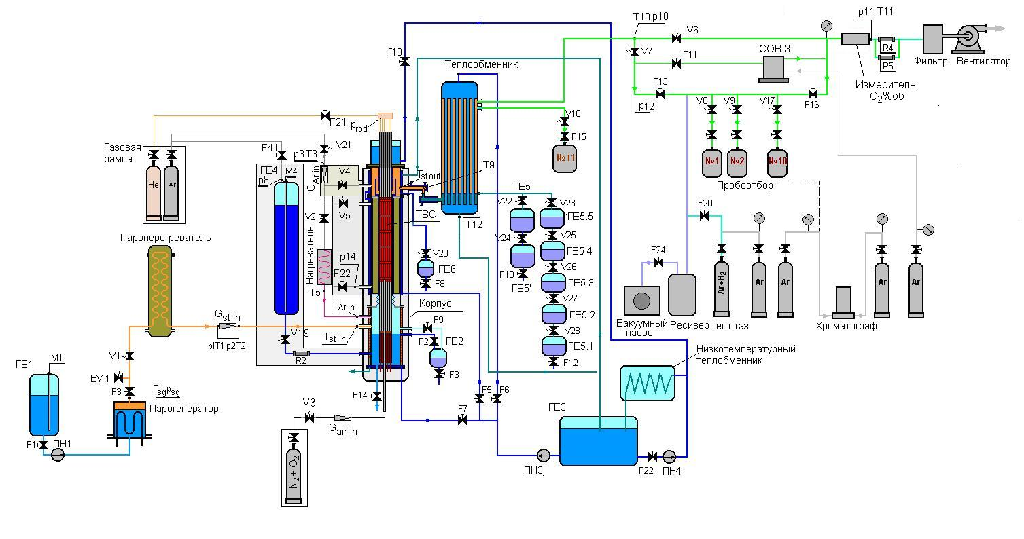
Test facility
Functional scheme

Slide 7
Results of check of technological systems
- Parameters of argon and pair;
- Air flowrate;
- Calibration of the hydrogen measurement device;
- Parameters of the bottom flooding;
- Trial experiment at 500°С.

Slide 8
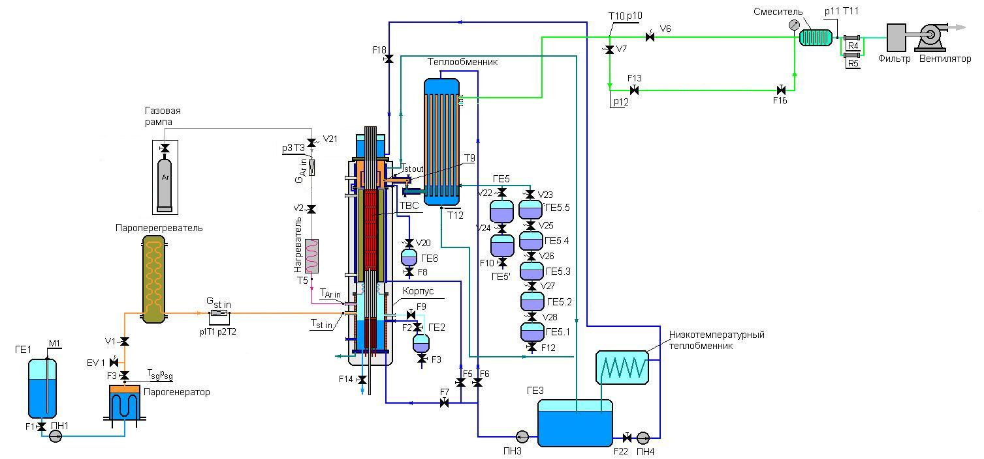
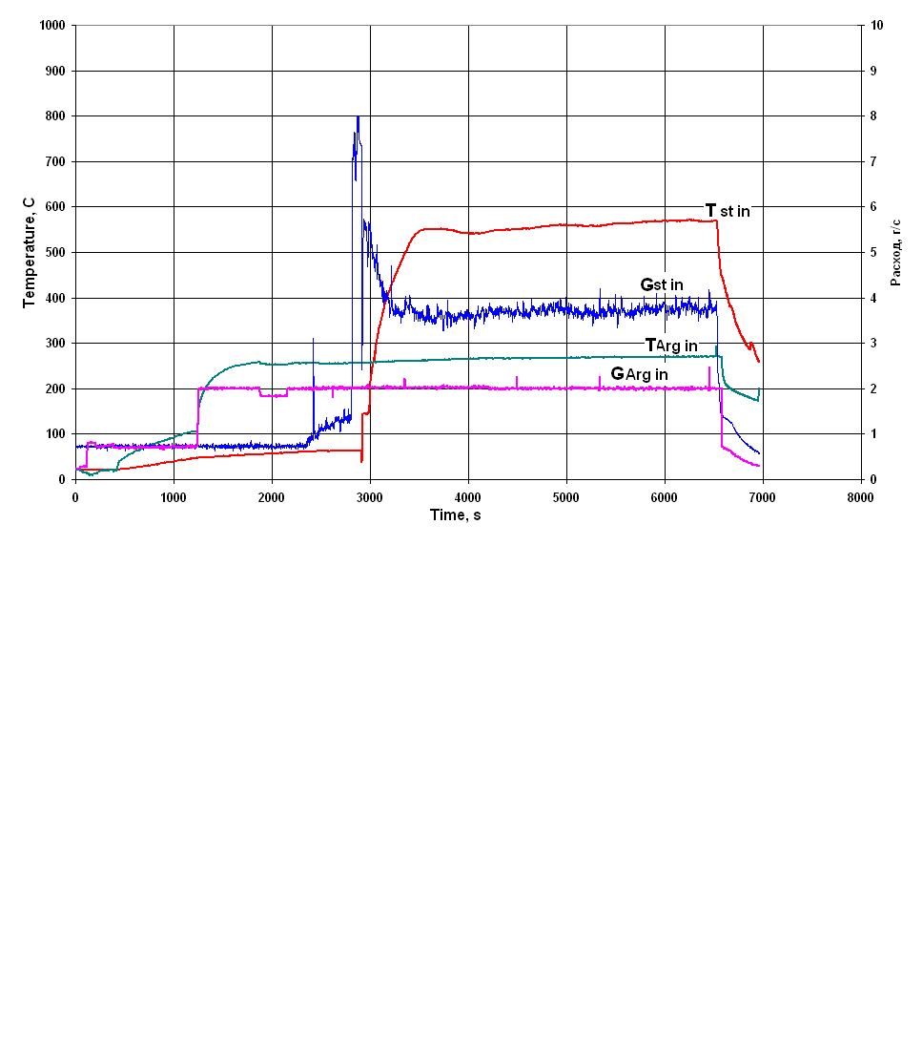
Results of measurement of parameters of argon and steam
G st in = 3,5 g/s Tst in = 500±50°C
Garg in = 2 g/s T arg in = 280±20°C

Slide 9
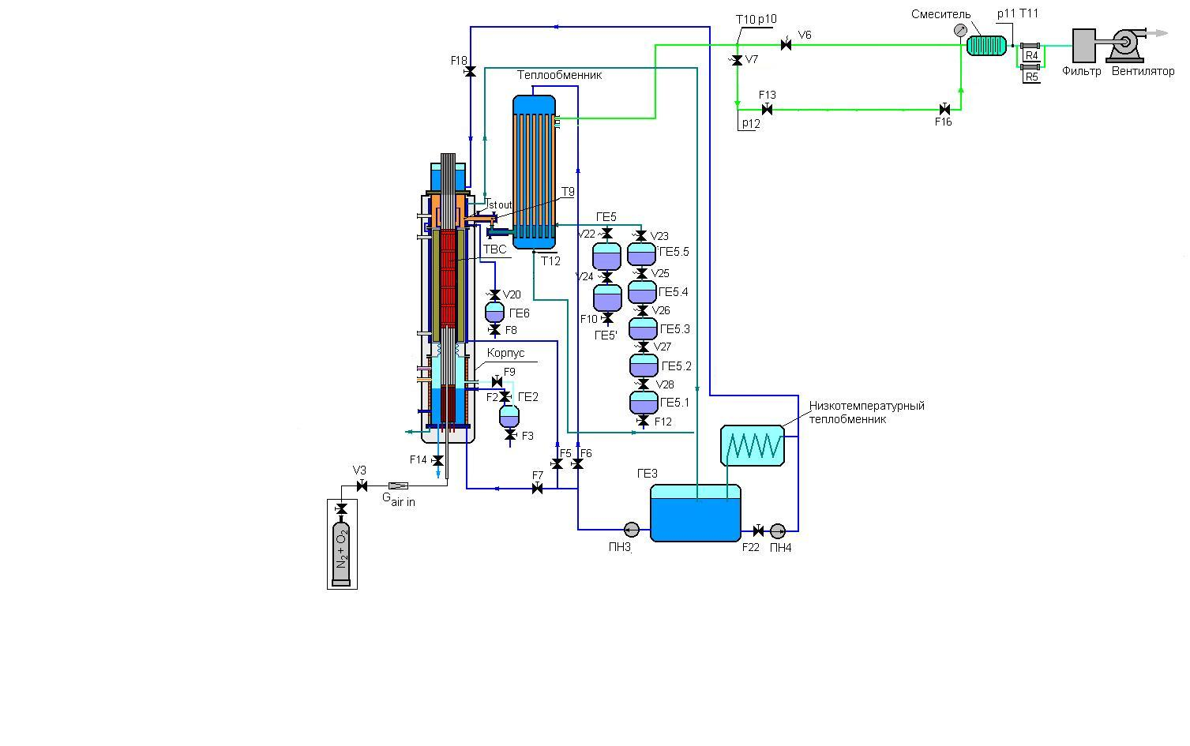
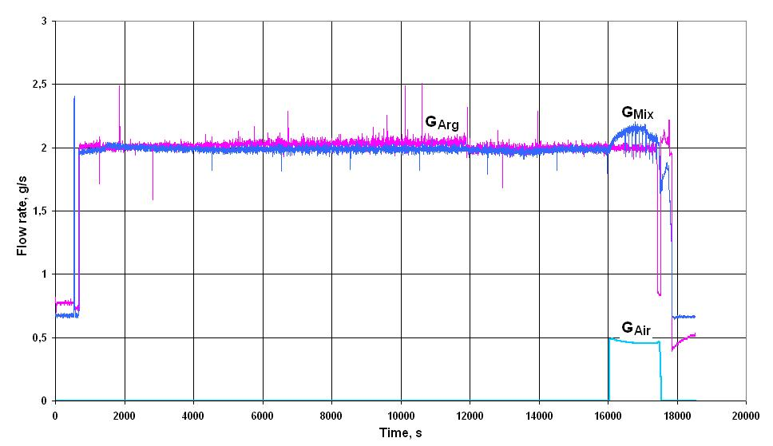
Results of check of system of measurement of the air flow rate
Gair = 0,48±0,04 g/s
Tair = 30±5°C

Slide 10
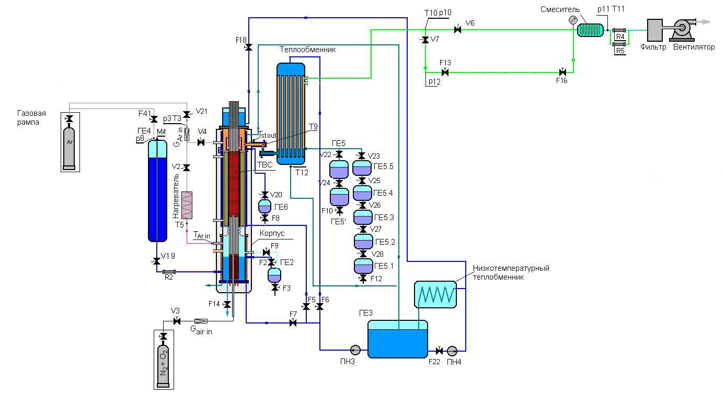
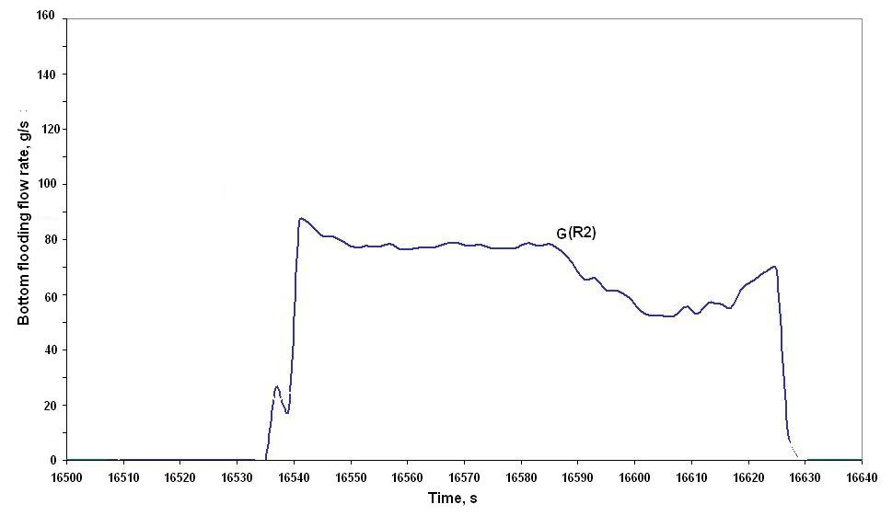
Check of system of the bottom flooding
Gbf = 80 g/s

Slide 11
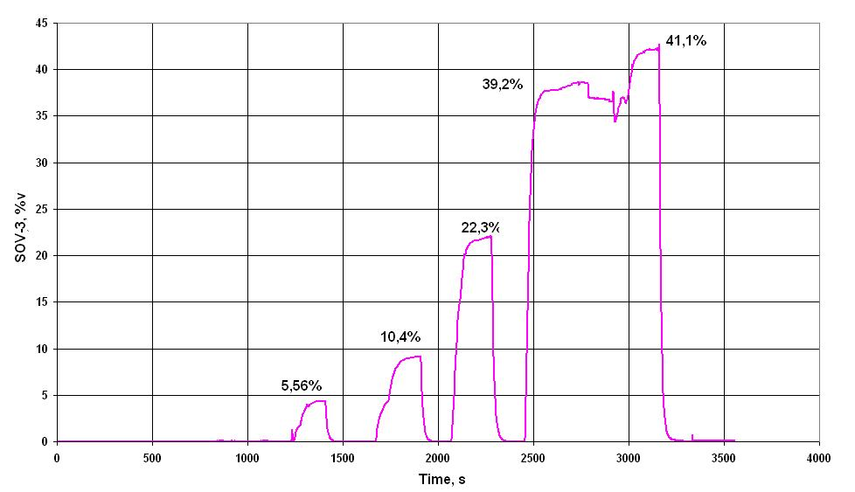
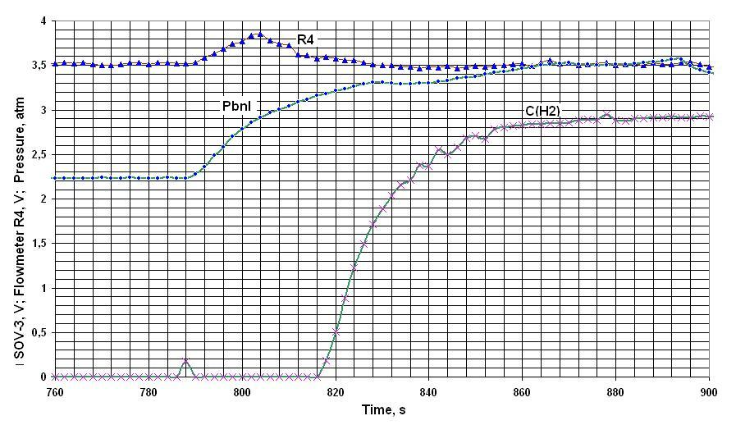
Check of the monitoring system of hydrogen
№ items | Reference gas mix. (Ar + X %H2), X%
1 | 5,56
2 | 10,4
3 | 22,3
4 | 39,2
5 | 41,1
ΤCv(H2) ≈ 100 s

Slide 12
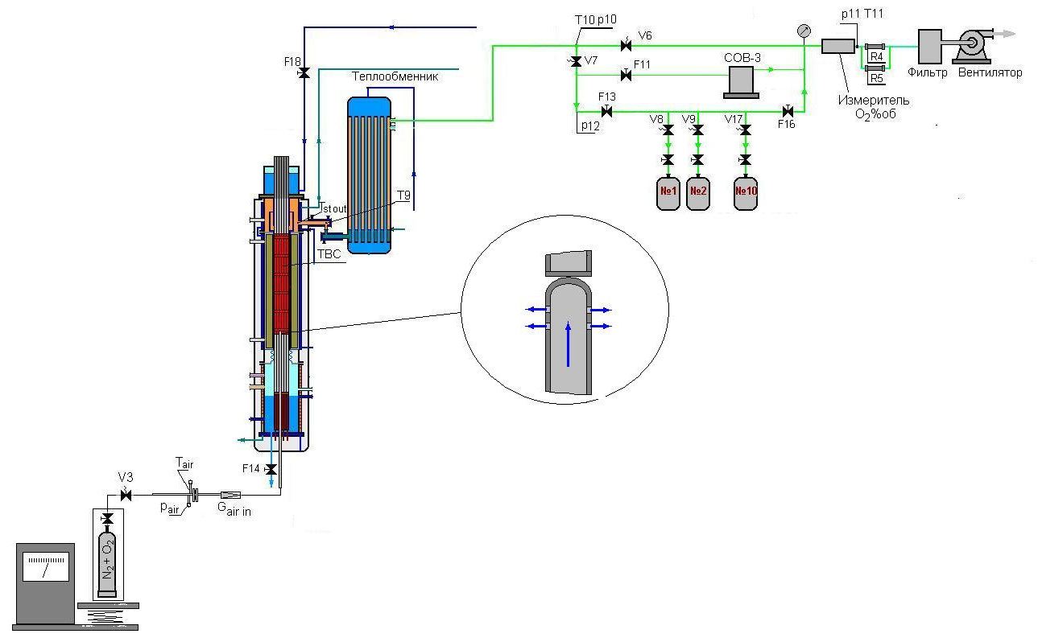
Check of the monitoring system of air
The analysis of oxygen
OLCT-20D
Controll gas - О2
Range of measurements - 0 - 30 % v.
The basic error:
Resulted 0 - 5 %v. - ±5 %;
Relative - 5 - 30%v. - ±5 %
Measurement of air flow rate
EL - FLOW
Controll gas - (20 %) O2 + (80 %) N2
Range of measurements - 0 - 3,75 kg/h
Accuracy of measurements - ±0,5 %

Slide 13
Check of the monitoring system of air
Time of an establishment of signal
of OLCT - 20
Calibration of air flow rate
IN FLOW
Τ ≈ 170 – 200 s

Slide 14
Some experimental results of control test
The scenario of test experiment

Slide 15
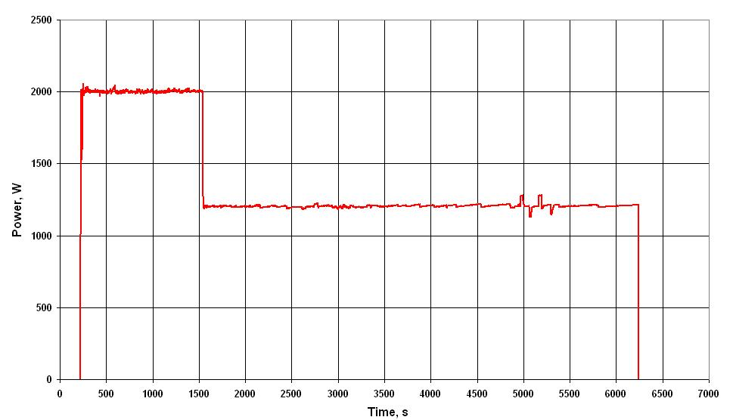
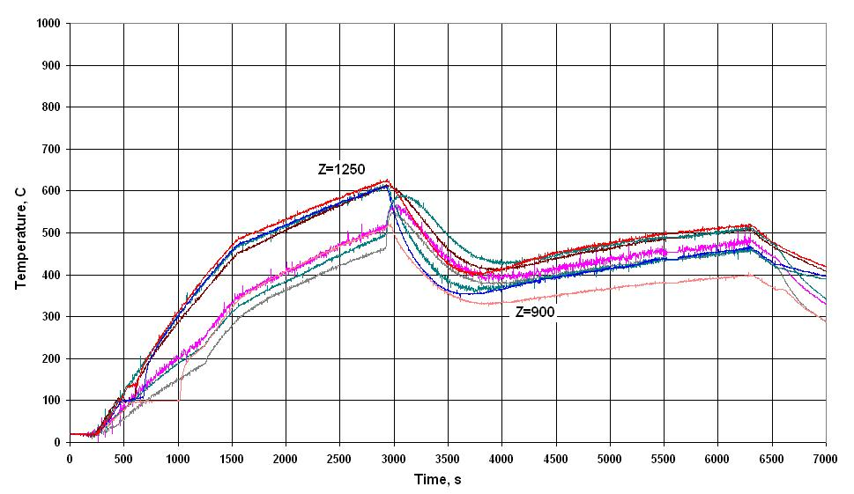
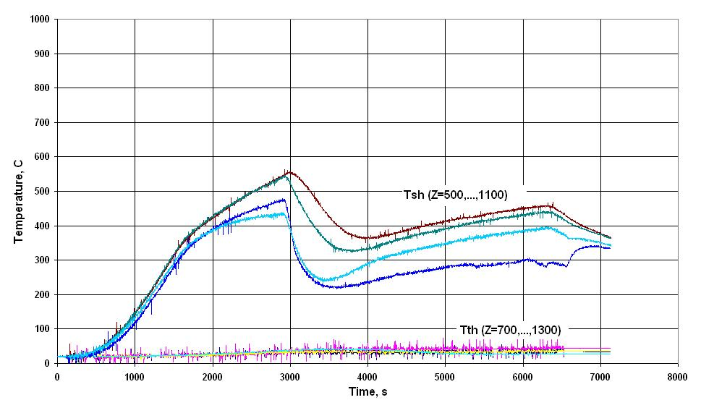
Some experimental results
Параметры ТВС
Electrical power
Parameters steam and argon
Temperature of bundle
Temperature of cladding and shroud

Slide 16
CONCLUSIONS
It is made and established in the PARAMETER facility the 19-rods bundle VVER-1000 for carrying out of experiment under severe accident, including stages of ingress of air and a bottom flooding. 2. Submission of argon flow (Garg = 2 g/s, Тarg = 280±20°С) and steam flow (Gst = 3,5 g/s, Тst = 500±50°С) in the test bundle is provided. 3. The system of bottom flooding (Gbf = 80 г/с flow rate) of test bundle is checked up. 4. The system of ingress (Gair=0,5 g/s) of air (20%О2+80%N2) in the test bundle is checked up.
5. . Calibration of system of the gas analysis on reference gas mixes (Ar+XH2, X= (5,56; 10,4; 22,3; 39,2; 41,1))%v.is carried out.

