Slide 1
FSUE SRI SIA “LUCH”
IBRAE RAS
FSUE EDO “GIDROPRESS”
ISTC
Post-test examination of the PARAMETER–SF4 fuel assembly
Presented by D.Ignatiev
15th International QUENCH Workshop, Forschungszentrum Karlsruhe, 03-05 November 2009
Notes:
Dear coleegs!!! I’d like to introduse you repotr abour my work - Post-test examination of the PARAMETER SF-4 fuel assembly
As you know the experiment sf4 was carried out …….. Now in our laboratory in Podolsk we analyze obtained results
and therefore in this presentation I’ll show results of prior investigations of sf4 fuel assembly.

Slide 2
Objective
The experiment SF4 and its preliminary post-test examinations were performed according to the Work Plan for ISTC Project No.3690 “Study of fuel assemblies under severe accident top quenching conditions in the PARAMETER SF test series”.
The experiment SF4 was conducted with the aim to study the 19-rod model FA of VVER-1000 under the simulated conditions of severe accident including air ingress and bottom flooding and namely:
Study of the VVER-1000 19-rod model FA structural components behaviour in air ingress and bottom flooding;
Study of the oxidizing degree of the structural components of 19-rod model FA of VVER-1000;
Study of interaction and structural-phase changes in the materials of model FA of VVER-1000 (fuel pellets and claddings);
Study of the hydrogen release.
The main task for material investigation was studying of ZrN formation and its behaviour under flooding.

Slide 3
Fuel assembly
Fuel rod simulators and the model FA
Number of fuel rods heated | 18
Number of fuel rods unheated | 1
Outer/inner diameter of fuel rod cladding, mm | 9.13/7.73
Cladding material | Zr-1%Nb
Heater material | Ta
Sizes of the fuel rod heater, mm:
diameter/height | 4/1275
Fuel pellets
Fuel rods heated Outer diameter/of central hole/height, mm | UO₂ pellets with holes 7.6^{-0.03}/4.2^{+0.15}/11^{±0.1}
Fuel rod unheated | No UO₂ pellets
Spacing grid
Material | Zr-1%Nb
Height, mm | 20
Number, pcs. | 6
FA shroud
Material | Zr-1%Nb
Size: diameter/wall thickness, mm | 70/2
Thermal insulation
Material | ZrO₂ ZYFB-3
Notes:
I briefly say a few words about test bundle:

Slide 4
The cladding temerature during preoxidation and transient phase
Notes:
During the experiment:
- The preoxidation stage lasted ∼ 6000 s at temperature of claddings about 1200 C as was registrated by termocouples at (1250 – 1300) мм level
- Then the bundle was cooled to a tempetature about 900 C, this temperature was reached after ∼ 2469 s, at this momen we replased steam flow by air ∼ 0,48 г/с
Then we rise temperature again and with registration of temperature 1740 С the power and air flow were turn off ad turn on bottom floding which was sterted after 15-20 s. Duration of flooding stage was about ∼ 474 с.
Durin this stage most termocouples through whole heigh were broken, that indicate strong degradation in bundle
The prior analysis of hidrogen amount measuring show that during the preoxidation stage 21 g of hidrogen were generated and during the flooding stage 86 g of hidrogen were generated confirm the idea about strong degradation and melting

Slide 5
Posttest appearance of the PARAMETER-SF4 bundle
Z = 300…700 mm
encapsulation of the SF4 test bundle was performed by filling with epoxy resin from top and bottom;
after dismounting test bundle appear severely damaged particularly in the region above 300 mm;
the most part of shroud seems to be partially molten and has reacted with fiber insulation;
Z = 800…1200 mm
Z = 1200…1400 mm
Notes:
After analisys of experiment results as we provide for strong degadatinon of fuel bundle we deside to encapsulate it before dismounting.
We started incapsulation from bottom but after achievement the specified level incapsulation was stoped obviously because of the large blockage in the middle of the bundle and we finshed incapsulation from top side of bundle
After demounting test bundle appear severely damaged particularly in the regione above 300 mm, most part of thermoinsulatinon was impregnated by epoxy but after removal of it we observe that:
Shroud remain intact in low region;
most part of shroud was partialy molten and melt has reacted with fiber insulation;
In the middle part we see rathe large zone of ceramic melt of gray color
In the top of bundle we see de-clad fuel rods ant melt on them with black color

Slide 6
Program for posttest investigations of the PARAMETER-SF4 bundle
Sectioning of the test bundle
10 polished cross sections for microstructural analysis:
- optical microscopy,
- EDX analysis;
3-5 samples for x-ray analysis;
Study of structural-phase changes in the materials of SF4 bundle (fuel pellets and claddings);
Describing the final bundle state;
Sampling for express analysis – 4 cross sections:
Z = 130, 260, 300 and 1200 mm.
Notes:
After visual inspection, photo documentation an collecting of fragments this bundle was sectioned on fragment and slubs
We plan to make at least 10 polished cross sections for microstructural analysis:
- optical microscopy,
- EDX analysis;
3-5 samples for x-ray analysis;
After Studying of structural-phase changes in the materials bundle (fuel pellets and claddings) and Analysys of obtained results we want to describe the final bundle state ;

Slide 7
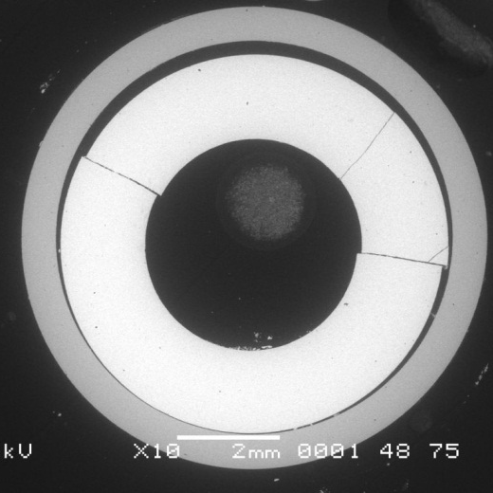
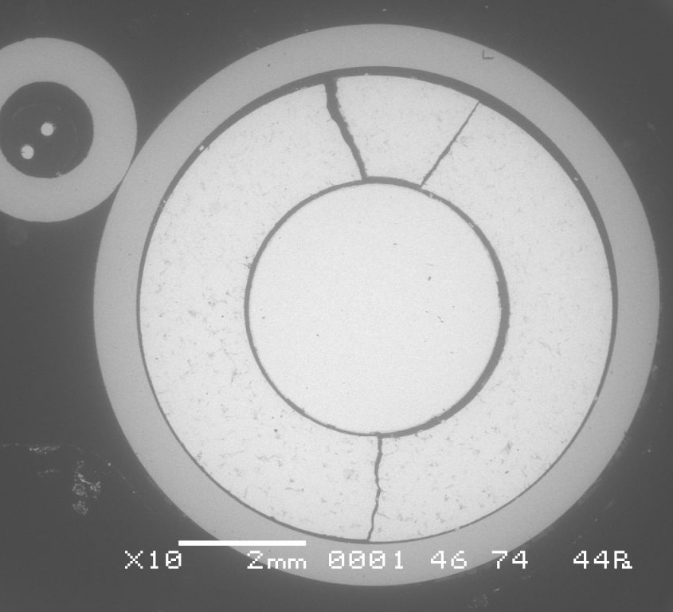
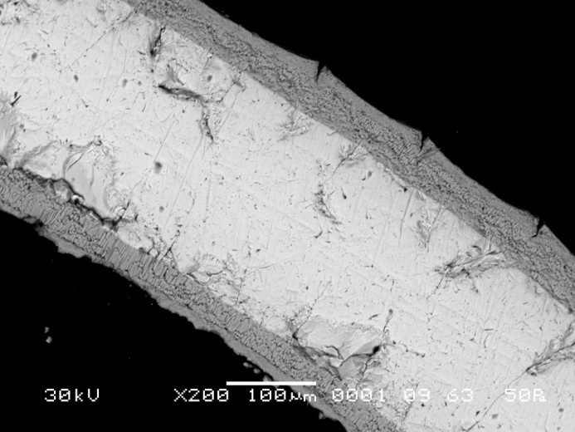
Cross section of the bundle at Z = 130 mm (top)
Rod 2.4
ZrO2 scale ∼ 5…10 μm
Rod 1.1
Rod 2.6
Spacer grid remnant
Notes:
At the 130 mm elevation there are practically no visible damages. Bundle configuration remained quite unchainged Some pellets have cracs, But it obviously occurred durin cutting
the diox Zr scale thikness around 5…10 mkm, measured for the bundle components, indicates minor oxidation with small scatter
We find out small Spacer grid remnant, which moved from higher elevations

Slide 8
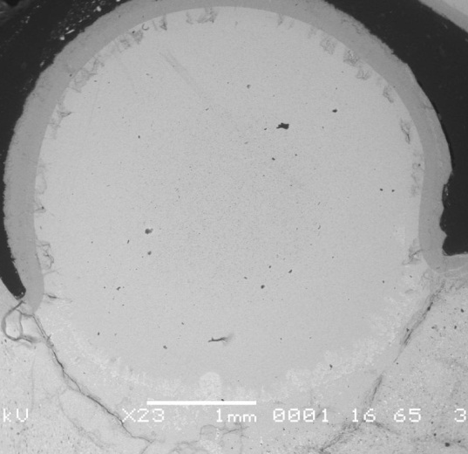
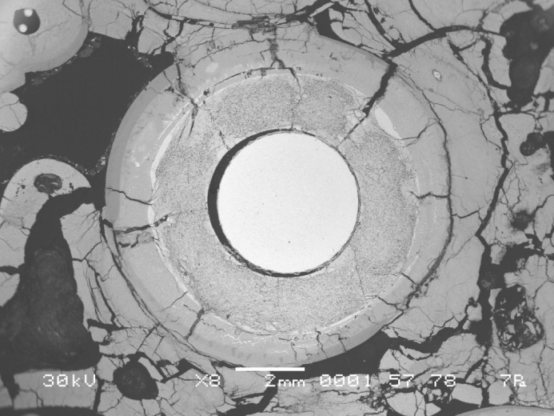
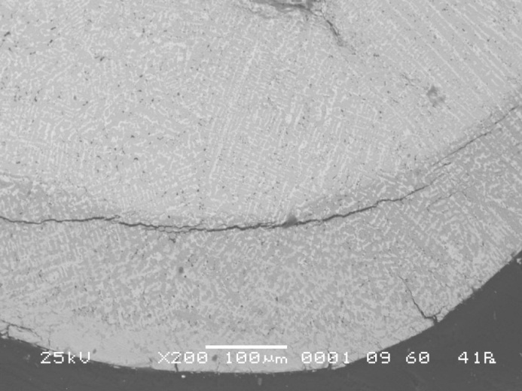
Cross section of the bundle at Z = 260 mm (top)
Rod 2.2
Rod 2.4
Periferial rod
Rod 2.6
Melt oxidation
Notes:
At the 260 mm elevation relocated masses have formed a blockage which fill the inner part almost completely. this melt has local variations in the brightness of color and a pattern of gross cracks
Interaction with melt took place from booth sides from claddings
where the Zr elements were getting surrounded by melt it was more protected from fast steam oxidation, so at this elevation
The microstructures demobstrate that some melt had already high contents of dissolved oxygen an continyed to oxidise on free surfaces

Slide 9
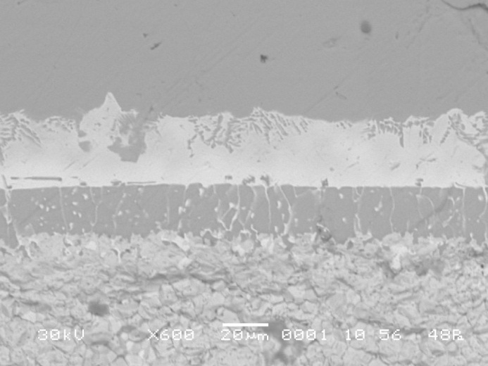
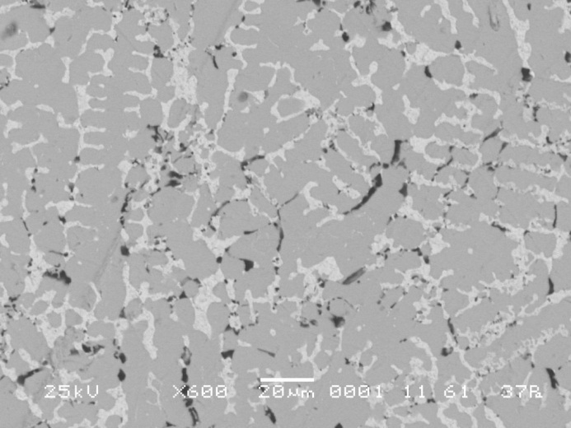
Cross section of the bundle at Z = 260 mm (top)
a – Zr(O)
(U,Zr)
a – Zr(O)+ (U,Zr)
Rod 2.2
UO2
ZrO2 scale ∼ 150…200 μm
eutectic Zr-UO2 interaction
Rod 2.3
melt In the gaps cladding-fuel
(U,Zr,O) melt
Notes:
the diox Zr scale thikness of bundle components around 150…200 mkm,
for an interaction of cladding and fuel in solid state we can see srquence of phases, Known to be typical for Zr-UO2 interaction.
In case of liquid phase interaction we does not obsrerve any voids formation or melt relocation, so the peak temperature of this level did not reach the Zr melting temperature. This is in agreement with fact that ZrUO melt with similar or higher melting range solidified here

Slide 10
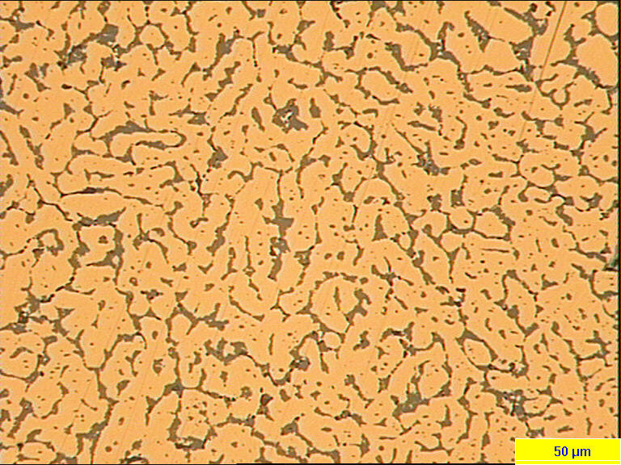
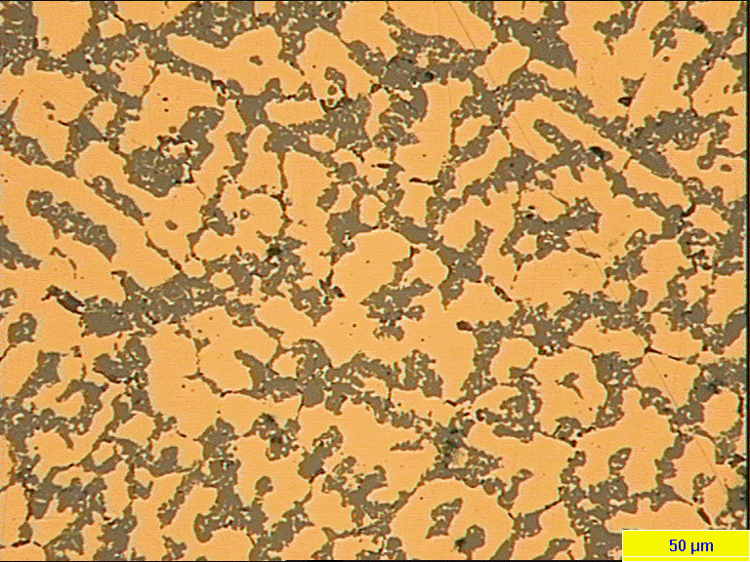
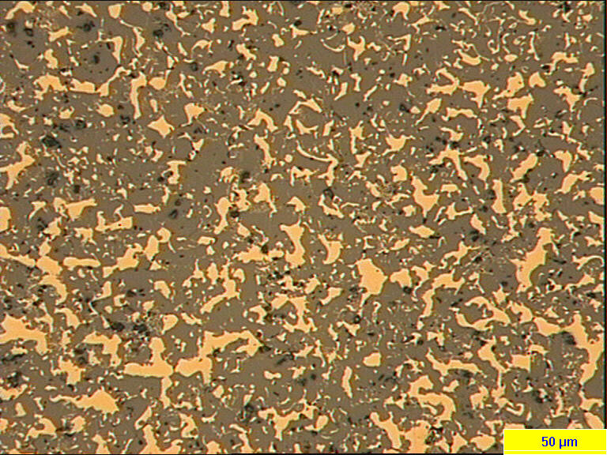
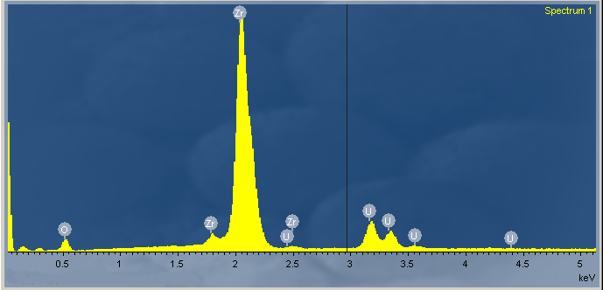
Cross section of the bundle at Z = 260 mm (top)
(U,Zr,O) melt (content of ceramic precipitates)
Gray phase
18 %
38 %
67 %
SEM image
EDX spectra of (U,Zr,O) melt
Light phase
Notes:
We compared different melt regions are in microstructure al this elevation. Whereas the one is essentially of metallic character with ceramic precipitates of different size. The other is a duplex mixture of metallic and ceramic phases.
EDX spectra of melts phases confermed that all type of melts at this elevation are of (Zr,U,O) type with different oxigen content

Slide 11
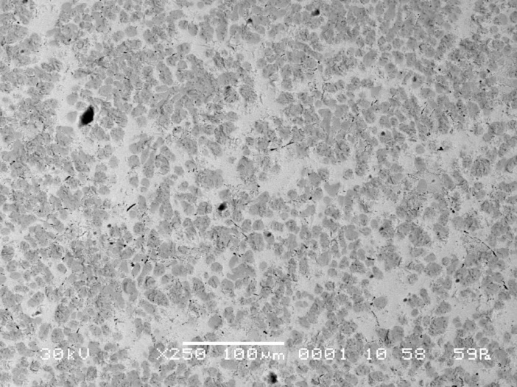
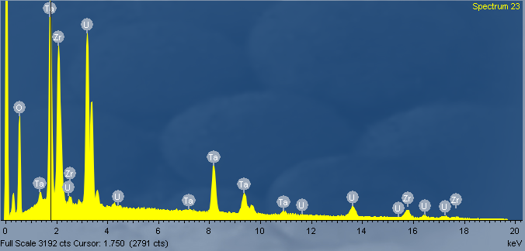
Cross section of the bundle at Z = 300 mm (bottom)
Fuel rod
Fuel rod
SEM image
(U,Zr,Ta,O) melt
EDX spectra of (U,Zr,Ta,O) melt
Notes:
At the 300 mm elevation the strongest degradation of the bundle that can be.
We find only two remnants of fuel rods, which fuel was qite dissoluted. There are no more construction ore fuel elements were found
the melt, which we observe at this elevation essentially differ from metallic UZrO melt by color and macrostucture wery high porosity. It has rether difficult composition because Ta heaters and ZrO2 termoinsulation, all materials of termocouples were dissoluted

Slide 12
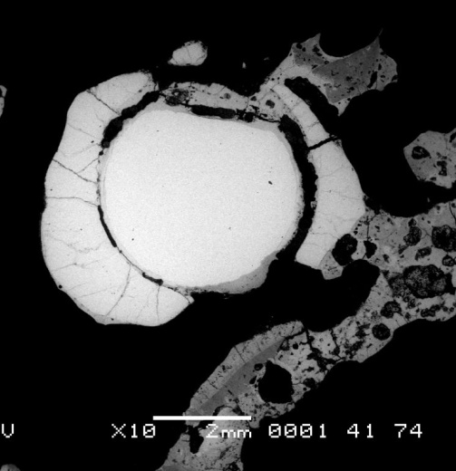
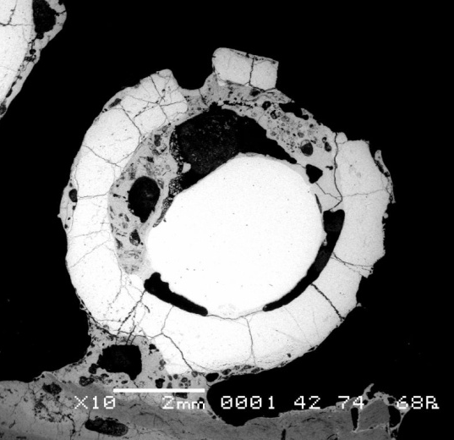
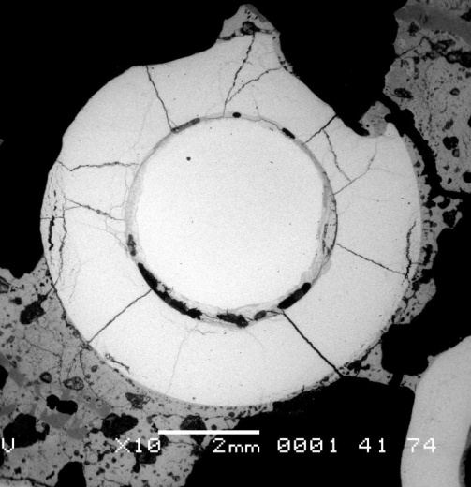
Cross section of the bundle at Z = 1200 mm (bottom)
Macrographs of fuel rods show melting of claddings and fuel dissolution
Notes:
The cross section at 1200 mm elevation make obvious that bundle at highest elevations of heatet zone very weakly retained its original configuration. Fuel rods are seriously damaged by cladding oxidation, melt formation and fuel dissolutionthe shroud and periferial rods were melted and distroed/ We can srr only remnants of sroud oxide. The integrity of residual rods y was saved only at the expense of heaters.
In some regons of this cros section wi found remnants of oxide scales on the surfase of fuel rods
The diametr of pellets and Ta heaters decreased because of dissoluting by molten Zr, Which it seems leak on surface of fuel rods
we can se remnants of this melt.

Slide 13
CONCLUSION
1. Encapsulation of the SF4 test bundle was successfully performed by epoxy resin before bundle dismounting.
2. In the height region below 130 mm we observe low bundle oxidation and absence of any material interactions.
3. At the elevation 260 mm relocated melt formed a blockage. The claddings are partially dissolved and oxidized.
4. At 300 mm the strongest degradation was found – there are quite no more construction, fuel or heater materials. The ceramic melt has very difficult composition – (U,Zr)O2 + ZrO2 + Ta2O5 + trace concentrations of indefinite phases.
5. At the top of the bundle heated zone the SF4 experiment resulted in:
- cladding oxidation;
- melt formation and relocation;
- fuel and heaters partial dissolution by relocated melt.

