Slide 1
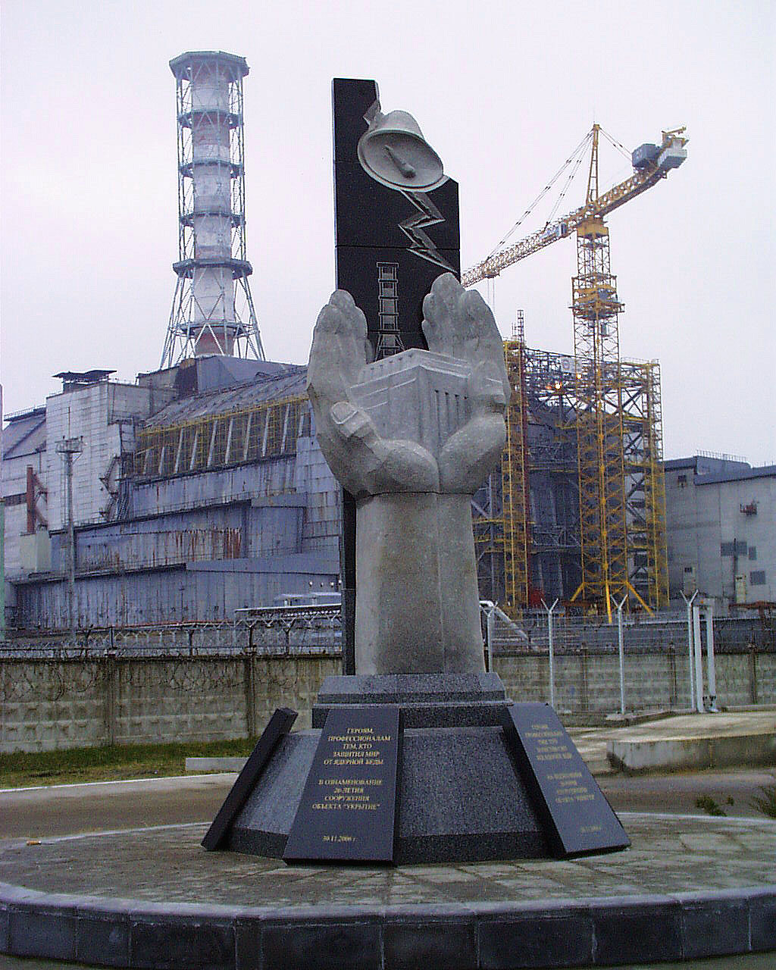
Presented at 17th
CEG-SAM Meeting
Institute for Safety
Problems of NPP National Academy of
Sciences of Ukraine
March 29-31.2010
Madrid
Status of STCU Project #4758:
«Estimate - experimental research of hidden nuclearly -hazardous clusters of fuel-containing materials in ruined ChNPP Unit 4»
Notes:
1

Slide 2
Permission for Project #4758 work implementation was obtained from Ukraine’s Ministry of Sciences and forwarded to STCU Affiliate.
Project Collaborator Letter from Dr. Pretsch was received and also forwarded to STCU.
3. Dr. Bottomley and Dr. Journeau Support Letter was received and forwarded to Mr. Andrew Hood, STСU Executive Director address.
4. The proposal was ready to be sent to party reviewers by STCU (March 2009).
5. Project #4758 funding was not yet initiated. But in spite of this fact the works being planned in Project were performed by us in 2009 year.
6. Works results for Project #4758 were presented at 15^{-th} and 16^{-th} CEG-SAM Meeting in Villigen, Switzerland and Moscow.

Slide 3
Main work results for Project #4758

Slide 4
On April 26, 1986, a most global technogenic catastrophe took place at the Unit 4 of Chernobyl Nuclear Power Plant with RBMK-1000 reactor.
As result of reactor core destruction, around 50∙10⁶ Ki activity were released into atmosphere.
Inside the ruined Unit, approximately 180 t nuclear fuel had remained, which is located in shape of reactor core fragments, fuel-containing materials of diverse type, radioactive water and radioactive fuel dust.
Unit’s building structures were subject to a considerable destruction.
On the survivor building structures after destruction, a protective building with the name of «Shelter» Object («Sarcophagus») was erected.

Slide 5
As result of active stage of nuclear accident at ChNPP Unit 4 with RBMK-1000 reactor the lava-like fuel containing materials – LFCM produced. They had originated in premises of sub-reactor room 305/2 and spread along Unit premises with forming clusters of diverse configuration and uranium content.
“Sarcophagus”

Slide 6
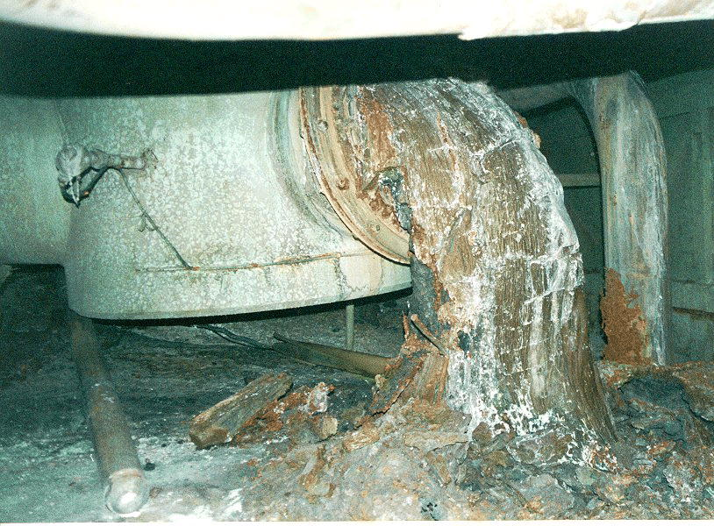
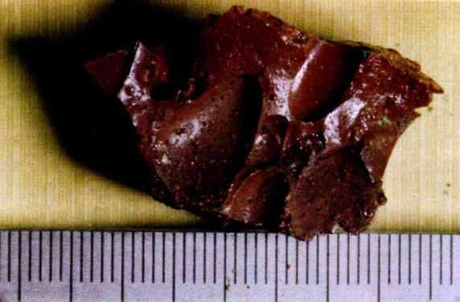
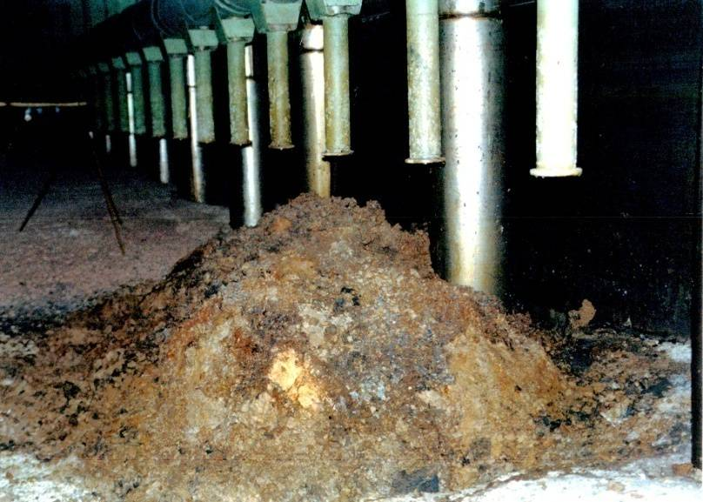
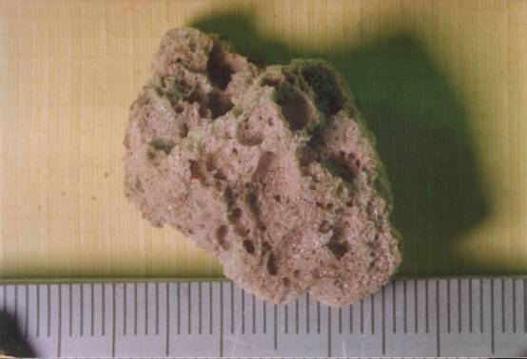
A part of LFCM is in open state and is sufficiently well studied.
Such clusters contain some 5-10% uranium and are nuclearly safe.
LFCM cluster in room 210/7 – steam-distributing corridor (brown ceramics)
LFCM cluster on first floor of pressure suppression pool (porous ceramics)

Slide 7
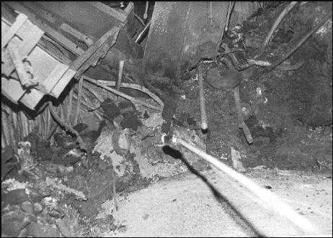
Part of LFCM hidden under destroyed Unit debris and 1986 year concrete is practically inaccessible and few studied.
Currently, fusion penetration areas are covered with post-accident concrete («new» concrete) and produce so called «hidden» LFCM clusters with uranium content 40% per mass and more. Such clusters under specified conditions can represent a nuclear hazard.

Slide 8
To study namely such hidden clusters, which present nuclear hazard, Project #4758 initial works were aimed at.
Now some words about work results of 2009 year.

Slide 9
Clusters have produced as result of interaction of fuel melt with foundation plate concrete, graphite, metal structures, filling materials (batch).
The melt consists of upper layer of black FCM (light) with uranium content 5-10% (mass) and bottom (heavy) with uranium content 40% (mass) and more.
Upper (light) FCM layer, during its production process, was flowing down via a breach in room 304/3 of object «Shelter» wall with forming horizontal flow of more 50-m length.

Slide 10
Measurement of temperature in boreholes in 2009 year have shown that in borehole Ю.9.Б (fusion penetration area No 1) temperature discharges in water effusing from this borehole are observed.
In fusion penetration area No 2 (borehole Ю.9.В), water is, assumedly, absent or located below the mark +8.80 m.

Slide 11
In 2009 year we have in details studied and restored dynamics of neutron flux density growth (June 1990) in fusion penetration area №1 and stated that:
1. Neutron flux density growth was caused by critical incident occurred as a result of a water ingress to hot LFСМ cluster in this area.
2. Critical incident had been proceeded within 92 hours. The total number of fissions has made more than 10¹⁸ and energy evolution - 170 Мj.
3. SCR (self-sustaining chain reaction) cessation has occurred as a result of cluster extra-wetting.

Slide 12
Heterogeneous
structure
In 2009, we have carried out a preliminary evaluation of mass- and geometry parameters of multiplying systems (homogenous and heterogenous with U content from 50-65%).
Estimate results have demonstrated that the systems, whose geometry is inscribed in volume of fusion penetration area No1, reach their criticality under a specified wetting. Water excess does bring that systems in subcritical state.

Slide 13
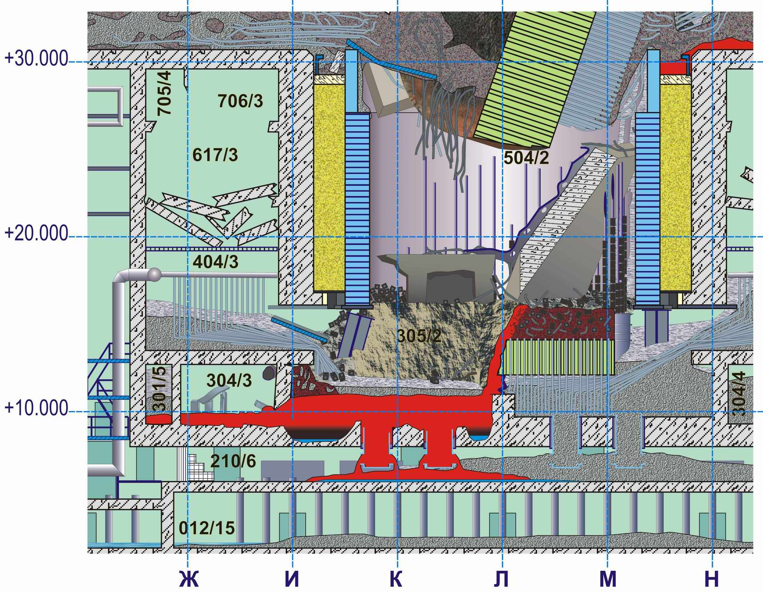
LFCM in sub-reactor room 305/2 after catastrophe
Based on the last researches (data on borehole core’s activities, temperature and neutron fields’ dynamics), it was stated that ChNPP accident in the year of 1986 had provoked a melting in foundation plate of reactor vault
As a result, two fusion penetration areas had produced, which contain LFCM with fuel concentration making 40% (on mass) and more
Reactor vault’s foundation plate
Fusion penetration area №1, №2

Slide 14
Condition of Project #4758
1. The project is not funded at all.
2. At 15th and`16th CEG-SAM Meetings we had come to conclusion about a need in updating the project name and scopes of some work branches.
3. Dr. Bottomley has sent to us his remarks and offers.
4. The Project #4758 works were a kind of initiation or qualitative evaluation of hidden nuclearly hazardous clusters.
5. Now we have already registered in STCU a new Project #5244:
«Research of objects - nuclear fuel interaction products with structural materials under heavy nuclear-radiation accidents»,
which will be a practical continuation of Project #4758.
The Project #5244 will cover researches and estimate-experimental works aimed at definition of structure, content, neutron-physical and physicochemical characteristics of corium in hidden LFCM clusters, as well as development of measures to control subcriticality of such clusters.

Slide 15
Thank You all for attention and your support.

