Slide 1
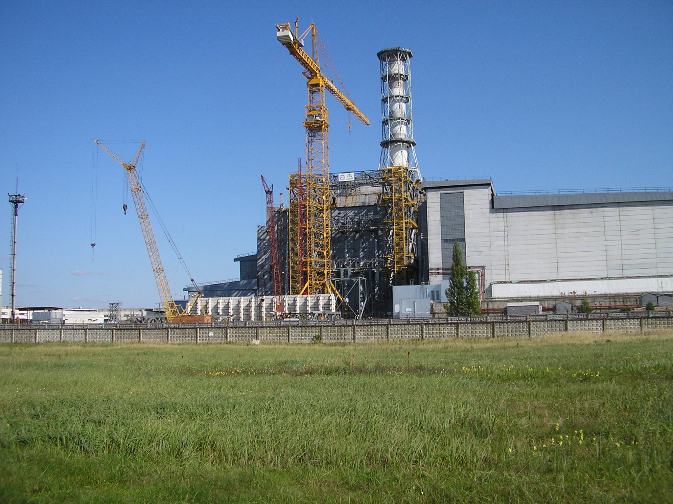
Presented at 17th
CEG-SAM Meeting
Institute for Safety
Problems of NPP National Academy of
Sciences of Ukraine
March 29-31. 2010
Madrid
Status of STCU Project #5244:
«Research of objects - nuclear fuel interaction products with structural materials under heavy
nuclear-radiation accidents»
Notes:
1

Slide 2
Contents:
Preliminary remarks concerning Project #5244 :
Collaborators
Expected results
Status of the project
2. Main work results for Project #5244

Slide 3
Preliminary remarks concerning Project #5244

Slide 4
Collaborators
GRS, Germany
Dr. G. Pretzsch
CEA Cederech,
DEN/ DTN/STRI, France
Dr. C. Journeau
JRC-ITU Institute of Trans-uranium Elements Karlsruhe, Germany
Dr. P. Bottomley
AECL , Chalk River, ON, Canada
Dr. M. Krause
Coordinator
STCU,
Kyiv, Ukraine
Operation Agent: Institute for NPP safety problems of UNAS, Ukraine, Chornobyl
ChNPP
Ukraine, Chornobyl
Project Duration: 30 months
Total Project Cost : 279,180 USD

Slide 5
Expected results:
In this Project will be analyzed:
visual observation data;
information obtained when drilling research boreholes;
results of sampled lava-like fuel-containing materials (LFCM) analysis;
instrumental measurement data;
mechanisms of LFCM cluster production with high - content uranium.
Considering above data, as well on the basis of neutron and heat estimates, new instrumental measurement data and research results of physicochemical properties of newly taken samples from cluster area, will be:
defined: structure, geometry, and LFCM physicochemical properties in two critmass risk areas, in south-west quadrant of sub-reactor room 305/2 ChNPP Unit 4 («Shelter» object);
researched: neutron physical processes occurring in clusters under impact of external factors.

Slide 6
Status of the project:
1. Project Collaborator Letter from Dr. Pretsch is received and also forwarded to STCU.
2. Dr. Bottomley Support Letter is received and forwarded to Mr. Andrew Hood, STСU Executive Director address.
Permission for Project #5244 work implementation is obtained from Ukraine’s Ministry of Sciences and forwarded to STCU Affiliate.

Slide 7
Why the works specified in Project #5244 have such importance?
When erecting New Safe Confinement (NSC), temperature growth and moisture decrease can entail, with high probability, occurrence of self-sustaining chain reaction.
In connection with this, Concept of nuclear safety of “Shelter” Object shall be revised in terms of preventive criticality suppression in critmass risk areas, that will be the objective of Project works.

Slide 8
Diagram of criticality state of hidden nuclearly hazardous LFCM clusters in sub-reactor room 305/2 of «Shelter» Object
Heterogeneous
Structure
Homogeneous
structure
Reactivity, β
4. During the NSC erection, temperature growth and moisture decrease can entail, with high probability, repeated nuclear incident.
1988 y.
t 200 ºC
Nuclear incident of 1990 y.
t 100 ºC
2010 y.
t 40-50 ºC
Water volume, %
1. 1988 y. – temperature of LFCM – more 200 ºC.
Cluster is dry and is in subcritical state.
2. 1990 y. - temperature of LFCM– less 100 ºC.
Water penetrates in cluster –self-sustaining chain reaction occurs.
3. 2010 y. - temperature of LFCM– of order 50 ºC.
Cluster is covered with water and is in subcritical state.

Slide 9
Thank You for attention and support of Project #5244

