Slide 1
17th Contact Expert Group for Severe Accident & Measures (17th CEG-SAM)
CIEMAT, Madrid, 29th March 2010
Preliminary Report on the SAROV intermediate Scale Test on Molten Corium- Concrete Interaction.
(Meeting at Nizhny Novgorod, 26-27th Jan 2010)
by D. Bottomley (ITU Karlsruhe), C. Journeau (CEA Cadarache), J. Stuckert (KIT Karlsruhe), A. Fargette (AREVA ANP-Erlangen), K. Atken (EDF, Lyon)

Slide 2
#3831 Large Scale MCCI project –development grant at VNIIEF Offices in Nizhny Novgorod, Russia, 26-27th January 2010
by by D. Bottomley (ITU Karlsruhe), C. Journeau (CEA Cadarache), J. Stuckert (KIT Karlsruhe), A. Fargette (AREVA ANP-Erlangen), K. Atken (EDF, Lyon)
Outline of presentation
Test Facility
Results
3) Sample Analysis
4) Future work

Slide 3
#3831 MCCI Intermediate Test
Introduction
VNIIEF have developed a chemical heating technique (PTC – PyroTechnic Compound) using briquettes made by pressing together Zr and Fe₂O₃ powder (d=50mm & h=20mm of 120g) that are wrapped in Al foil.
Reaction: 3Zr +2Fe₂O₃ = 3ZrO₂ + 4Fe
(generates heat: 2840 kJ/kg - with a useful energy release of ~900 kJ/kg).
Concrete selected: 2/3 limestone and 1/3 siliceous
(60cm diameter & 70cm height, cast with array of t/c in concrete
central cavity: 40 cm diameter and 55 cm height)

Slide 4
#3831 Sarov intermediate scale tests

Slide 5
Diagram of intermediate scale test facility
#3831 MCCI Intermediate Test
camera 1
mirror
chute
briquette bundle of 6 briquettes, each briquette 120g
propane burner
4m
60°
0.61m
The crucible was initially packed with 72 special briquette bundles of Zr & FeO powder of each 720g.
4 propane /air gas burners to maintain the corium surface at about 1800°C and to stop it crusting over
camera 2
40cm initial diameter
8 m

Slide 6
Instrumentation of #3831 MCCI Intermediate Test
32 K-type thermocouples (20 inside the crucible bottom and 12 inside the crucible sidewall) to follow the advance of the ~1300°C isotherm
2 W/W-Re thermocouples in centre of the concrete cavity bottom on the boundary between melt and concrete
3 High temperature metal (W, Ta, Mo) plates on top of steel tubes set in the bottom of the concrete crucible, glass optical fibre cables inside the steel tube, aimed at the plates enabled pyrometric temperature measurement of the concrete/corium temperature.

Slide 7
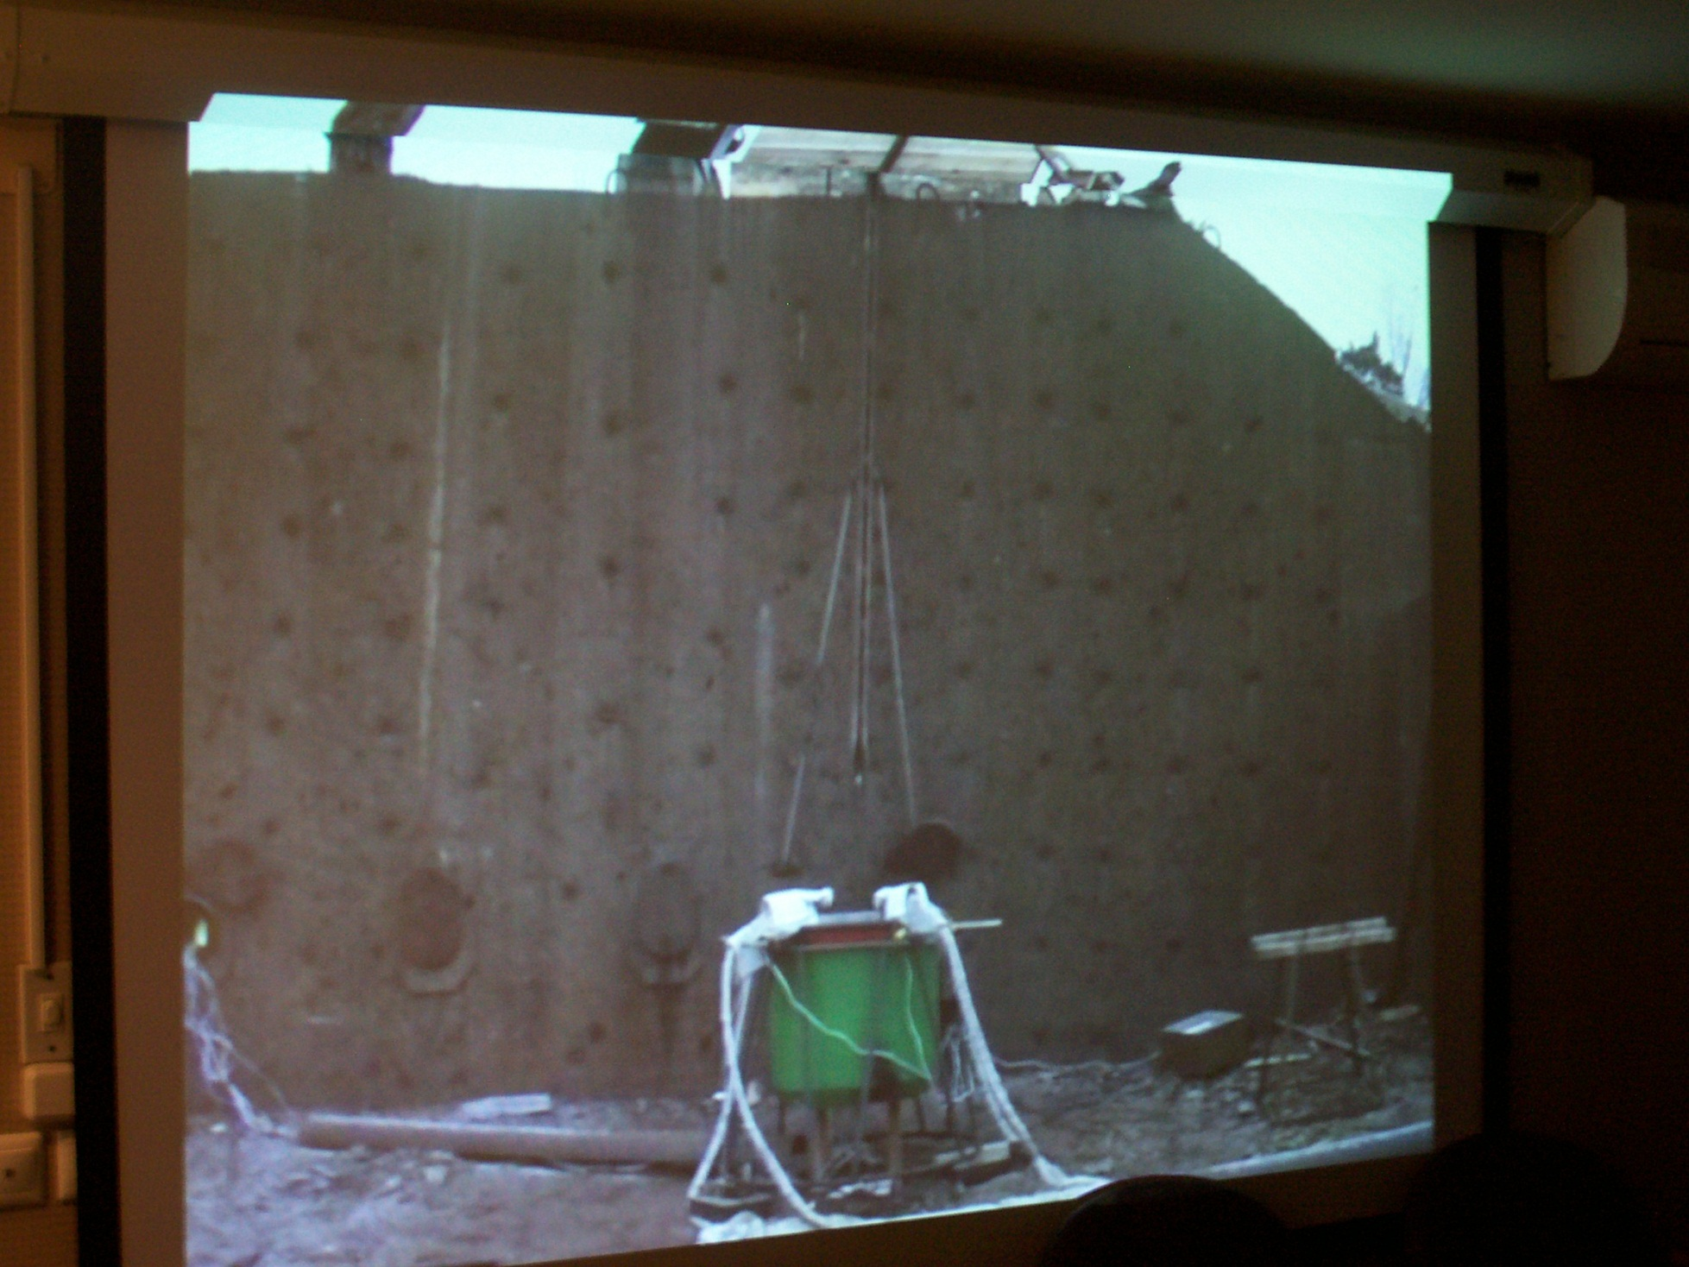
#3831 MCCI Intermediate Test
Briquettes added ~every 7s (100g/s of PTC equivalent to 280kW) for about 500s.
Final corium weight ~100kg.
chute
concrete container with initial PTC load

Slide 8
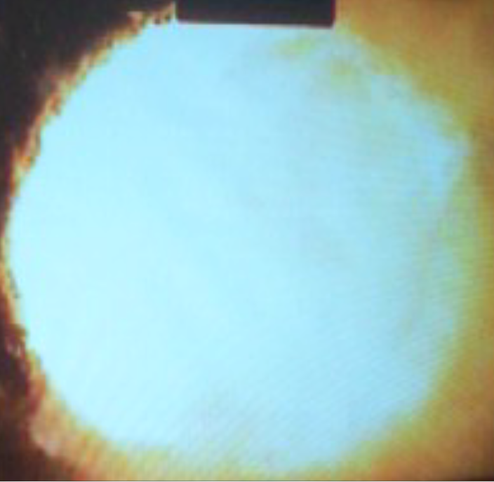
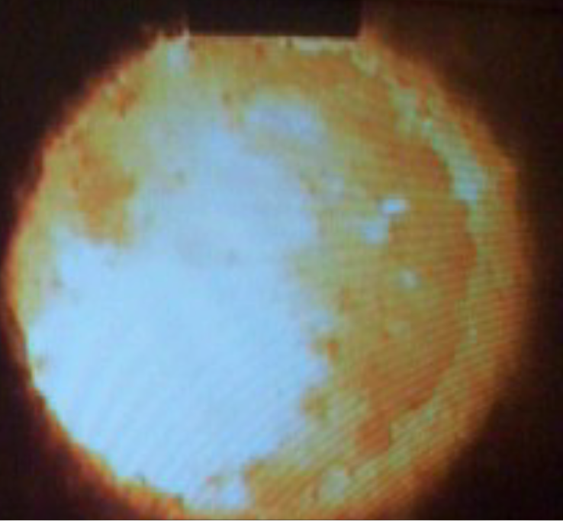
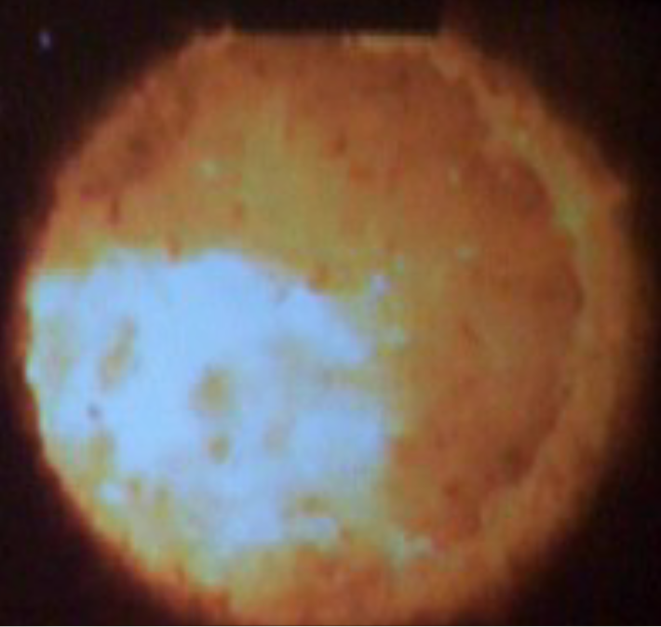
#3831 MCCI Intermediate Test
b) a few seconds later c) note the thin crust
a) Briquette impact zone
Glowing particles of corium spat out from the crucible. Total weight measured as 1.5 - 2 kg.

Slide 9
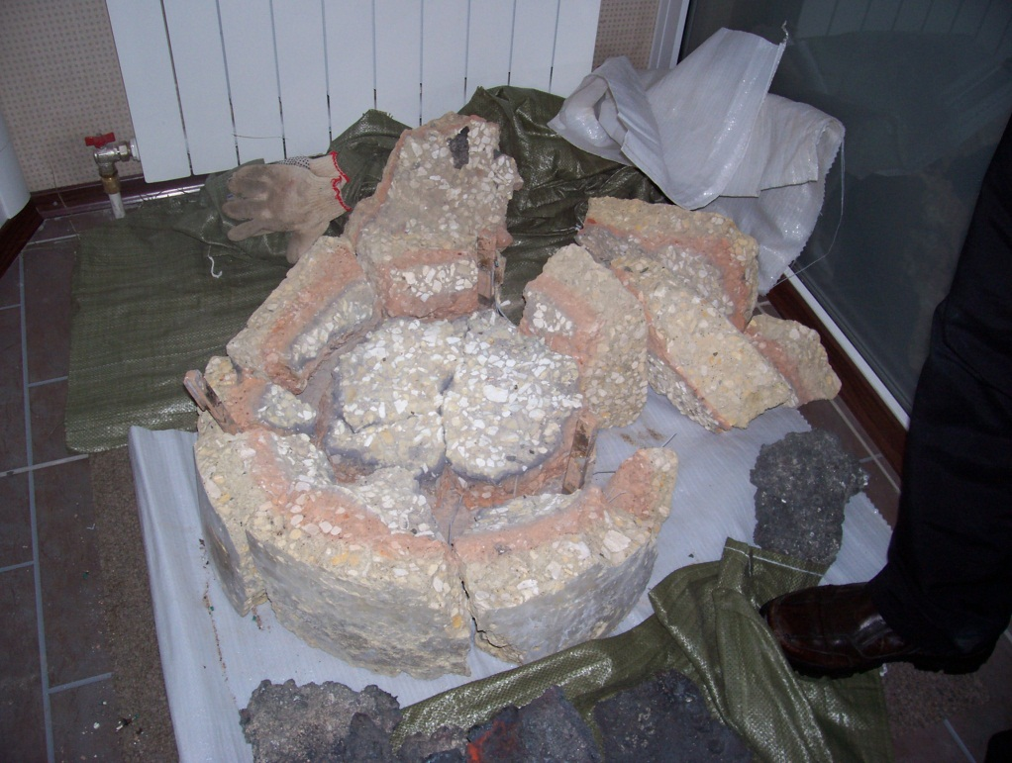
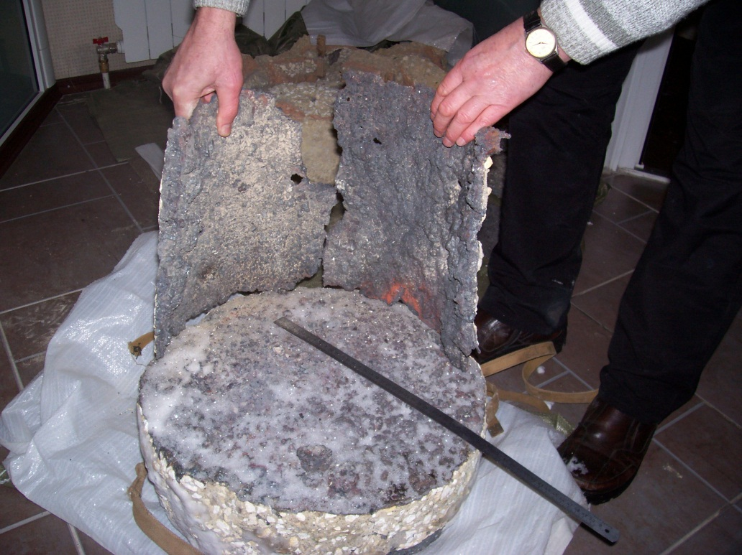
#3831 MCCI Intermediate Test
sidewall splashes
corium block
concrete basemat
Concrete basemat after disassembly Corium block
Pyrometers on the bottom of the concrete cavity functioned for approx. 2-3 minutes and indicated temperatures of ~2500-3000°C for the melt temperature.
There was no great difference between the readings of the 3 different metals.
W/W-Re thermocouples gave temperatures of 2440°C & ~2600°C.
Deeper K thermocouples lasted for about an hour

Slide 10
#3831 MCCI Intermediate Test
40cm
thin corium layer induced by splashes
initial concrete position
lateral ablation 2.5cm
45cm
final corium block
axial ablation 2 to 3 cm
Final erosion profile

Slide 11
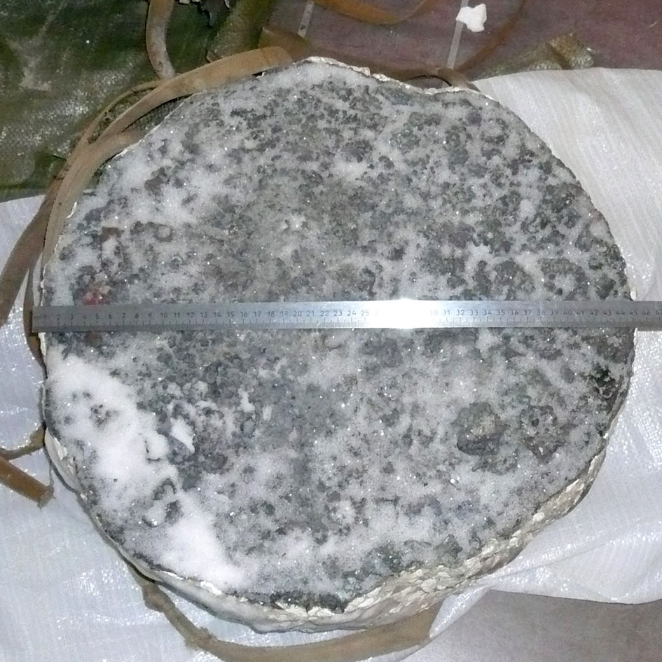
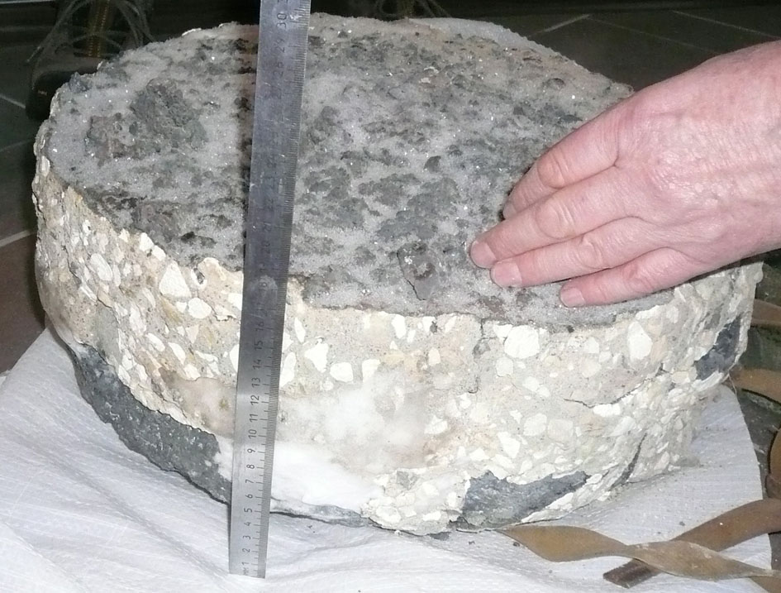
#3831 MCCI Intermediate Test
Figure 8: Frozen melt tablet. Top view. D=450 mm. | Figure 9: Frozen melt tablet. Side view. H~185 mm.

Slide 12
#3831 MCCI Intermediate Test
At 20mm depth the max temperature recorded was ~1400°C, & at 30mm depth it was ~700°C. Max. temperatures were recorded after ~37mins
In hindsight would have used more HT W/W-Re thermocouples
Heat flux to the concrete was similar to CEA's tests and in a typical range for a MCCI simulation (100-200kW/m²).

Slide 13
#3831 MCCI Intermediate Test
Final reporting.
Need 2 months for all the necessary permissions from Rosatom. (not be before the CEG-SAM meeting in Madrid).
Draft report done by April '10 for distribution to the collaborators.
Their comments in the course of the next month(s) Final project text for Jun'10.
Dr. Kondrashenko available for the CEG-SAM Meeting in StP September '10.
Final Comments
Technique has very many possibilities: insertion of Fe components at any time down the chute would be possible or having steel rebars in the concrete crucible

Slide 14
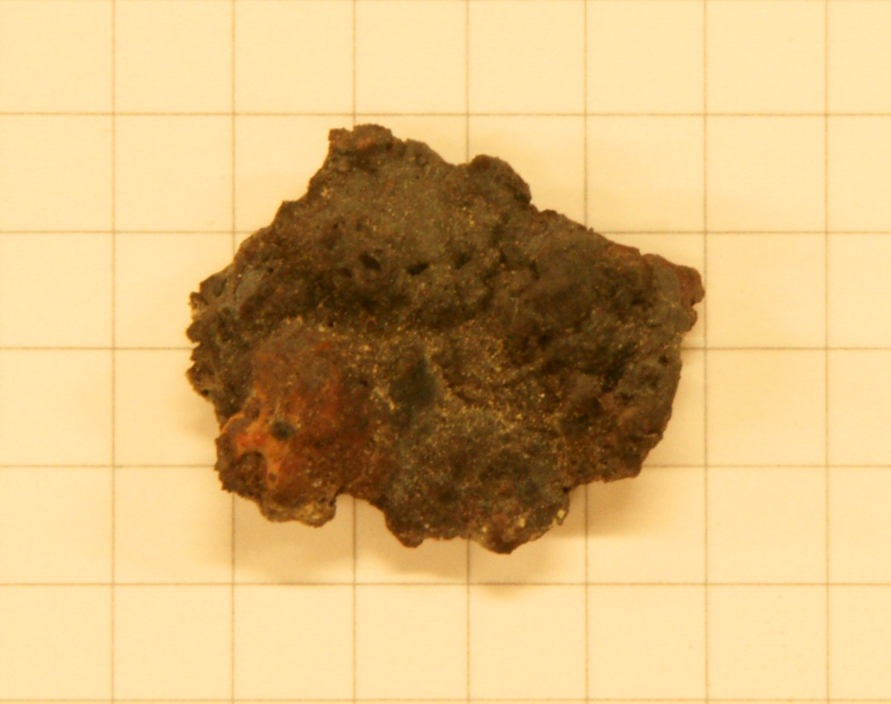
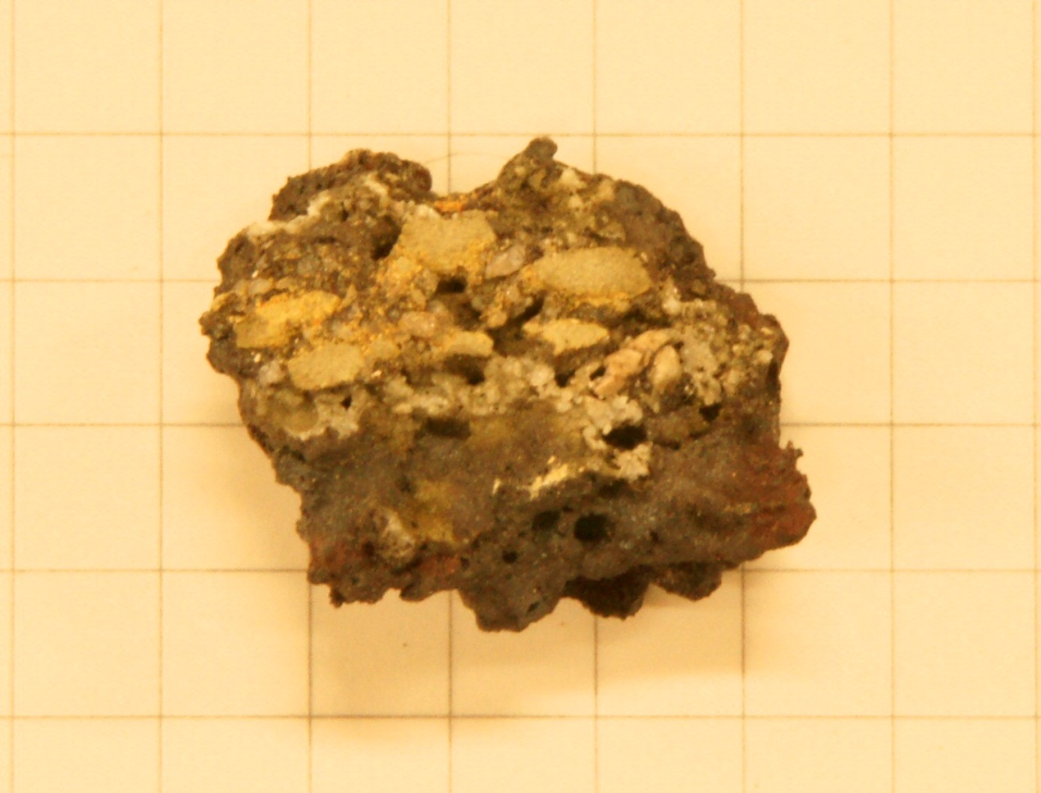
#3831 MCCI Intermediate Test
Sample taken from the splash zone of the melt

Slide 15
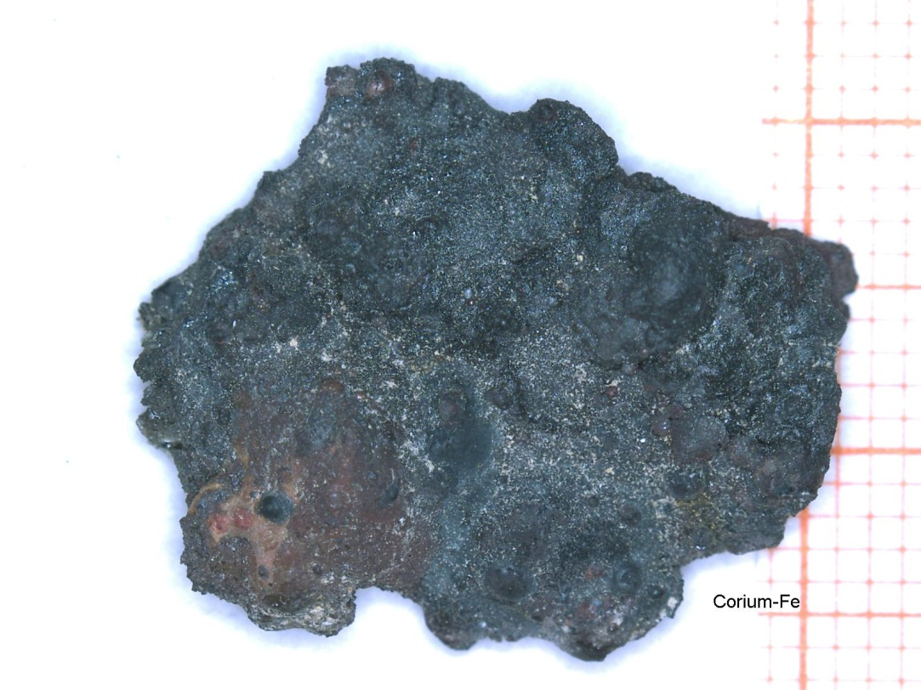
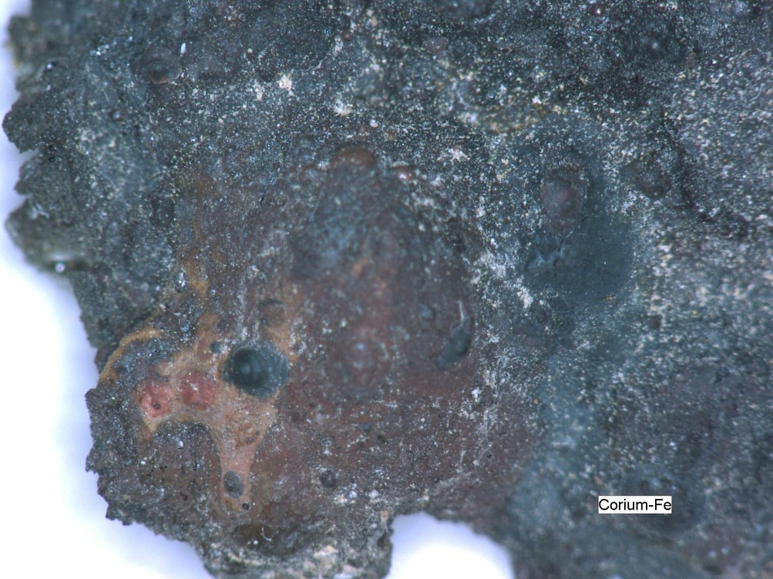
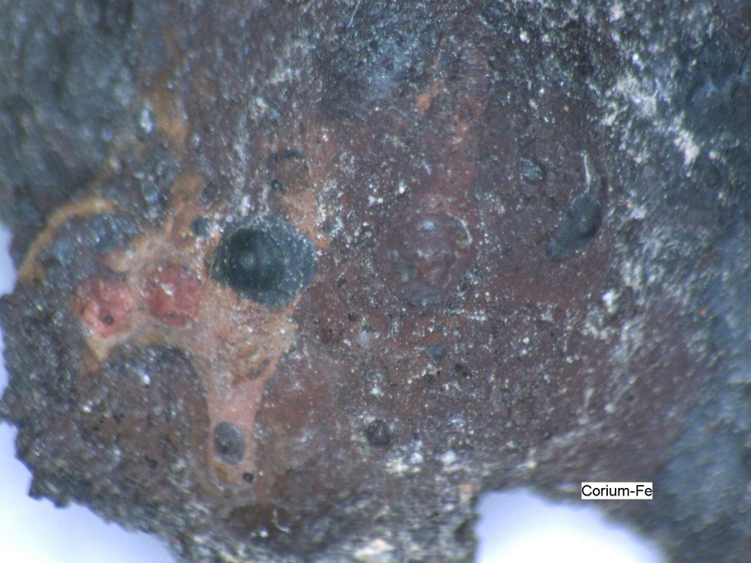
#3831 MCCI Intermediate Test
Fe nodules & Fe Oxide areas seen, also ZrO2 seen

