Slide 1
PARAMETER-SF4 post-test calculation with MAAP4.07 Update
Andreas SCHUMM, Emilie BEUZET
September 2010

Slide 2
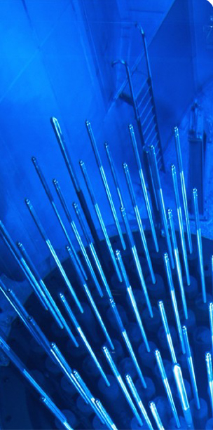
Outline
1. PARAMETER-SF4 test section
2. Specification of PARAMETER-SF4 test
3. Model parameters used in MAAP
5. Comparison with the first post-calculations
4. Results of PARAMETER-SF4 post-test calculation
➔ Temperatures at different elevations (pre-ox)
➔ Hydrogen production
➔ Temperatures at different elevations (air)
➔ O₂ flow rates
5. Conclusions

Slide 3
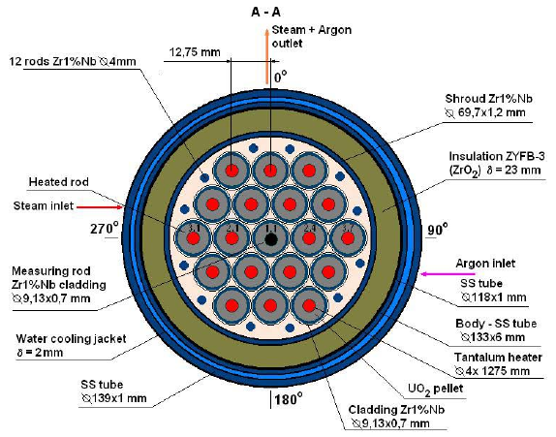
PARAMETER-SF4 test section
PARAMETER cross section
PARAMETER test facility

Slide 4
Specification of PARAMETER-SF4 test
Post-test calculation for PARAMETER SF4 has been carried out with a customized version of MAAP4.07, containing extensions developed by EDF, specifically :
- Zr oxidation by air,
- introduction of material properties of the heater element materials (tantalum, molybdenum and brass) used in PARAMETER.
The simulation covers :
- establishment of a stable pre-oxidation plateau,
- power reduction,
- air ingress phase,
The simulation does not cover :
- hydrogen production during bottom reflood.
➔t_{0MAAP}=t_{SF4}-1452 (the simulation begins with steam injection)

Slide 5
Specification of PARAMETER-SF4 test
~2020 K
Argon 2g/s
Air 0.5g/s
Steam 3.5g/s
~1470 K
~1170 K
~770 K
Bottom reflood 80g/s
1452 s
16000 s

Slide 6
Model parameters used in MAAP
Steam pre-oxidation = Cathcart + Urbanic correlation
Air oxidation = NUREG correlation (like before)
External resistance : 8.5mΩ / rod (4.5mΩ during 1st simulation) (established on the other PARAMETER experiments)
Distribution in : - 4 rows : 1 unheated rod / 6 rods / 12 rods / 12 peripheral rods
(instead of 3 rows for the first post-calculations 1-6-12/12), - 58 axial meshes : 5 for the lower plenum, 48 for the core and 5 for the upper plenum.

Slide 7
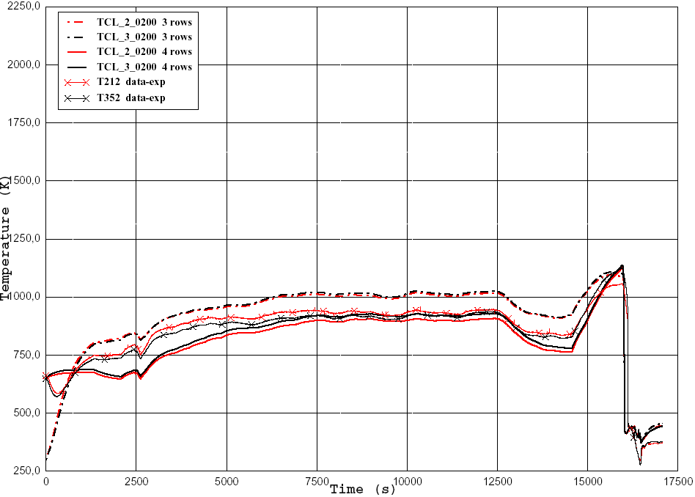
Comparison with the first post-calculations (at 200 mm : overestimated before)

Slide 8
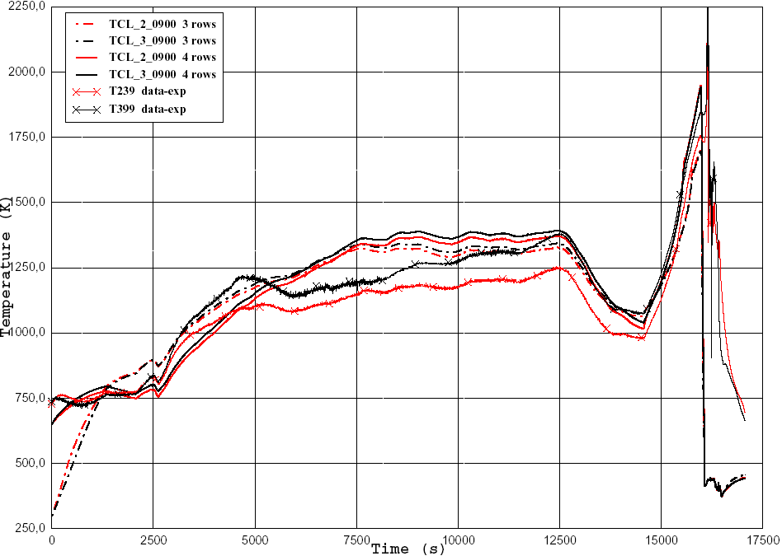
Comparison with the first post-calculations (at 900 mm)

Slide 9
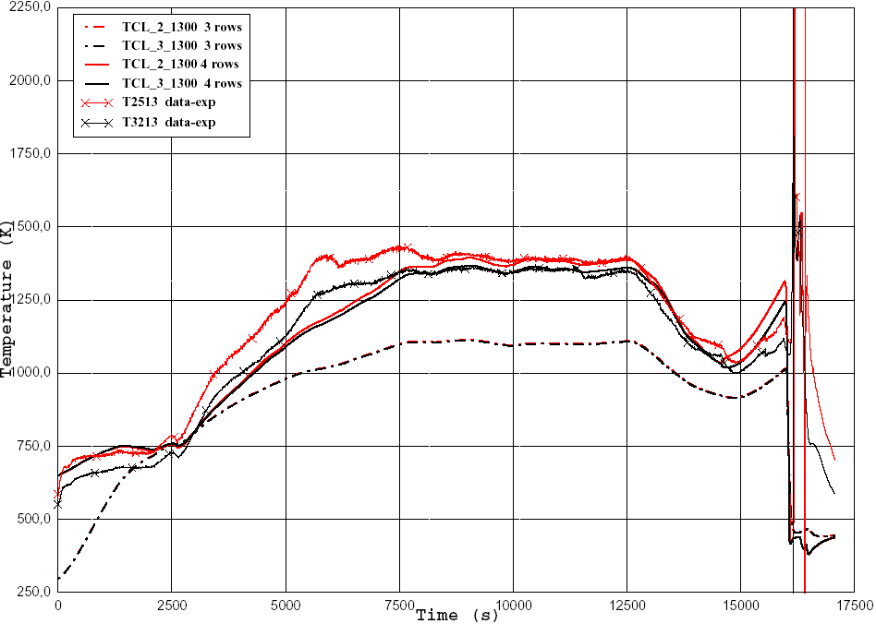
Comparison with the first post-calculations (at 1300 mm: underestimated before)

Slide 10
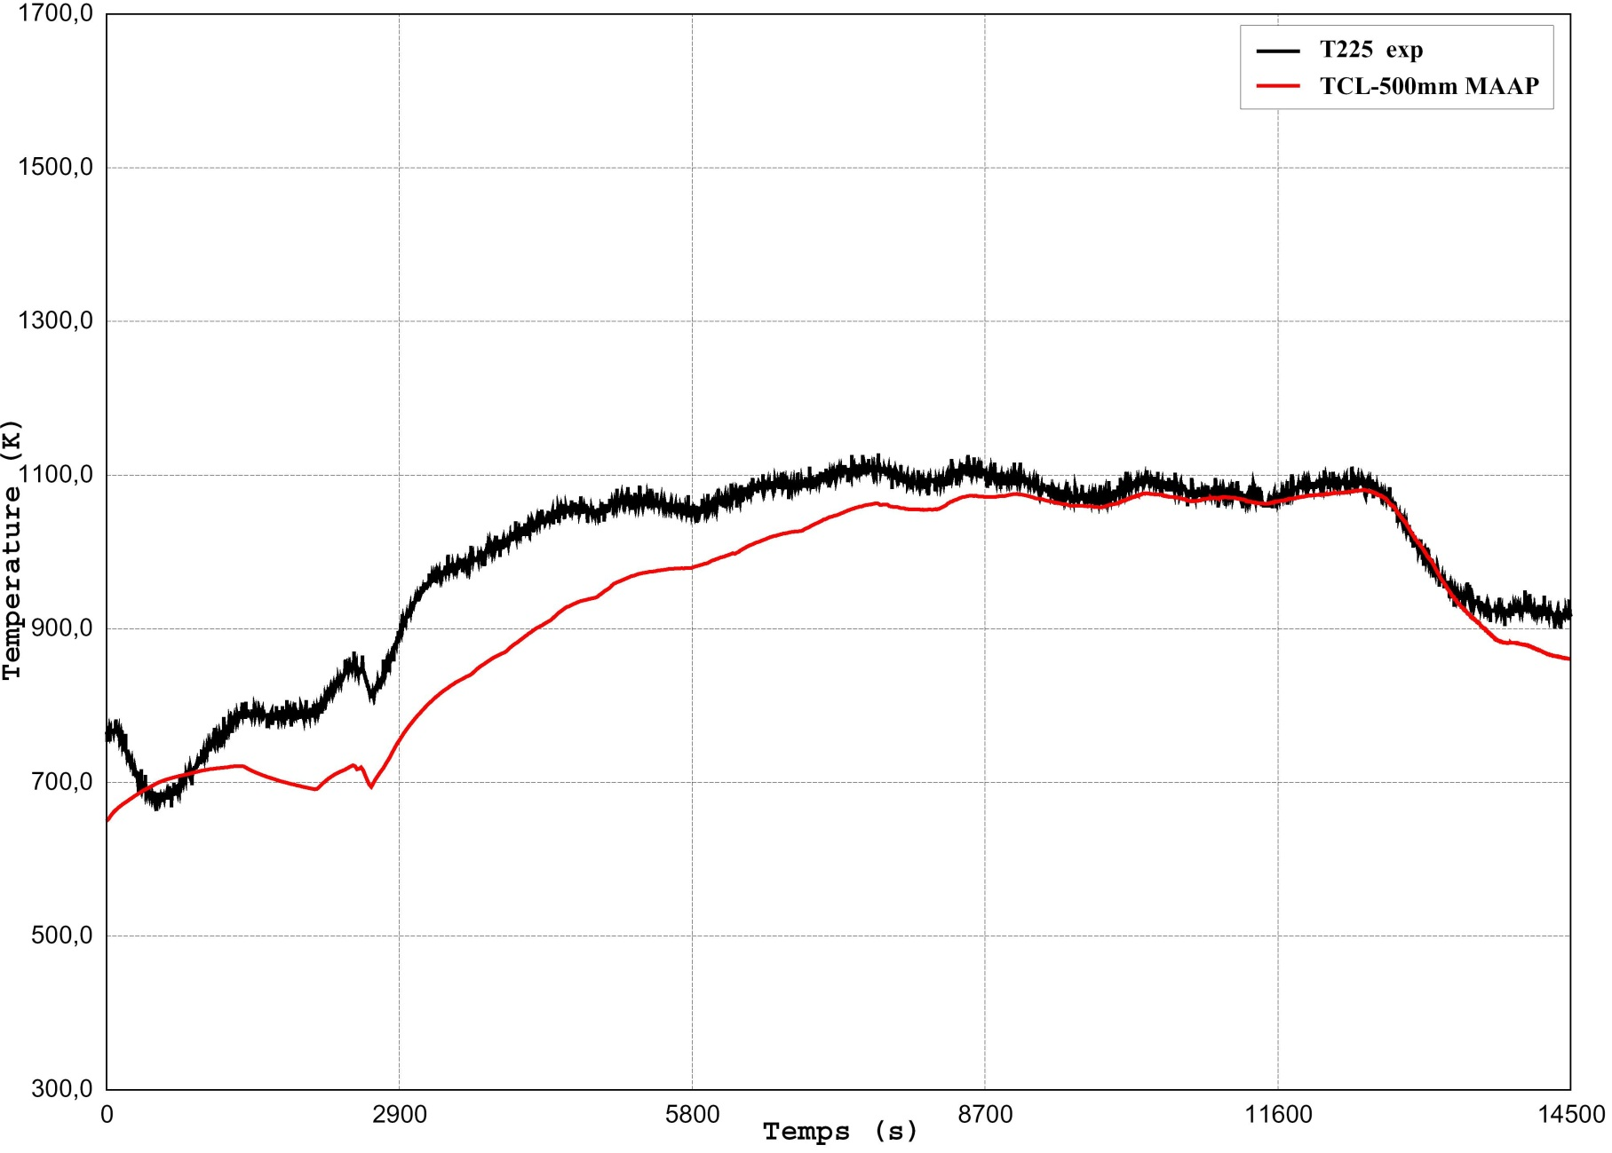
Cladding temperatures at 500 mm high (pre-oxidation phase and air ingress separated)

Slide 11
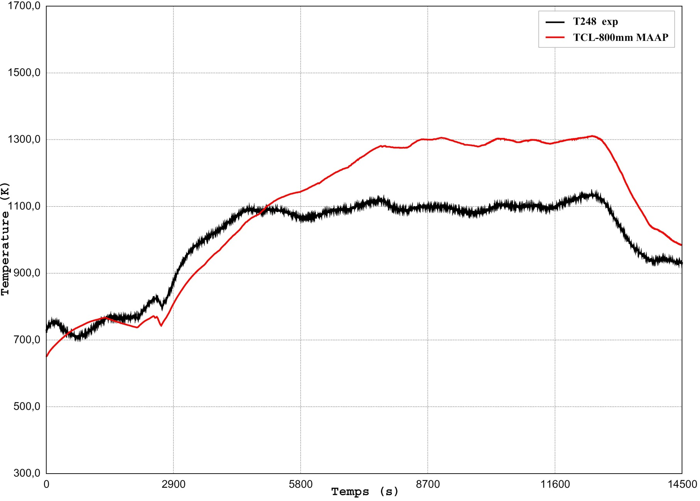
Cladding temperatures at 800 mm high (pre-ox)

Slide 12
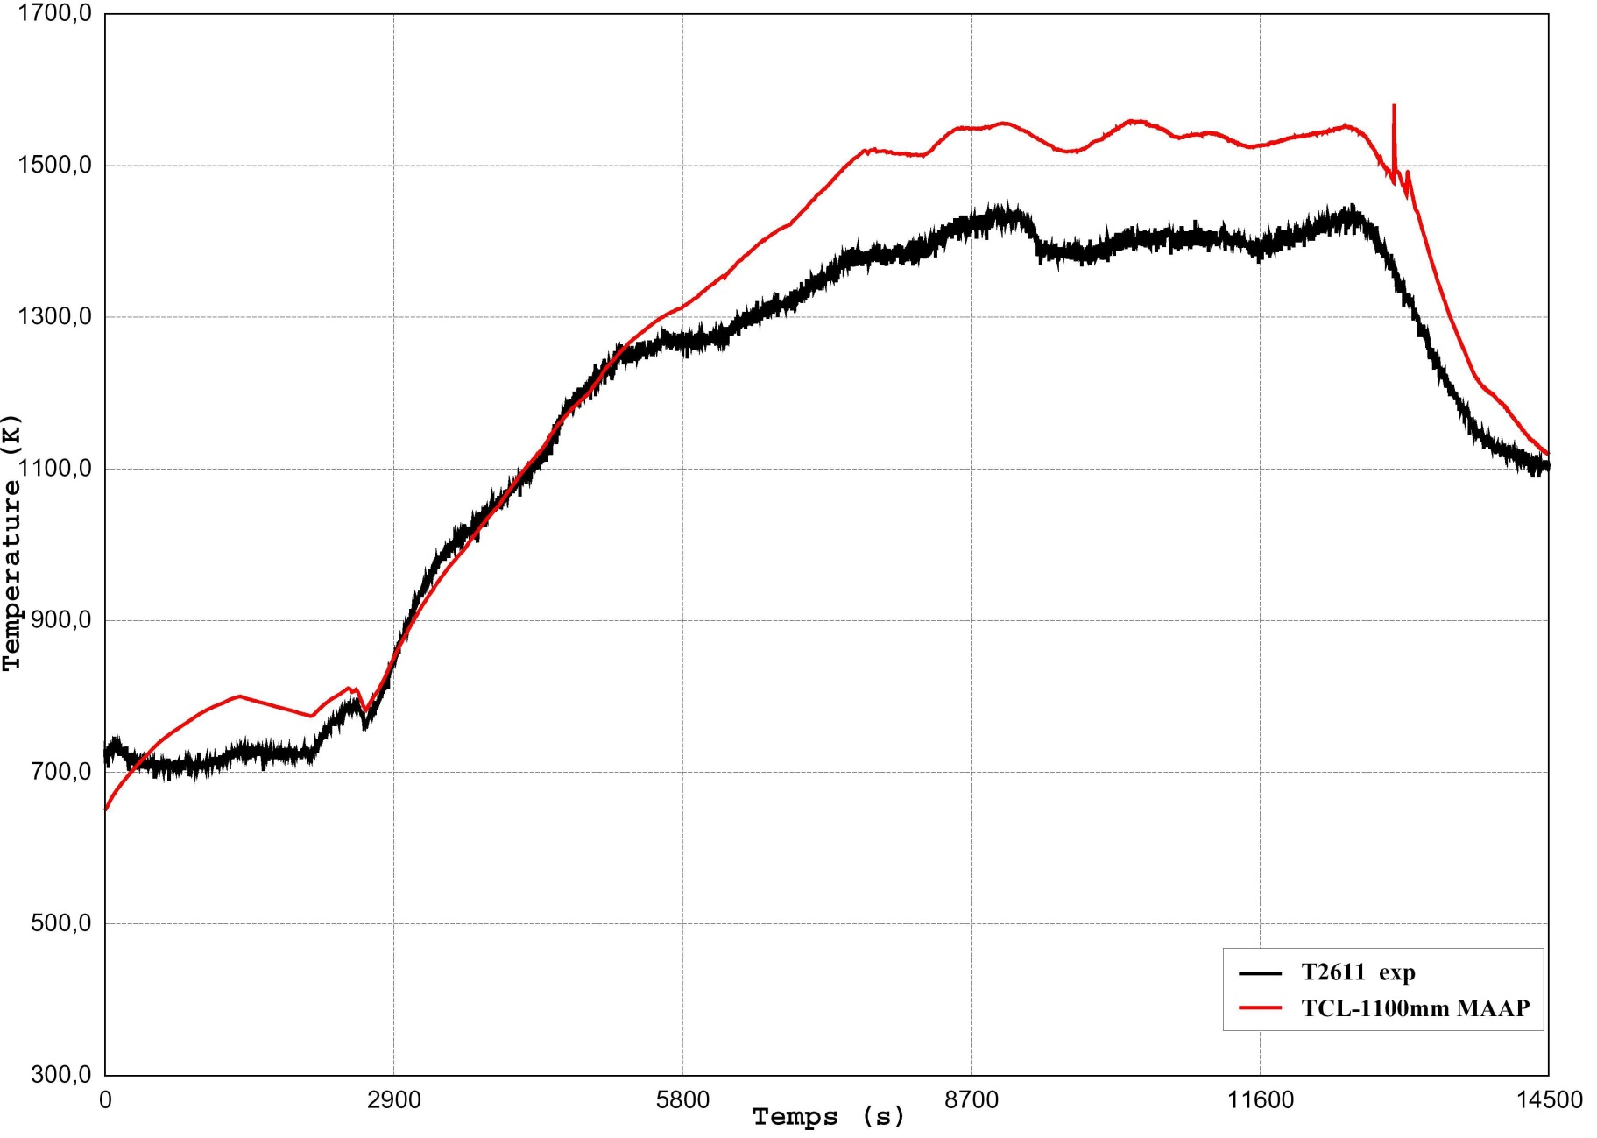
Cladding temperatures at 1100 mm high (pre-ox)

Slide 13
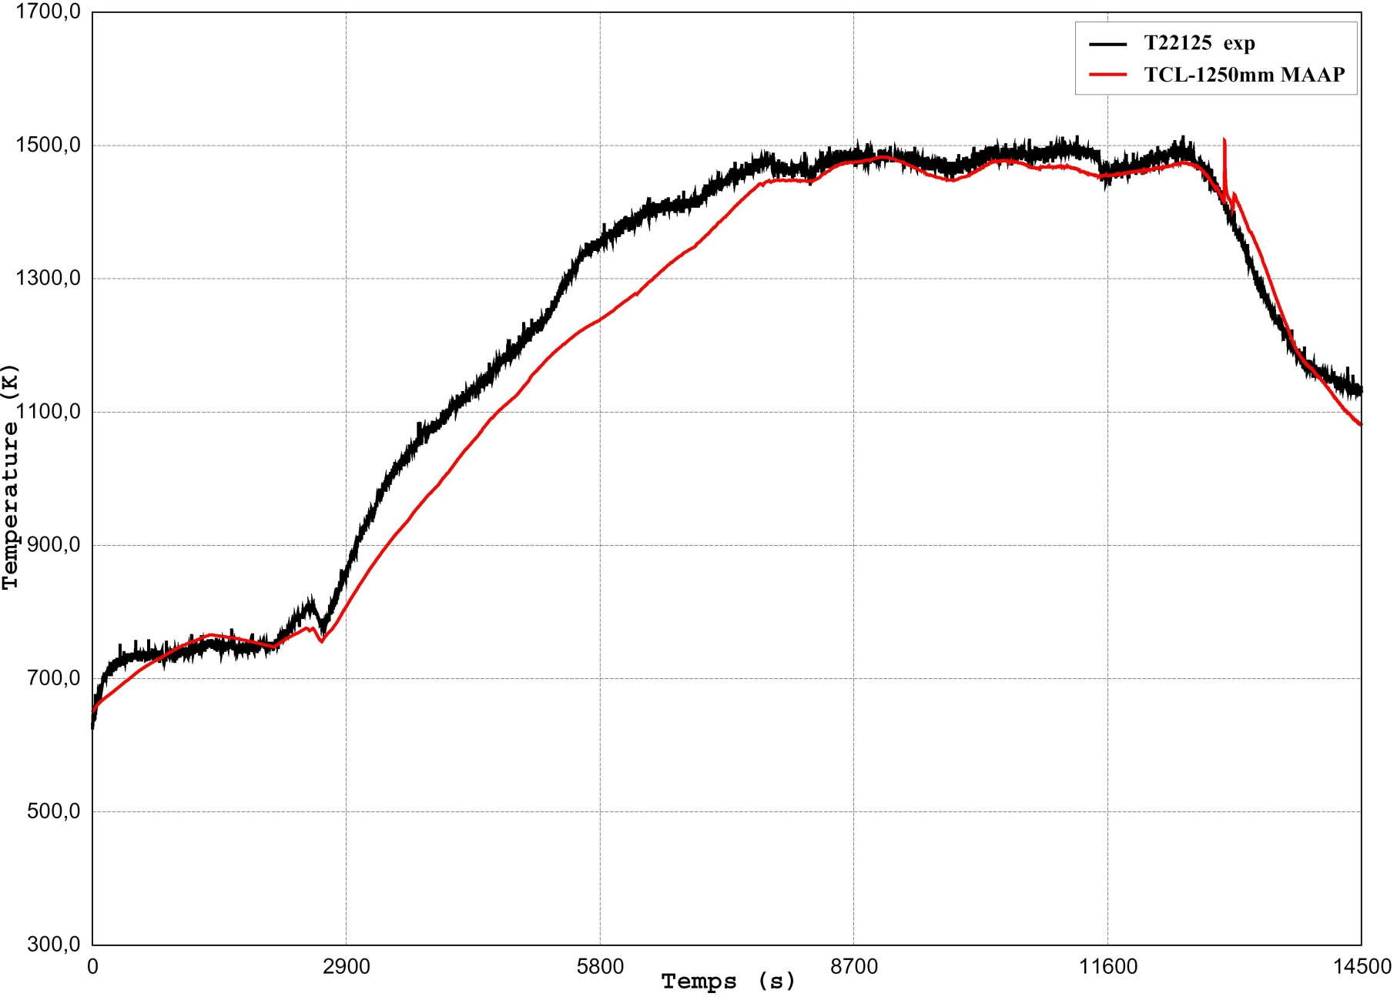
Cladding temperatures at 1250 mm high (pre-ox)

Slide 14
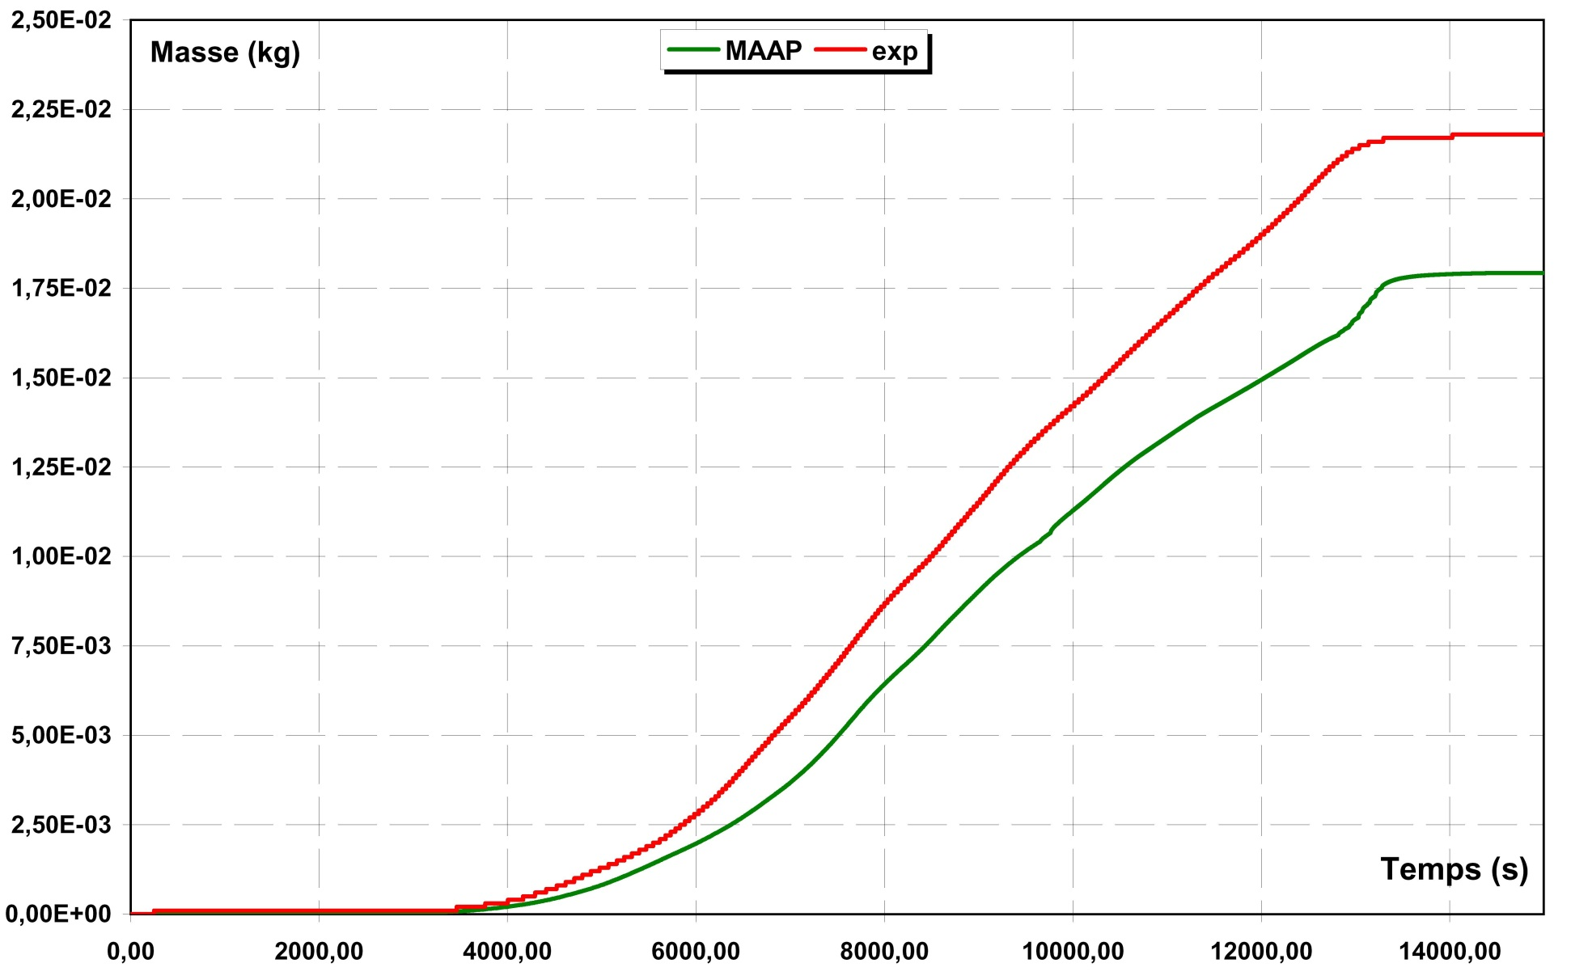
Hydrogen production
good prediction of the hydrogen production during pre-oxidation phase
Good cinetics, but still underestimate quantity

Slide 15
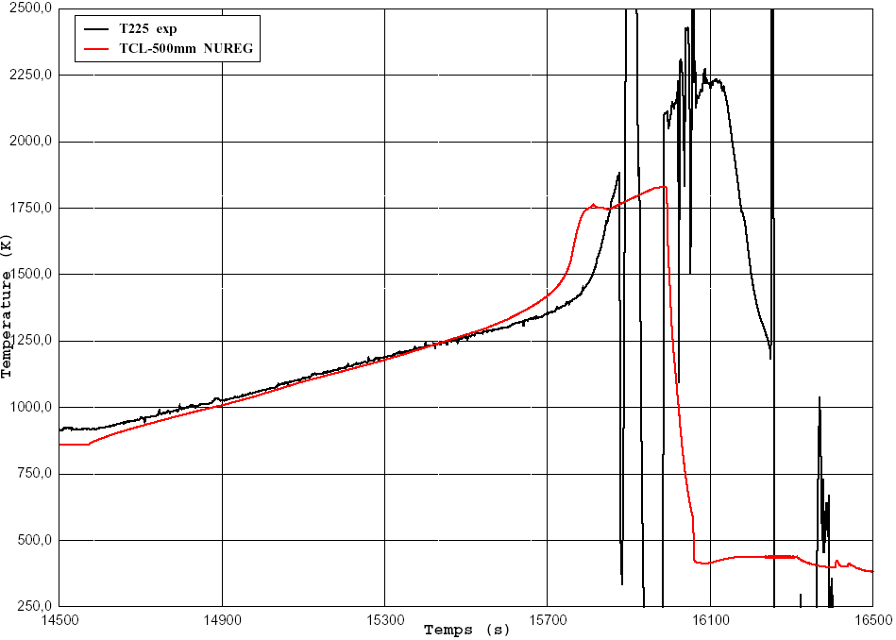
Cladding temperatures at 500 mm high (air)

Slide 16
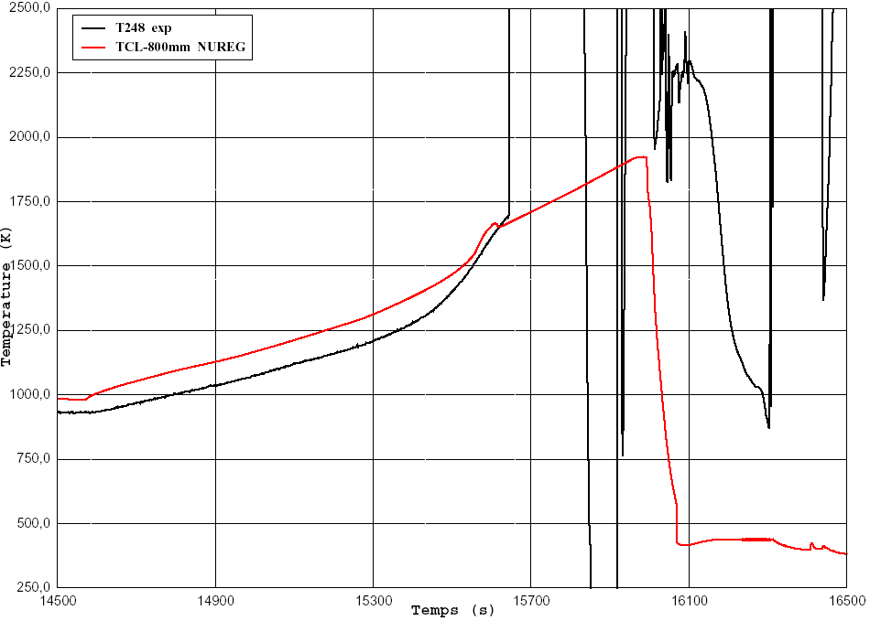
Cladding temperatures at 800 mm high (air)

Slide 17
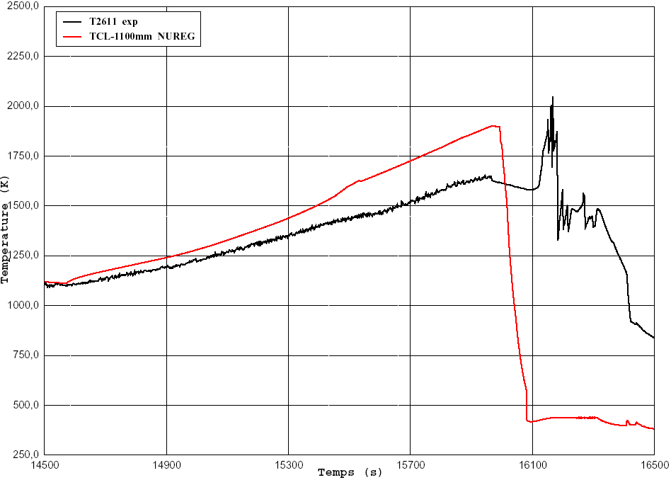
Cladding temperatures at 1100 mm high (air)

Slide 18
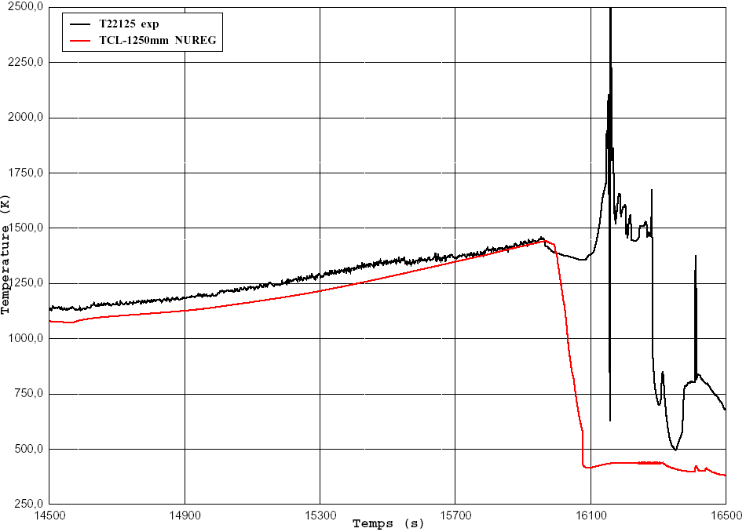
Cladding temperatures at 1250 mm high (air)

Slide 19
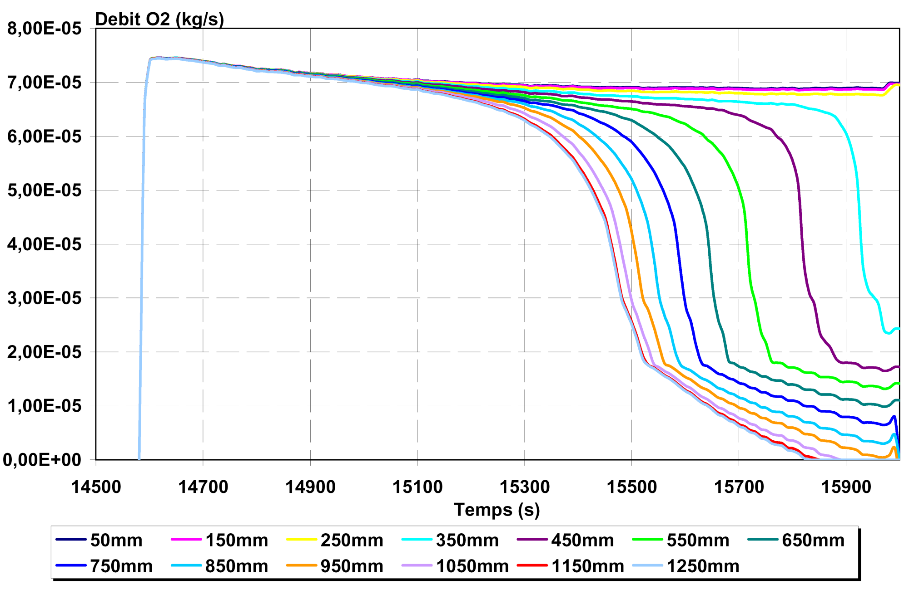
O₂ flow rates during air ingress
Modelling predicts O₂ starvation during air ingress at about 17292 s (15840 s in MAAP time) and about 17100 s for the experiment.

Slide 20
Conclusions
Thermal behaviour :
- better modelling with 4 rows than 3 rows (for the bottom and the top of the bundle)
- good prediction during the steam phase
- good prediction during the air phase for the upper part the bundle but analysis is difficult for the rest of the bundle due to thermocouples failure
Hydrogen production :
- good prediction during pre-oxidation phase, slight underestimation, almost identical to first simulation
- simulation does not cover reflood yet
Modelling now predicts O₂ starvation but about 200 s later than the experiment : it is probably due to an under-estimation of temperatures during air ingress (parabolic correlation for the post-breakaway regime)
Nitruration not taken into account (no correlation available)

Slide 21
Thanks for your attention …

