Slide 1
FSUE SRI SIA “LUCH”
IBRAE RAS
FSUE EDO “GIDROPRESS”
Post-test examination of the PARAMETER-SF2 and –SF3 fuel assemblies
(ISTC project #3690)
Presented by T.Yudina
15th CEG-SAM Meeting, Villigen, Switzerland, 10-12 March 2009 г.

Slide 2
SF2 bundle material investigation results
The studies included :
  encapsulation and sectioning of the FA;
  preparation of cross section slabs;
  optical and electronic microscopy;
  X-ray analysis;
  analysis of the obtained results.
The results are documented in Report “Analysis of material studies of WWER-100 model assembly tested in the PARAMETER-SF2 experiment under the conditions of severe accident with top and bottom flooding.”
Scientific aspects of the investigations were discussed at 14th International QUENCH Workshop Karlsruhe, 4-6 November2008
Main outcomes:
  SF2 bundle reveals pronounced breakaway oxidation over 500-1300 mm;
  cladding oxide scale over 900-1300 mm includes inner compact oxide with columnar structure on the metallic layer and external multi-layer spalled off oxide;
  over 1100-1300 mm inner compact oxide is split or tends to split; possible reason could be cool down and heat up cycle during combined quenching
  maximum calculated cladding oxide scale thickness corresponds to the hottest elevation (1250 mm);
  inner cladding oxidation over 900-1300 mm is weak;
  cladding fragmentation is non-pronounced;
  no fuel relocation.

Slide 3
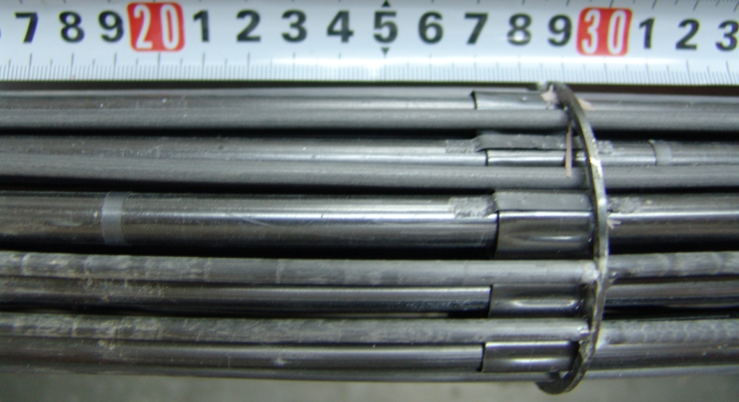
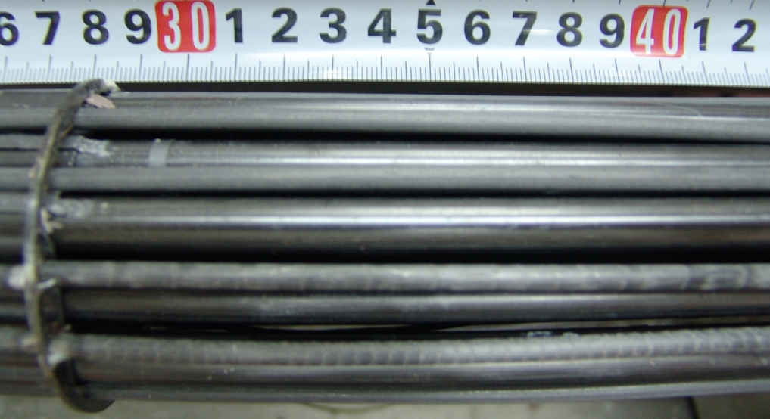
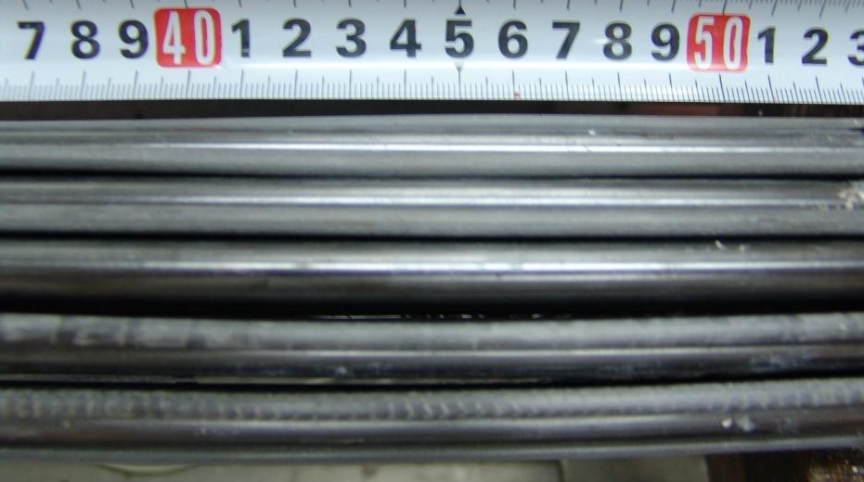
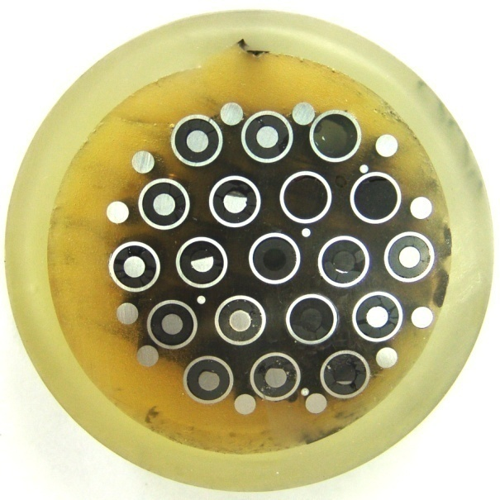
Post-test appearance of SF3 bundle at 200-500 mm
Rod 3.5
Rod 3.5
200-300 mm elevation
300-400 mm elevation
Rod 3.5
400-500 mm elevation
Z=500 mm elevation

Slide 4
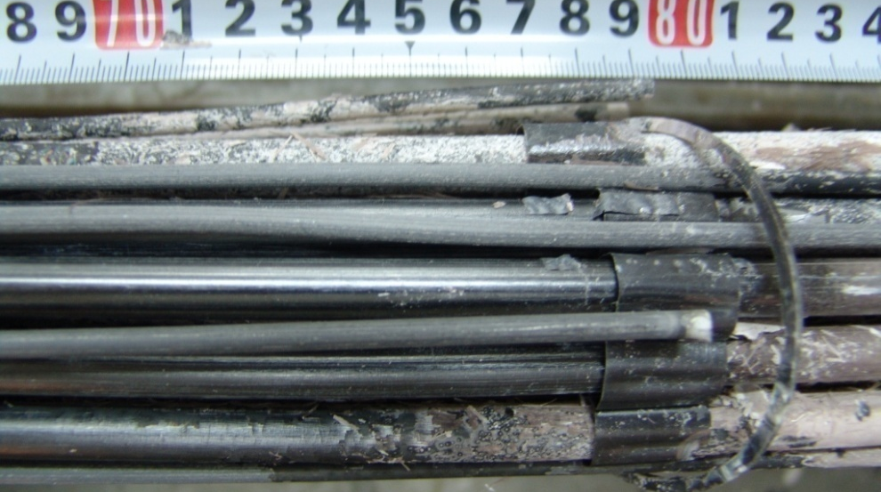
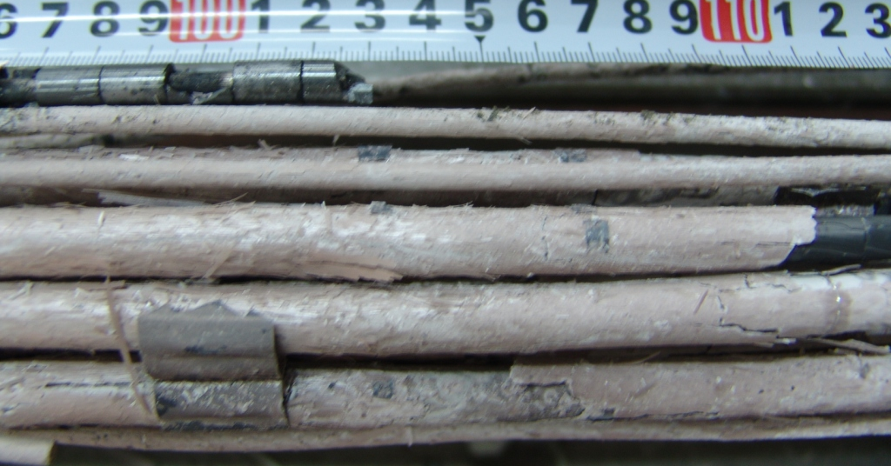
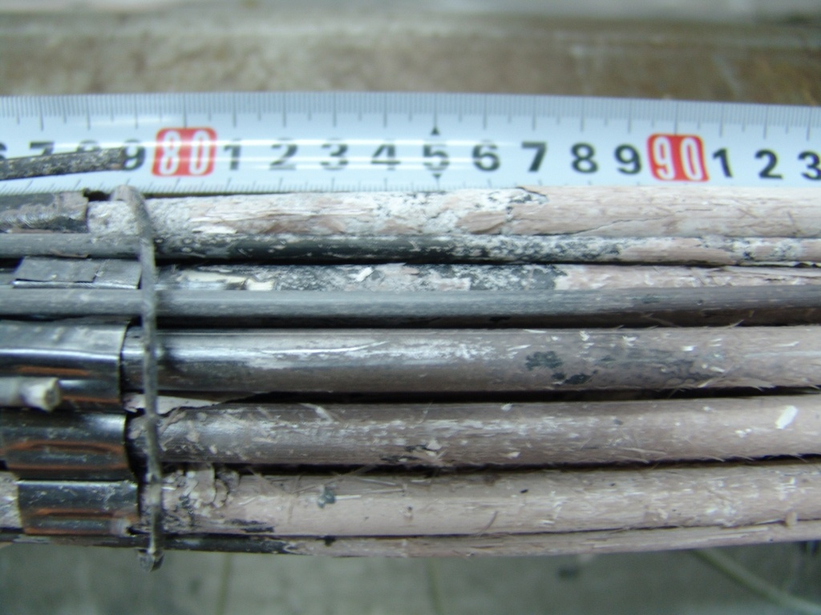
Post-test appearance of SF3 bundle at 700-1100 mm
Rod 3.5
Rod 3.5
700-800 mm elevation
1000-1100 mm elevation
Rod 3.5
800-900 mm elevation
Pronounced inhomogeneous oxidation

Slide 5
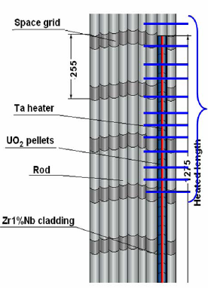

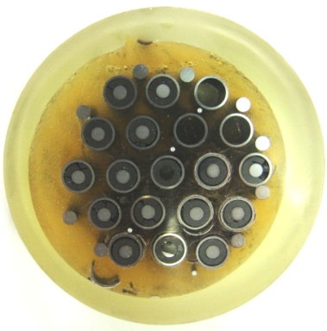
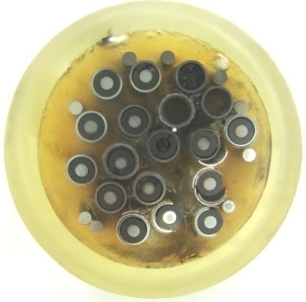
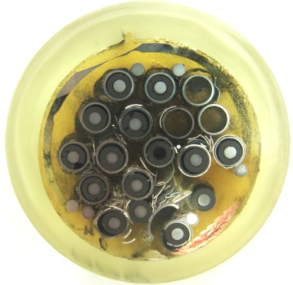
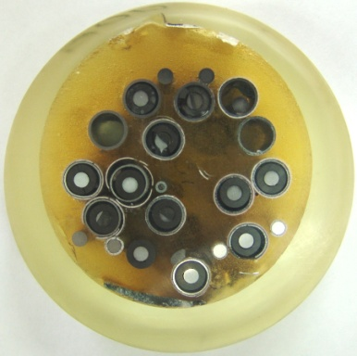
Overview of sectioning map for metallographic examination
Over 400-1500 mm 13 crosscuts were made
4 cross-section were examined at 800, 1000, 1250, 1300 mm
500 мм
600 мм
700 мм
800 мм
900 мм

Slide 6
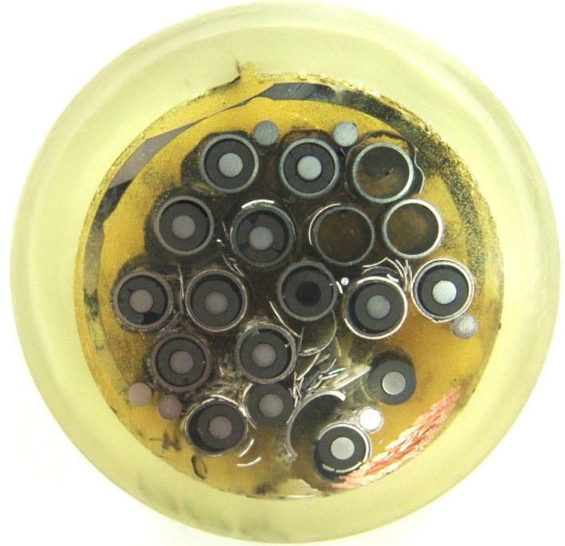
Metallographic examination of the cross -section at Z=800 mm
18 fuel roads
6 peripheral rods and 1 thermocouple
12 fuel roads are kept in original arrangement
Cladding fragmentation
2 rods lost their claddings
Spacer grid fragment
Oxide scale remnants between rods
rods
3.3
TC

Slide 7
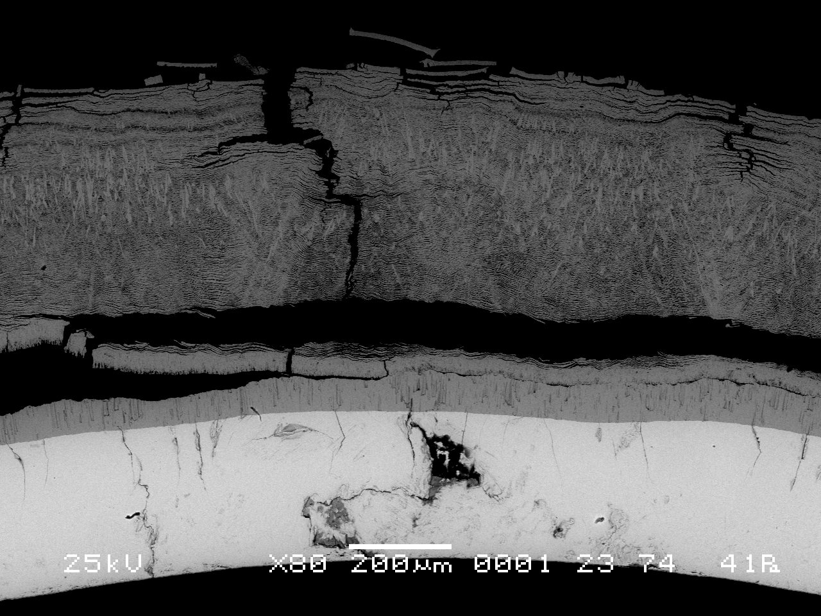
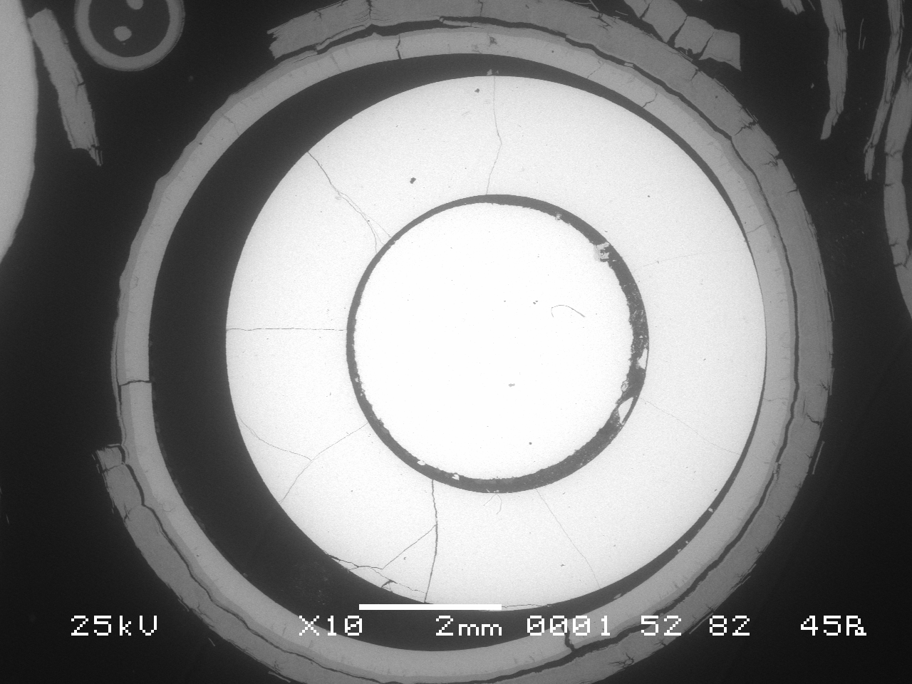
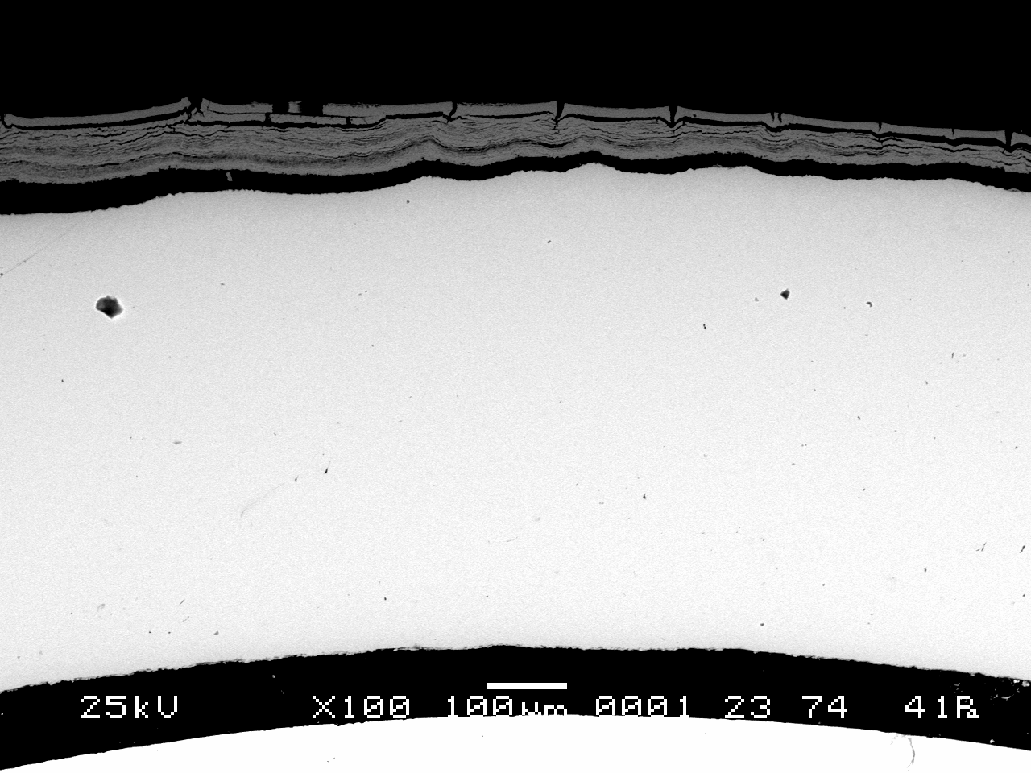
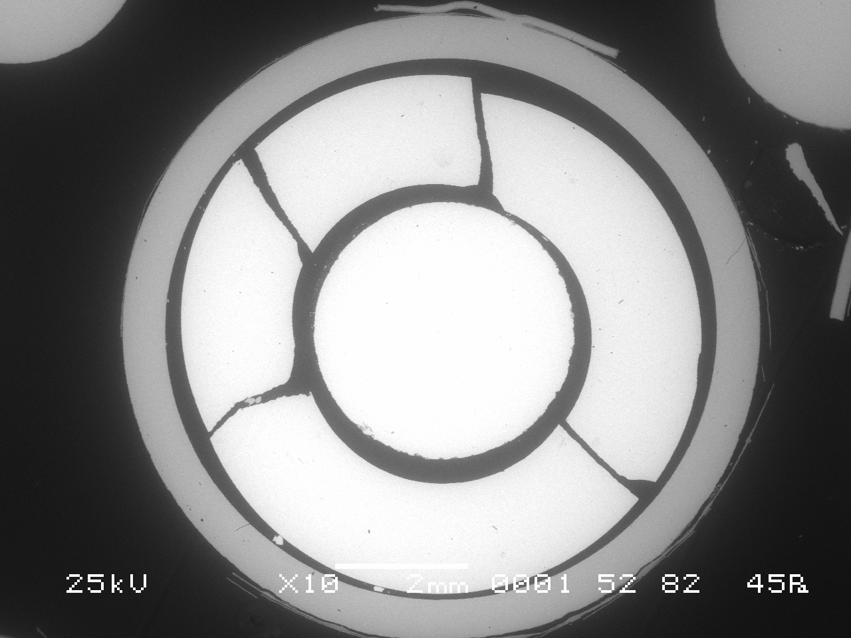
Metallographic examination of the cross -section at Z=800 mm
Rod 2.5
Rod 3.6

Slide 8

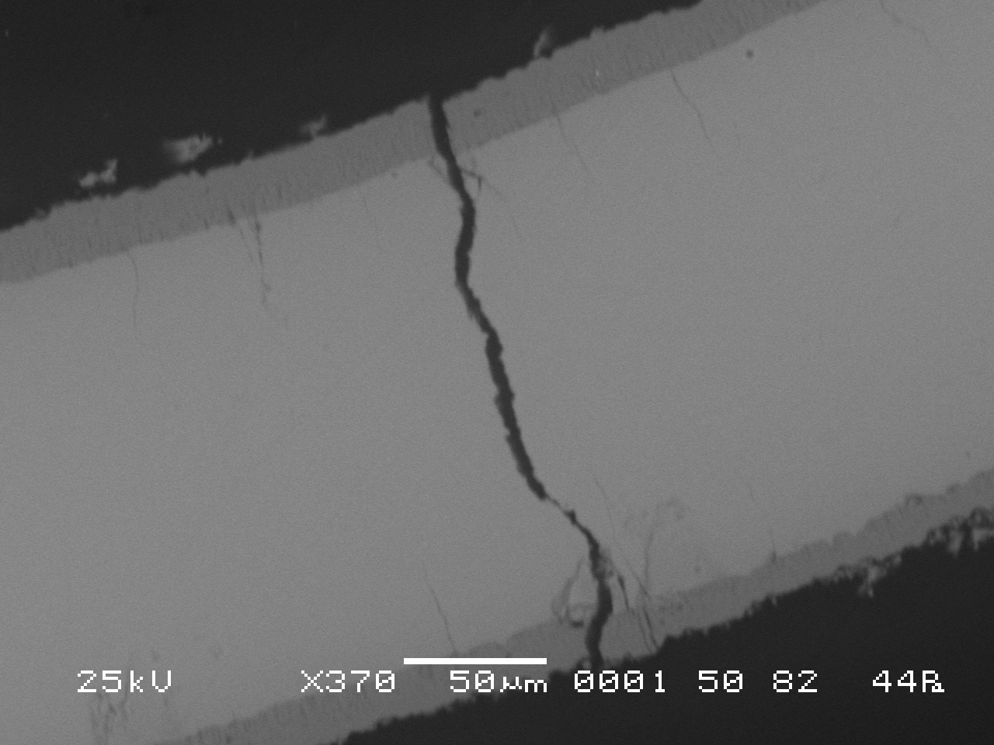

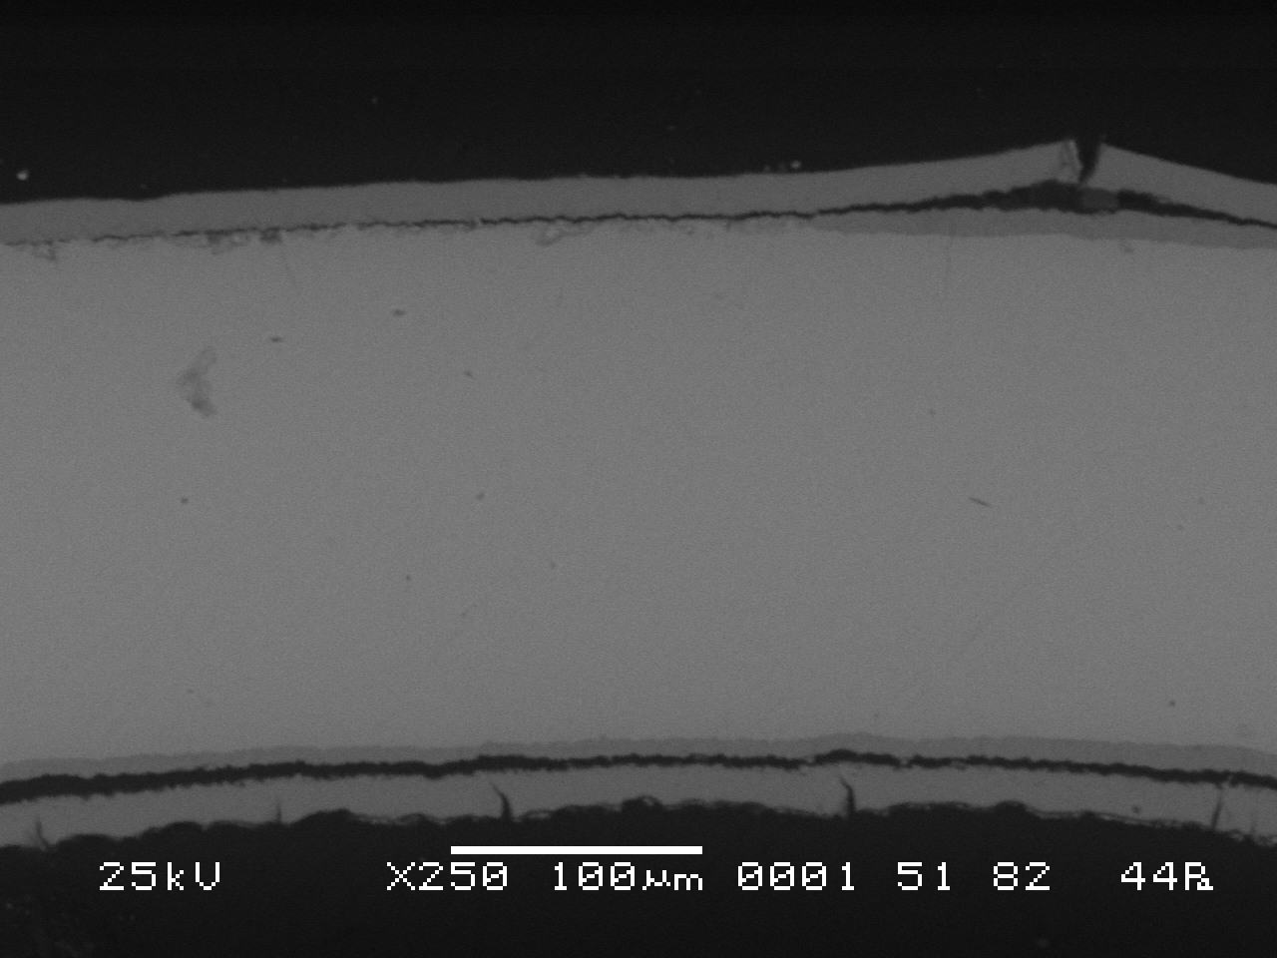
Spacer grid Z=800 mm
Double side oxidation
Trend to spallation
Brittle metal layer
Rod 3.5
Rod 3.5

Slide 9
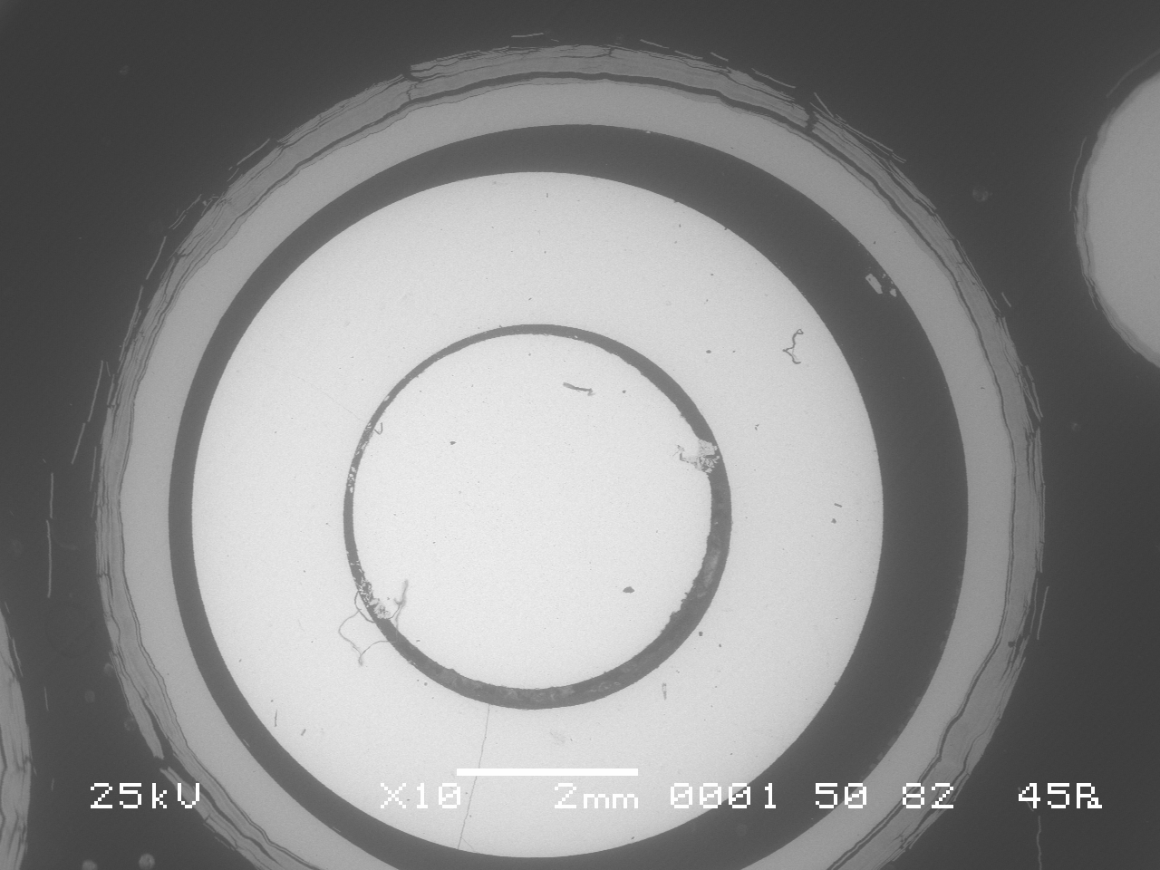
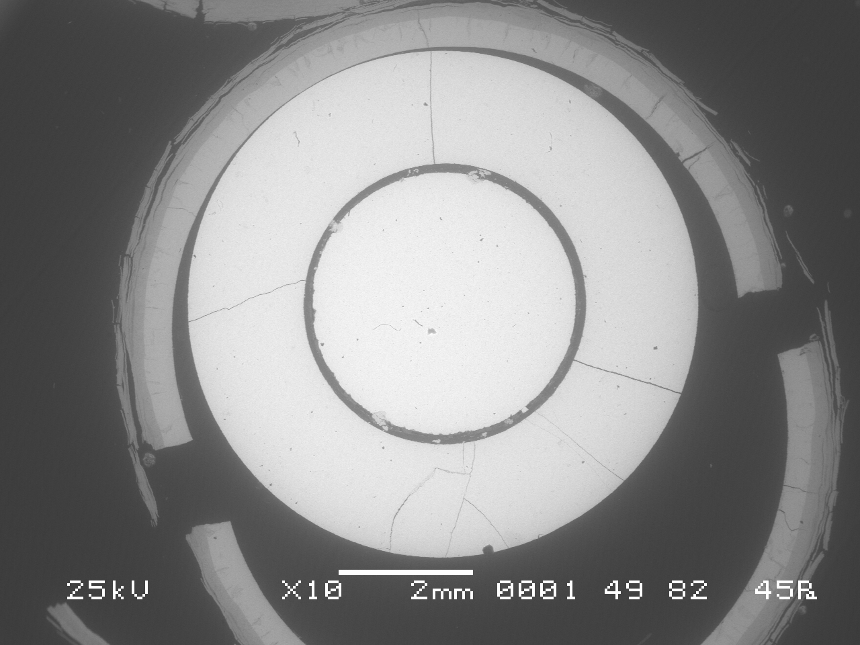
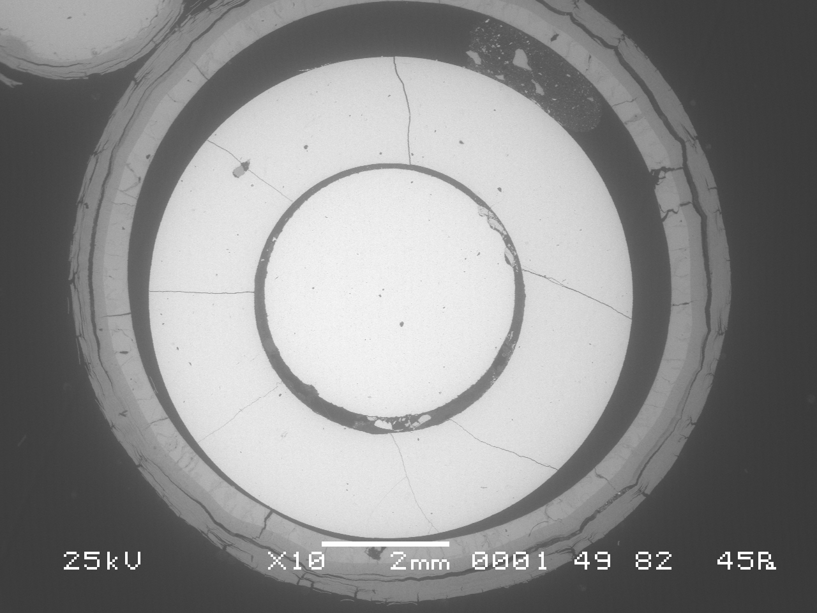
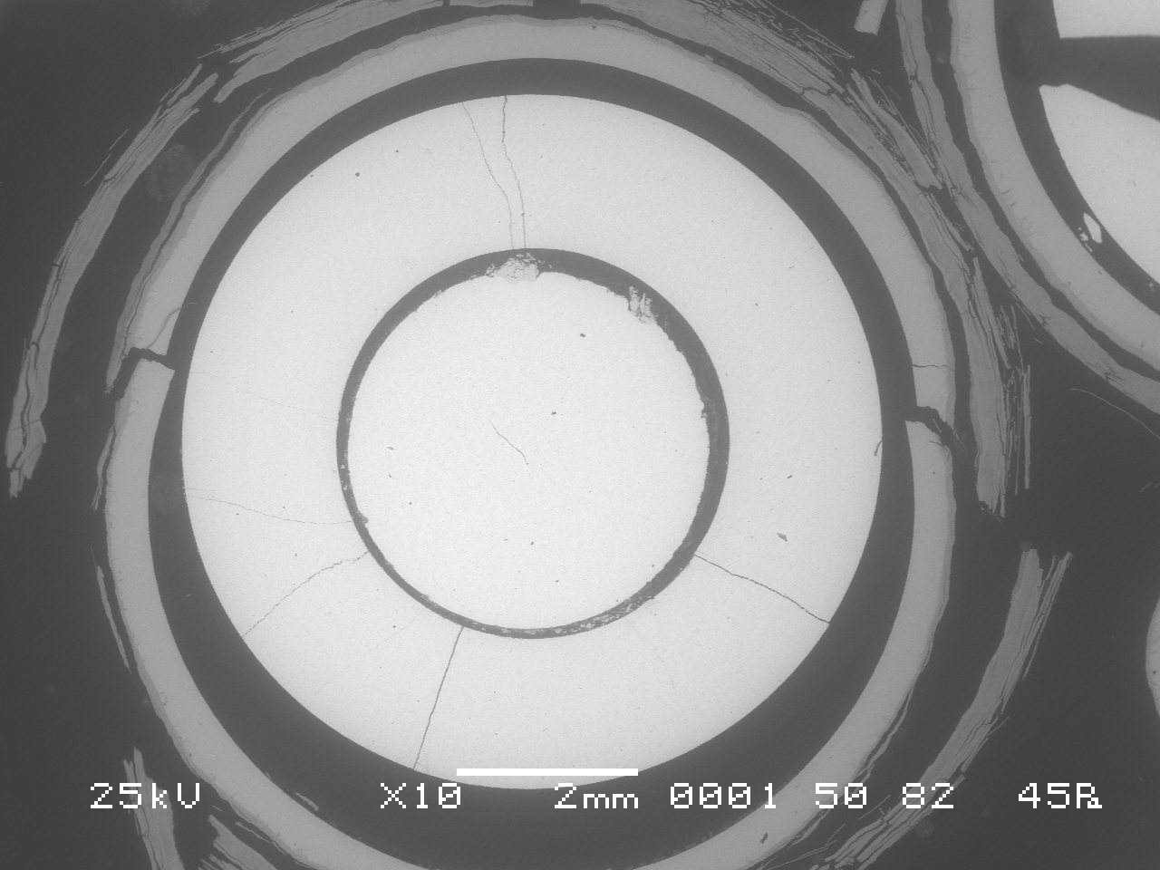
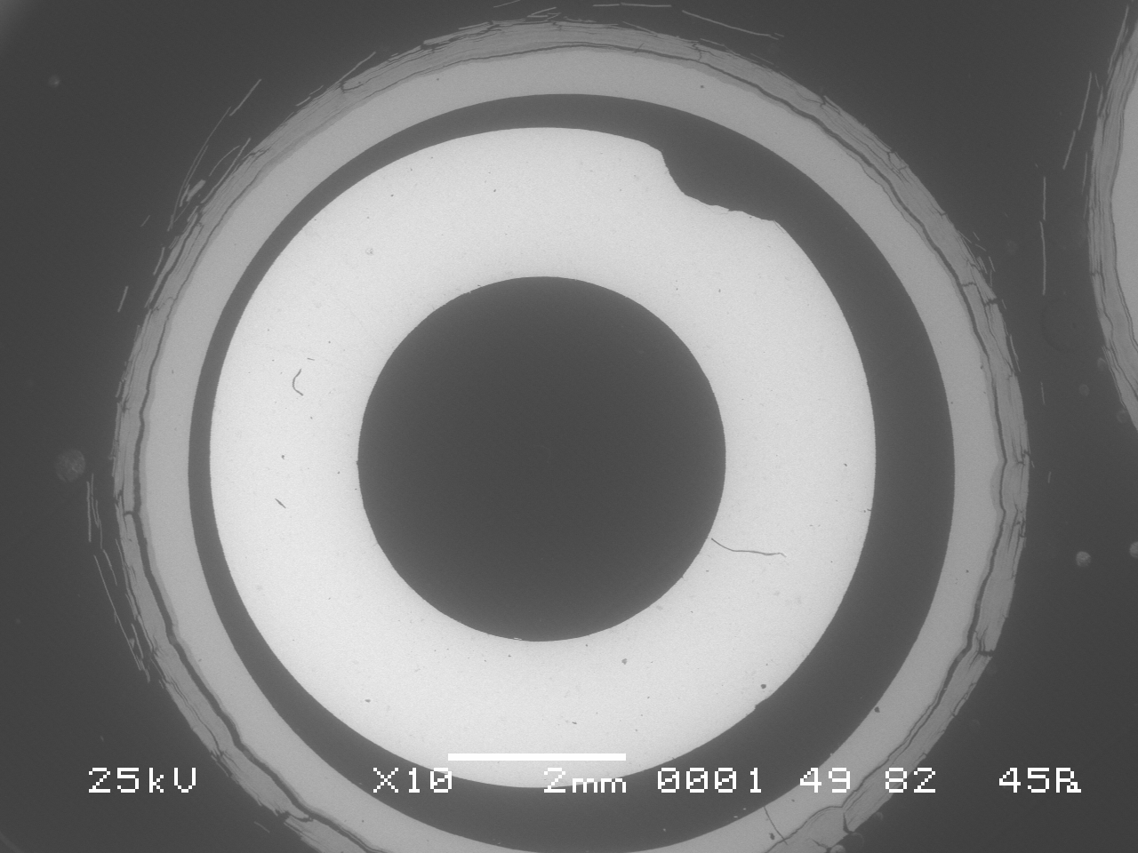
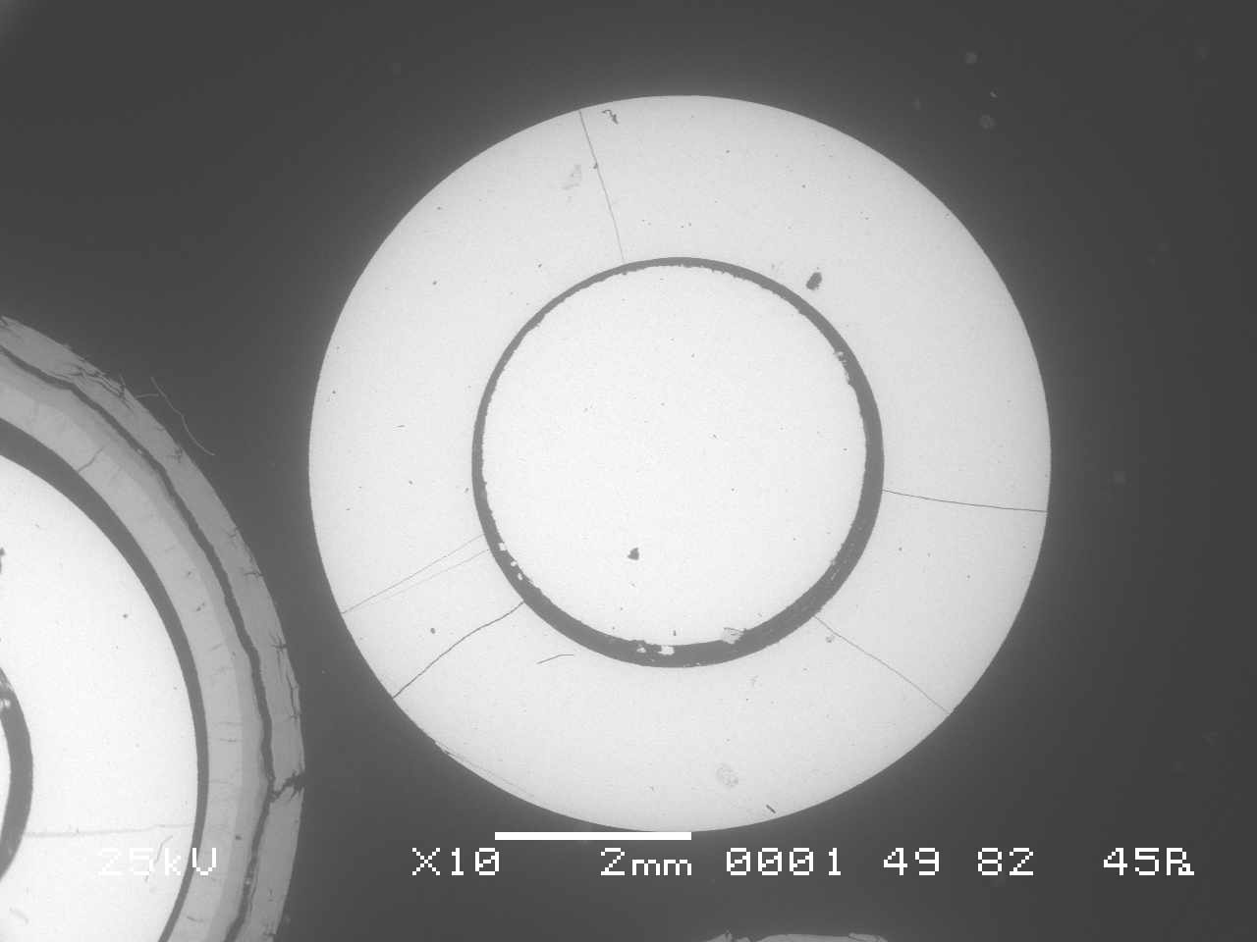
Metallographic examination of the cross- section at Z=1000 mm
Some fuel rods are absent
13 claddings and 5 peripheral rods are available for measurements;
Through-wall cracks and cladding fragmentation
Spacer grid is absent and only small fragment was kept at rod 3.7
Rod 17
Rod 16
Rod 7
Rod 11
Rod 18
Rod 20

Slide 10
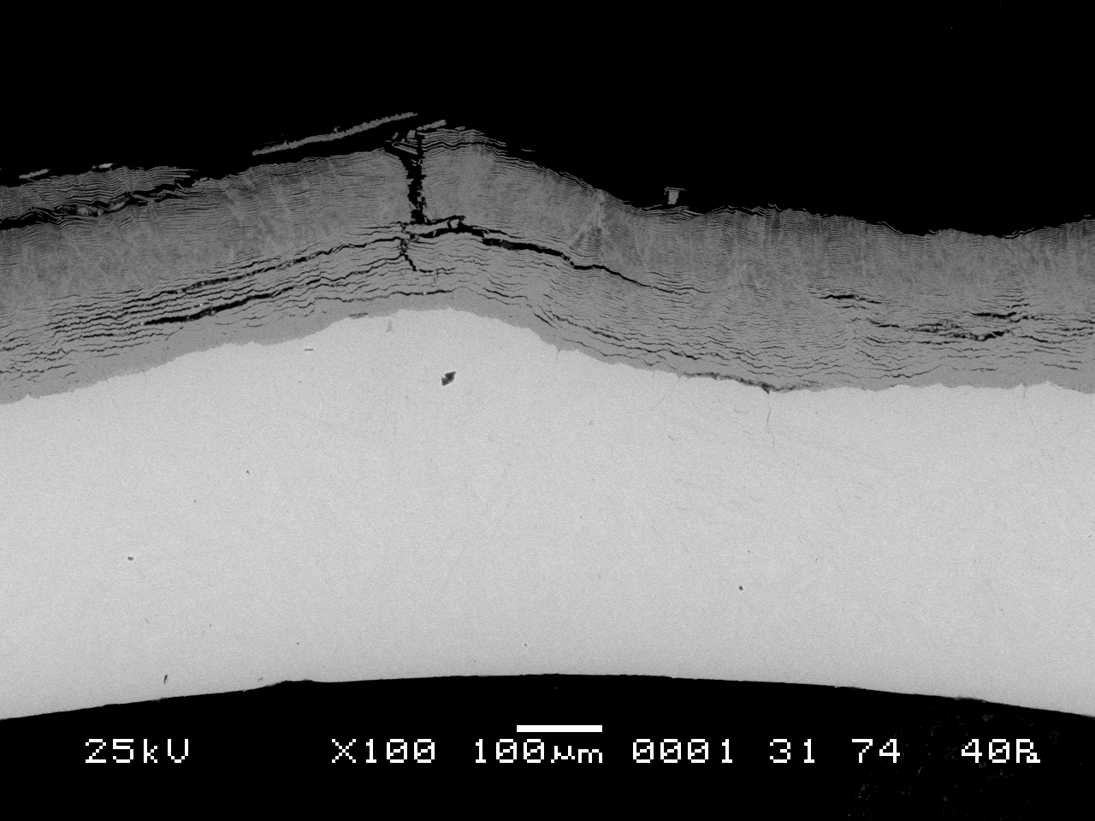
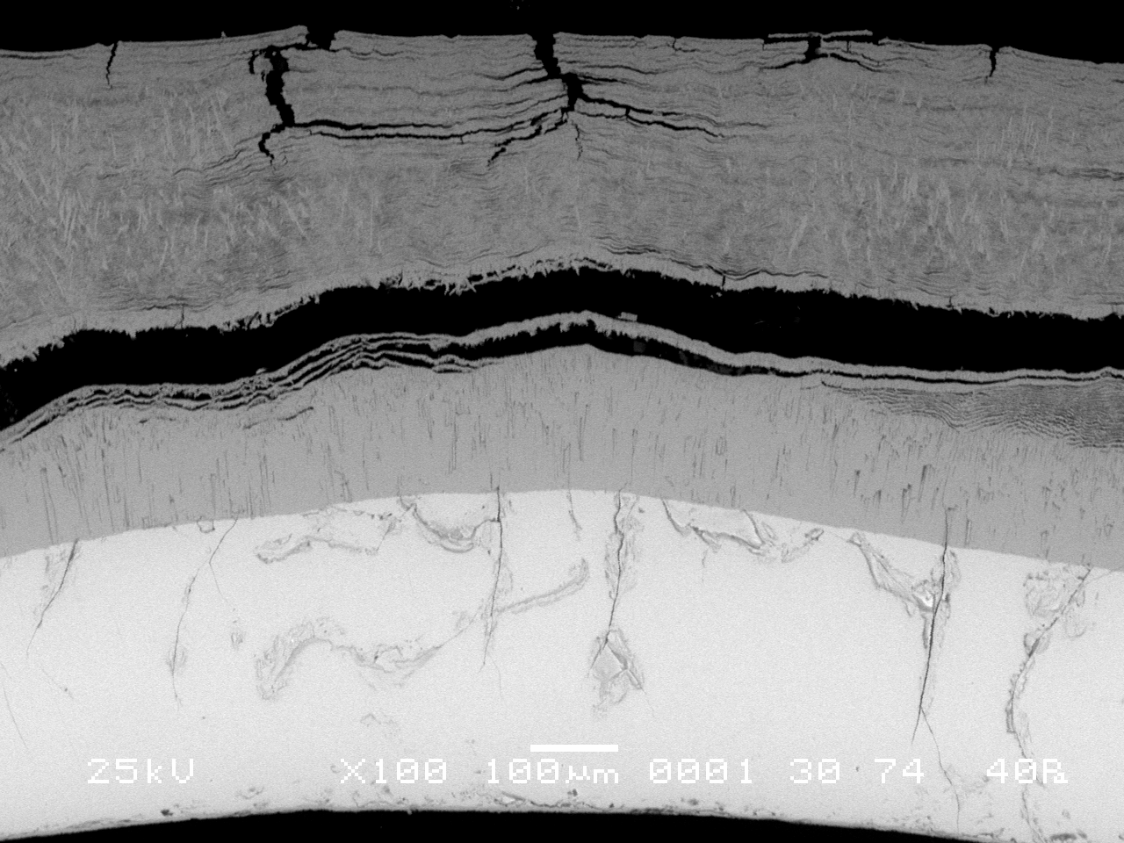
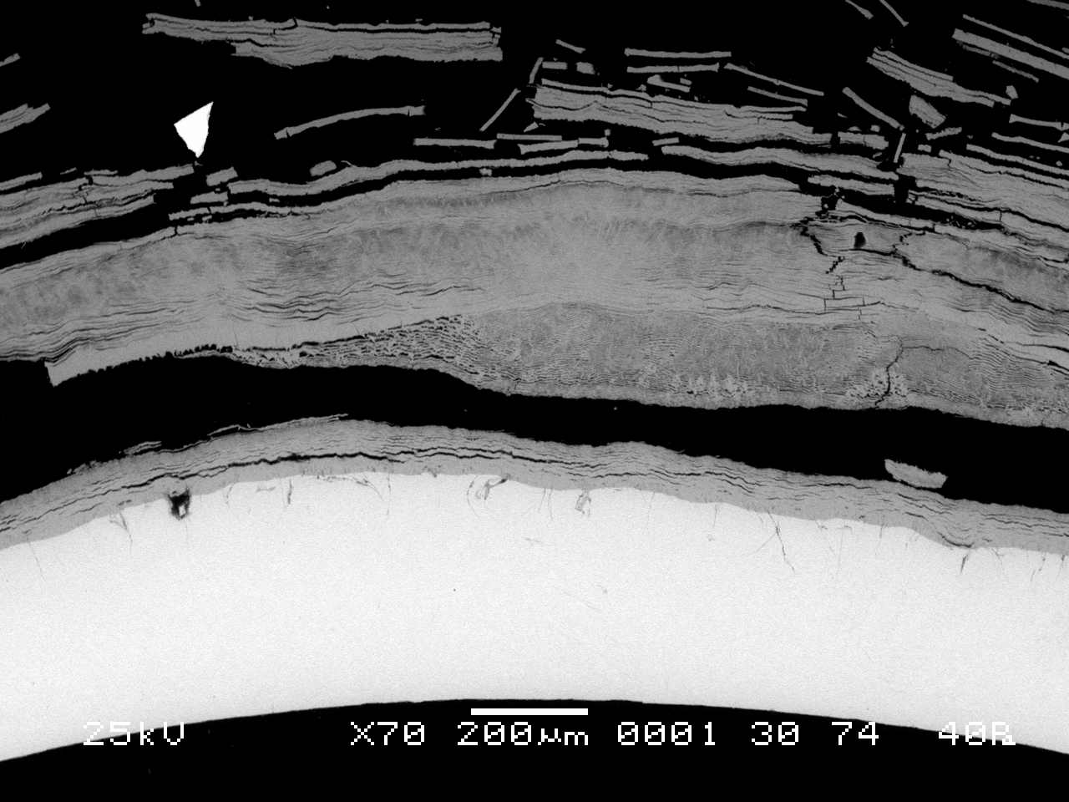
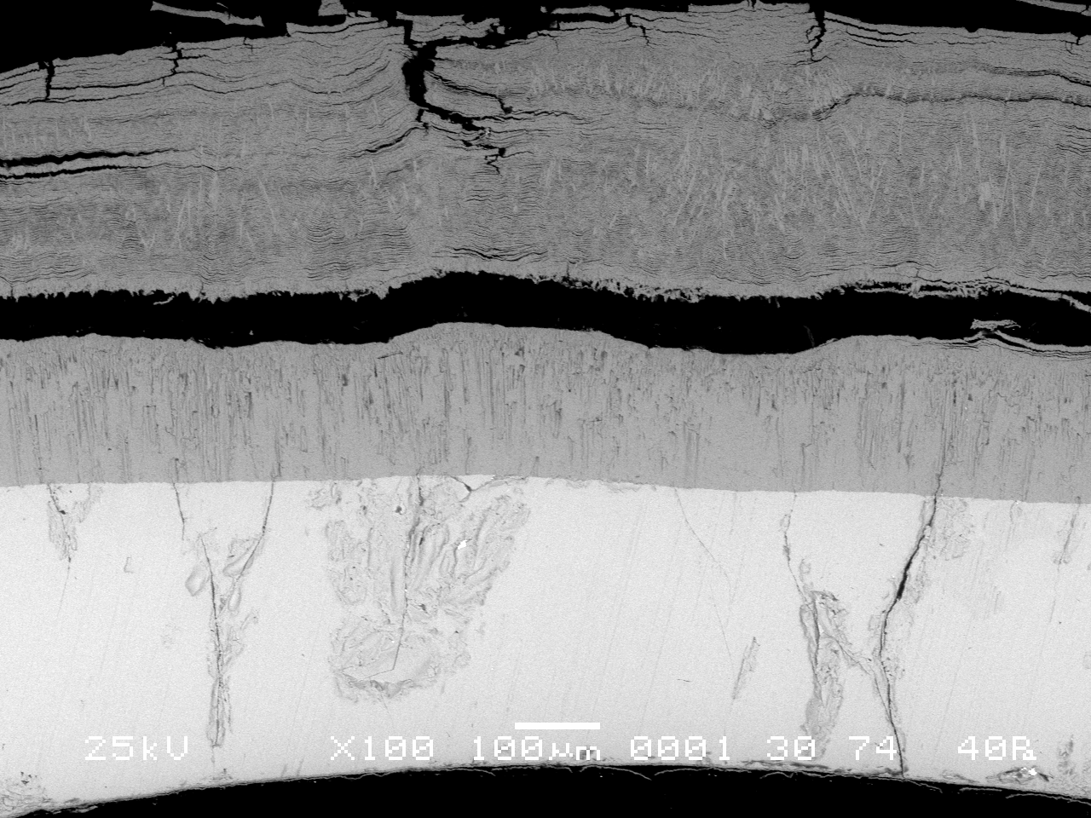
Cladding oxide layers structure at Z=1000 mm
Rod 8
Rod 15
Multilayerd spalled off oxide
Internal oxide with columnar
structure and older fine
films spalled off
Strong inhomogeneous distribution of residual metallic layer thickness
Oxide spallation
Internal compact oxide with columnar structure for strong oxidized claddings
Weak internal oxidation (~5 µm)
Rod 11
Rod 16

Slide 11
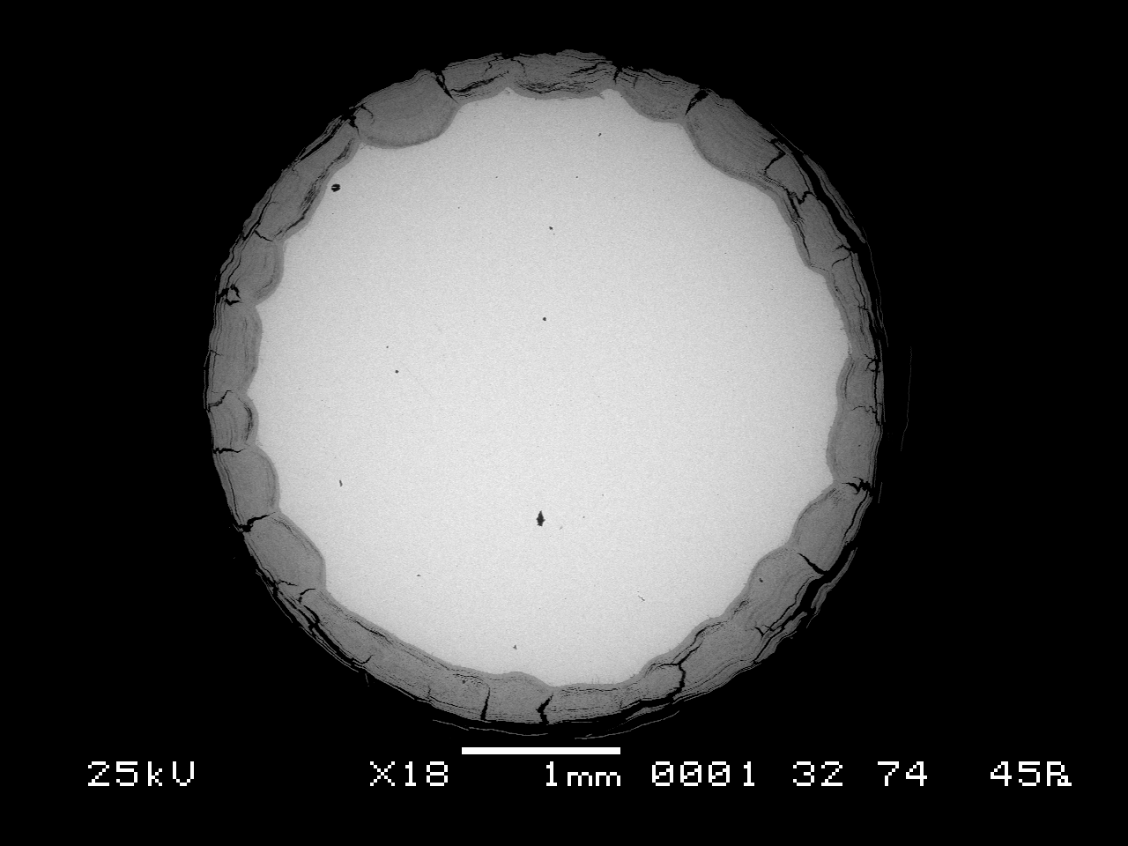
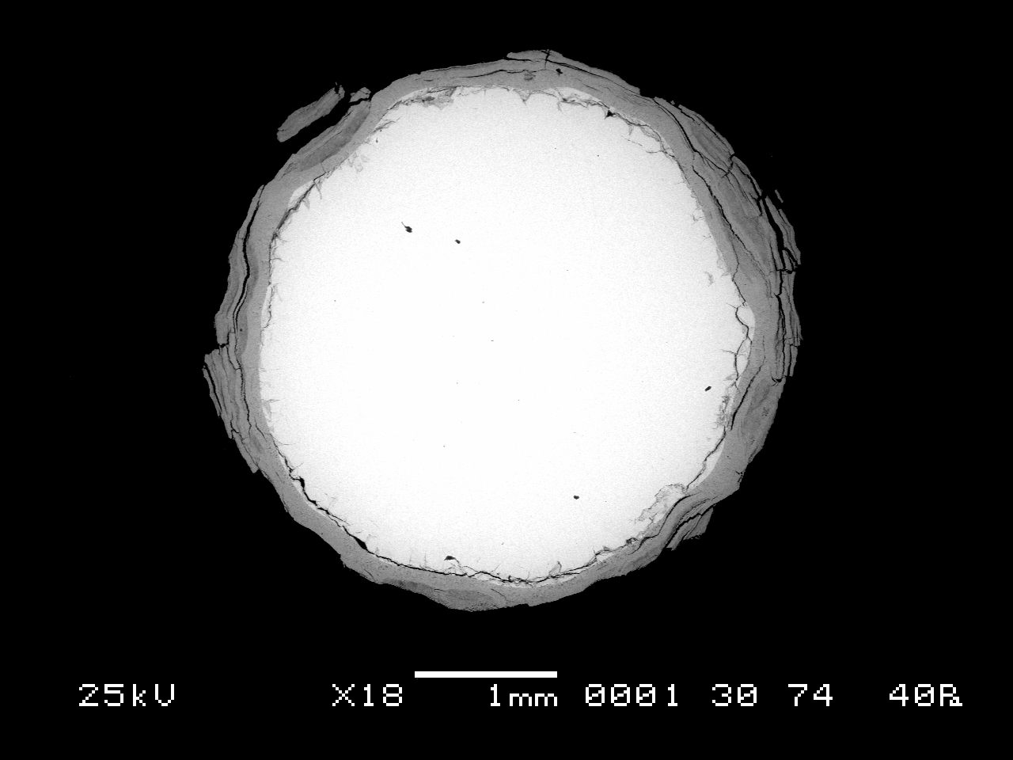
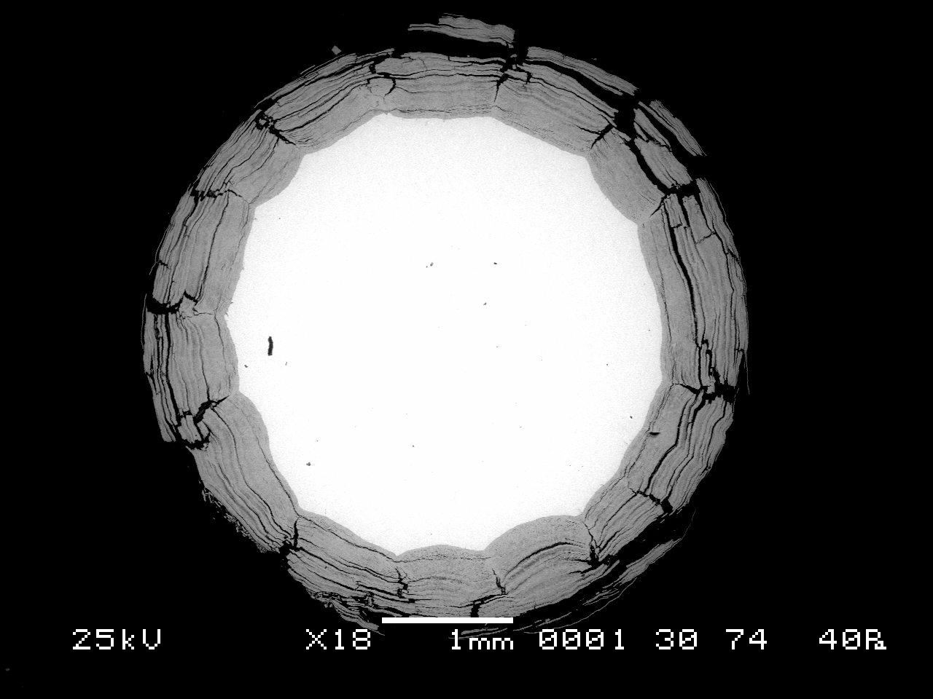
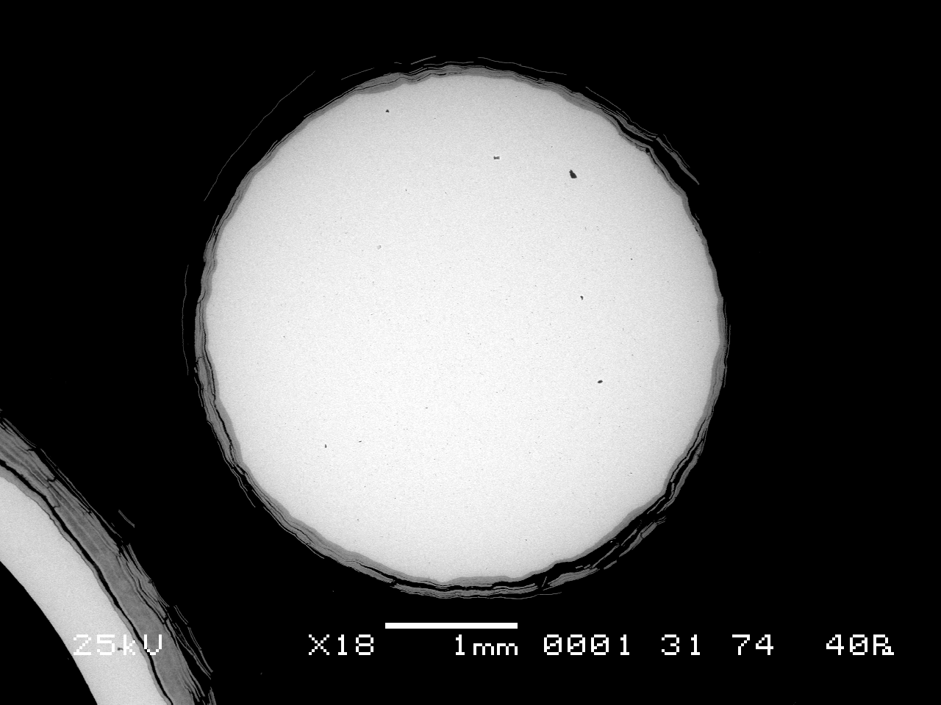
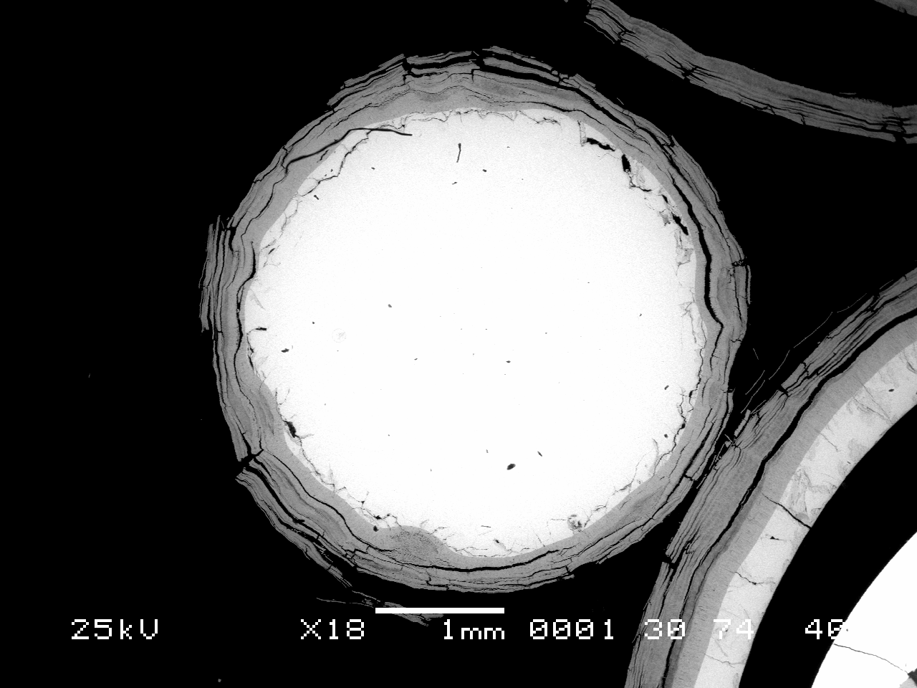
Peripheral rods oxidation status at Z=1000 mm
Rod 1
Rod 3
Rod 5
Rod 4
Strong inhomodenious oxide thickness distribution
separation tendency of an outer scale layer from younger oxide
Rod 2

Slide 12
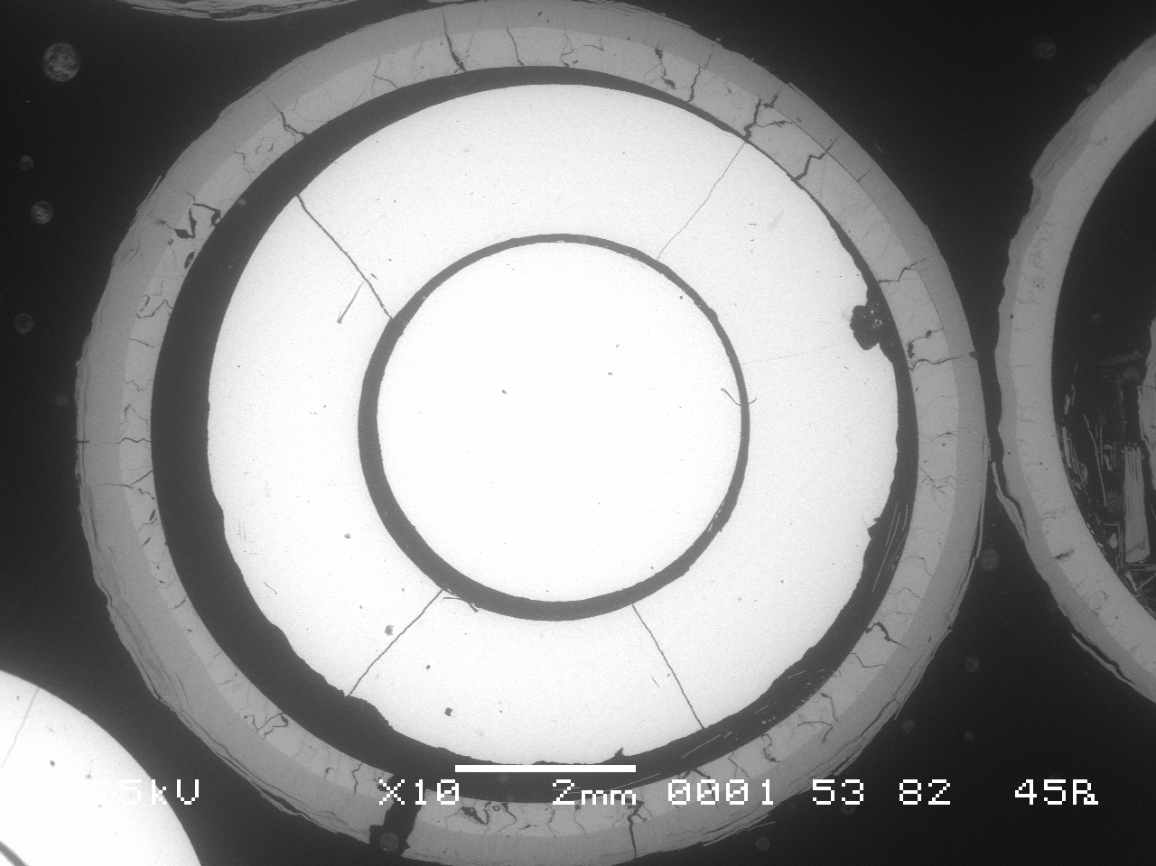
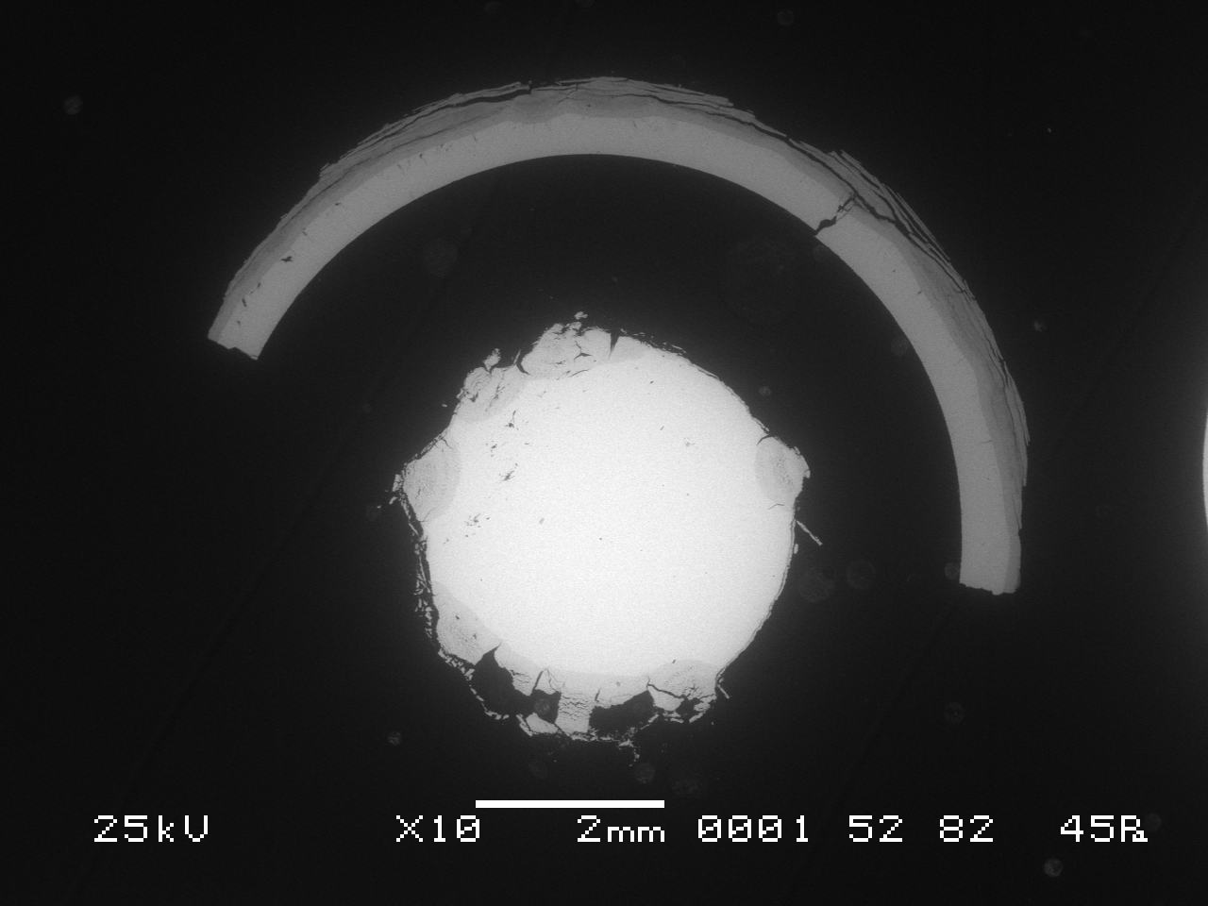
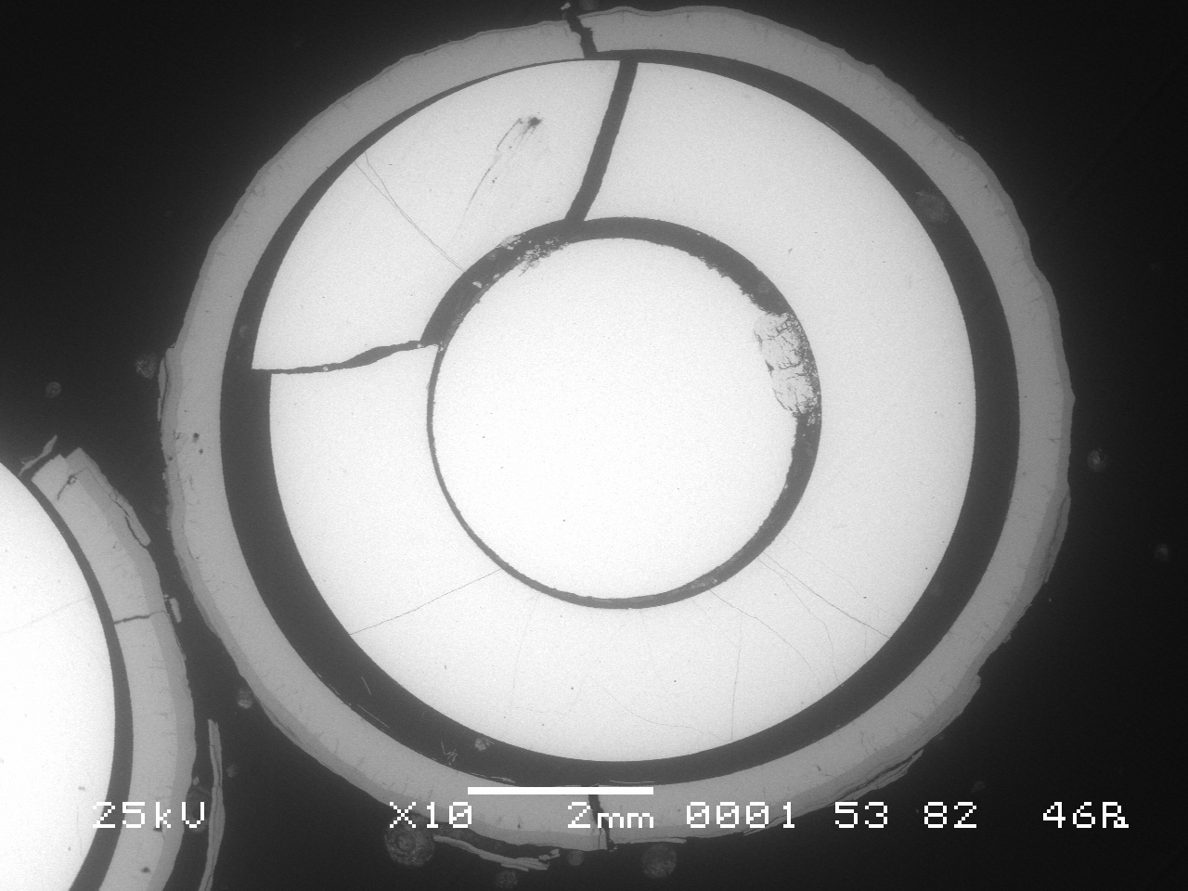
Metallographic examination of the cross section at Z=1250 mm
7 claddings and 3 peripheral rods are available for measurements;
thought-wall cracks claddings
cladding and fuel fragmentation and relocation
weak cladding internal oxidation
Ta heater oxidation
Rod 6
Rod 5
Rod 10
Rod 4

Slide 13
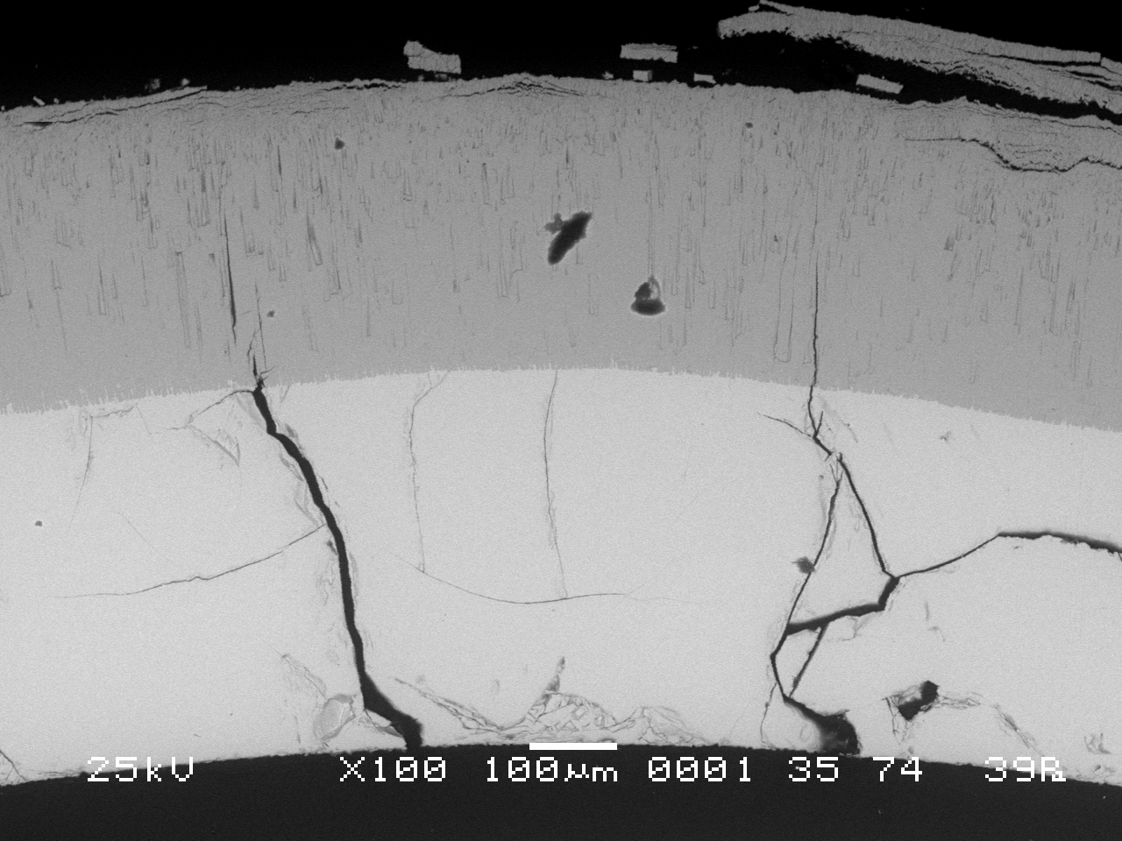
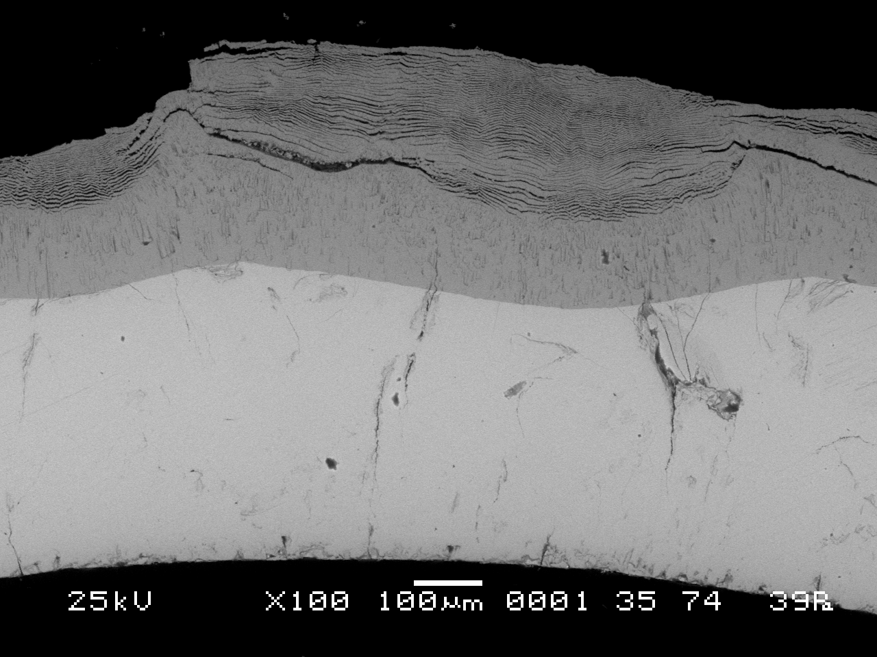
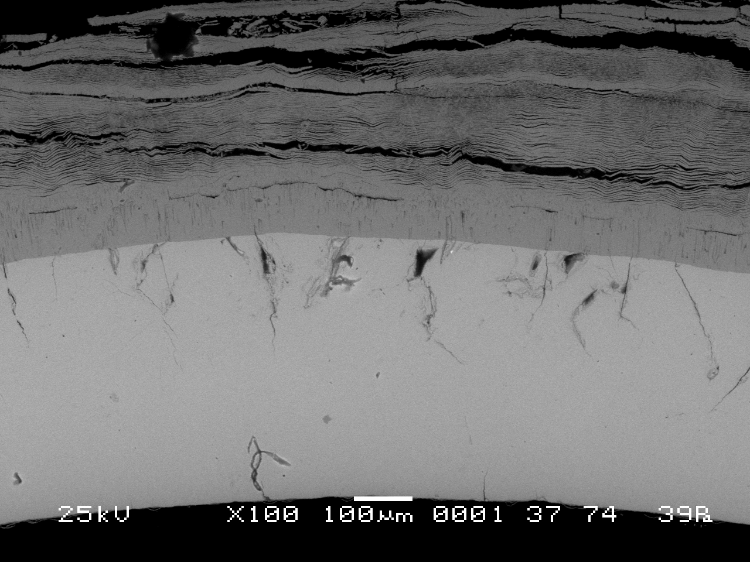
Cladding oxidation status at 1250 mm
compact inner oxide with columnar structure and fine multilayered spalled off external oxide
Rod 6
Metallic Zr - α-phase or α+β phases
No cracks oxidation
Rod 7
Rod 10

Slide 14
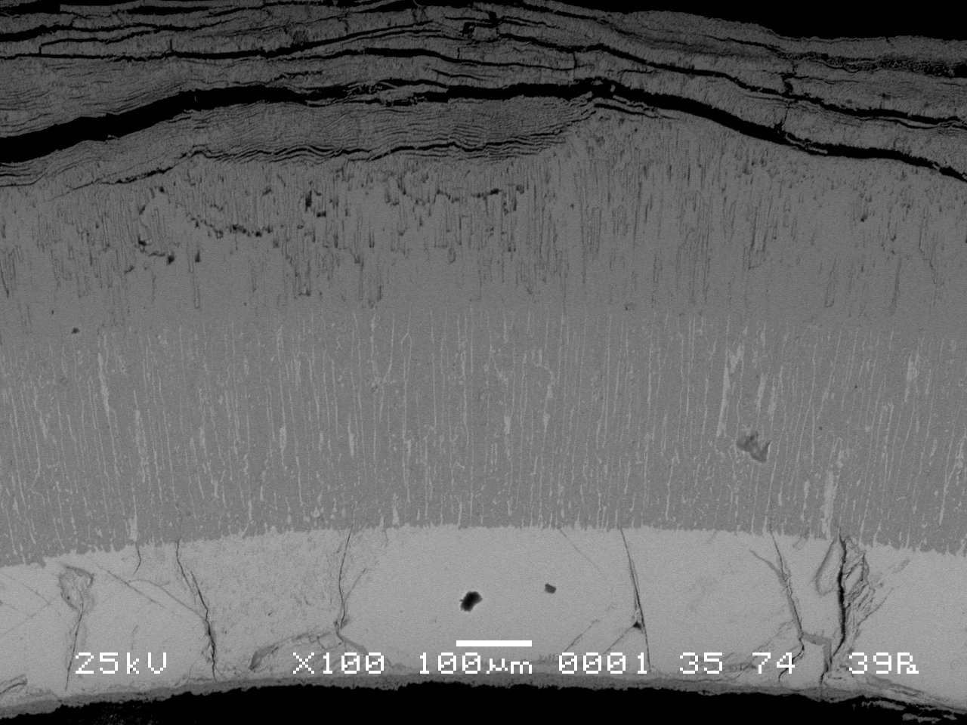
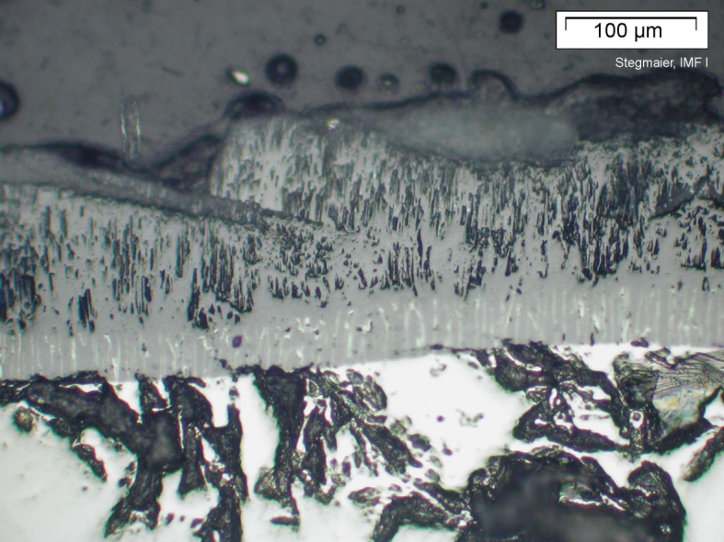
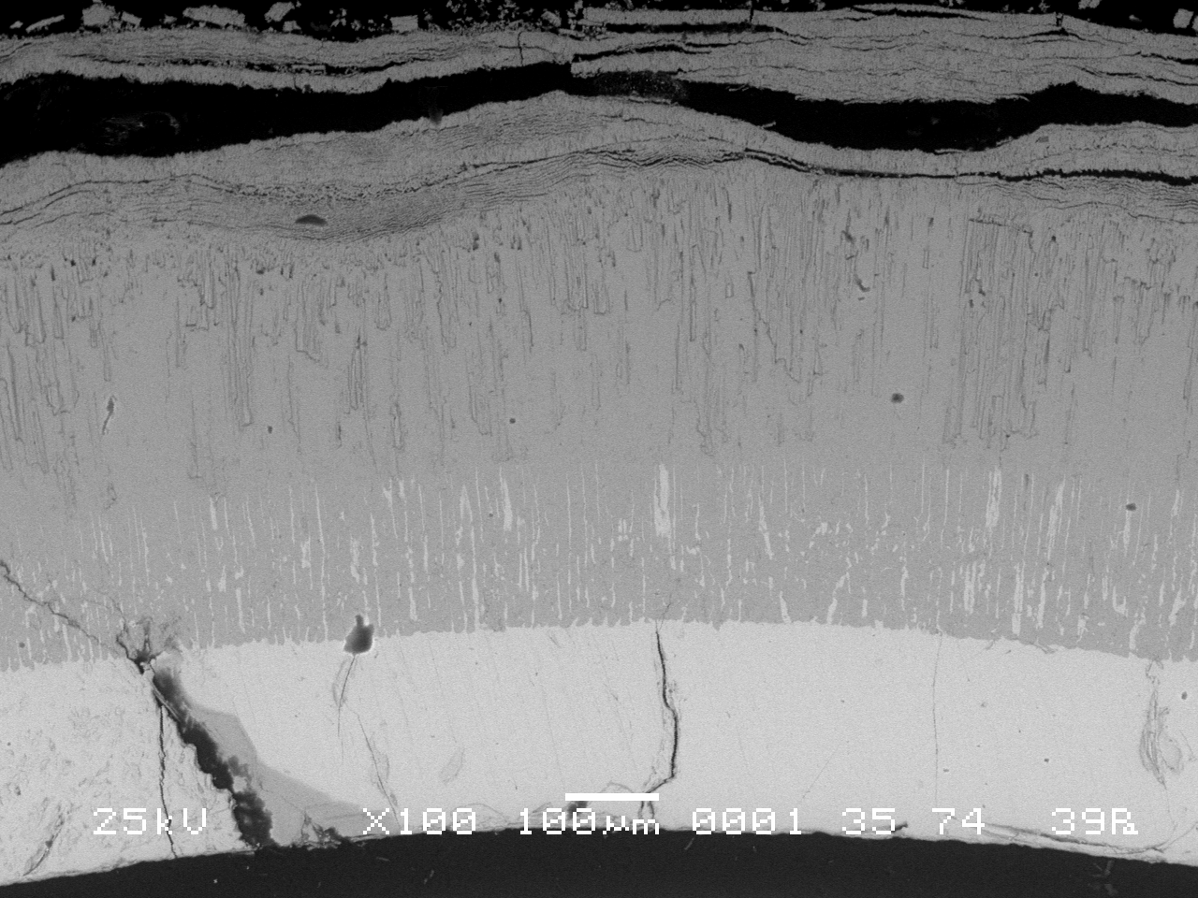
Cladding oxidation status at 1250 mm
ZrO2+αZr(O) layer on metallic layers could be interpreted to be
cubic oxide
Rod 8
ZrO2
QUENCH-12*
ZrO2+αZr(O)
αZr(O)
Rod 9
*J. Stuckert et al., "Results of the QUENCH-12 Experiment on Reflood of a VVER-type Bundle", FZKA 7307, Karlsruhe, 2008.

Slide 15
Metallographic examination of the cross section at Z=1300 mm
5 claddings and 3 peripheral rods are available for measurement
Cladding and fuel fragmentation
no fuel-cladding interaction
Mo electrodes oxidation

Slide 16
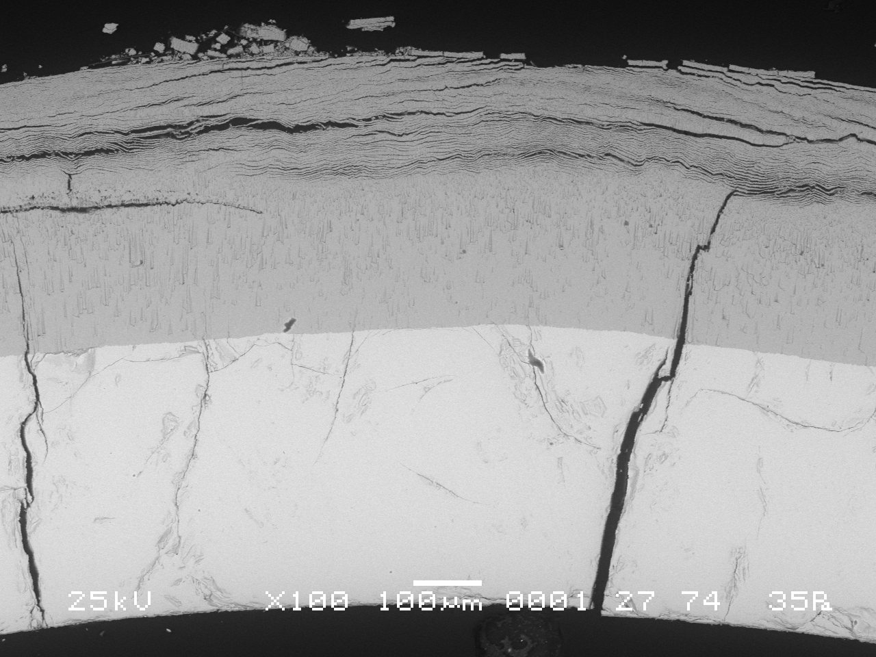
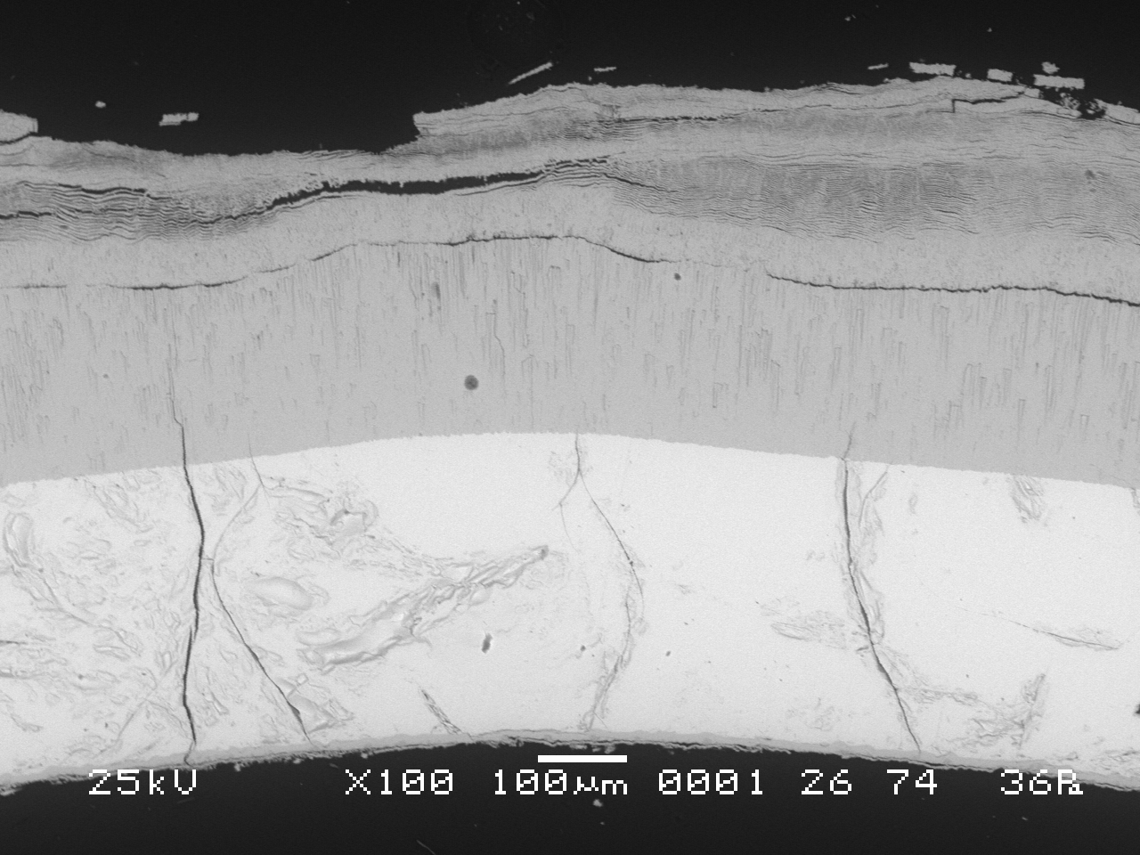
Claddings layers structure at Z=1300 mm
split inner compact oxide with columnar structure and spalled off layered outer oxide
weak inner cladding oxidation of some rods (~10µm)
complete β→α transformation
Through-wall cracks not oxidized
Rod 4
Rod 5

Slide 17
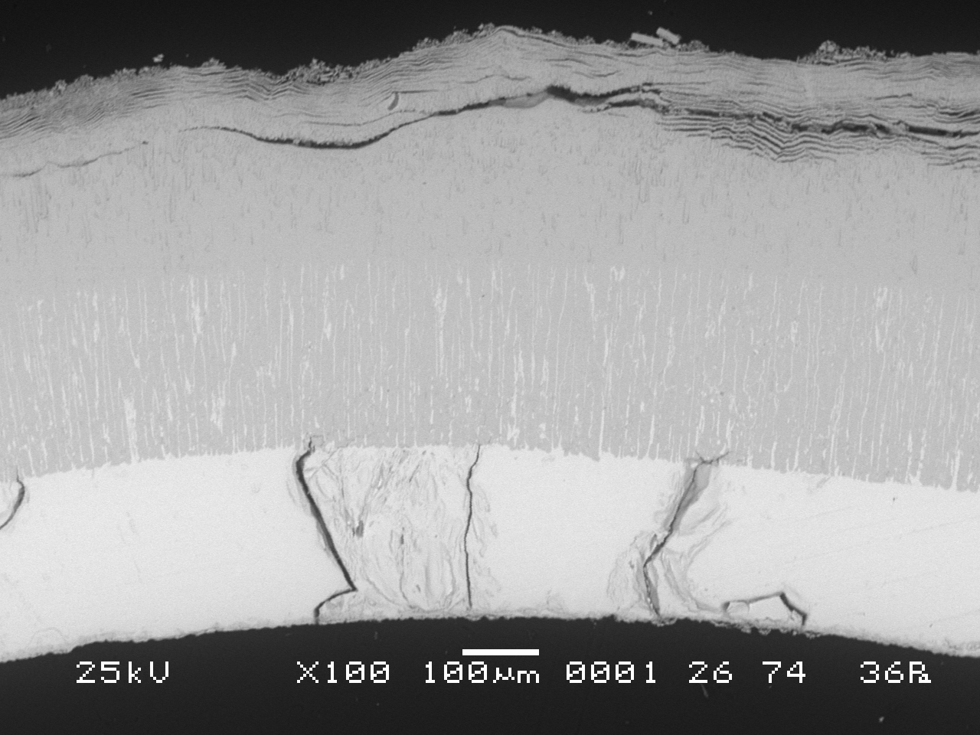
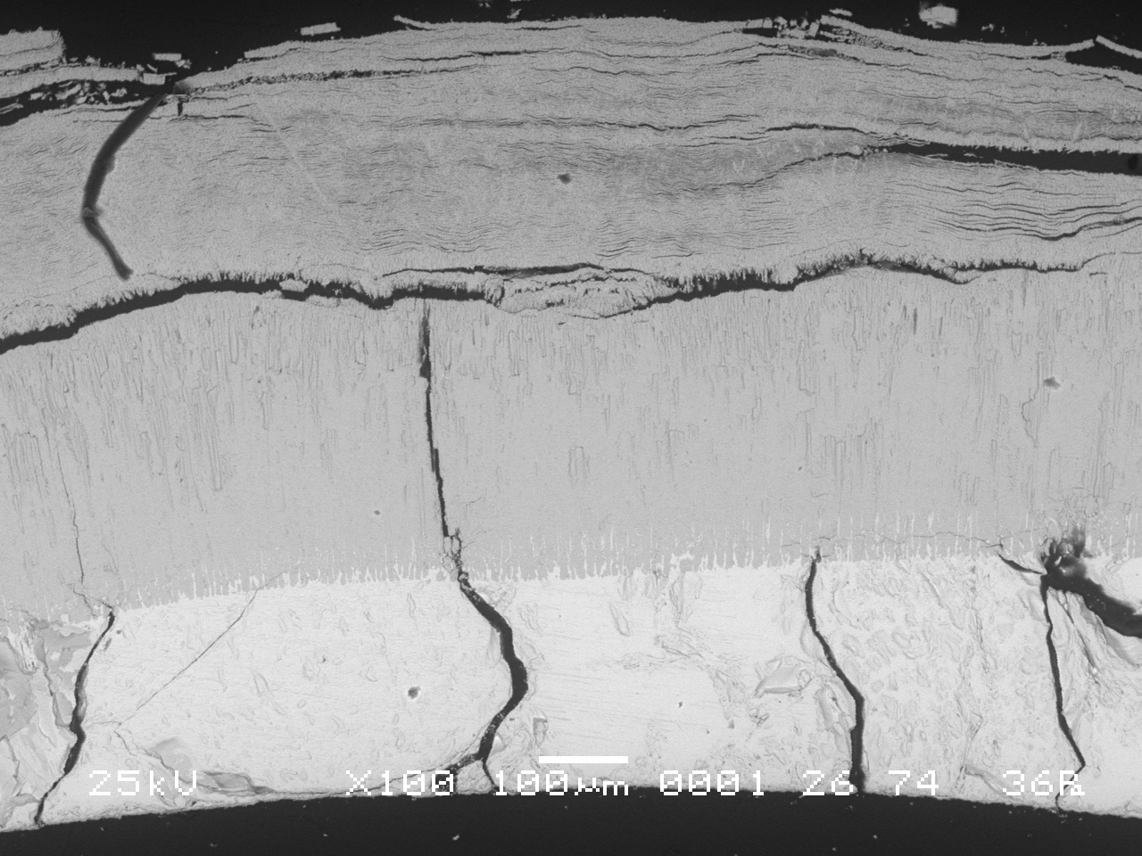
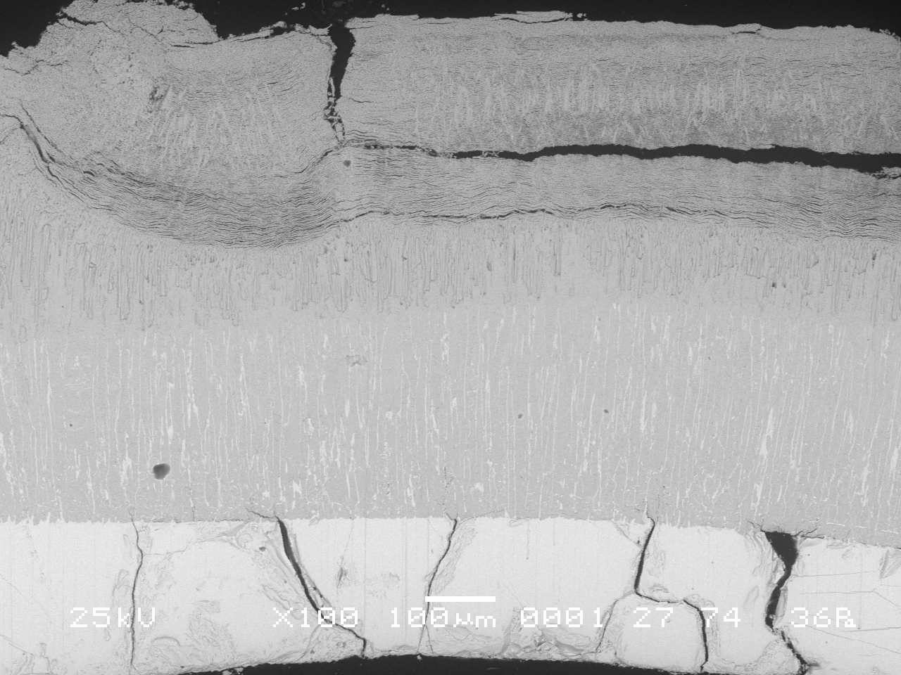
Claddings layers structure at Z=1300 mm
Rod 8
Rod 6
ZrO2+αZr(O)
Rod 7
Inner ZrO2+αZr(O) layer on metallic substrate

Slide 18
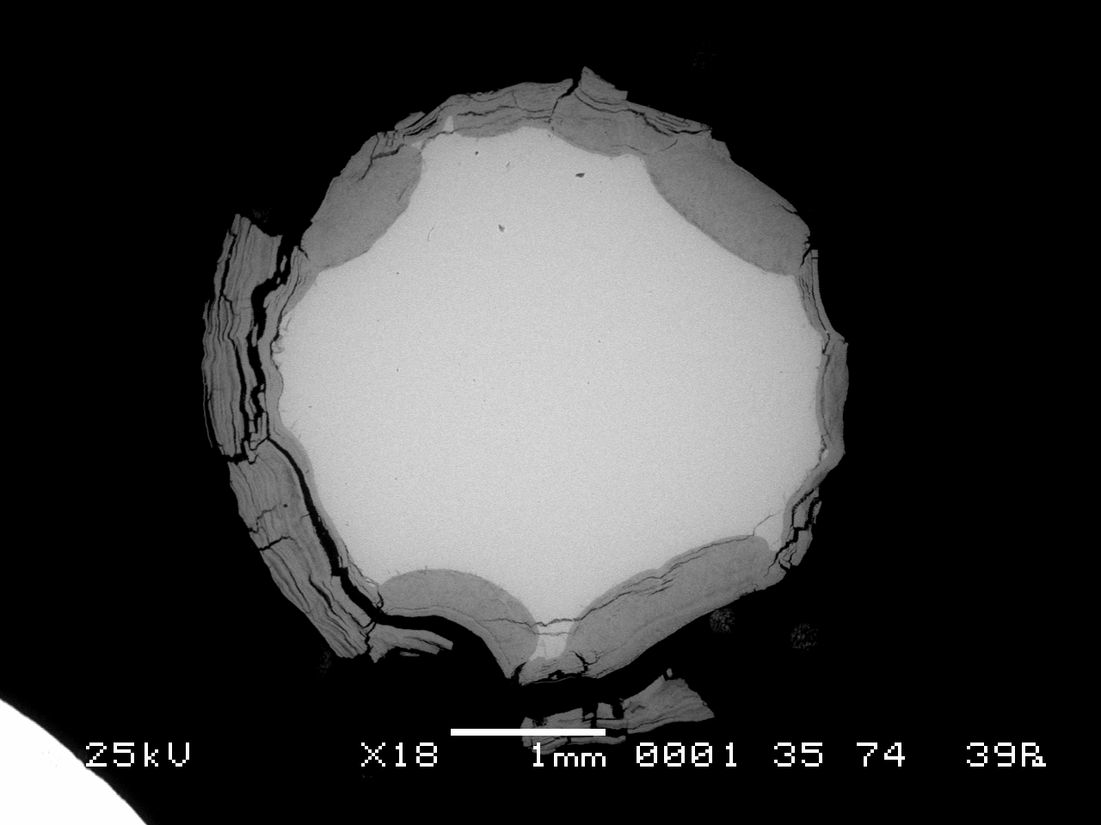
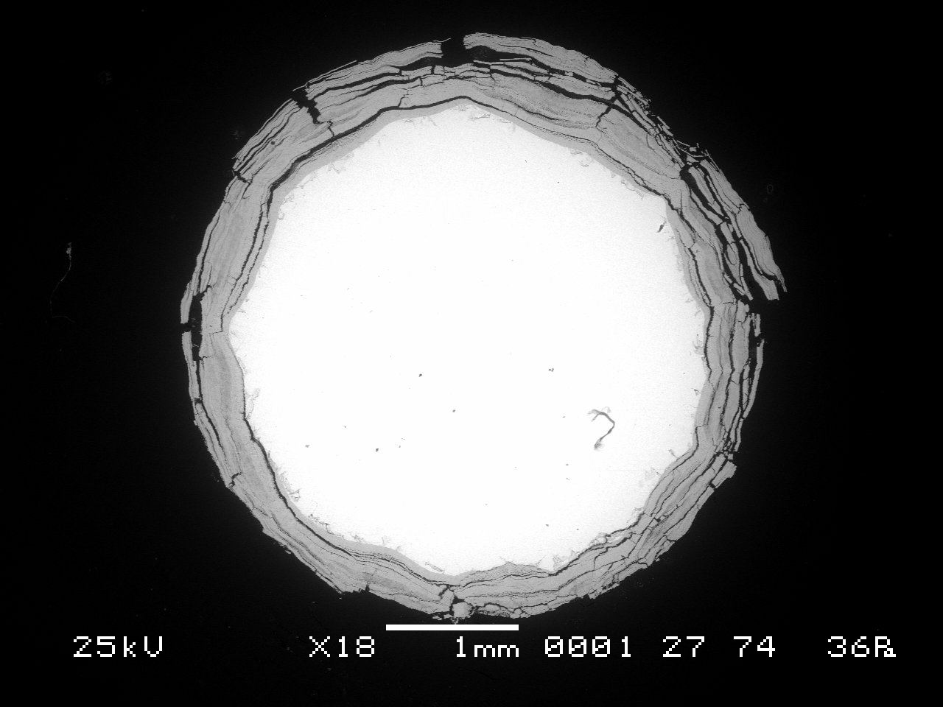


Peripheral rods oxidation status at 1250-1300 mm
1250 mm
1300 mm
Rod 1
Rod 3
Rod 3
Rod 2

Slide 19


Ta heaters and Mo electrodes oxidation status at 1250-1300 mm
1250 mm elevation
1250 mm elevation
Heater 7
Heater10

Slide 20
Oxide scale thickness* distribution
*1.56*exhausted metal

Slide 21
Main outcomes
SF3 material investigations are in progress;
SF3 shroud was found failed, weak external oxidation (up to 15 µm) was revealed over 1100-1250 mm
Four SF3 bundle cross-sections at 800, 1000, 1250, 1300 mm elevations were examined;
SF3 bundle reveals pronounced breakaway oxidation of claddings, shroud, peripheral rods at studied elevations;
Cladding oxide at 1250 and 1300 mm elevations consists of inner compact oxide with columnar structure and earlier grown fine multilayered oxide spalled off; at 800 and 1000 mm compact oxide was found on metallic substrate of some claddings.

Slide 22
Main outcomes
On metallic layer of some claddings at 1250 and 1300 mm mixed ZrO₂+αZr(O) layer was observed. It looks like similar early observed ones at high temperature elevations (>1800K) in QUENCH tests
Metal layer, compact oxide thickness were measured for claddings, peripheral rods, shroud, heaters, electrodes at examined elevations.
Both peripheral rods and claddings oxide layer thickness distribution over cross section is inhomogeneous.
Peak location of cladding oxide thickness calculated on base of metallic layer thickness measured corresponds to thermocouples readings

