Slide 1
FSUE SRI SIA “LUCH”
IBRAE RAS
FSUE EDO “GIDROPRESS”
ISTC project #3690: Post-test examinations of the PARAMETER-SF fuel assemblies
Presented by T.Yudina
IBRAE RAS
16th CEG-SAM Meeting, Moscow, Russian Federation
IBRAE, Nuclear Safety Institute of Russian Academy of Science
September 8-9, 2009

Slide 2
SF2 bundle material investigation results
The studies included :
  encapsulation and sectioning of the FA;
  preparation of cross section slabs;
  optical and electronic microscopy;
  X-ray analysis;
  analysis of the obtained results.
The results are documented in Report “Analysis of material studies of WWER-100 model assembly tested in the PARAMETER-SF2 experiment under the conditions of severe accident with top and bottom flooding.”
Scientific aspects of the investigations were discussed at 14th International QUENCH Workshop Karlsruhe, 4-6 November2008
Main outcomes:
  SF2 bundle reveals pronounced breakaway oxidation over 500-1300 mm;
  cladding oxide scale over 900-1300 mm includes inner compact oxide with columnar structure on the metallic layer and external multi-layer spalled off oxide;
  over 1100-1300 mm inner compact oxide is split or tends to split; possible reason could be cool down and heat up cycle during combined quenching
  maximum calculated cladding oxide scale thickness location corresponds to the hottest elevation (1250 mm);
  inner cladding oxidation over 900-1300 mm is weak;
  cladding fragmentation is non pronounced;
  no fuel relocation.

Slide 3
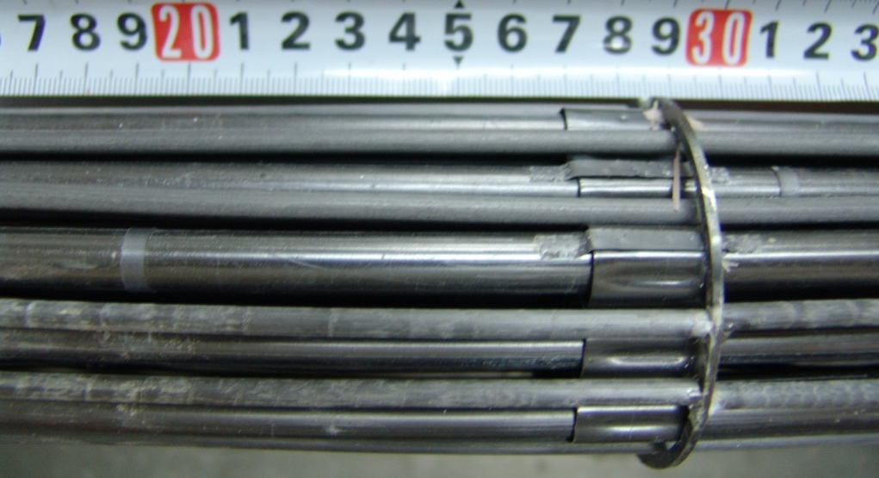
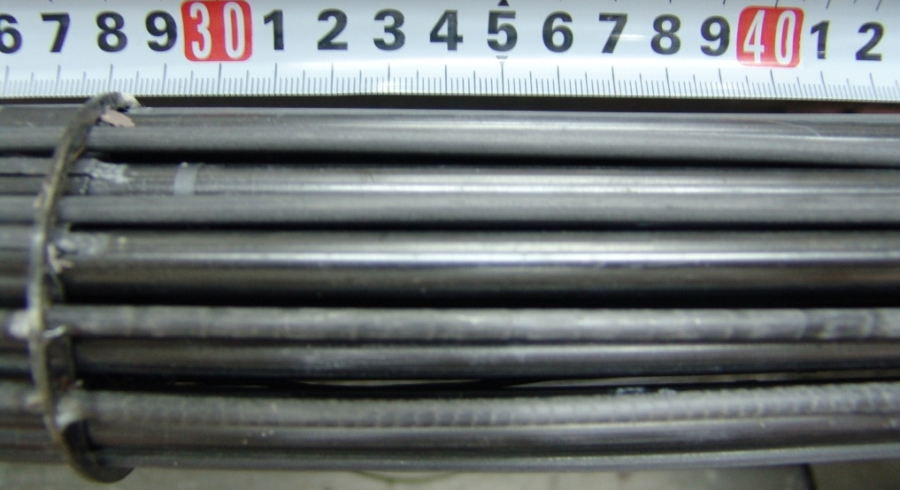
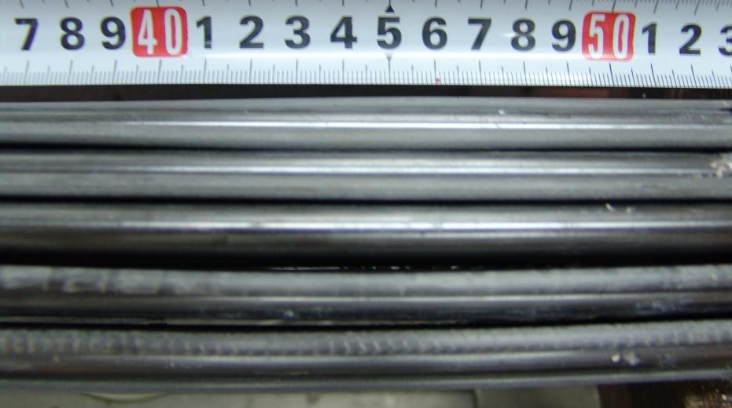
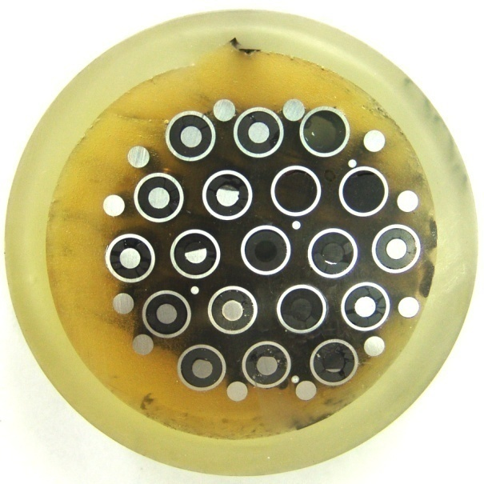
Post-test appearance of SF3 bundle at 200-500 mm
Rod 3.5
Rod 3.5
200-300 mm elevation
300-400 mm elevation
Rod 3.5
400-500 mm elevation
Z=500 mm elevation

Slide 4
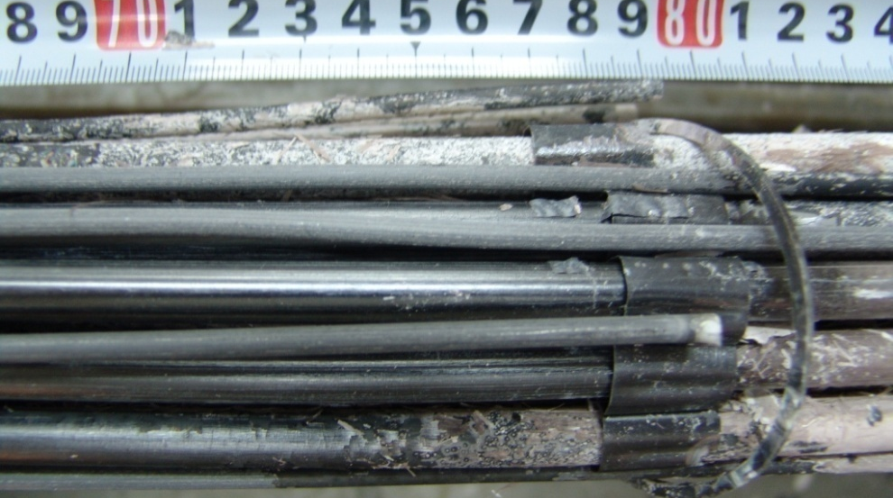
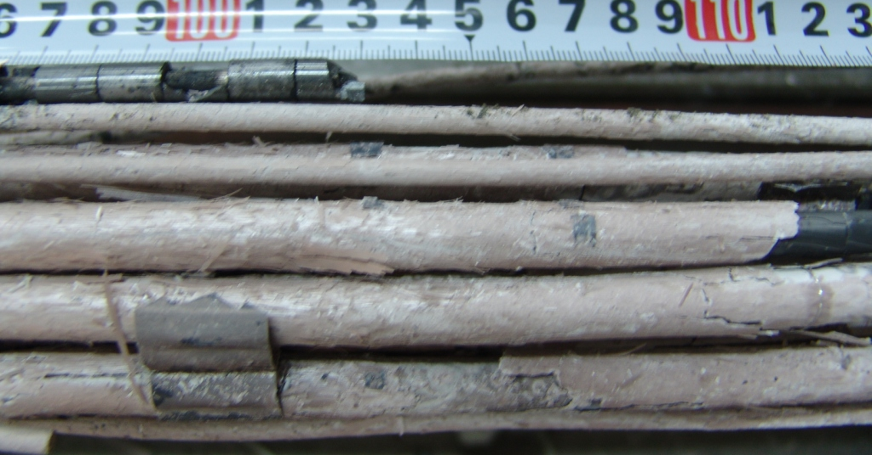
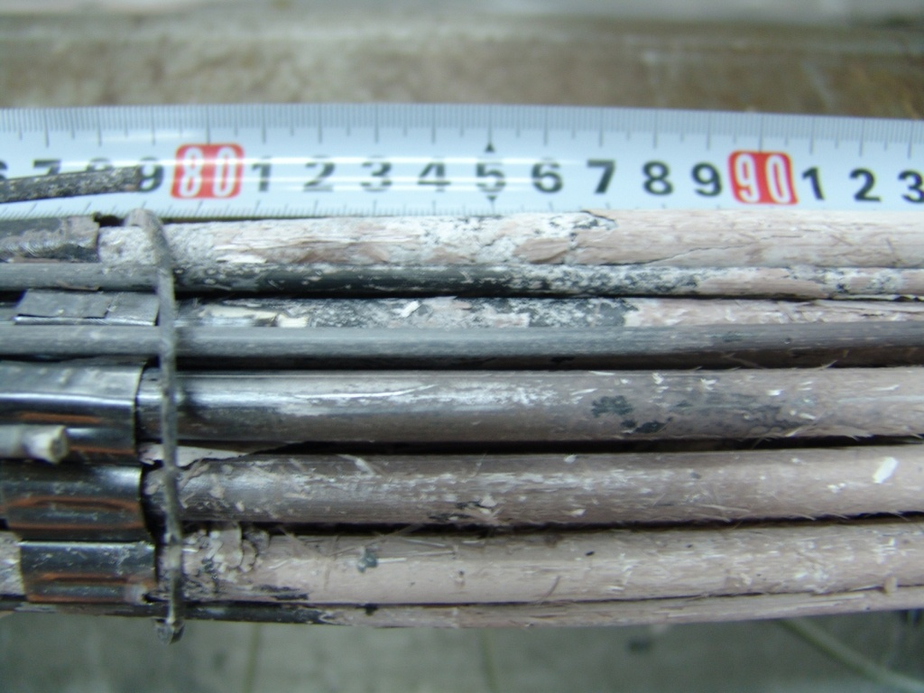
Post-test appearance of SF3 bundle at 700-1100 mm
Rod 3.5
Rod 3.5
700-800 mm elevation
1000-1100 mm elevation
Rod 3.5
800-900 mm elevation
Pronounced inhomogeneous oxidation

Slide 5
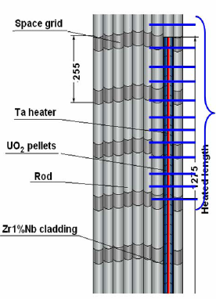

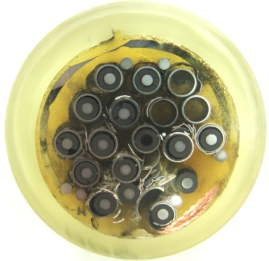
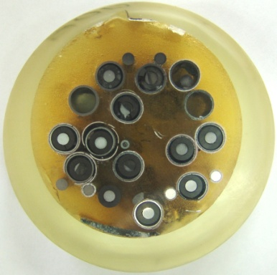
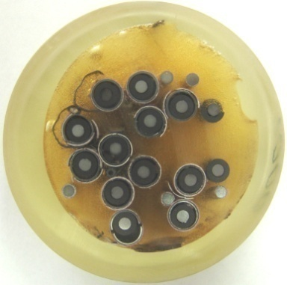
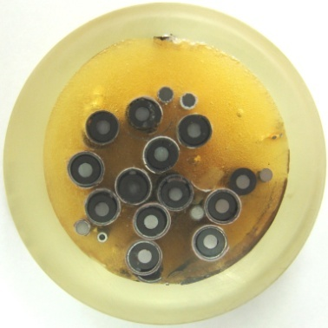
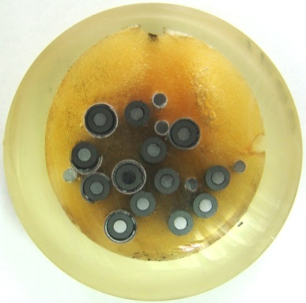
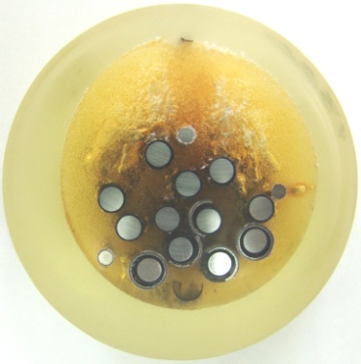
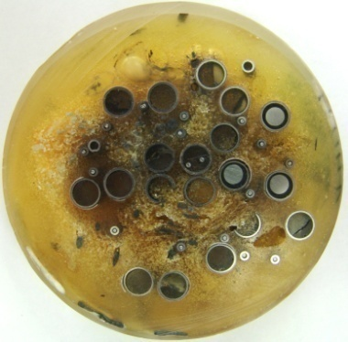
Overview of sectioning map for metallographic examination
Over 400-1500 mm 13 crosscuts were made and polished for metallographic investigations
500 мм
800 мм
900 мм
1000 mm
1100 mm
1200 mm
1300 mm
1400 mm
Some fuel rods were missed during handling

Slide 6
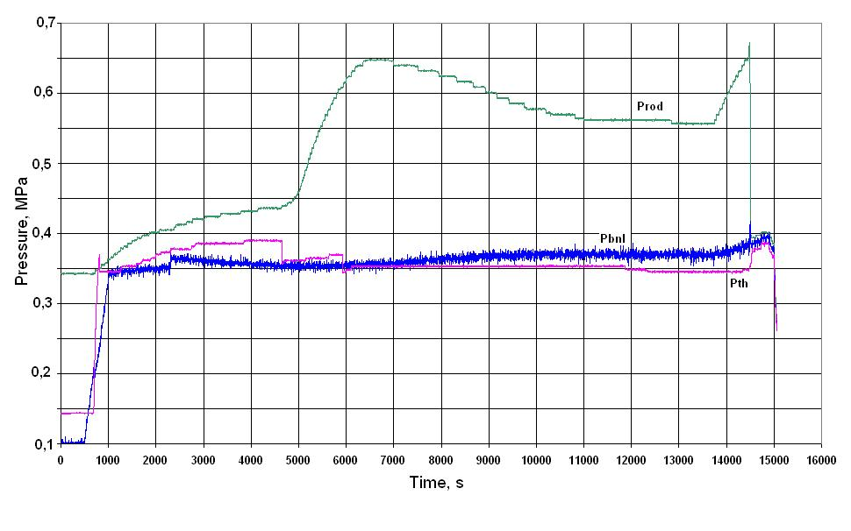
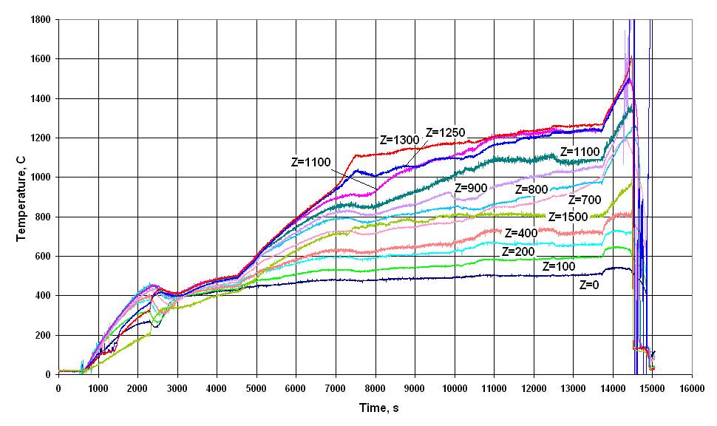
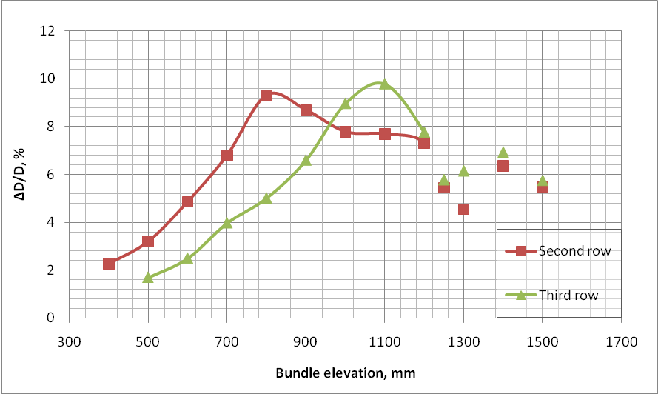
SF3 test peculiarities (1)
Method of SF3 cladding oxide thickness estimation:
cladding internal diameters and residual metallic layer thickness measurements
ballooned cladding thickness estimation
Cladding oxide layer thickness estimation

Slide 7
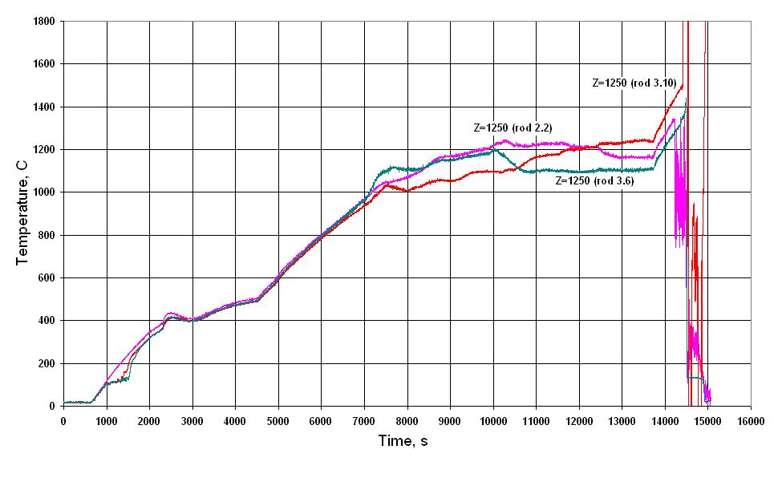
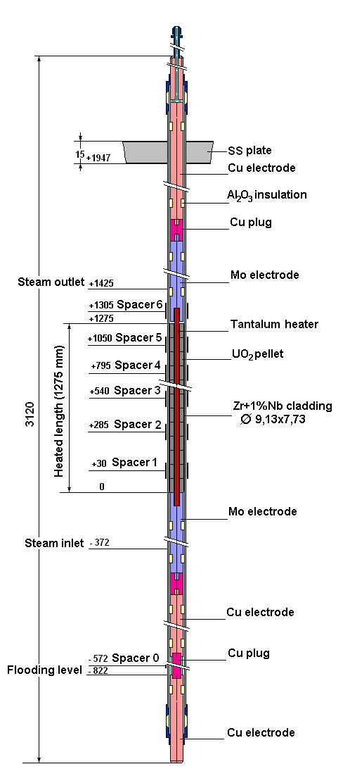
SF3 test peculiarities (2)
List of heater failure
№ | Rod designation | Time at failure, s
1 | 3.9 | 9898
2 | 3.6 | 10046
3 | 3.5 | 10166
4 | 3.4 | 10222
5 | 2.3 | 10497
6 | 3.3 | 11545
7 | 3.2 | 12421

Slide 8
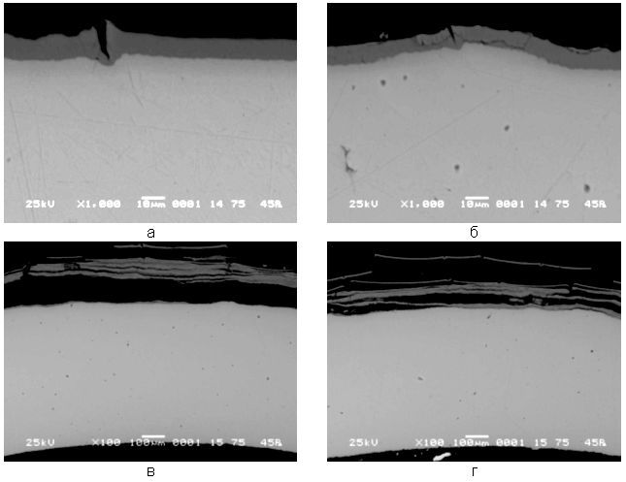
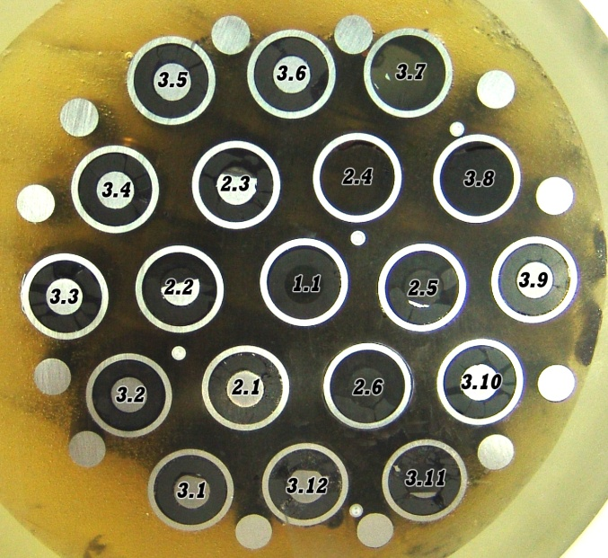
PARAMETER-SF3 test. Metallographic examination of the cross -section at Z=500 mm
Rod 1.1
Rod 2.3
Rod 2.6
Rod 3.10
Cladding compact oxide scale thickness ≤10 µm

Slide 9
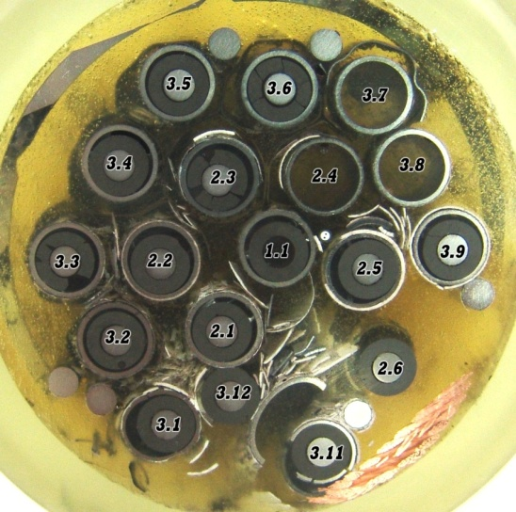
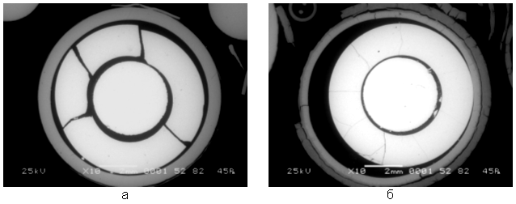
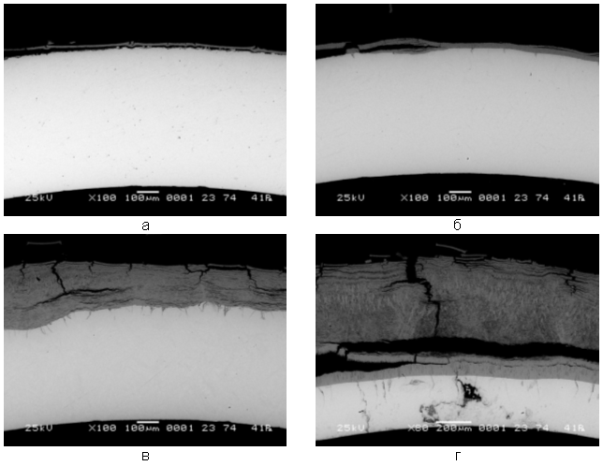
Metallographic examination of the cross -section at Z=800 mm
Rod 3.6
Rod 2.5
Rod 3.2
Rod 2.2

Slide 10
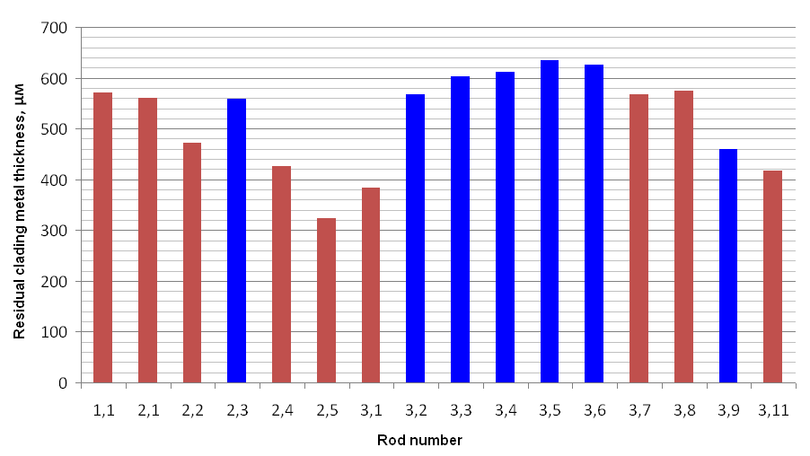
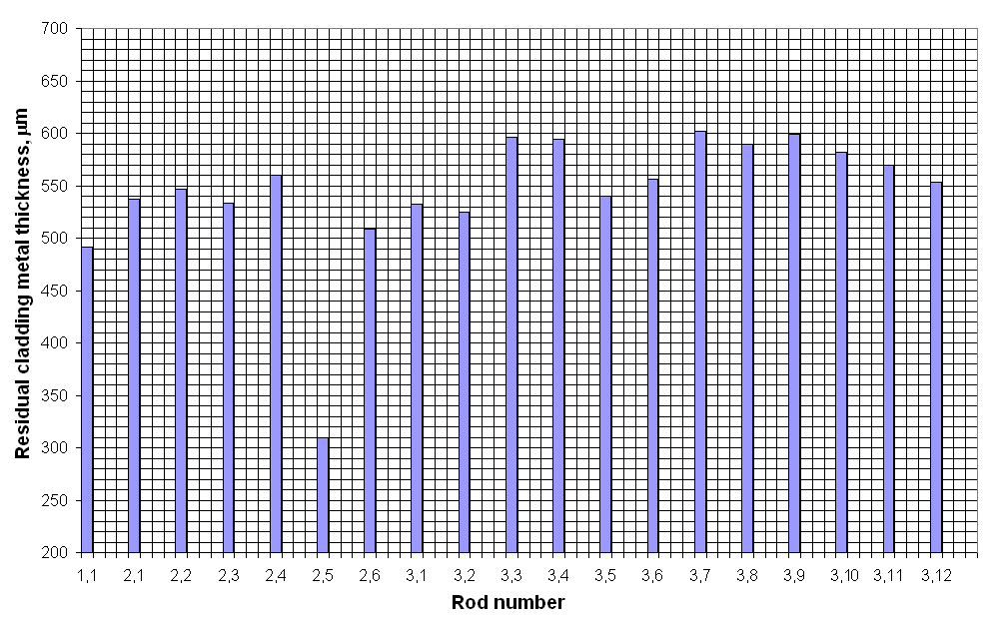

Metallographic examination of the cross -section at Z=800 mm
failed heaters
Rod 3.5
SF2 test, 1033 mm
SF3 test

Slide 11
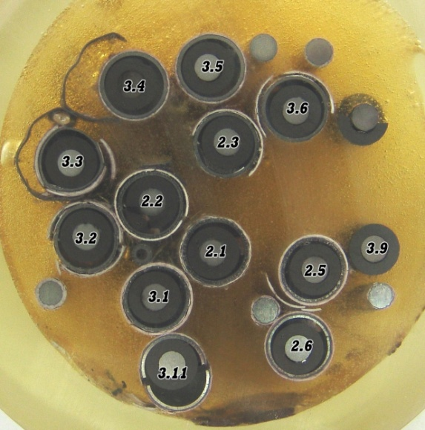
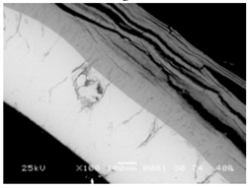
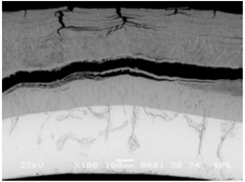
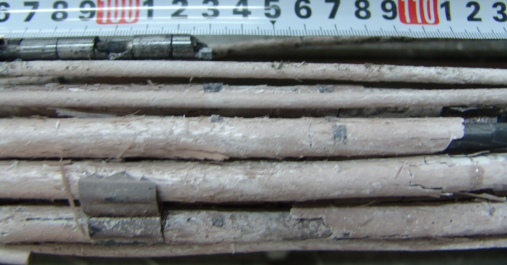
PARAMETER-SF3. Metallographic examination of the cross- section at Z=1000 mm
Internal compact oxide with columnar structure under external spalled off multilayer oxide
Rod 2.1
Rod 2.5

Slide 12
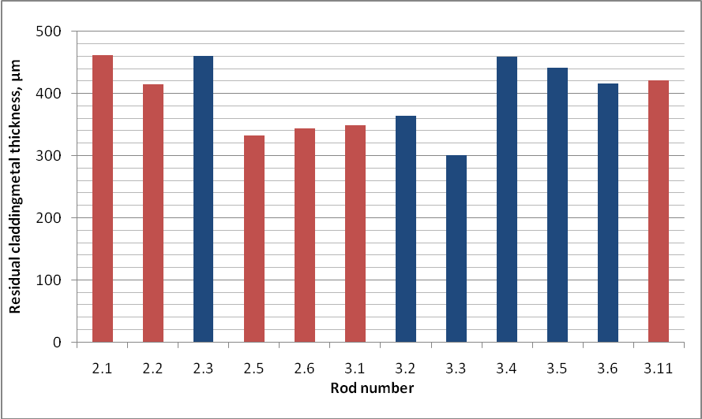
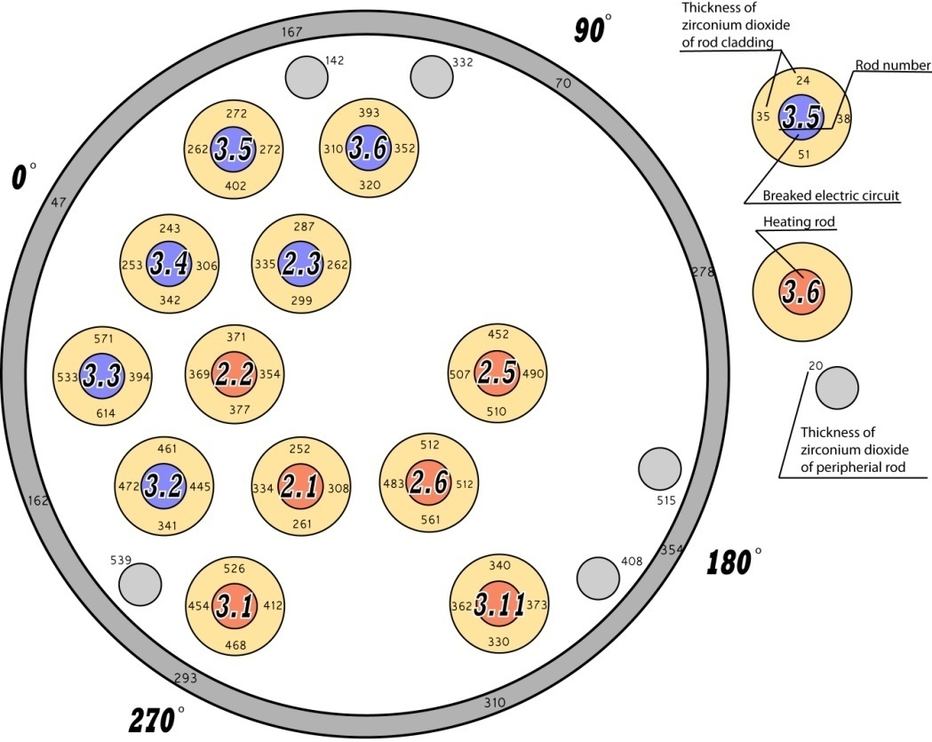
PARAMETER-SF3. Metallographic examination of the cross- section at Z=1000 mm
12 claddings are available for metallographic examinations after handling
Non homogeneous oxidation but no clear effect of heater failures
calculated oxide scale on external surfaces of claddings, shroud and periphery rods

Slide 13

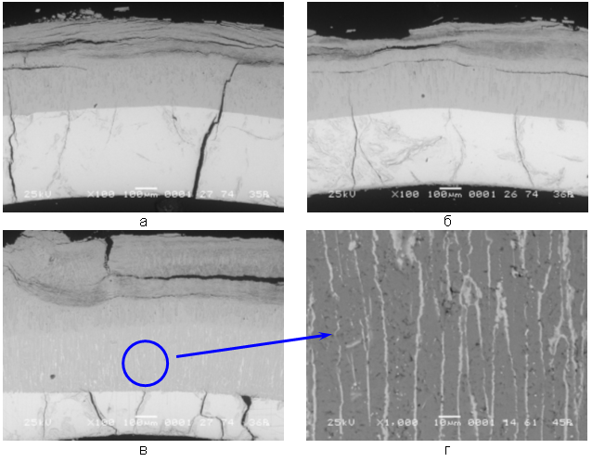
Metallographic examination of the cross section at Z=1300 mm
5 claddings are available for measurement after handling
split inner compact oxide with columnar structure and spalled off layered outer oxide
weak inner cladding oxidation of some rods (~10µm)
complete β→α transformation
through-wall cracks not oxidized
ZrO2+αZr(O) layer on metallic layers could be interpreted to be cubic oxide
ZrO2+αZr(O)
αZr(O)

Slide 14
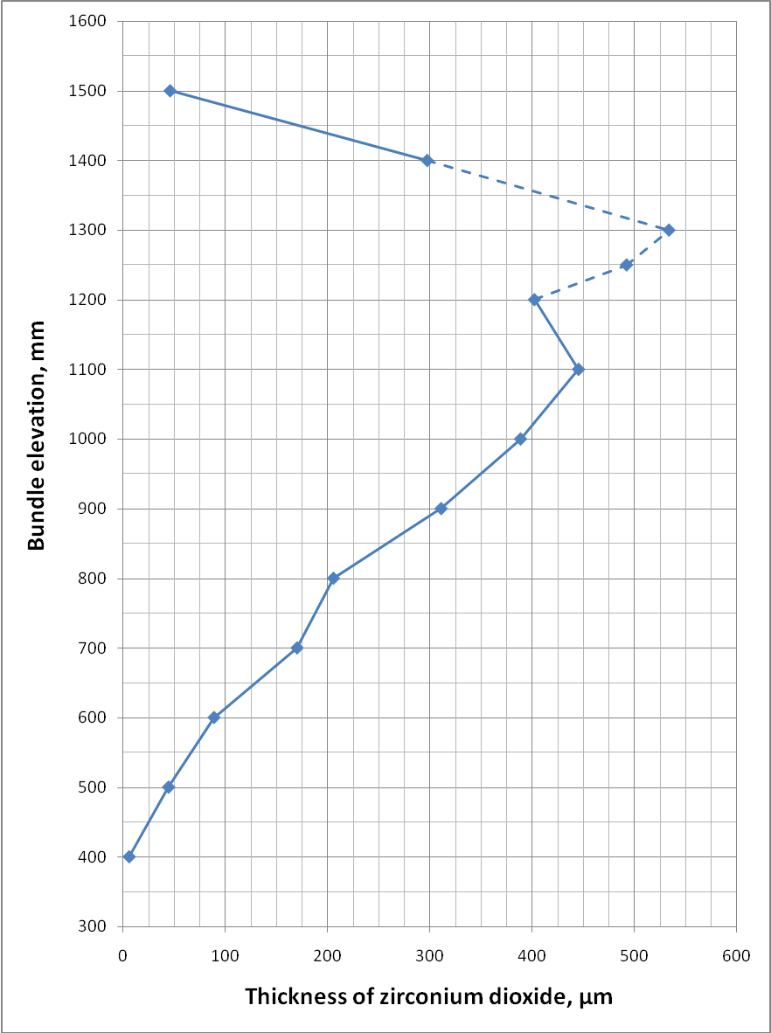
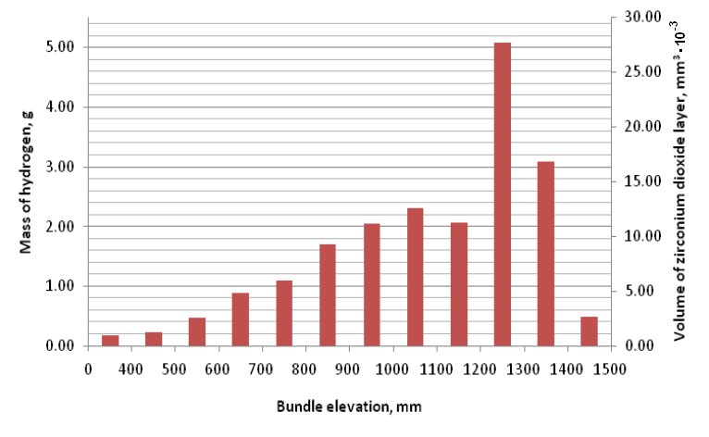
Cladding oxide scale thickness* distribution
* 1.56*exhausted metal of ballooned claddings

Slide 15
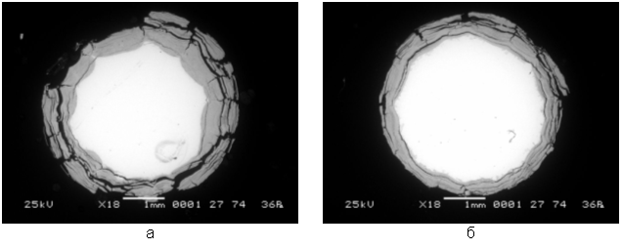
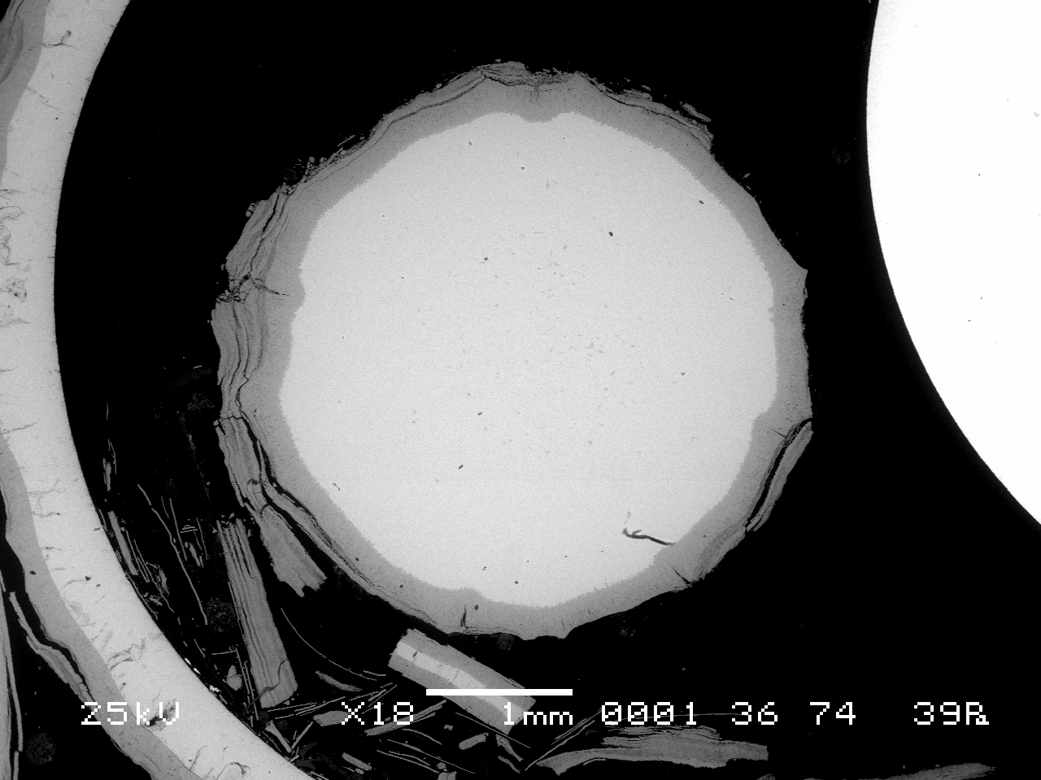
Estimated hydrogen mass (upper limit)
Claddings ≤22 g
peripheral rods ≤6,5 g
Shroud ≤8 g
Thermocouple sheathes ≤ 2 g
Spacer grids ≤ 2 g
Heaters ≤1.5 g
Total mass ≤ 42 g
Experiment - 34 g
Rod 1
peripheral rods oxdation, 1300 mm
Heater oxidation, 1250 mm

Slide 16
Main outcomes
SF3 material investigations are completed.
SF3 shroud was found failed, weak external oxidation (up to 15 µm) was revealed.
13 SF3 bundle cross-sections over 400 - 1500 mm elevations were examined.
SF3 claddings, shroud, peripheral rods reveal pronounced breakaway oxidation. Cladding oxide scale over 900-1300 mm includes inner compact oxide with columnar structure on the metallic layer and external multi-layer spalled off oxide.
Weak cladding internal oxidation.
Metal layer, compact oxide thickness were measured for claddings, peripheral rods, shroud, heaters, electrodes at examined elevations.

Slide 17
Main outcomes
Both peripheral rods and claddings oxide layer thickness distribution over cross section are non homogeneous.
Weak cladding ballooning was found.
Calculated cladding oxide thickness profile and oxide volume distributions trend prove the hottest zone location (1300 mm).
Contribution of spacer grids, thermocouples and heaters oxidation (usually non modeled in test calculations) in hydrogen mass balance estimated to be 13% in SF3 test.
Detail information on metallographic investigations can be found in corresponding report which will be issued as Appendix to annual Report on ISTC Project #3690

